Slide 1
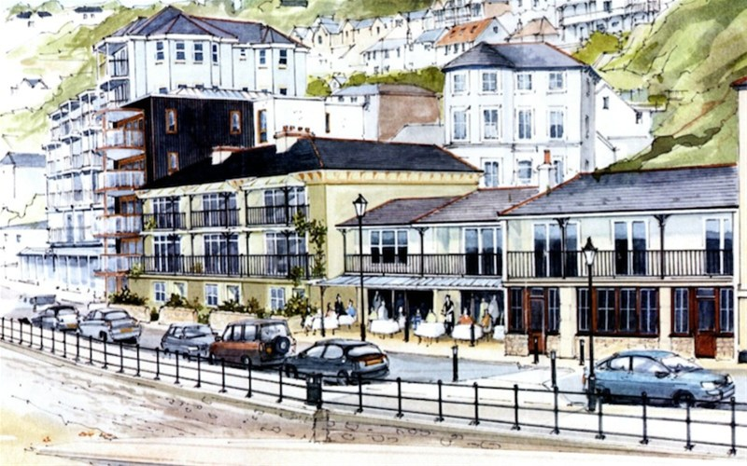

2015 Our Place Survey Results for Ventnor
Survey: Investigation

Slide 2
Presentations Available: Detailed Results
◊ Priorities
◊ Facilities
◊ Opportunities
◊ Engagement
◊ Projects
◊ Investigation
____________________
◊ Comments
◊ Postcodes
2015
Our Place
Survey Results
For
Ventnor

Slide 3
Our Place Ventnor Survey
Basic Demographics

Slide 4
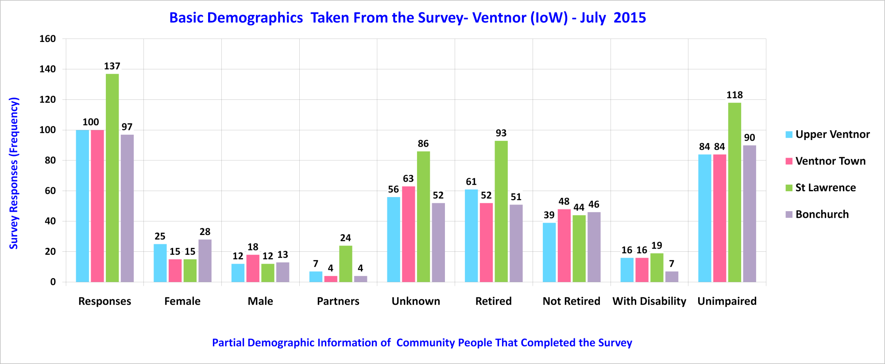
Sampled Ventnor Community

Slide 5
Our Place Ventnor Survey
Demographic Points of Interest

Slide 6
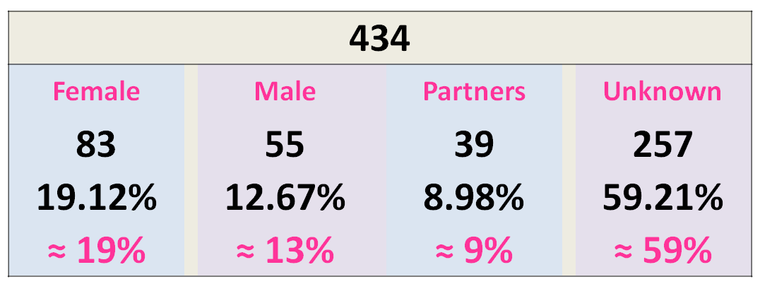
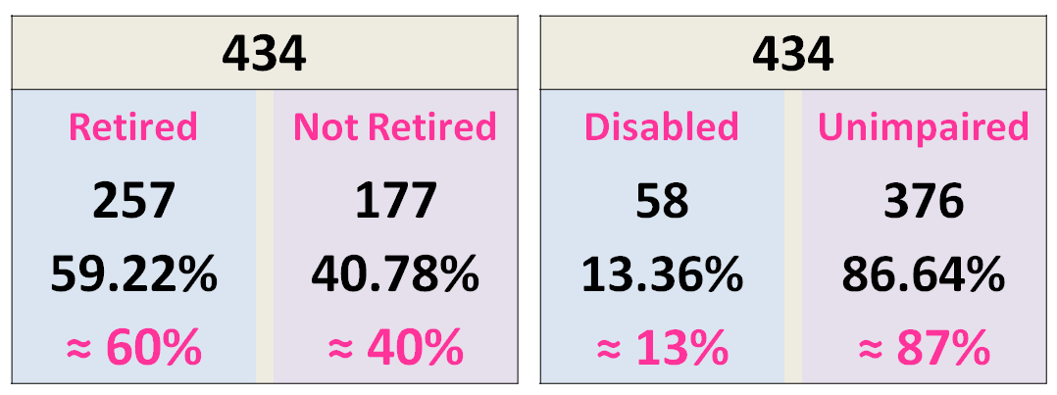
Basic Demographics - 1 of 1
Across Ventnor
Upper Ventnor
Ventnor Town
St Lawrence
Bonchurch
Notes:
Beach 72% Maintain local beaches to the highest standards.
Outdoors 63% Maintain local green spaces to high standards.
Health 62% Provision of health and social care services.
Elderly 54% Develop support networks for older people.
Transport 51% Better and cheaper transport to-and-from Ventnor.
Young 48% More opportunities for Ventnor's young people.
Housing 44% Affordable and decent housing for local people.
Parking 42% Manage and operate a selection of local car parks.
Business 41% Opportunities and support for new and local business.
Jobs 35% Improve local job access and employer training provision.
Space 25% Foster a community space in Upper Ventnor.

Slide 7
Our Place Ventnor Survey
Priorities to Projects Matching

Slide 8
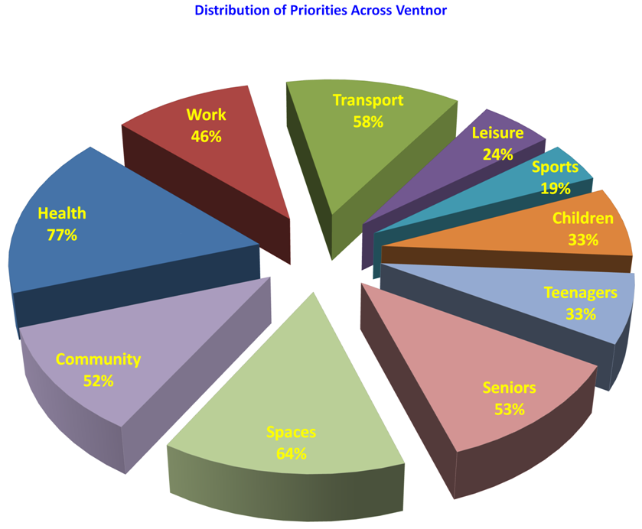
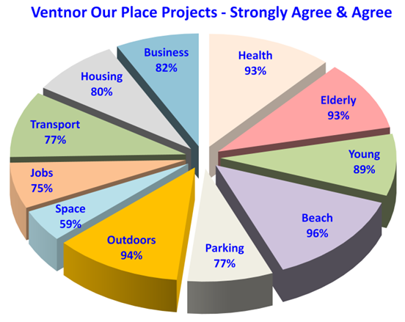
Priorities to Projects Matching - 1 of 3
Priorities
Projects
Community Survey Responses for Each Area of Interest in Percentage terms
Note: The above charts are not Pie Charts, i.e. Distributed over 100%
Notes:
Beach 72% Maintain local beaches to the highest standards.
Outdoors 63% Maintain local green spaces to high standards.
Health 62% Provision of health and social care services.
Elderly 54% Develop support networks for older people.
Transport 51% Better and cheaper transport to-and-from Ventnor.
Young 48% More opportunities for Ventnor's young people.
Housing 44% Affordable and decent housing for local people.
Parking 42% Manage and operate a selection of local car parks.
Business 41% Opportunities and support for new and local business.
Jobs 35% Improve local job access and employer training provision.
Space 25% Foster a community space in Upper Ventnor.

Slide 9
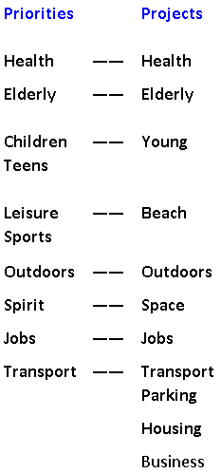
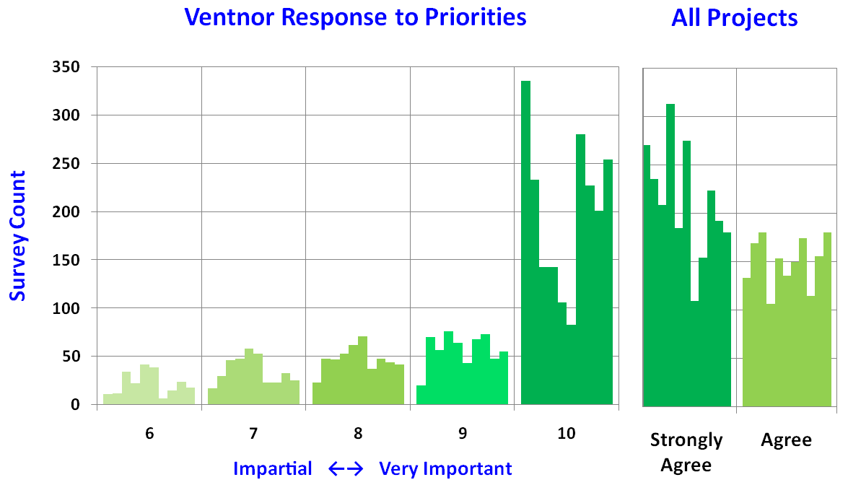
Priorities to Projects Matching - 2 of 3
Notes:
Beach 72% Maintain local beaches to the highest standards.
Outdoors 63% Maintain local green spaces to high standards.
Health 62% Provision of health and social care services.
Elderly 54% Develop support networks for older people.
Transport 51% Better and cheaper transport to-and-from Ventnor.
Young 48% More opportunities for Ventnor's young people.
Housing 44% Affordable and decent housing for local people.
Parking 42% Manage and operate a selection of local car parks.
Business 41% Opportunities and support for new and local business.
Jobs 35% Improve local job access and employer training provision.
Space 25% Foster a community space in Upper Ventnor.

Slide 10
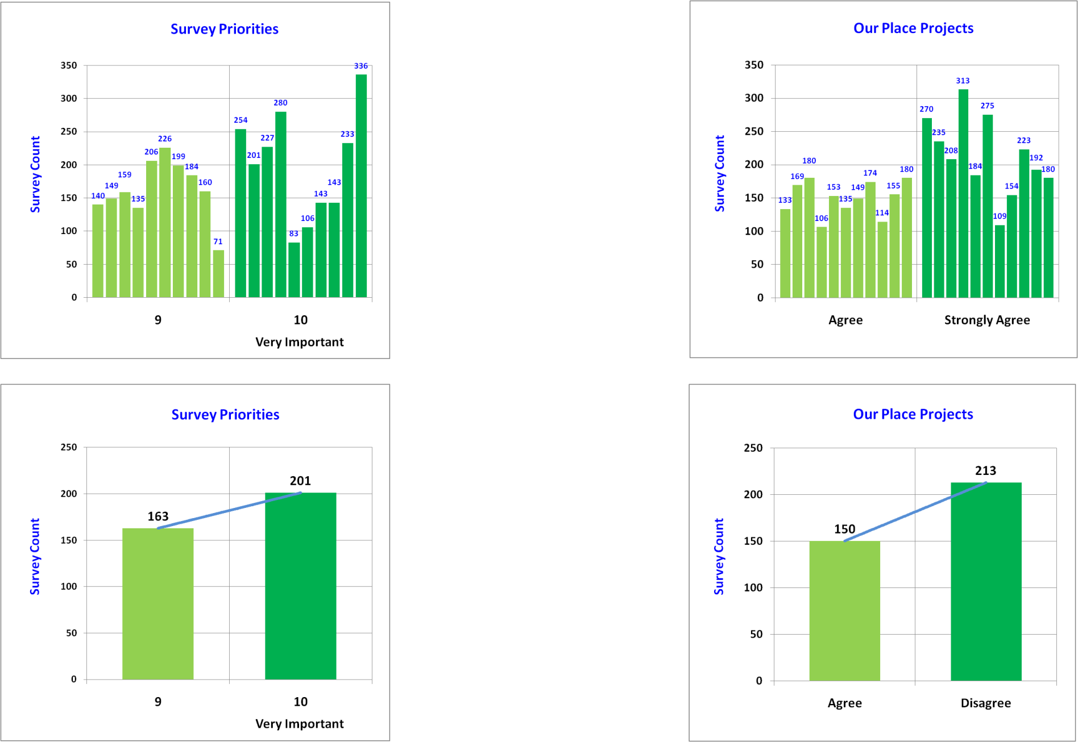
Priorities to Projects Matching - 3 of 3
Statistically combined, the two charts are very close.
The slopes of the trend lines are almost identical.
The people across Ventnor are thinking the same way.
Notes:
Beach 72% Maintain local beaches to the highest standards.
Outdoors 63% Maintain local green spaces to high standards.
Health 62% Provision of health and social care services.
Elderly 54% Develop support networks for older people.
Transport 51% Better and cheaper transport to-and-from Ventnor.
Young 48% More opportunities for Ventnor's young people.
Housing 44% Affordable and decent housing for local people.
Parking 42% Manage and operate a selection of local car parks.
Business 41% Opportunities and support for new and local business.
Jobs 35% Improve local job access and employer training provision.
Space 25% Foster a community space in Upper Ventnor.

Slide 11
Our Place Ventnor Survey
Priority Data Flavours

Slide 12
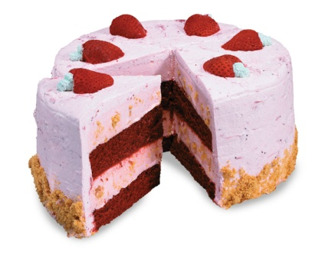
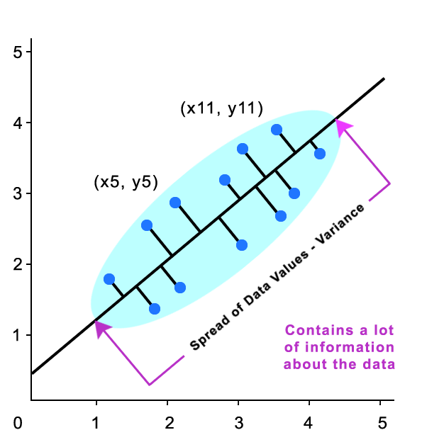


Priority Data Essence Across Ventnor - 1 of 7
Notes:
Beach 72% Maintain local beaches to the highest standards.
Outdoors 63% Maintain local green spaces to high standards.
Health 62% Provision of health and social care services.
Elderly 54% Develop support networks for older people.
Transport 51% Better and cheaper transport to-and-from Ventnor.
Young 48% More opportunities for Ventnor's young people.
Housing 44% Affordable and decent housing for local people.
Parking 42% Manage and operate a selection of local car parks.
Business 41% Opportunities and support for new and local business.
Jobs 35% Improve local job access and employer training provision.
Space 25% Foster a community space in Upper Ventnor.

Slide 13
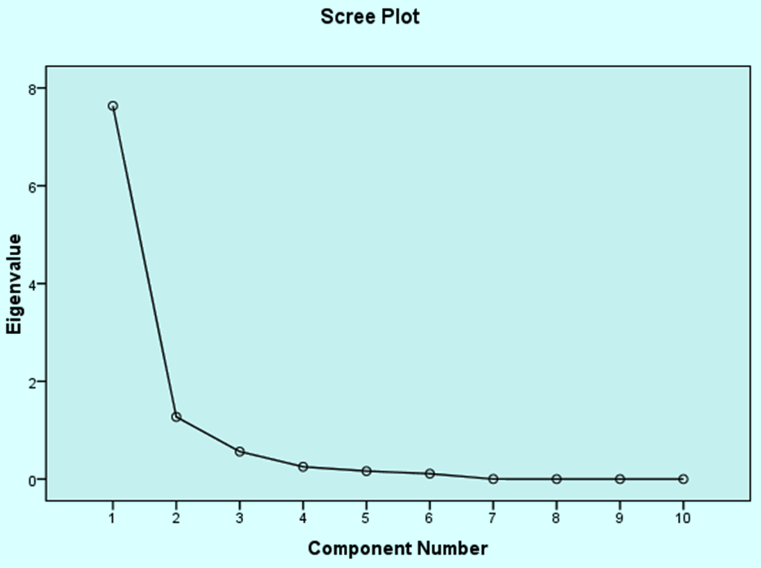
Priority Data Essence Across Ventnor - 2 of 7
Section A - Priorities
Q1 - Local Access to Health Services.
Q2 - Employment Opportunities.
Q3 - Public Transport Services.
Q4 - Leisure, Arts and Culture.
Q5 - Sports Activities.
Q6 - Provision for Young Children.
Q7 - Provision for Teenagers.
Q8 - Support for Older People.
Q9 - Cleanliness of Public Spaces.
Q10 - Sense of Community.
What is the Essence of the Data?
Is Critically Important – Component 1
Looks Like
4 Components Out of 10
Are Involved
(Principal Components)
Seems Very Important – Component 2
Is Important – Component 3
Seems Important – Component 4
Notes:
Beach 72% Maintain local beaches to the highest standards.
Outdoors 63% Maintain local green spaces to high standards.
Health 62% Provision of health and social care services.
Elderly 54% Develop support networks for older people.
Transport 51% Better and cheaper transport to-and-from Ventnor.
Young 48% More opportunities for Ventnor's young people.
Housing 44% Affordable and decent housing for local people.
Parking 42% Manage and operate a selection of local car parks.
Business 41% Opportunities and support for new and local business.
Jobs 35% Improve local job access and employer training provision.
Space 25% Foster a community space in Upper Ventnor.

Slide 14
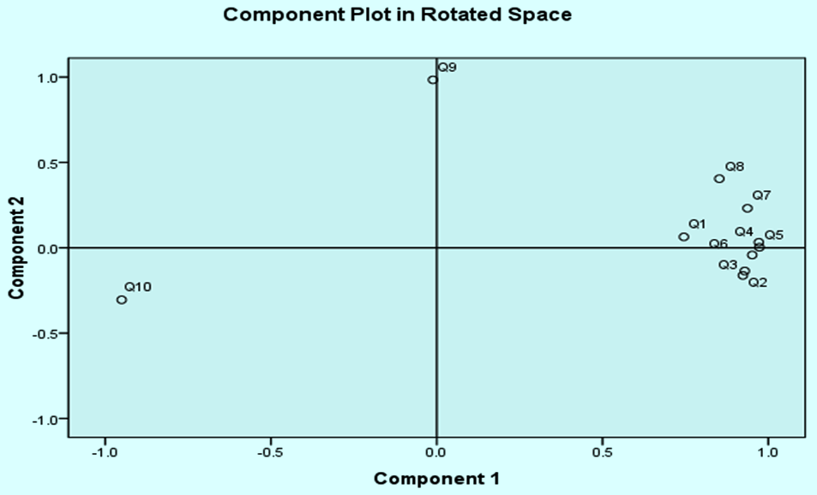
Priority Data Flavour Across Ventnor - 3 of 7
Section A - Priorities
Q1 - Local Access to Health Services.
Q2 - Employment Opportunities.
Q3 - Public Transport Services.
Q4 - Leisure, Arts and Culture.
Q5 - Sports Activities.
Q6 - Provision for Young Children.
Q7 - Provision for Teenagers.
Q8 - Support for Older People.
Q9 - Cleanliness of Public Spaces.
Q10 - Sense of Community.
Just taking the first 2 components, let’s see what happens when charted on two axes.
Where do the data results for the Priority questions go on the chart?
Notes:
Beach 72% Maintain local beaches to the highest standards.
Outdoors 63% Maintain local green spaces to high standards.
Health 62% Provision of health and social care services.
Elderly 54% Develop support networks for older people.
Transport 51% Better and cheaper transport to-and-from Ventnor.
Young 48% More opportunities for Ventnor's young people.
Housing 44% Affordable and decent housing for local people.
Parking 42% Manage and operate a selection of local car parks.
Business 41% Opportunities and support for new and local business.
Jobs 35% Improve local job access and employer training provision.
Space 25% Foster a community space in Upper Ventnor.

Slide 15
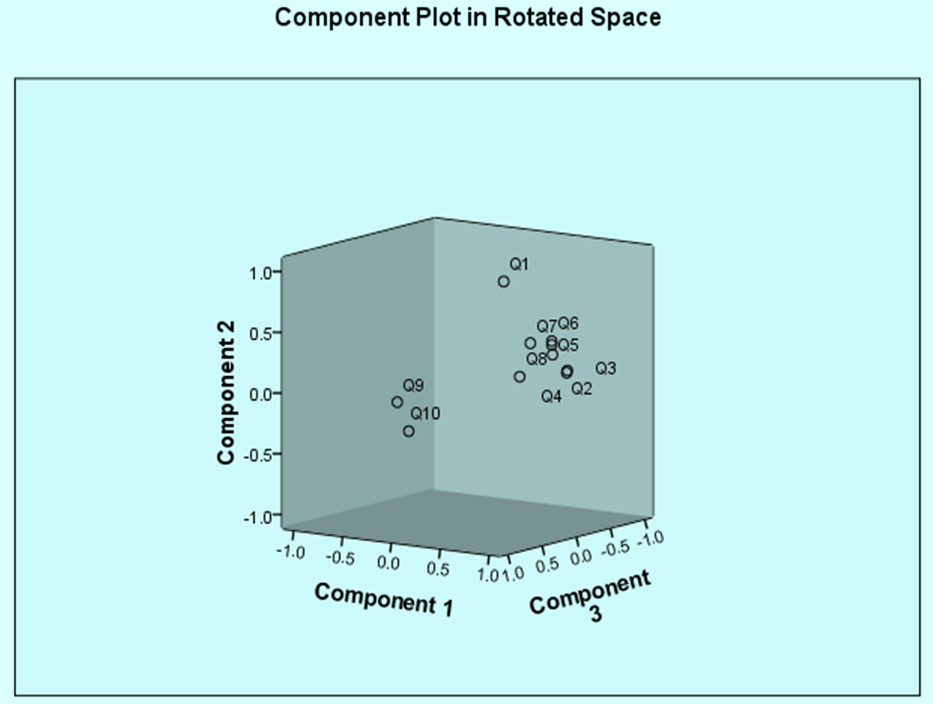
Priority Data Flavour Across Ventnor - 4 of 7
Section A - Priorities
Q1 - Local Access to Health Services.
Q2 - Employment Opportunities.
Q3 - Public Transport Services.
Q4 - Leisure, Arts and Culture.
Q5 - Sports Activities.
Q6 - Provision for Young Children.
Q7 - Provision for Teenagers.
Q8 - Support for Older People.
Q9 - Cleanliness of Public Spaces.
Q10 - Sense of Community.
Now let’s take the first 3 principle components, and see what happens.
Notes:
Beach 72% Maintain local beaches to the highest standards.
Outdoors 63% Maintain local green spaces to high standards.
Health 62% Provision of health and social care services.
Elderly 54% Develop support networks for older people.
Transport 51% Better and cheaper transport to-and-from Ventnor.
Young 48% More opportunities for Ventnor's young people.
Housing 44% Affordable and decent housing for local people.
Parking 42% Manage and operate a selection of local car parks.
Business 41% Opportunities and support for new and local business.
Jobs 35% Improve local job access and employer training provision.
Space 25% Foster a community space in Upper Ventnor.

Slide 16
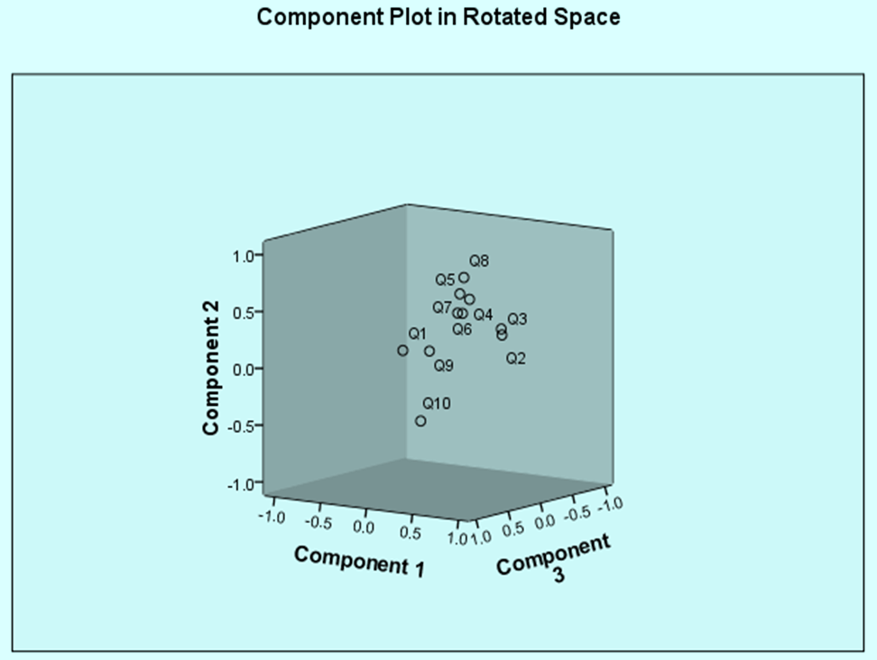
Priority Data Flavours Across Ventnor - 5 of 7
Section A - Priorities
Q1 - Local Access to Health Services.
Q2 - Employment Opportunities.
Q3 - Public Transport Services.
Q4 - Leisure, Arts and Culture.
Q5 - Sports Activities.
Q6 - Provision for Young Children.
Q7 - Provision for Teenagers.
Q8 - Support for Older People.
Q9 - Cleanliness of Public Spaces.
Q10 - Sense of Community.
Now let’s take all 10 principle components,
and see the subtle changes to the 3D chart.
Notes:
Beach 72% Maintain local beaches to the highest standards.
Outdoors 63% Maintain local green spaces to high standards.
Health 62% Provision of health and social care services.
Elderly 54% Develop support networks for older people.
Transport 51% Better and cheaper transport to-and-from Ventnor.
Young 48% More opportunities for Ventnor's young people.
Housing 44% Affordable and decent housing for local people.
Parking 42% Manage and operate a selection of local car parks.
Business 41% Opportunities and support for new and local business.
Jobs 35% Improve local job access and employer training provision.
Space 25% Foster a community space in Upper Ventnor.

Slide 17
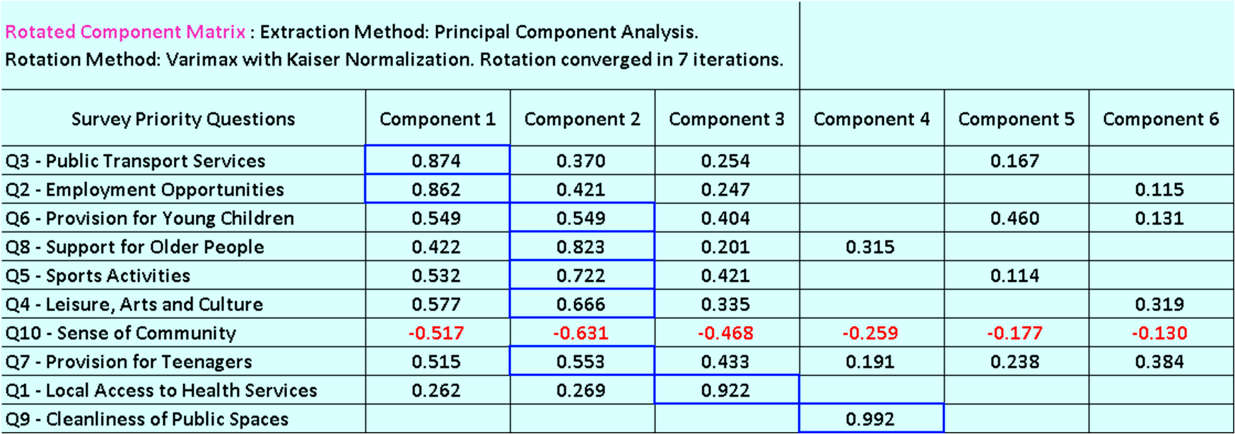
Priority Data Flavour Across Ventnor - 5 of 7
Having a peek underneath the bonnet...
We find they are just numbers in columns. Let’s explain them.
Notes:
The numerical values under each component indicate the level of contribution (worked out statistically) using the received data results for each Priority question.
In the above chart, Component 1 has a value of 0.874 for Question 3 – Public Transport Services; and for Question 2 – Employment Opportunities, a value of 0.862. These are significantly high and therefore characterise the nature of Component 1, or put another way provide Component 1 with its characteristic flavour.
Likewise Component 2 has higher values for the Priority Questions 6, 8, 5, 4 and 7 and is being characterised (or flavoured), through the received data results. The same also applies to Components 3 with a high value of 0.922 and Component 4 with a high value of 0.922. Components 5 and 6 exhibit no high values and are flavourless.

Slide 18
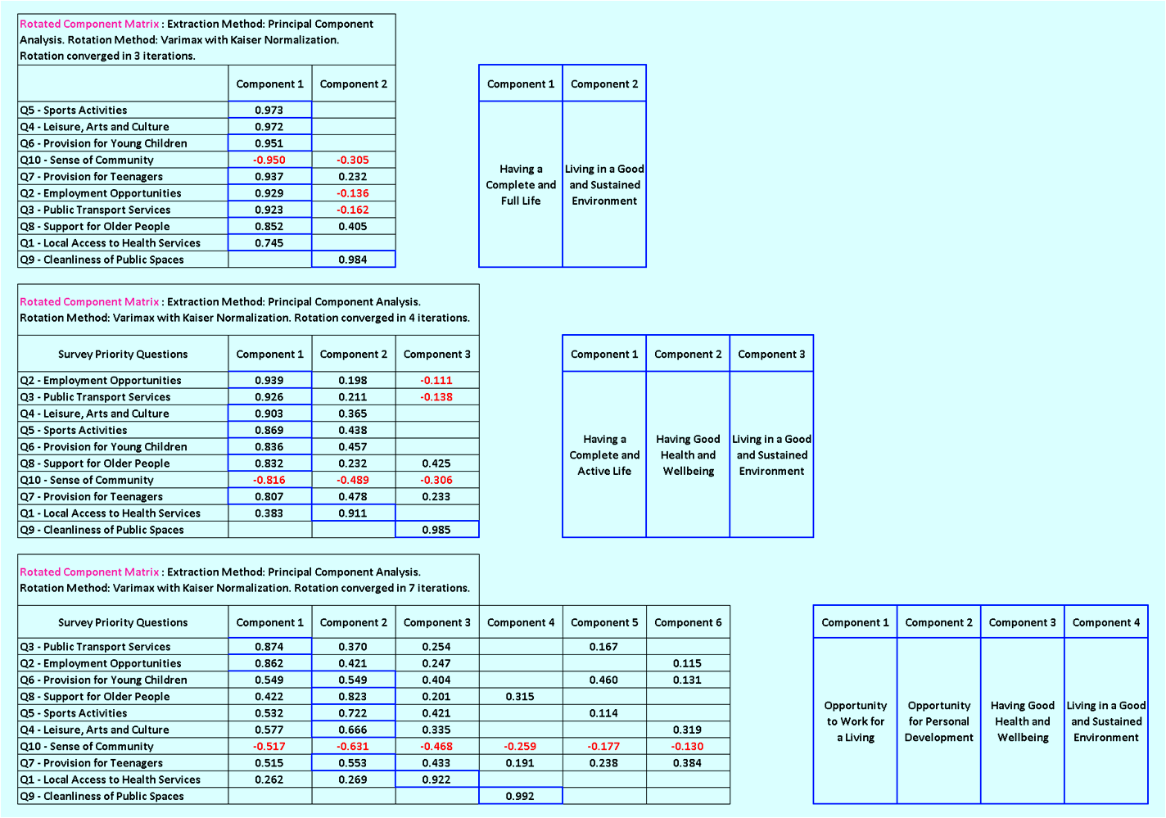
Priority Data Flavours Across Ventnor - 6 of 7
These are the suggested underlying characteristics for each principle component.
Note how they can change as
the components increase.
Notes:
Beach 72% Maintain local beaches to the highest standards.
Outdoors 63% Maintain local green spaces to high standards.
Health 62% Provision of health and social care services.
Elderly 54% Develop support networks for older people.
Transport 51% Better and cheaper transport to-and-from Ventnor.
Young 48% More opportunities for Ventnor's young people.
Housing 44% Affordable and decent housing for local people.
Parking 42% Manage and operate a selection of local car parks.
Business 41% Opportunities and support for new and local business.
Jobs 35% Improve local job access and employer training provision.
Space 25% Foster a community space in Upper Ventnor.

Slide 19
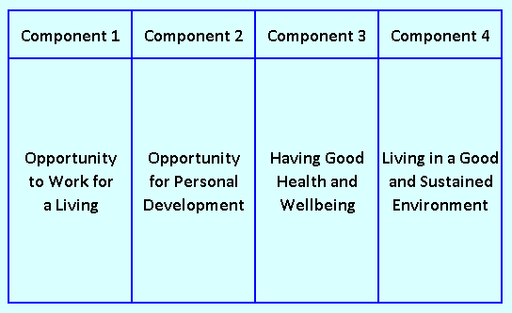
Priority Data Flavours Across Ventnor - 7 of 7
Do these Principal Component Flavours
ring any bells?
Health,
Wellbeing,
Economic Prosperity
And Community Capacity
Notes:
Beach 72% Maintain local beaches to the highest standards.
Outdoors 63% Maintain local green spaces to high standards.
Health 62% Provision of health and social care services.
Elderly 54% Develop support networks for older people.
Transport 51% Better and cheaper transport to-and-from Ventnor.
Young 48% More opportunities for Ventnor's young people.
Housing 44% Affordable and decent housing for local people.
Parking 42% Manage and operate a selection of local car parks.
Business 41% Opportunities and support for new and local business.
Jobs 35% Improve local job access and employer training provision.
Space 25% Foster a community space in Upper Ventnor.

Slide 20
Our Place Ventnor Survey
Postcode Evaluations

Slide 21
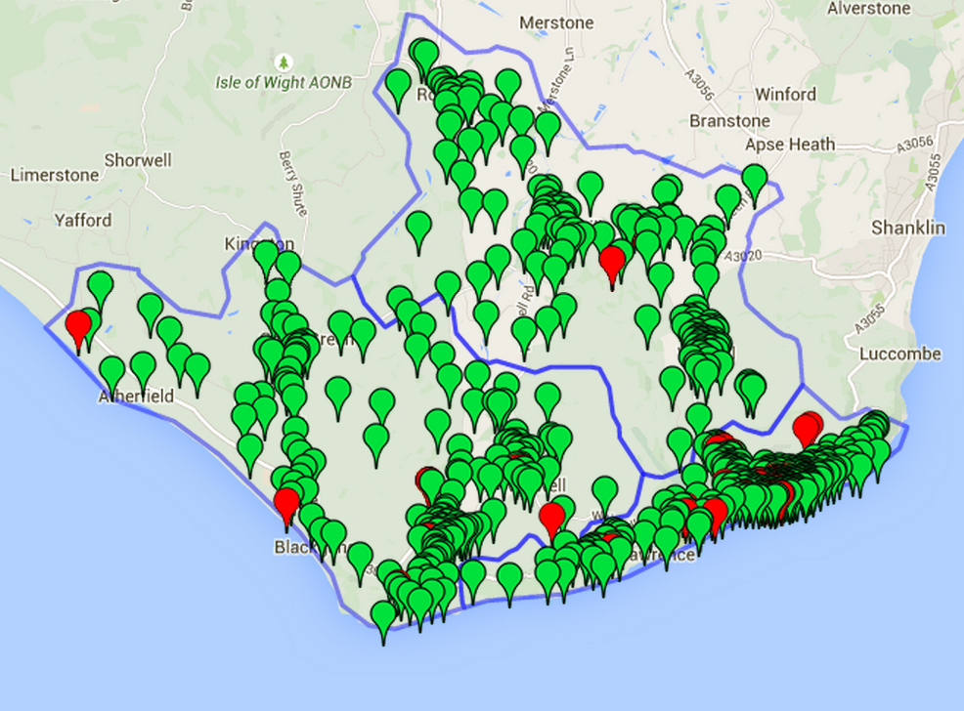
Postcode Areas of Ventnor - 1 of 4
Sector: PO38 3
(165 postcodes, 156 active)
Sector: PO38 2
(190 postcodes, 168 active)
Sector: PO38 1
(319 postcodes, 260 active)
Sector: PO38 9
(38 postcodes, 5 active)
Postcode:PO38 9AW Approx address:11 Church Street, Ventnor, Isle of Wight PO38 1SL, UK
Notes:
Beach 72% Maintain local beaches to the highest standards.
Outdoors 63% Maintain local green spaces to high standards.
Health 62% Provision of health and social care services.
Elderly 54% Develop support networks for older people.
Transport 51% Better and cheaper transport to-and-from Ventnor.
Young 48% More opportunities for Ventnor's young people.
Housing 44% Affordable and decent housing for local people.
Parking 42% Manage and operate a selection of local car parks.
Business 41% Opportunities and support for new and local business.
Jobs 35% Improve local job access and employer training provision.
Space 25% Foster a community space in Upper Ventnor.

Slide 22
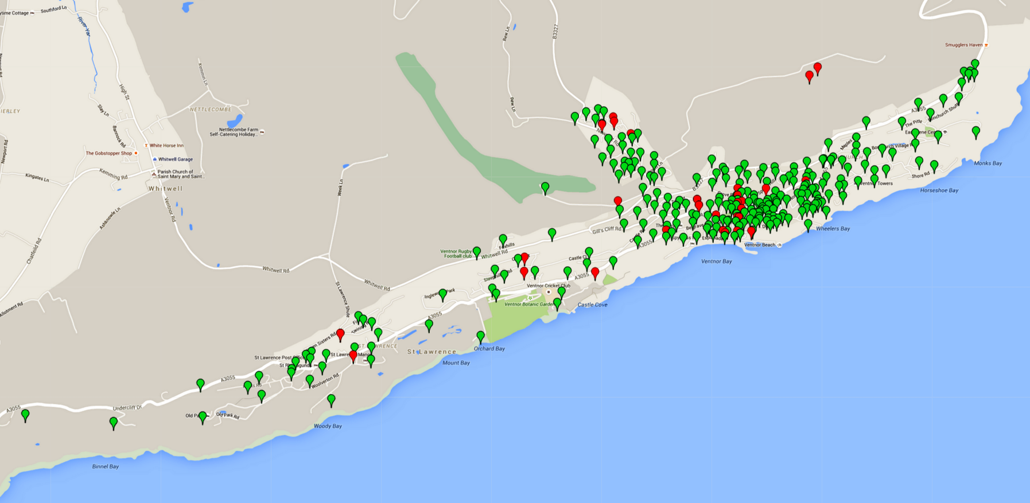
Span of Postcode Area PO38 - 2 of 4
Notes:
Beach 72% Maintain local beaches to the highest standards.
Outdoors 63% Maintain local green spaces to high standards.
Health 62% Provision of health and social care services.
Elderly 54% Develop support networks for older people.
Transport 51% Better and cheaper transport to-and-from Ventnor.
Young 48% More opportunities for Ventnor's young people.
Housing 44% Affordable and decent housing for local people.
Parking 42% Manage and operate a selection of local car parks.
Business 41% Opportunities and support for new and local business.
Jobs 35% Improve local job access and employer training provision.
Space 25% Foster a community space in Upper Ventnor.

Slide 23
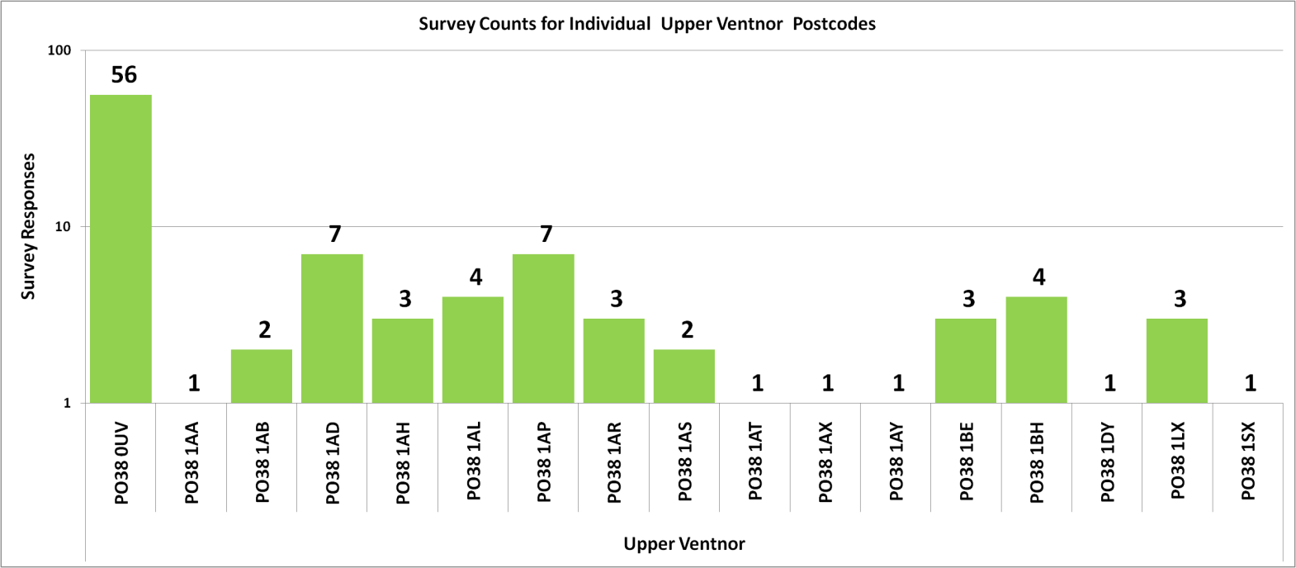
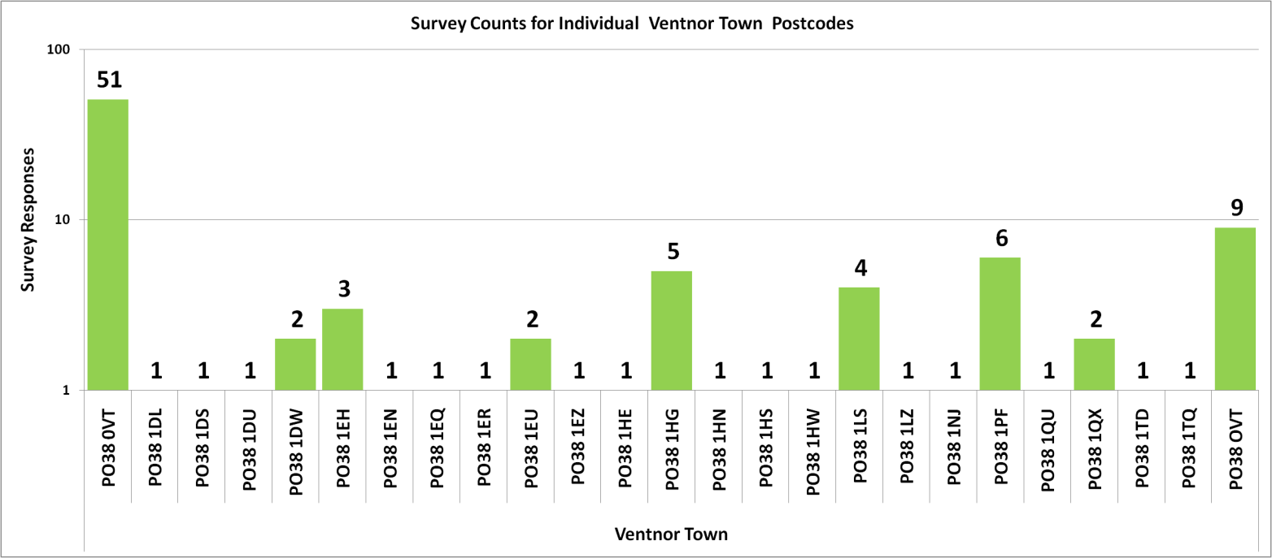
Postcodes - Surveys Returned - 3 of 4
Sector: PO38 1
(319 postcodes, 260 active)
16 Known
Upper
Ventnor
Postcodes
100 Surveys
Sector: PO38 1
(319 postcodes, 260 active)
24 Known
Ventnor
Town
Postcodes
100 Surveys
Notes:
Beach 72% Maintain local beaches to the highest standards.
Outdoors 63% Maintain local green spaces to high standards.
Health 62% Provision of health and social care services.
Elderly 54% Develop support networks for older people.
Transport 51% Better and cheaper transport to-and-from Ventnor.
Young 48% More opportunities for Ventnor's young people.
Housing 44% Affordable and decent housing for local people.
Parking 42% Manage and operate a selection of local car parks.
Business 41% Opportunities and support for new and local business.
Jobs 35% Improve local job access and employer training provision.
Space 25% Foster a community space in Upper Ventnor.

Slide 24
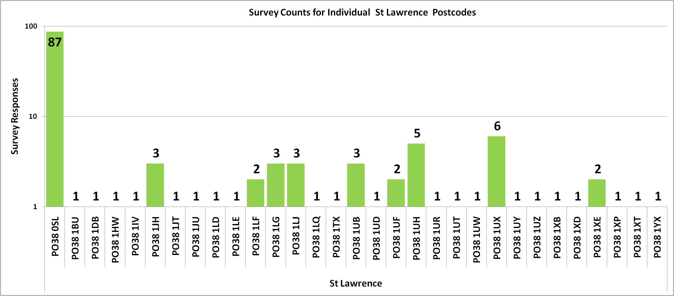
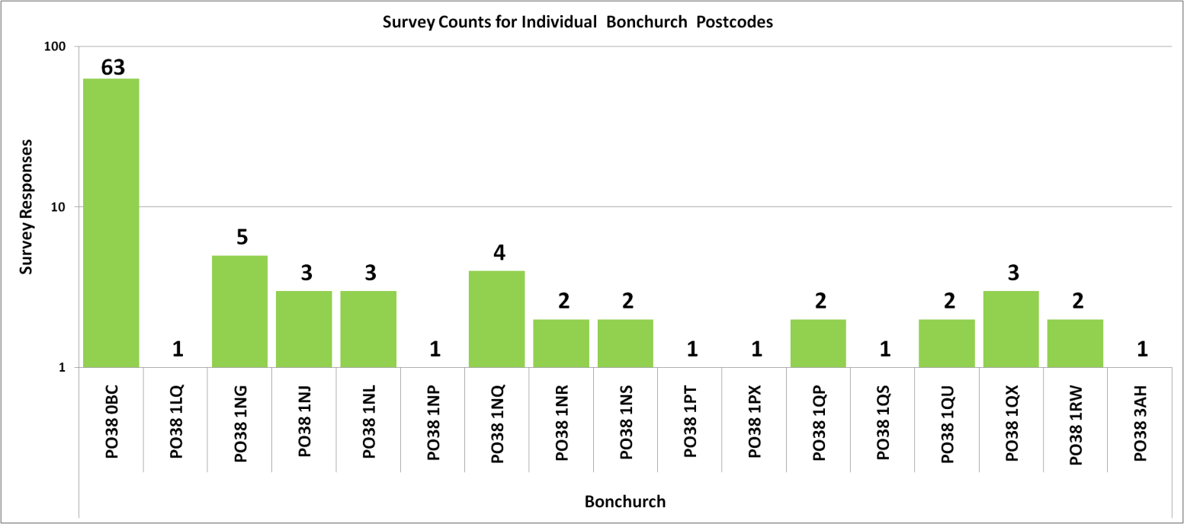
Postcodes - Surveys Returned - 4 of 4
Sector: PO38 1
(319 postcodes, 260 active)
30 Known
St Lawrence
Postcodes
137 Surveys
Sector: PO38 1
(319 postcodes, 260 active)
16 Known
Bonchurch
Postcodes
97 Surveys
Notes:
Beach 72% Maintain local beaches to the highest standards.
Outdoors 63% Maintain local green spaces to high standards.
Health 62% Provision of health and social care services.
Elderly 54% Develop support networks for older people.
Transport 51% Better and cheaper transport to-and-from Ventnor.
Young 48% More opportunities for Ventnor's young people.
Housing 44% Affordable and decent housing for local people.
Parking 42% Manage and operate a selection of local car parks.
Business 41% Opportunities and support for new and local business.
Jobs 35% Improve local job access and employer training provision.
Space 25% Foster a community space in Upper Ventnor.

Slide 25
Our Place Ventnor Survey
Priority Data Flavours – Advanced
Discussion Only.

Slide 26
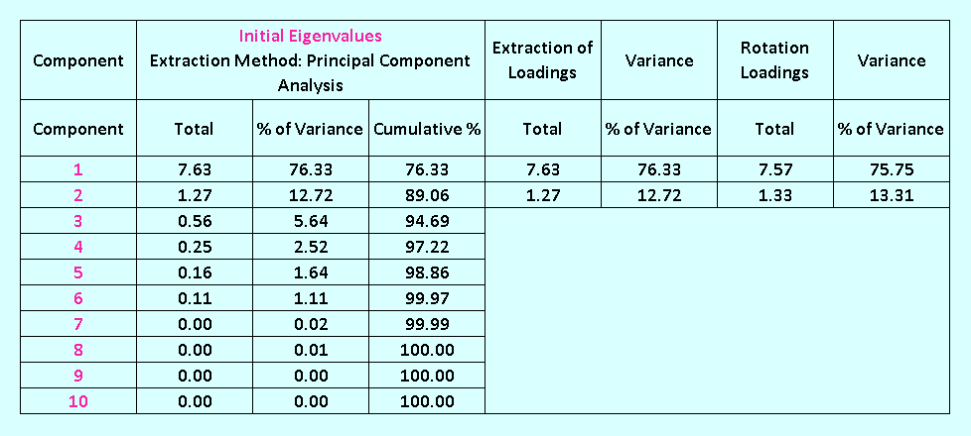
Priority Data Flavours - Advanced - 1 of 3
Notes:
Beach 72% Maintain local beaches to the highest standards.
Outdoors 63% Maintain local green spaces to high standards.
Health 62% Provision of health and social care services.
Elderly 54% Develop support networks for older people.
Transport 51% Better and cheaper transport to-and-from Ventnor.
Young 48% More opportunities for Ventnor's young people.
Housing 44% Affordable and decent housing for local people.
Parking 42% Manage and operate a selection of local car parks.
Business 41% Opportunities and support for new and local business.
Jobs 35% Improve local job access and employer training provision.
Space 25% Foster a community space in Upper Ventnor.

Slide 27
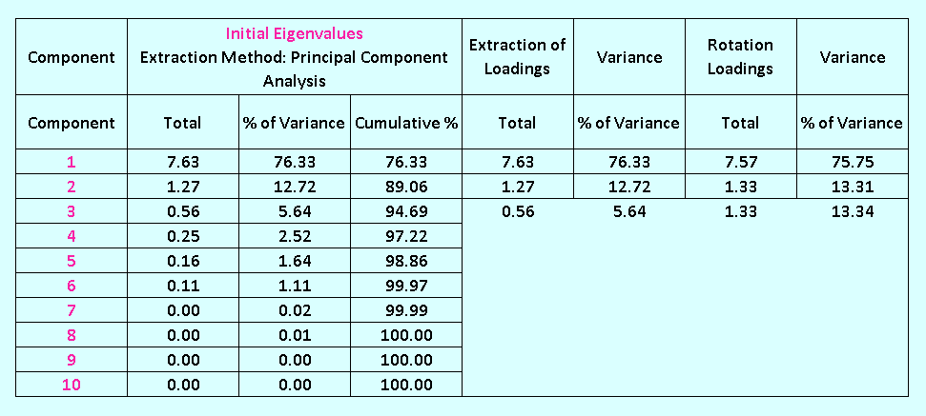
Priority Data Flavours - Advanced - 2 of 3
Notes:
Beach 72% Maintain local beaches to the highest standards.
Outdoors 63% Maintain local green spaces to high standards.
Health 62% Provision of health and social care services.
Elderly 54% Develop support networks for older people.
Transport 51% Better and cheaper transport to-and-from Ventnor.
Young 48% More opportunities for Ventnor's young people.
Housing 44% Affordable and decent housing for local people.
Parking 42% Manage and operate a selection of local car parks.
Business 41% Opportunities and support for new and local business.
Jobs 35% Improve local job access and employer training provision.
Space 25% Foster a community space in Upper Ventnor.

Slide 28
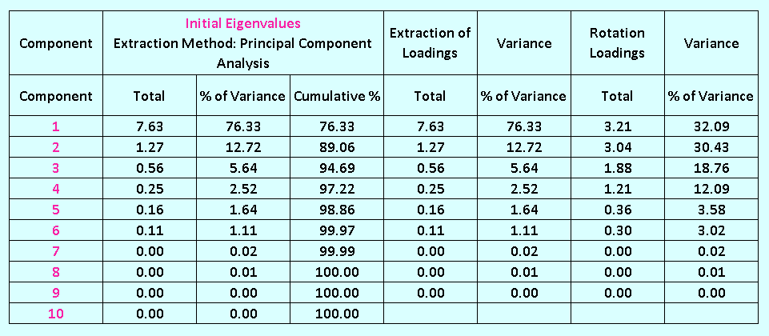
Priority Data Flavours - Advanced - 3 of 3
Notes:
Beach 72% Maintain local beaches to the highest standards.
Outdoors 63% Maintain local green spaces to high standards.
Health 62% Provision of health and social care services.
Elderly 54% Develop support networks for older people.
Transport 51% Better and cheaper transport to-and-from Ventnor.
Young 48% More opportunities for Ventnor's young people.
Housing 44% Affordable and decent housing for local people.
Parking 42% Manage and operate a selection of local car parks.
Business 41% Opportunities and support for new and local business.
Jobs 35% Improve local job access and employer training provision.
Space 25% Foster a community space in Upper Ventnor.

Slide 29
Our Place Ventnor Survey
Survey Investigation – The End
Notes:
http://www.jkp-ads.com/download.asp

