Slide 1
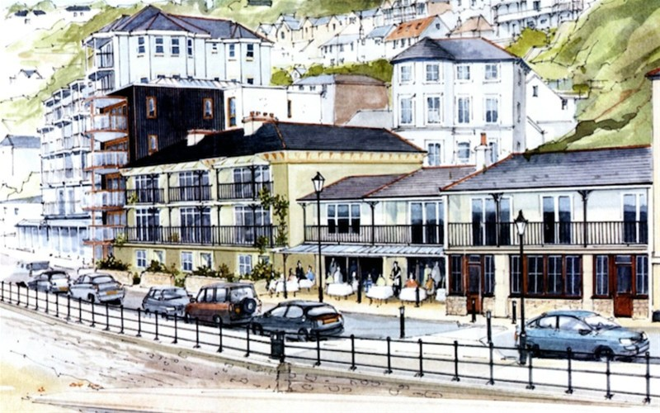

2015 Our Place Survey Results for Ventnor
Survey Section E: Comments

Slide 2
Presentations Available: Detailed Results
◊ Priorities
◊ Facilities
◊ Opportunities
◊ Engagement
◊ Projects
◊ Investigation
____________________
◊ Comments
◊ Postcodes
2015
Our Place
Survey Results
For
Ventnor

Slide 3
Our Place Ventnor Survey
Basic Demographics

Slide 4
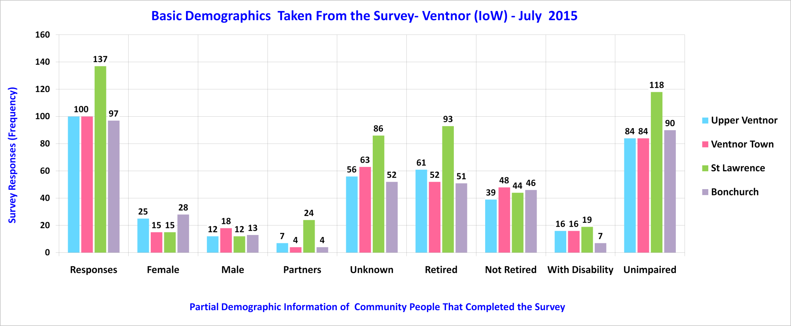
Sampled Ventnor Community

Slide 5
Our Place Ventnor Survey
Section B – Library Comments
Please note: Trend lines shown on some charts are for visual enhancement only.

Slide 6
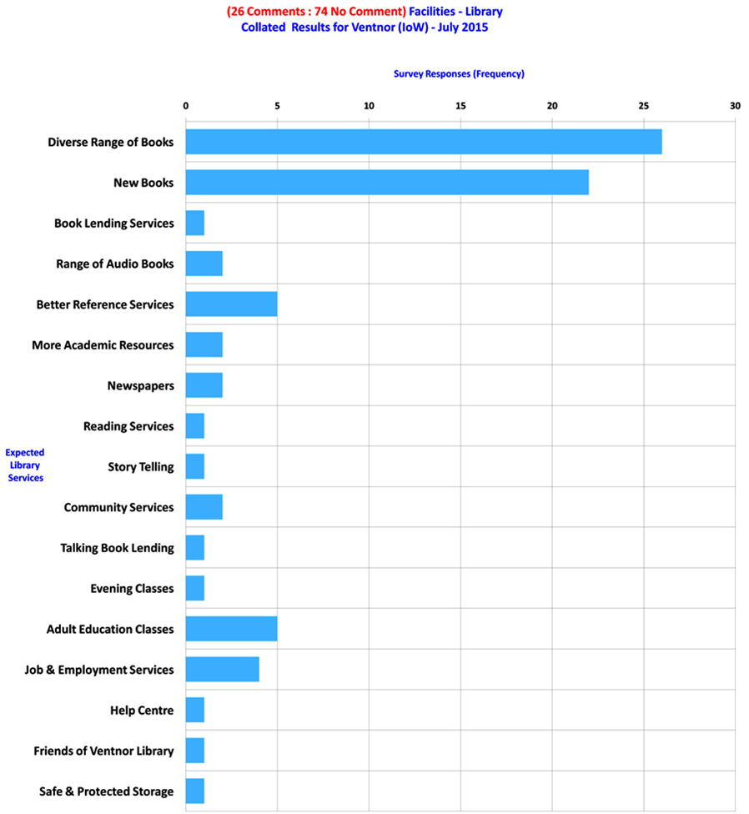
Library Comments Across Ventnor - 1 of 5

Slide 7
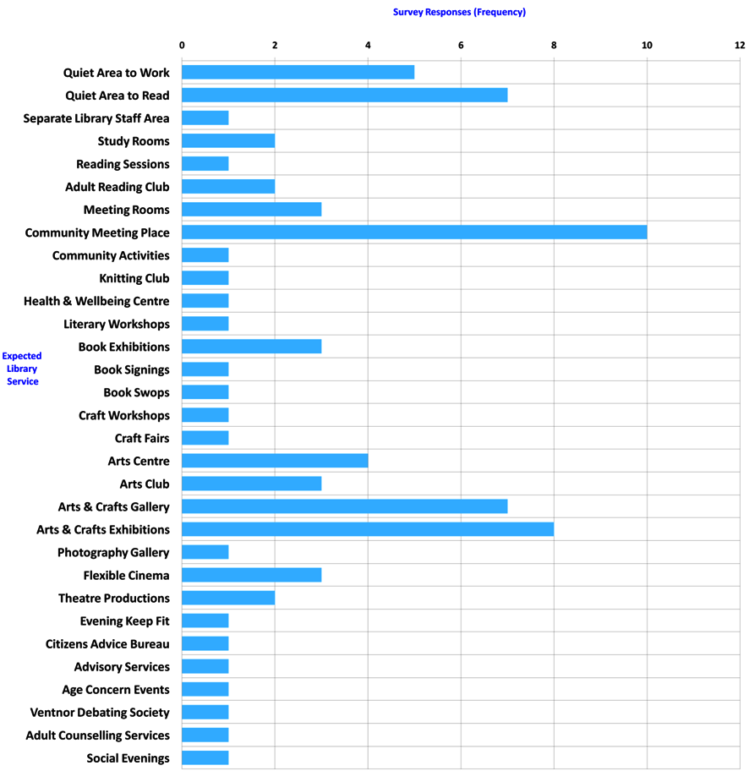
Library Comments Across Ventnor - 2 of 5

Slide 8
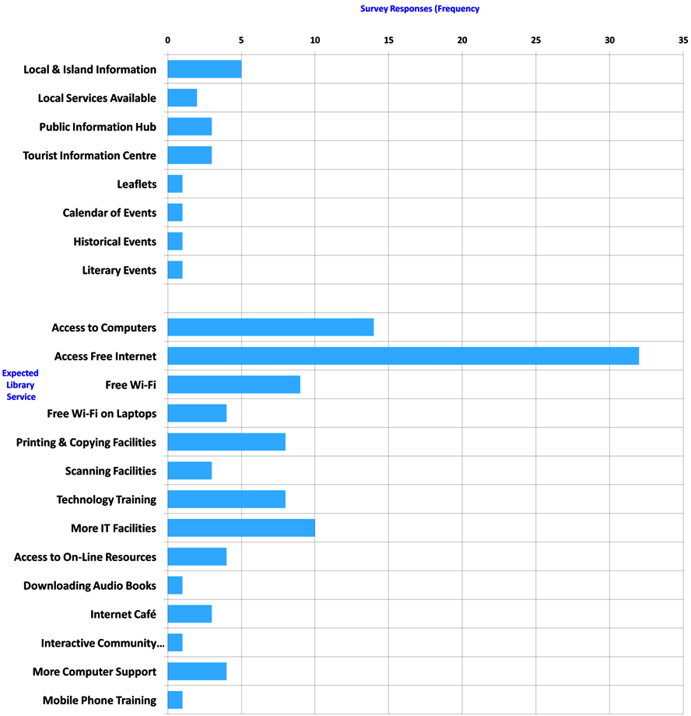
Library Comments Across Ventnor - 3 of 5

Slide 9
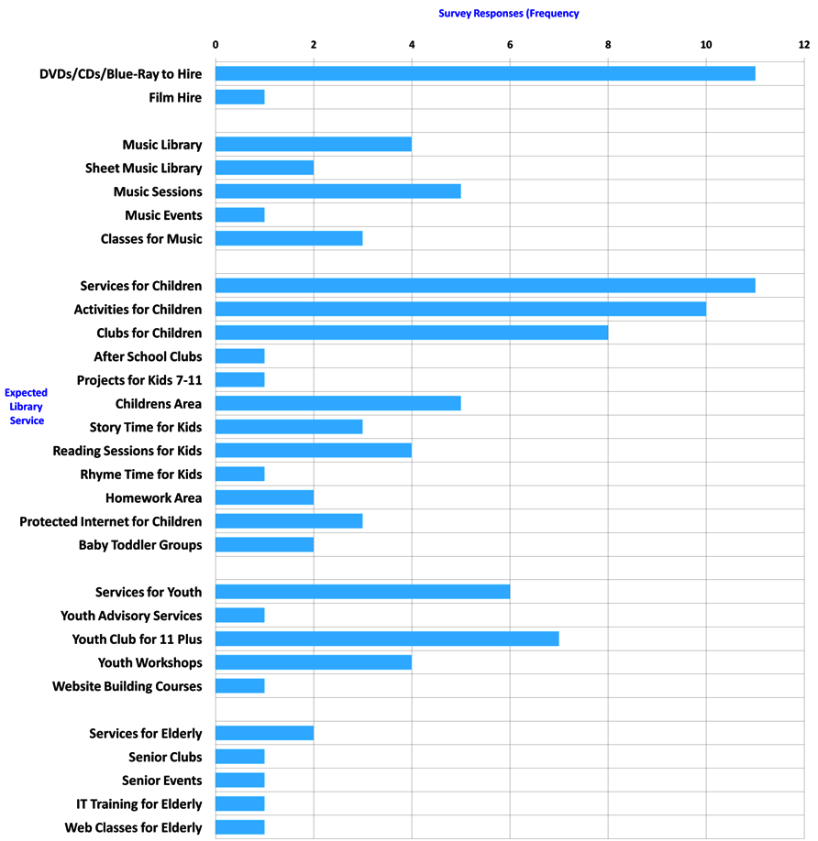
Library Comments Across Ventnor - 4 of 5

Slide 10
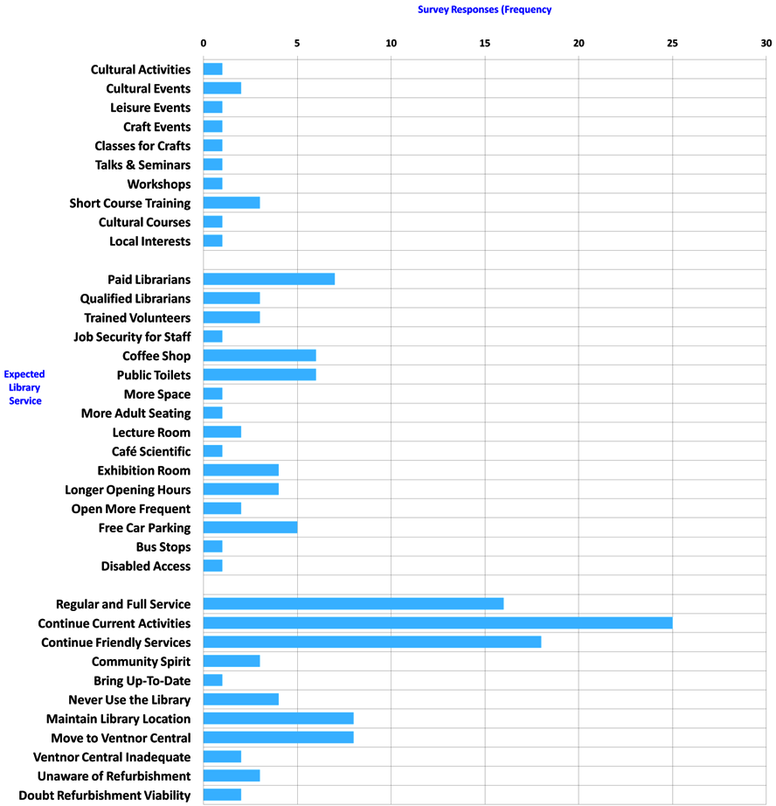
Library Comments Across Ventnor - 5 of 5

Slide 11
Our Place Ventnor Survey
Section E – Project Comments

Slide 12
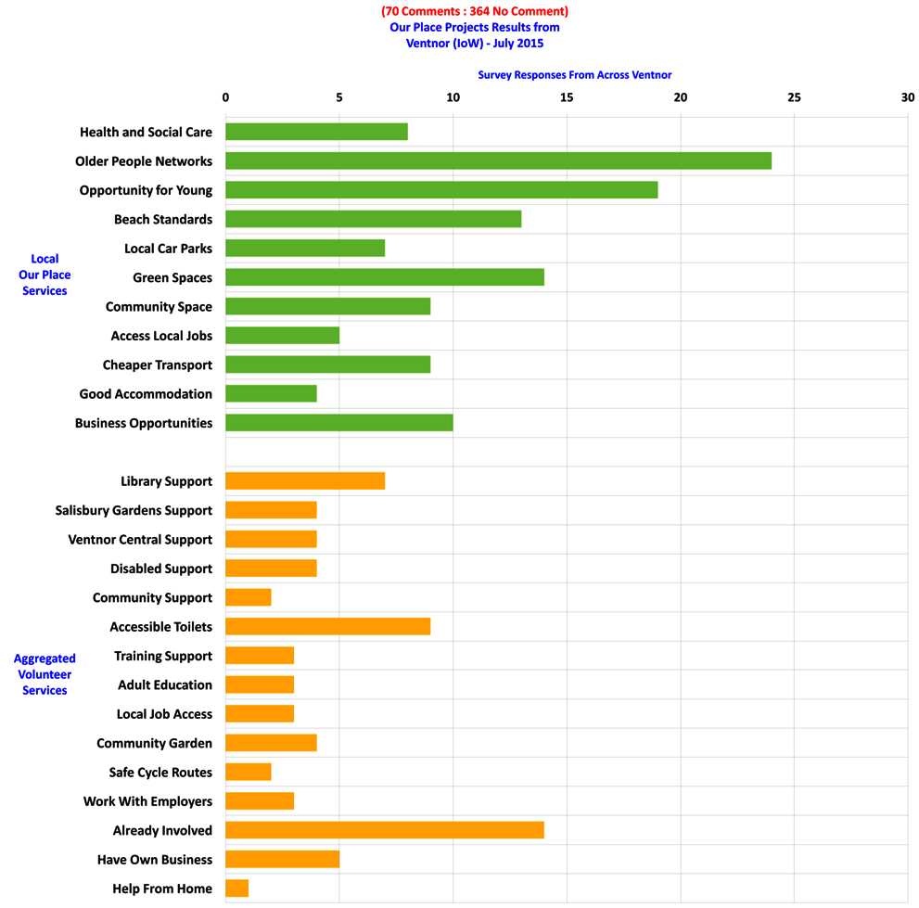
Library Comments Across Ventnor - 1 of 1

Slide 13
Our Place Ventnor Survey
Section E – Additional Comments

Slide 14
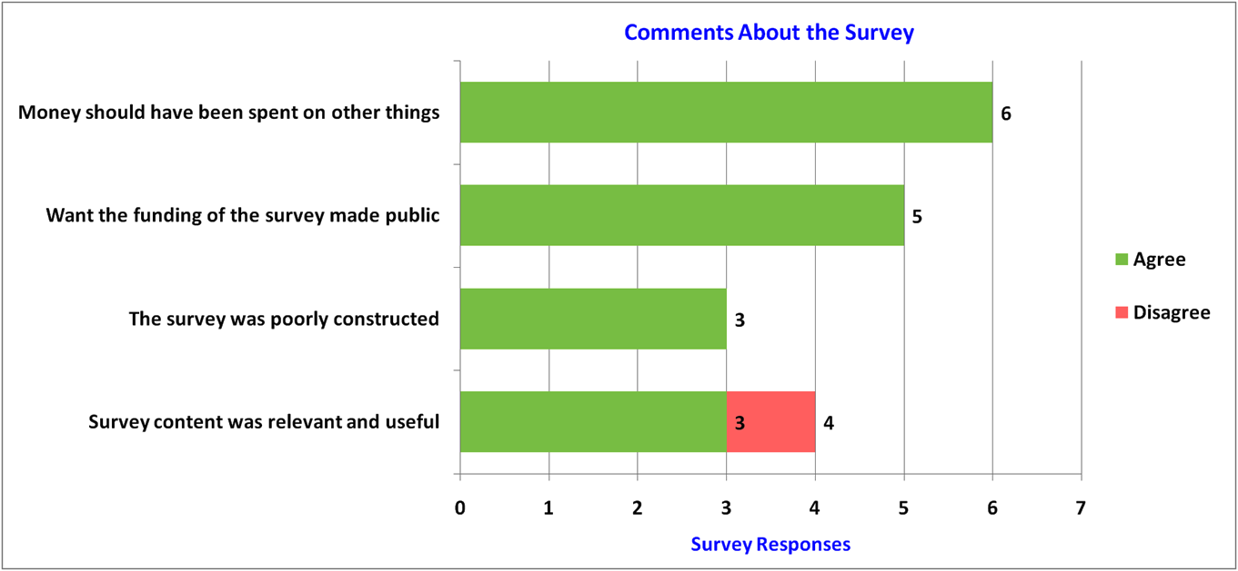
The Our Place Survey - 1 of 17

Slide 15
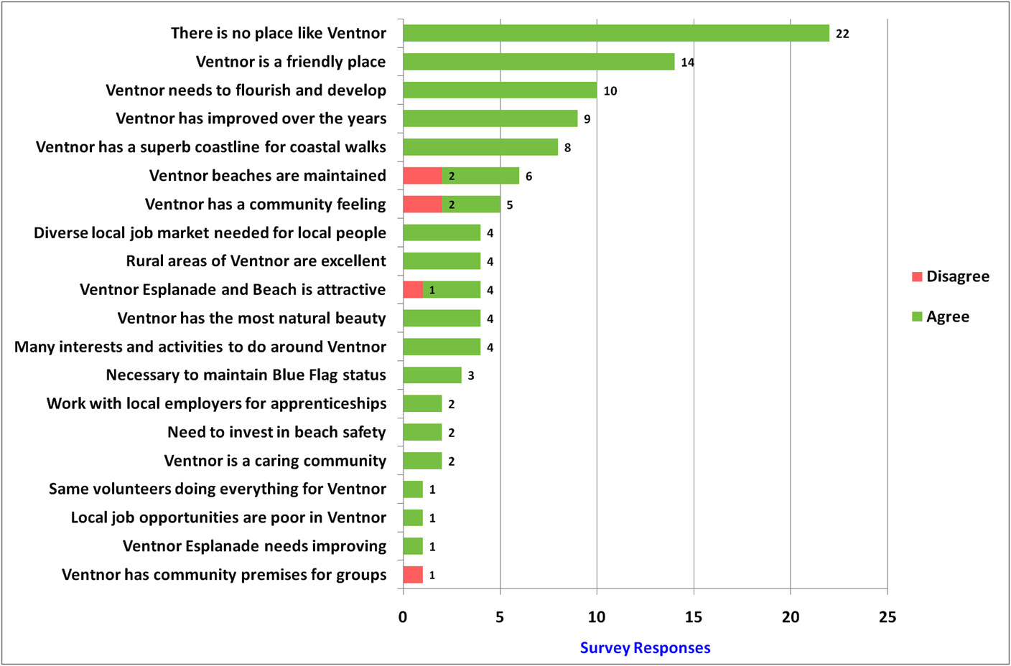
The Place Ventnor - 2 of 17

Slide 16
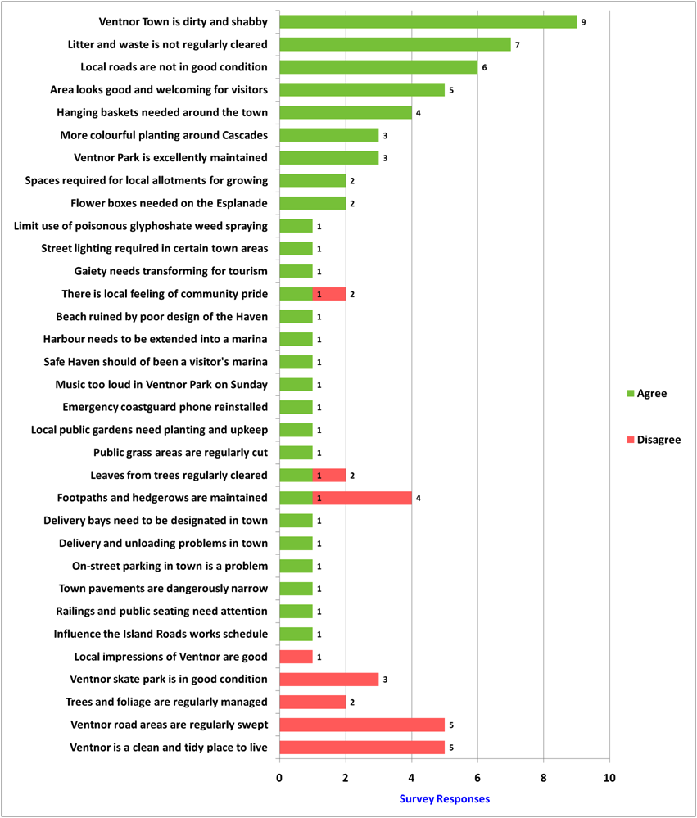
Local Environment - 3 of 17

Slide 17
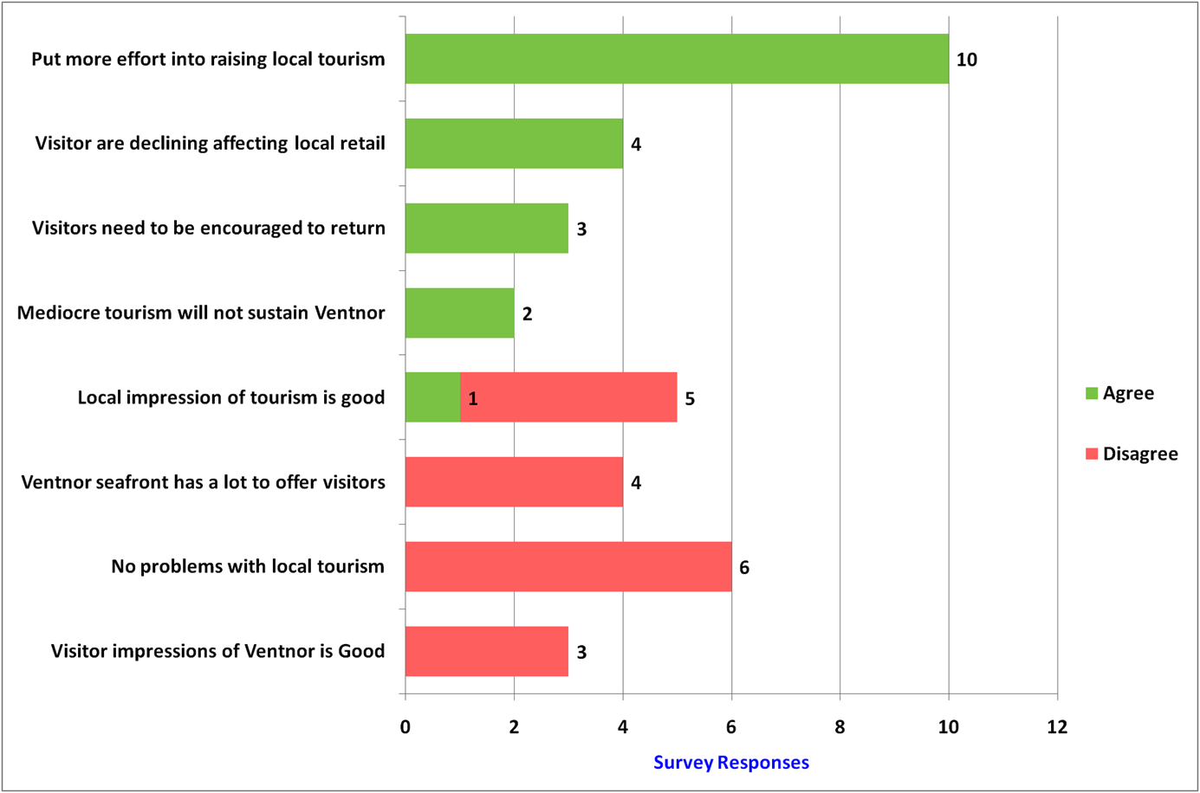
Local Tourism - 4 of 17

Slide 18
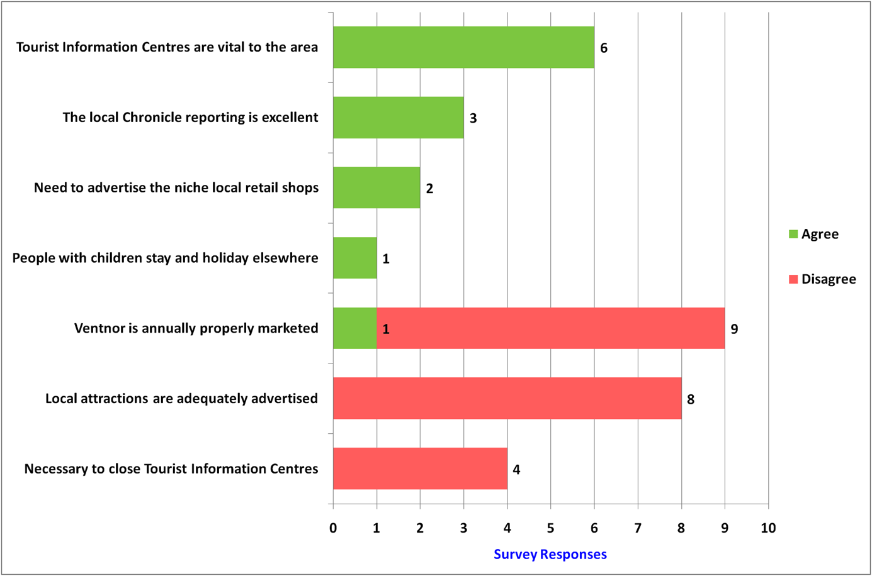
PR, Media & Marketing - 5 of 17

Slide 19
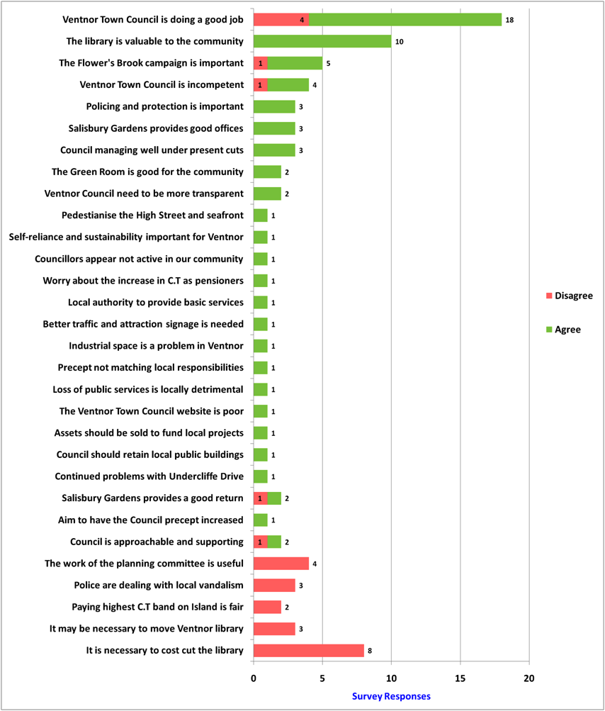
Ventnor Town Council - 6 of 17

Slide 20
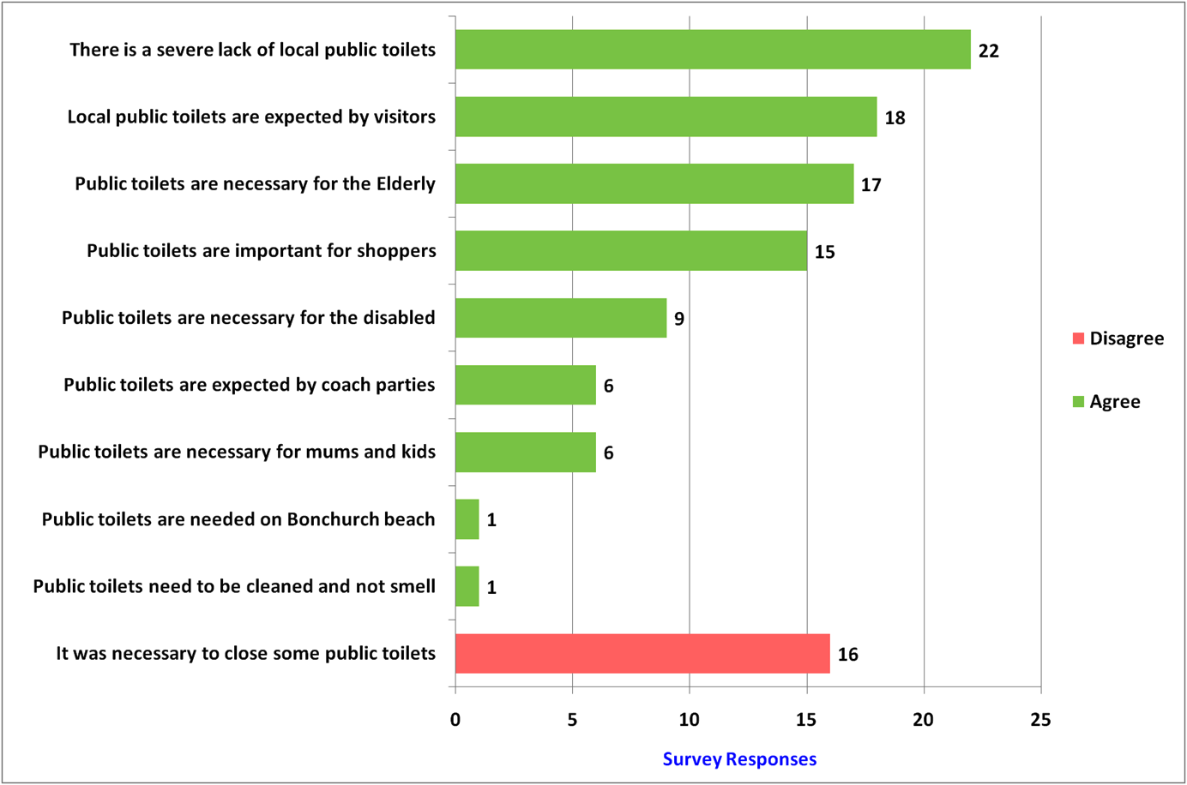
Local Public Toilets - 7 of 17

Slide 21
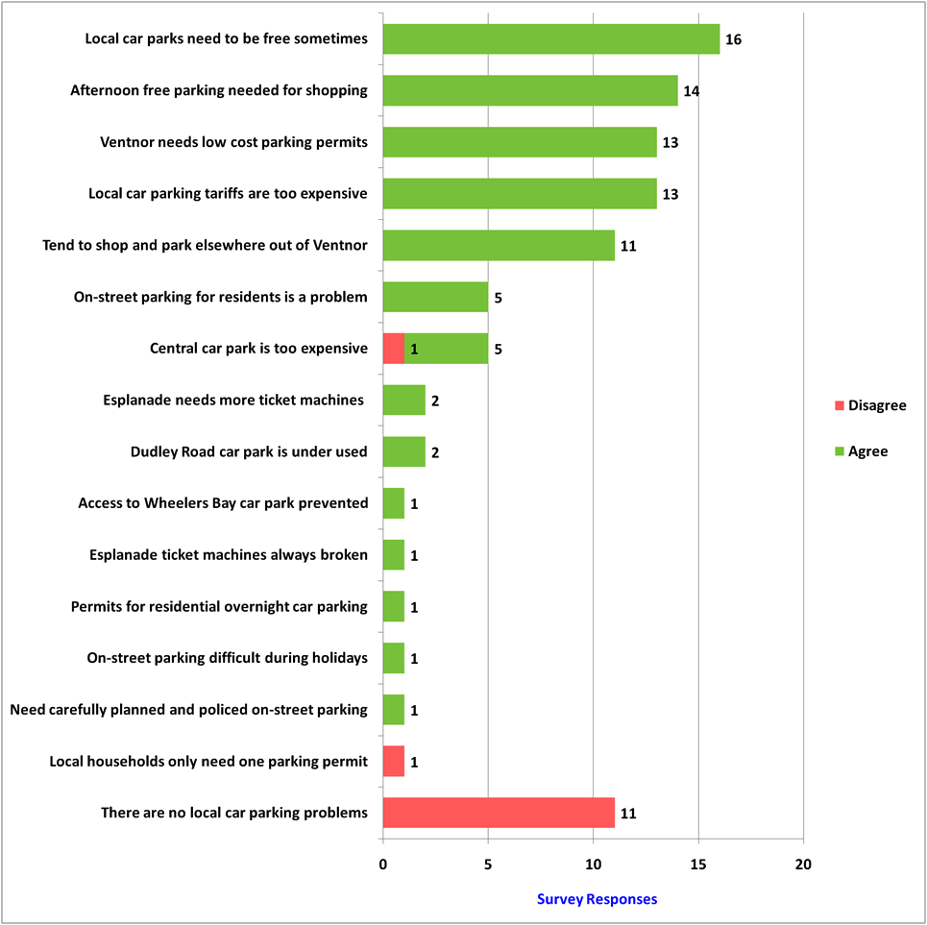
Local Car Parking - 8 of 17

Slide 22
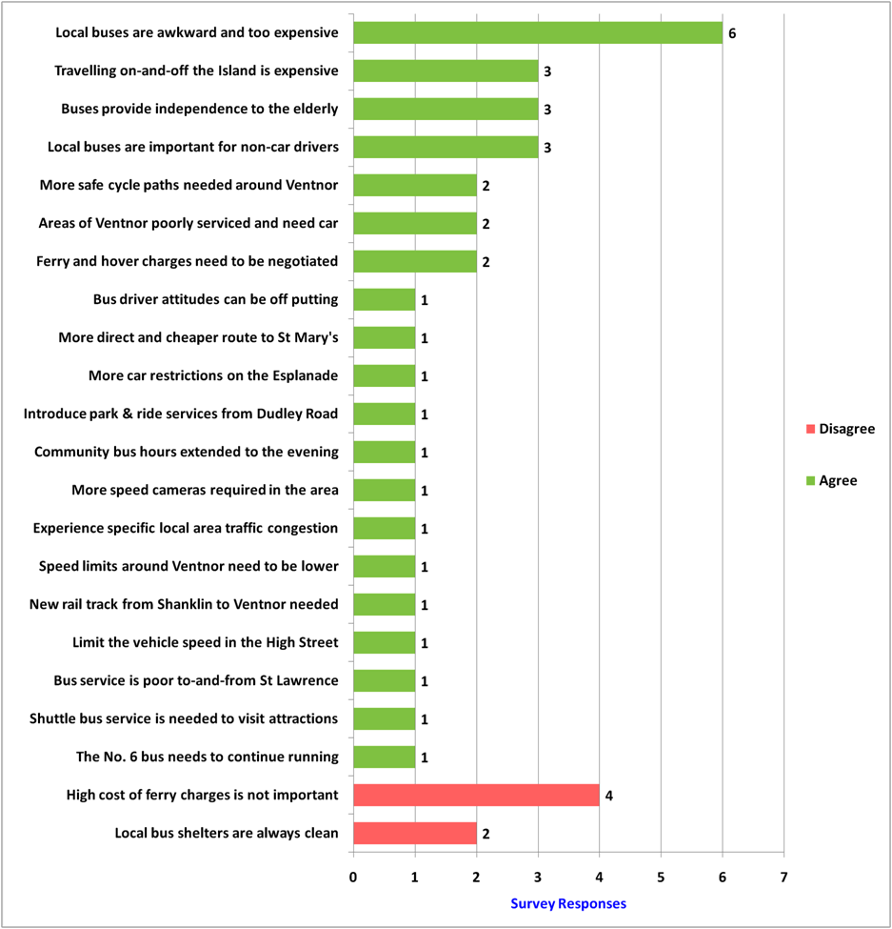
Local Transport - 9 of 17

Slide 23
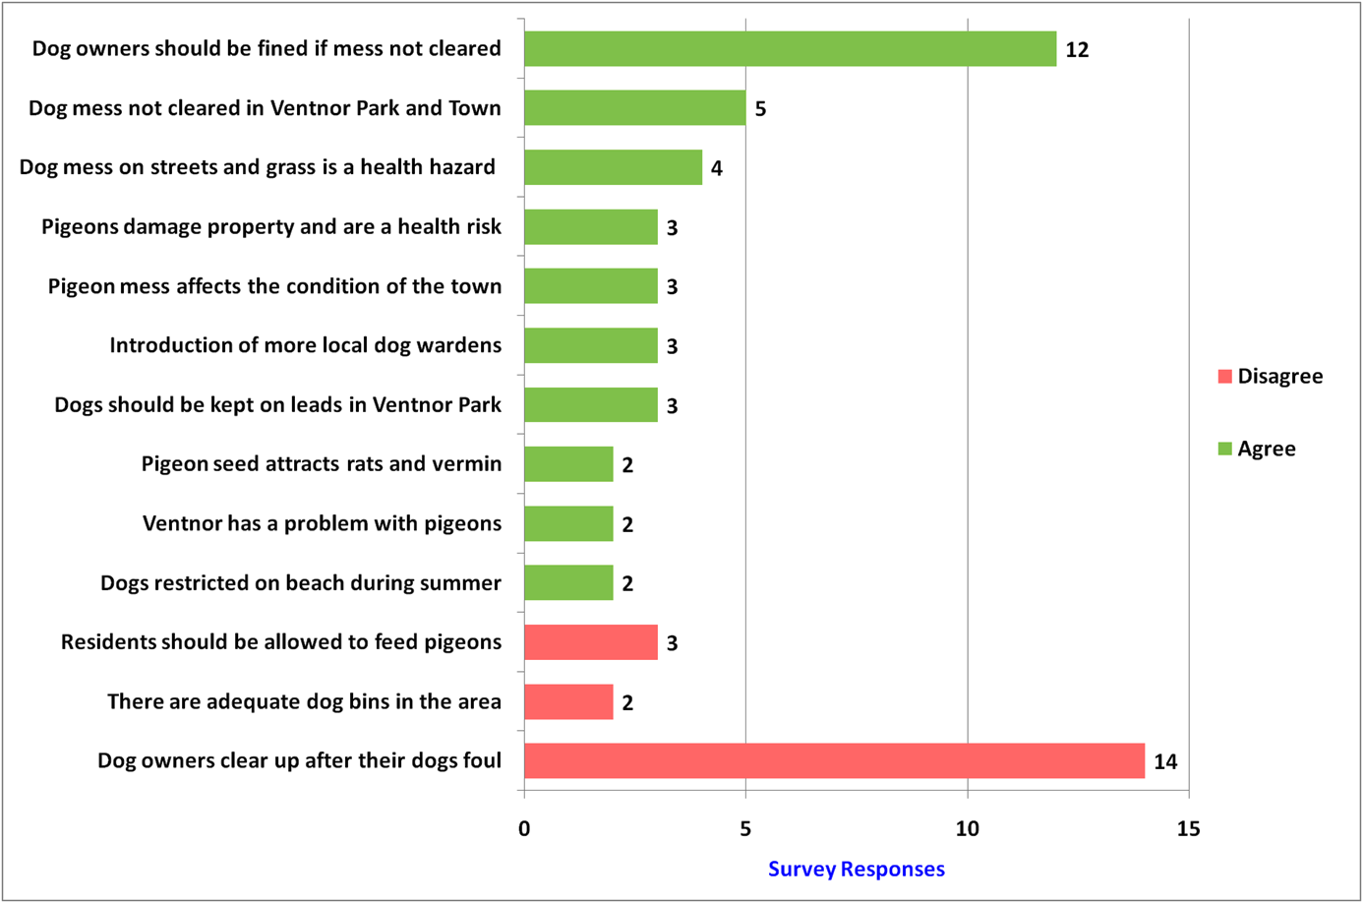
Dogs & Pigeons - 10 of 17

Slide 24
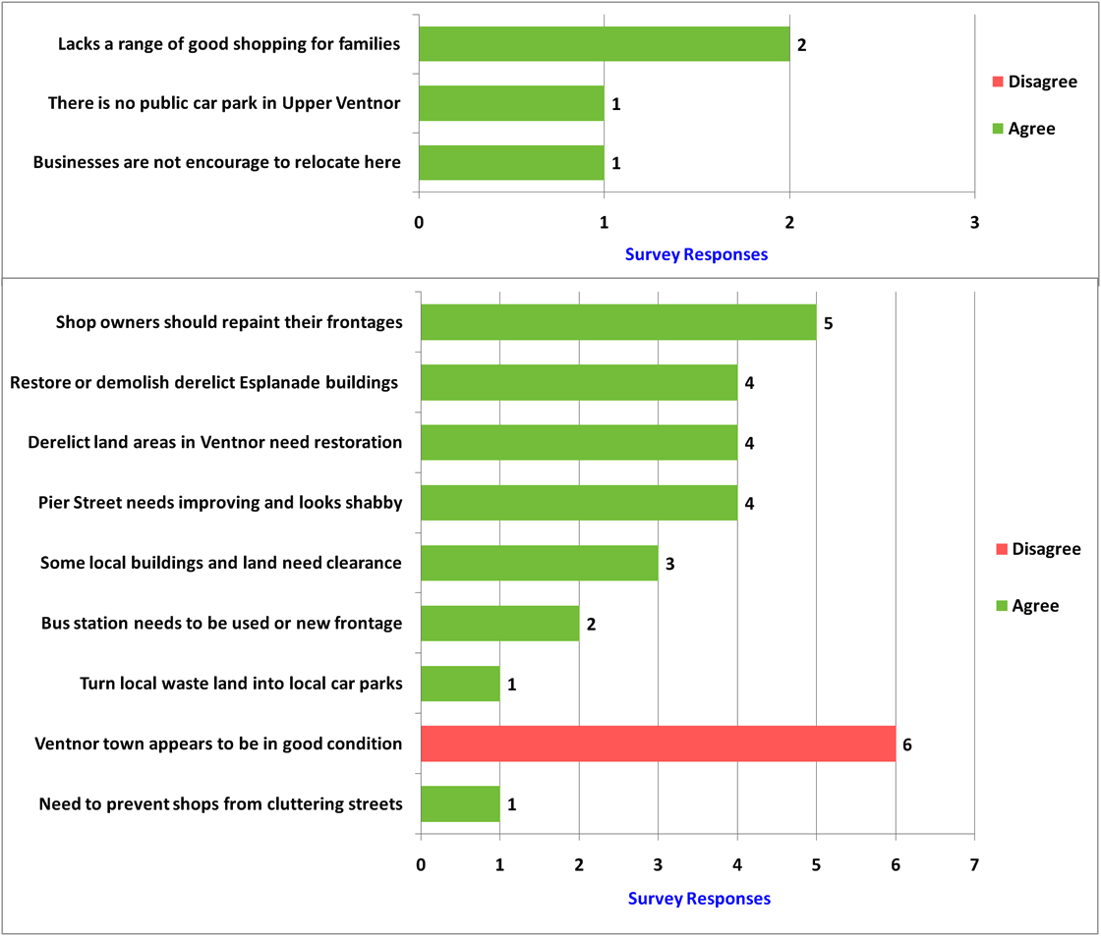
Upper Ventnor & Town - 11 of 17

Slide 25
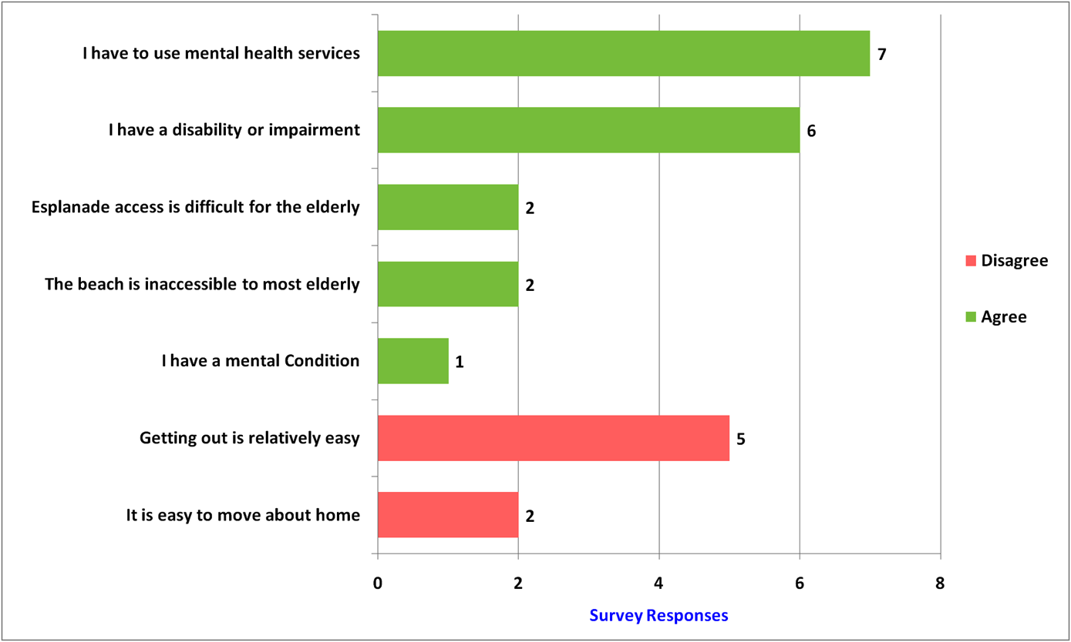
Personal - 12 of 17

Slide 26
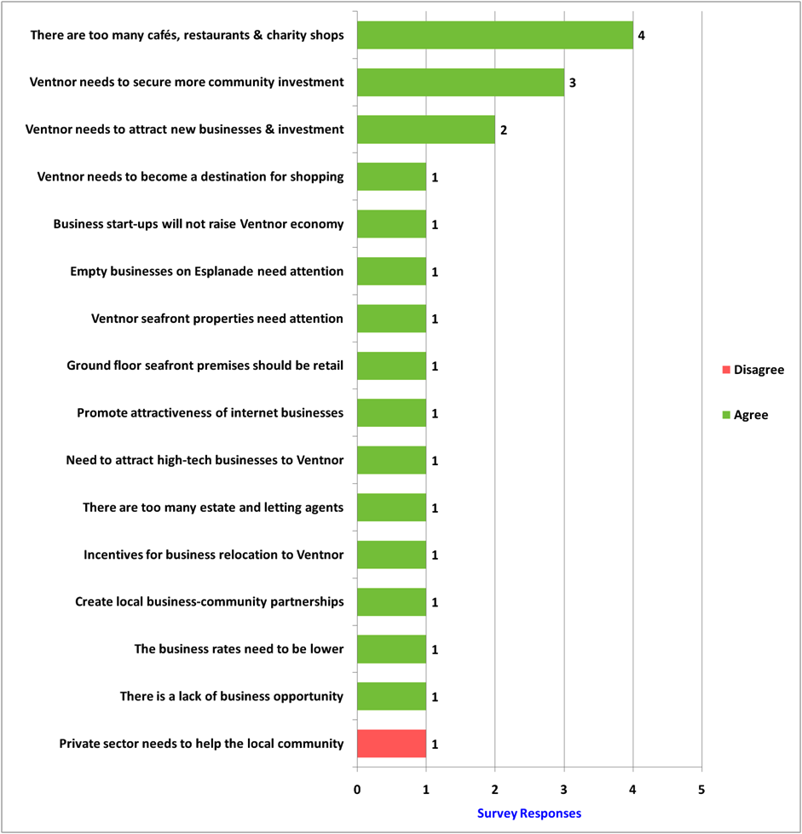
Local Business - 13 of 17

Slide 27
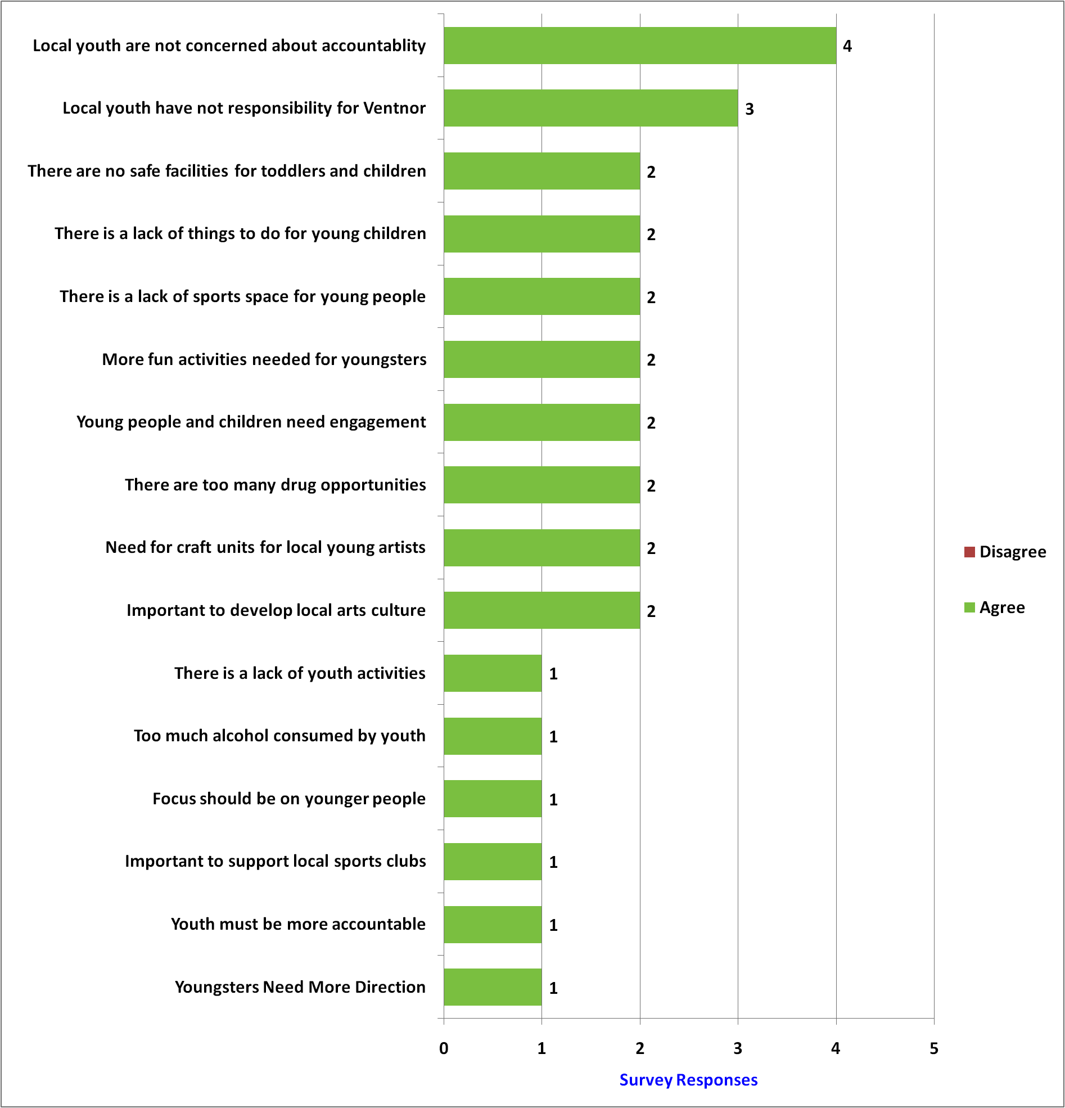
Local People - 14 of 21

Slide 28
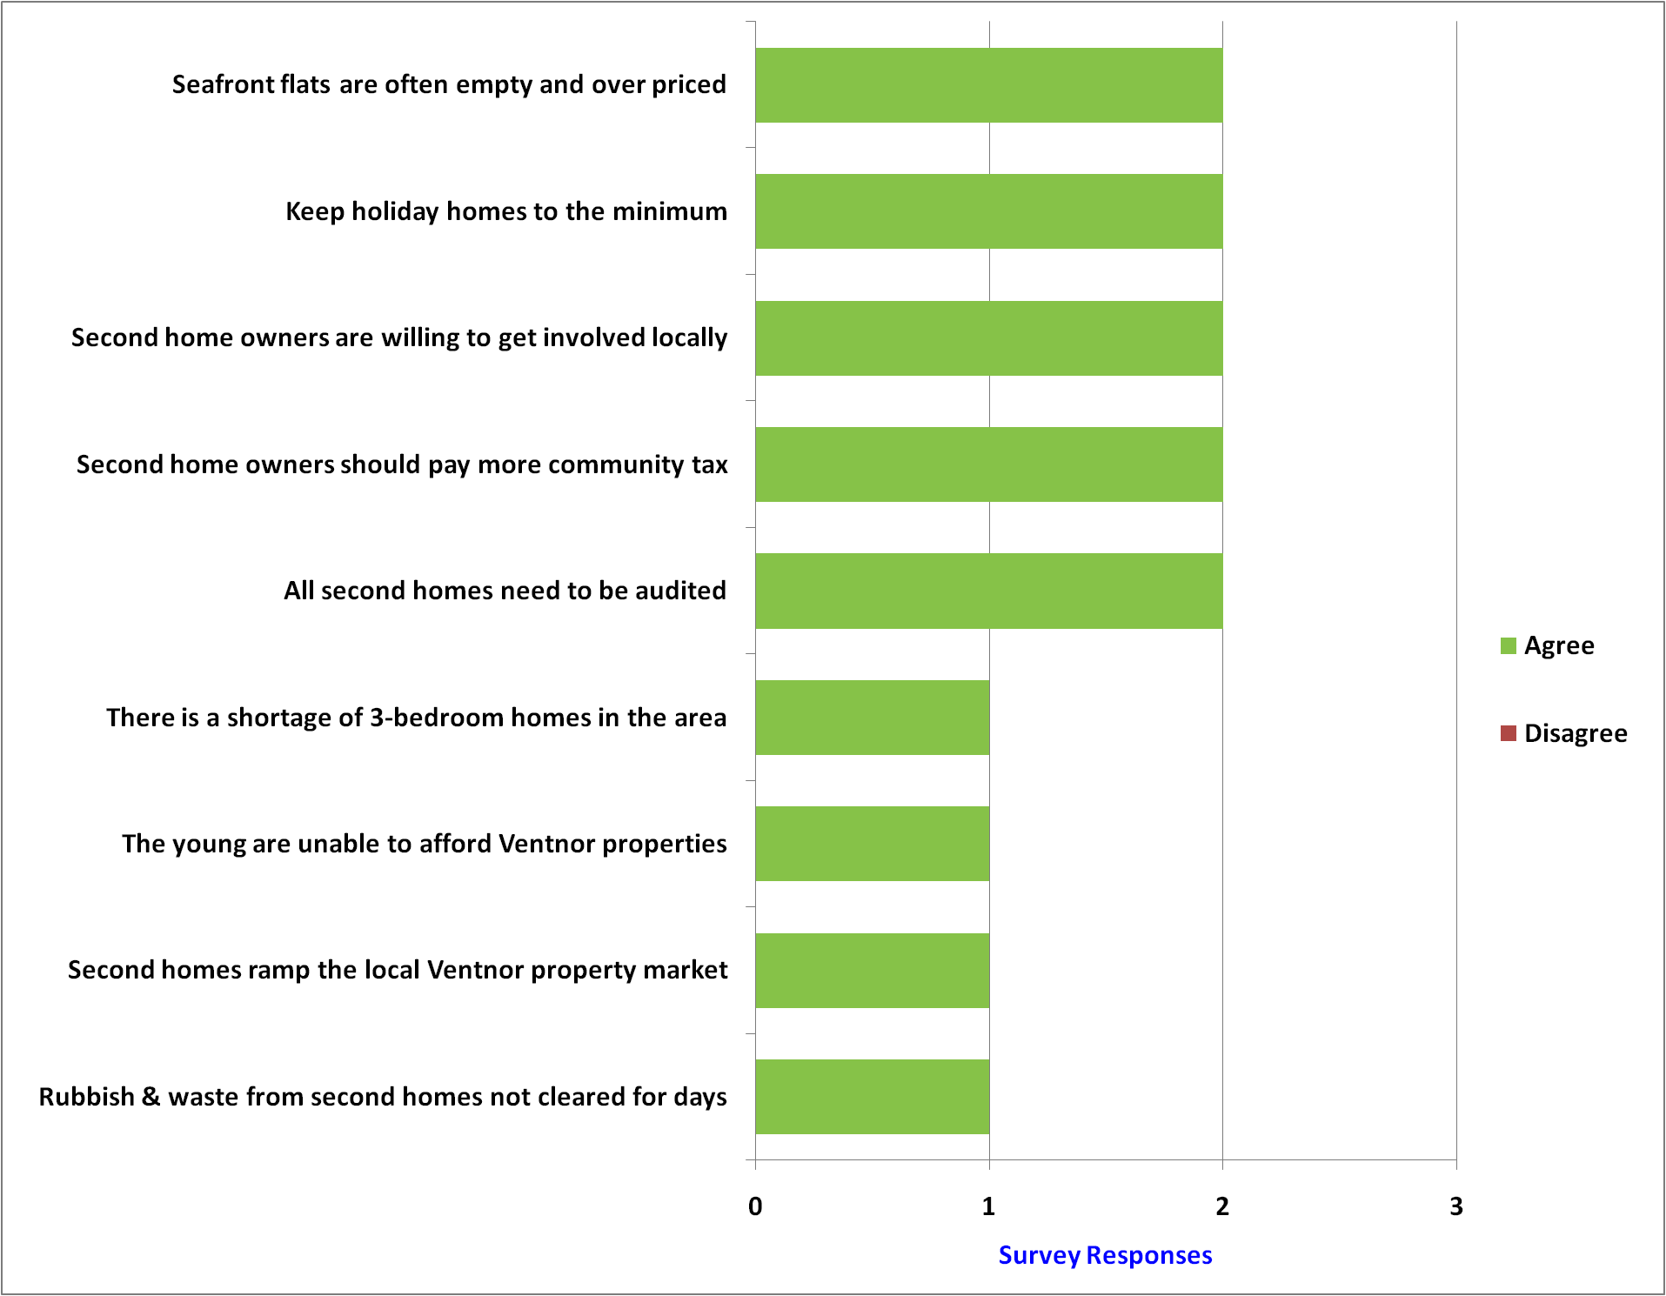
Local Property - 15 of 21

Slide 29
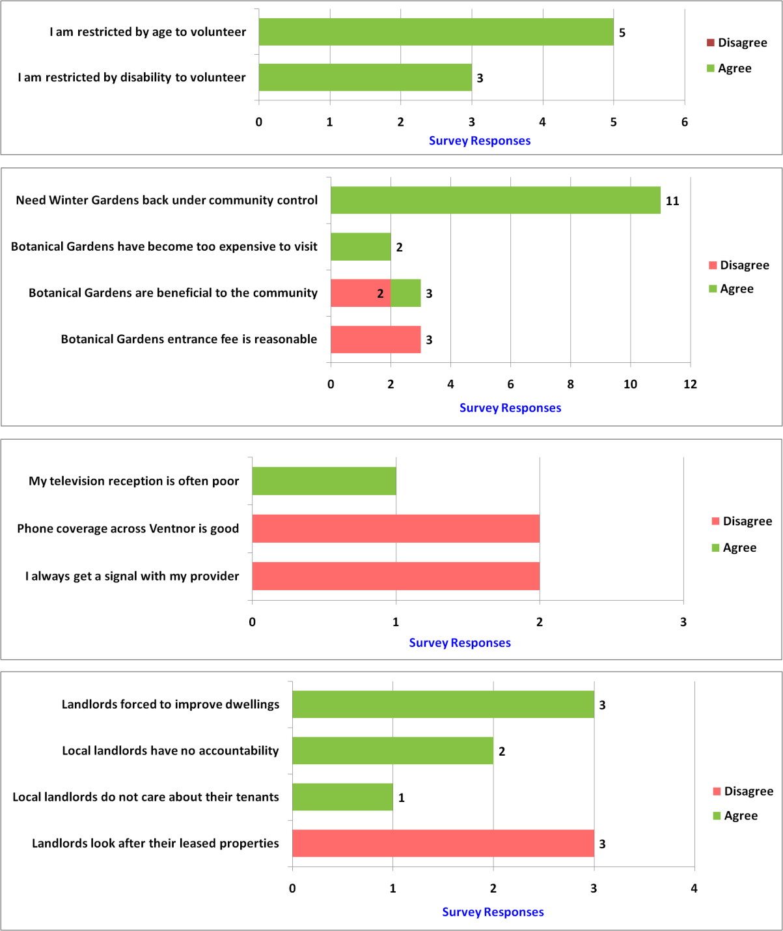
Volunteers, Assets, Landlords & Signal - 16 of 17

Slide 30
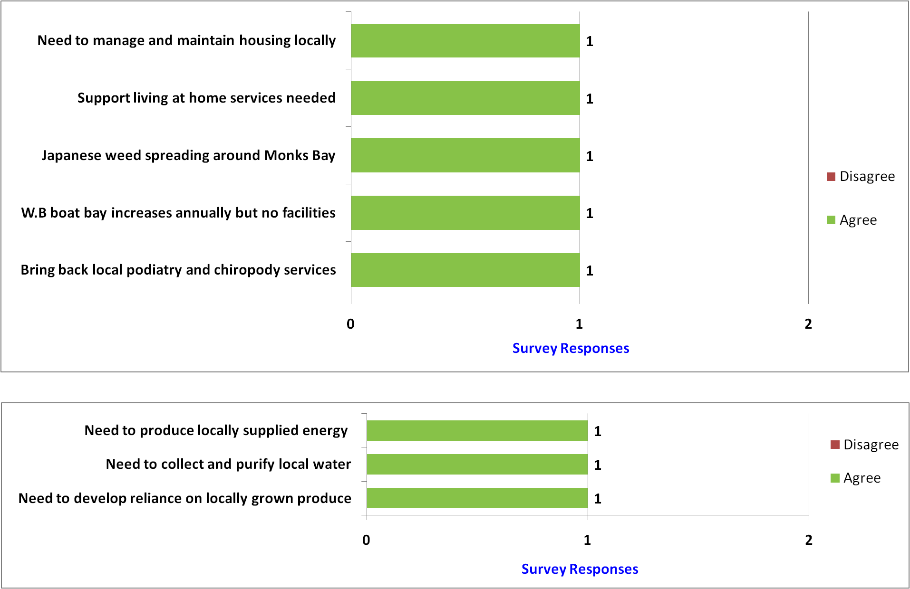
Services, Energy & Renewable - 17 of 17

Slide 31
Our Place Ventnor Survey
Section E - The End
Notes:
http://www.jkp-ads.com/download.asp

