Slide 1
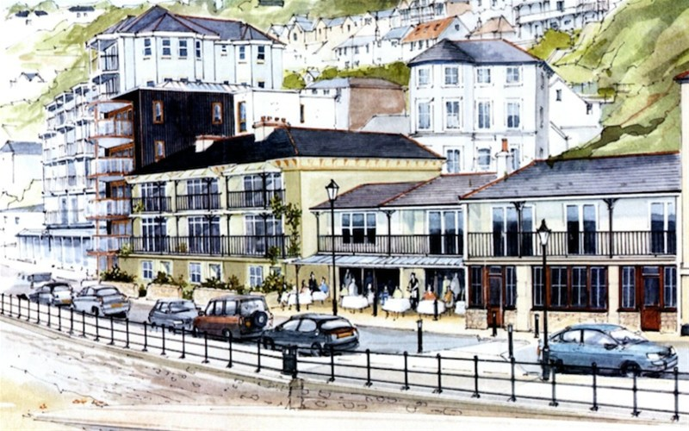

2015 Our Place Survey Results for Ventnor
Survey Section C: Projects

Slide 2
Presentations Available: Detailed Results
◊ Priorities
◊ Facilities
◊ Opportunities
◊ Engagement
◊ Projects
◊ Investigation
____________________
◊ Comments
◊ Postcodes
2015
Our Place
Survey Results
For
Ventnor

Slide 3
Our Place Ventnor Survey
Basic Demographics

Slide 4
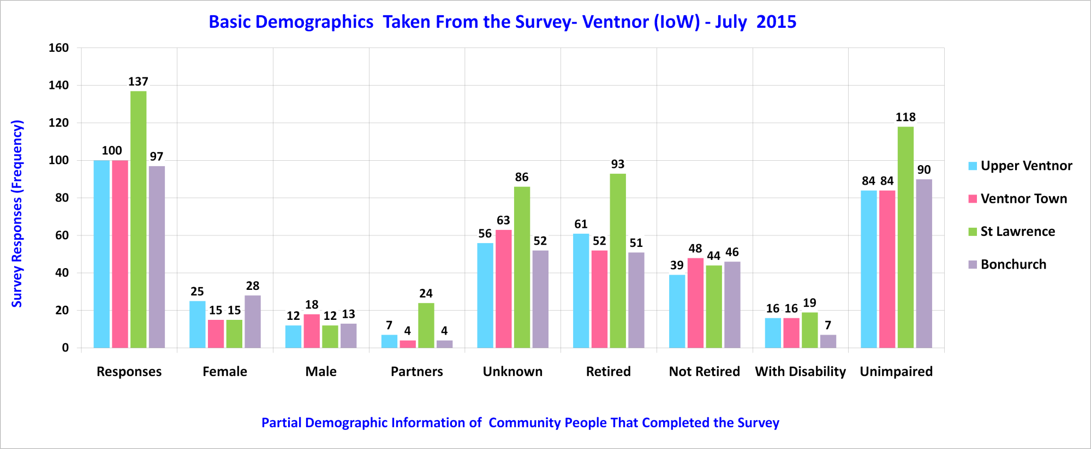
Sampled Ventnor Community

Slide 5
Our Place Ventnor Survey
Section C – Summary Projects
Please note: Trend lines shown on some charts are for visual enhancement only.

Slide 6
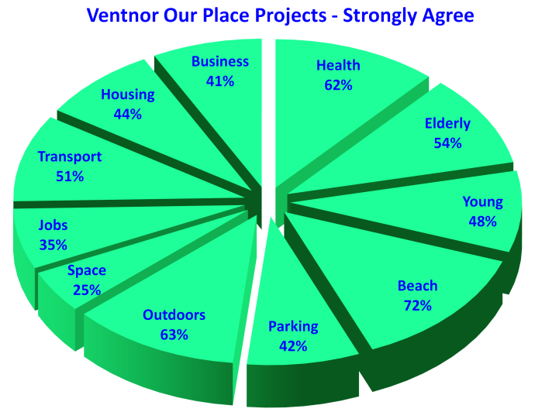
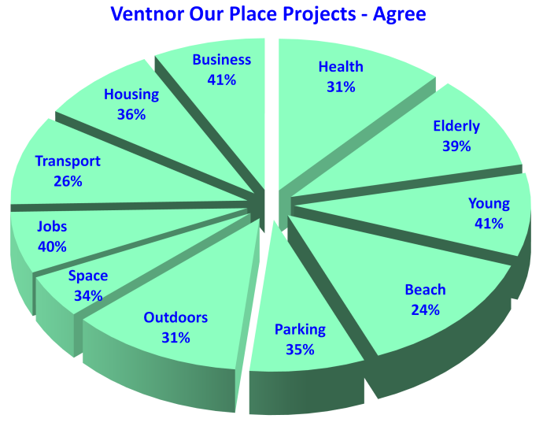
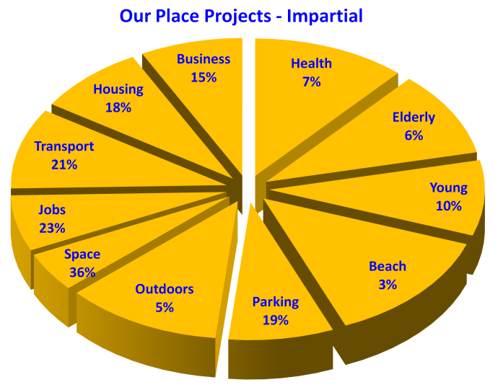
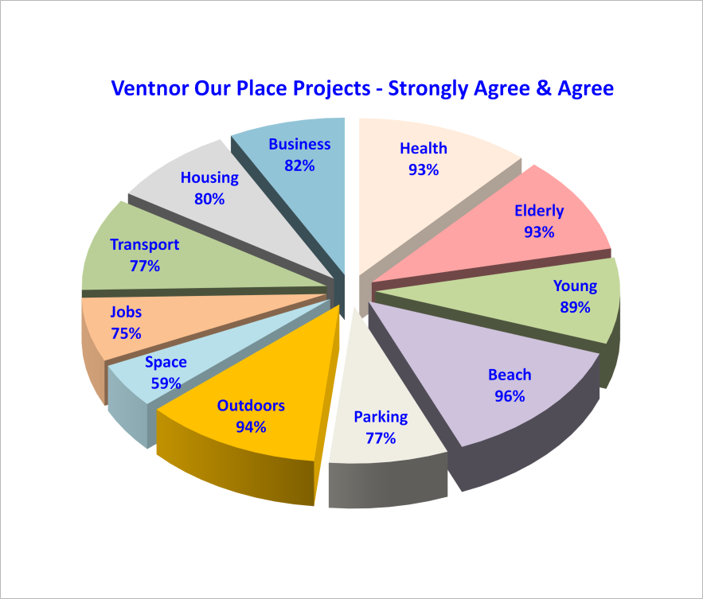
Projects From 434 Survey Responses – 12.4%
Beach 96% Maintain local beaches to the highest standards.
Outdoors 94% Maintain local green spaces to high standards.
Health 93% Provision of health and social care services.
Elderly 93% Develop support networks for older people.
Young 89% More opportunities for Ventnor's young people.
Business 82% Opportunities and support for new and local business.
Housing 80% Affordable and decent housing for local people.
Transport 77% Better and cheaper transport to-and-from Ventnor.
Parking 77% Manage and operate a selection of local car parks.
Jobs 75% Improve local job access and employer training provision.
Space 59% Foster a community space in Upper Ventnor.
Notes:
Beach 72% Maintain local beaches to the highest standards.
Outdoors 63% Maintain local green spaces to high standards.
Health 62% Provision of health and social care services.
Elderly 54% Develop support networks for older people.
Transport 51% Better and cheaper transport to-and-from Ventnor.
Young 48% More opportunities for Ventnor's young people.
Housing 44% Affordable and decent housing for local people.
Parking 42% Manage and operate a selection of local car parks.
Business 41% Opportunities and support for new and local business.
Jobs 35% Improve local job access and employer training provision.
Space 25% Foster a community space in Upper Ventnor.

Slide 7
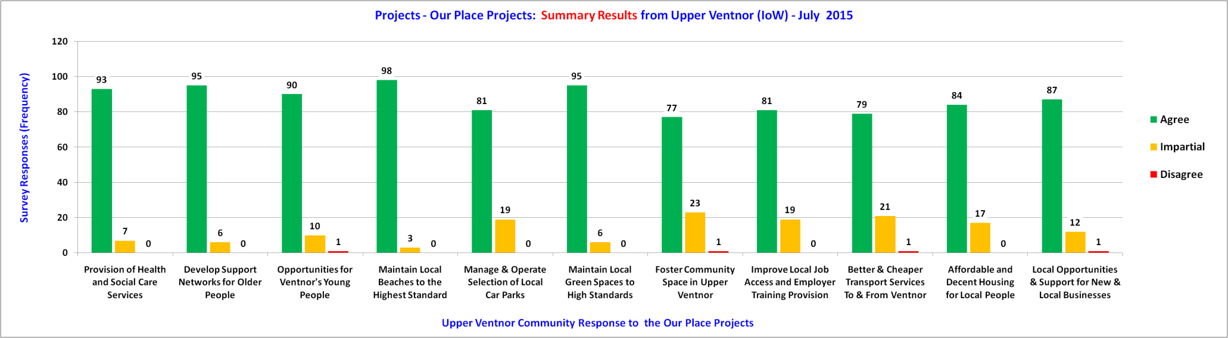
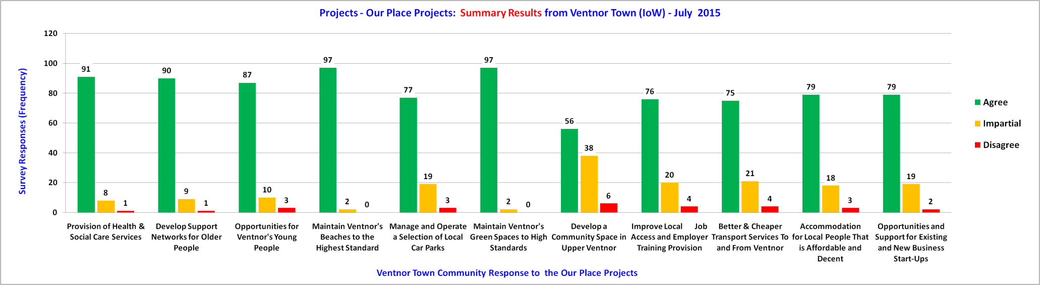
Projects - Upper Ventnor & Ventnor Town

Slide 8
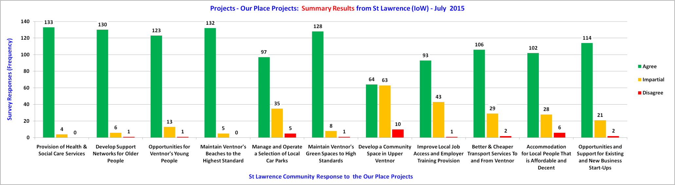
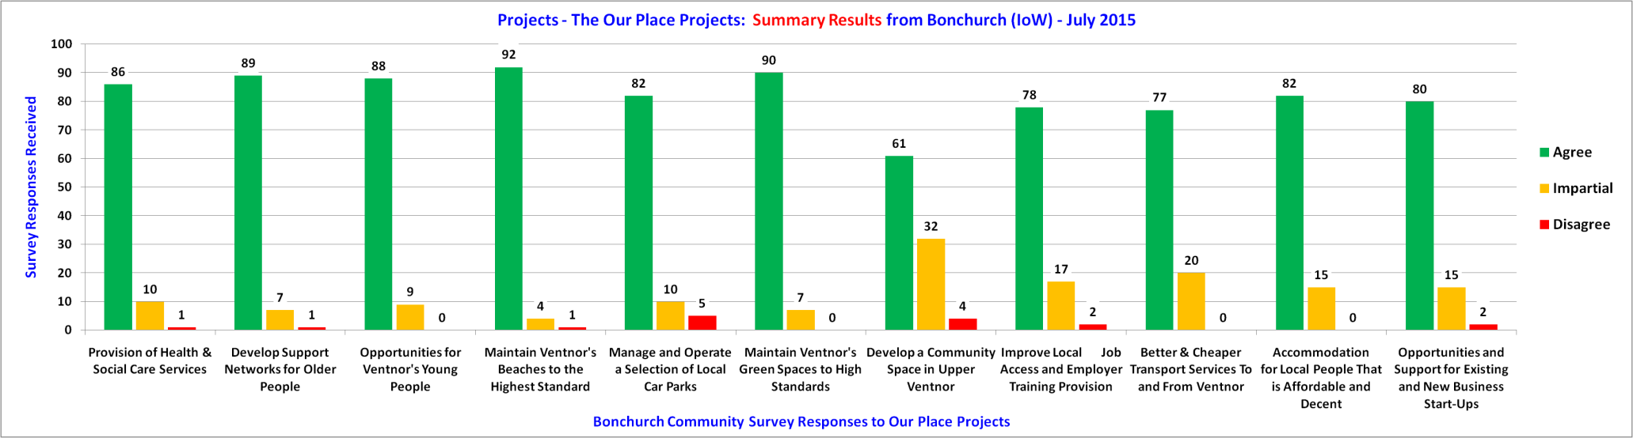
Projects - St Lawrence & Bonchurch

Slide 9
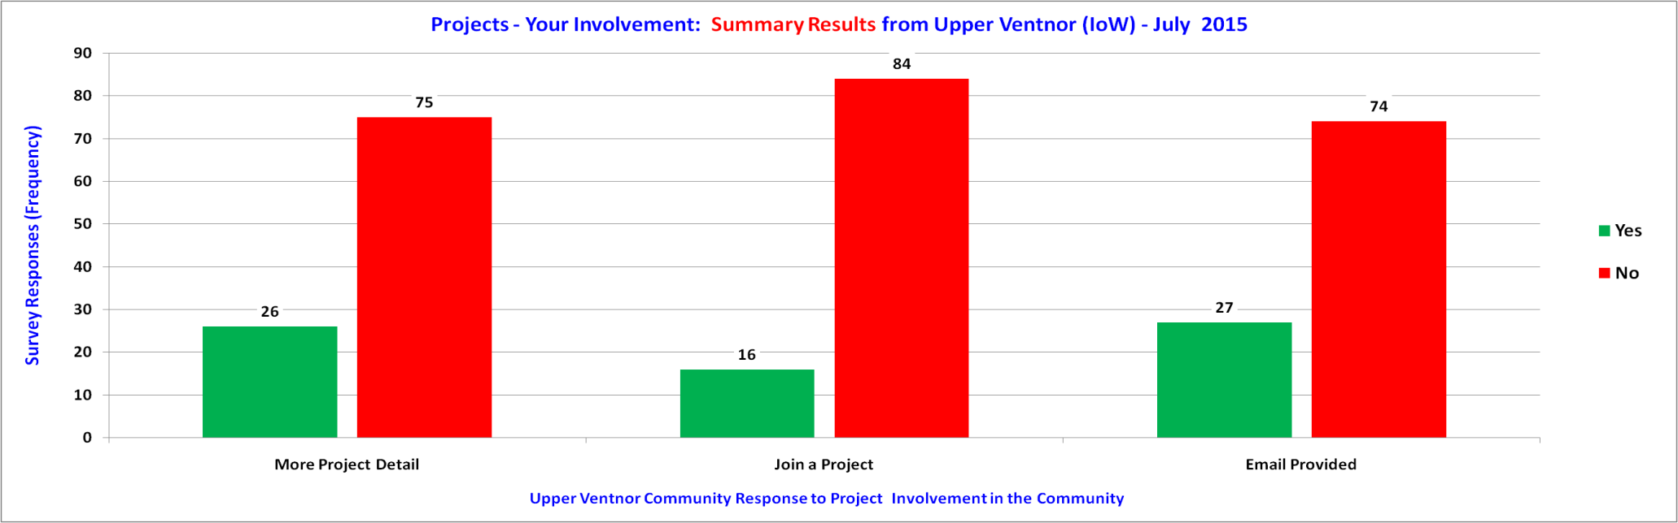
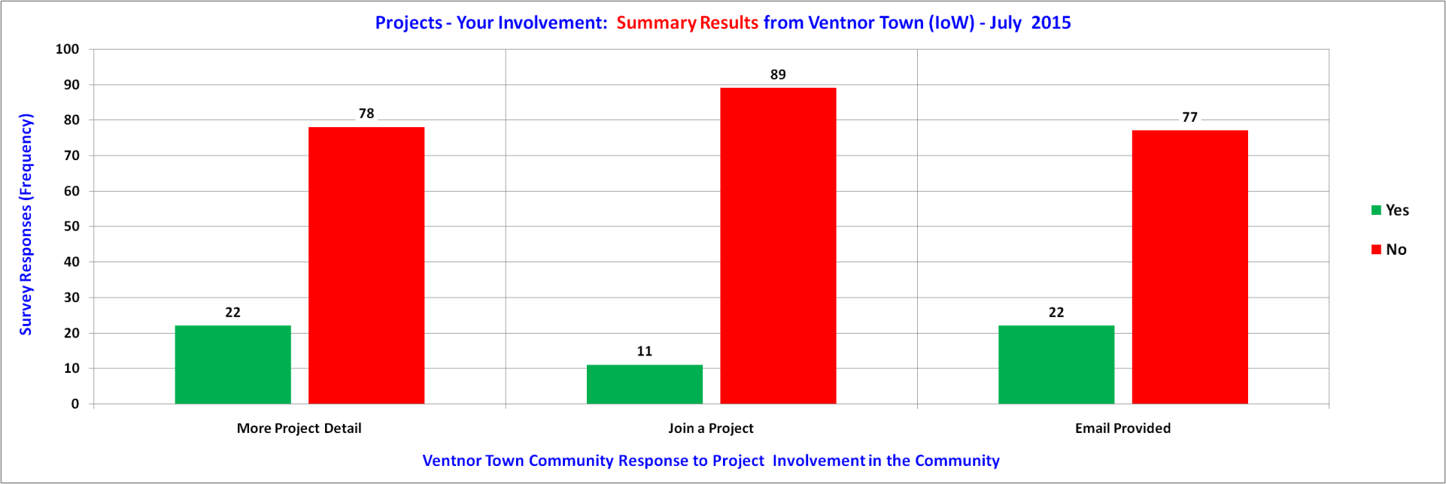
Projects - Upper Ventnor & Ventnor Town

Slide 10
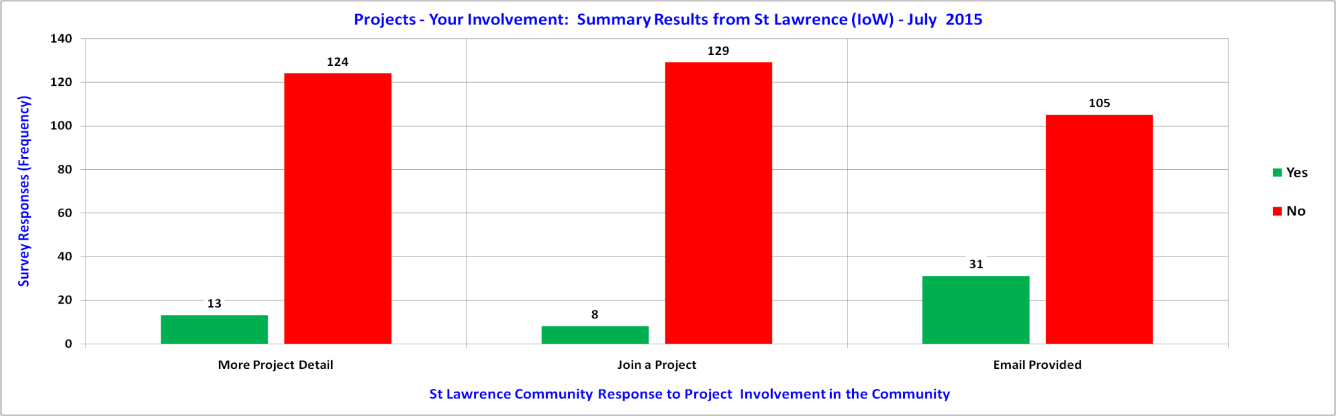
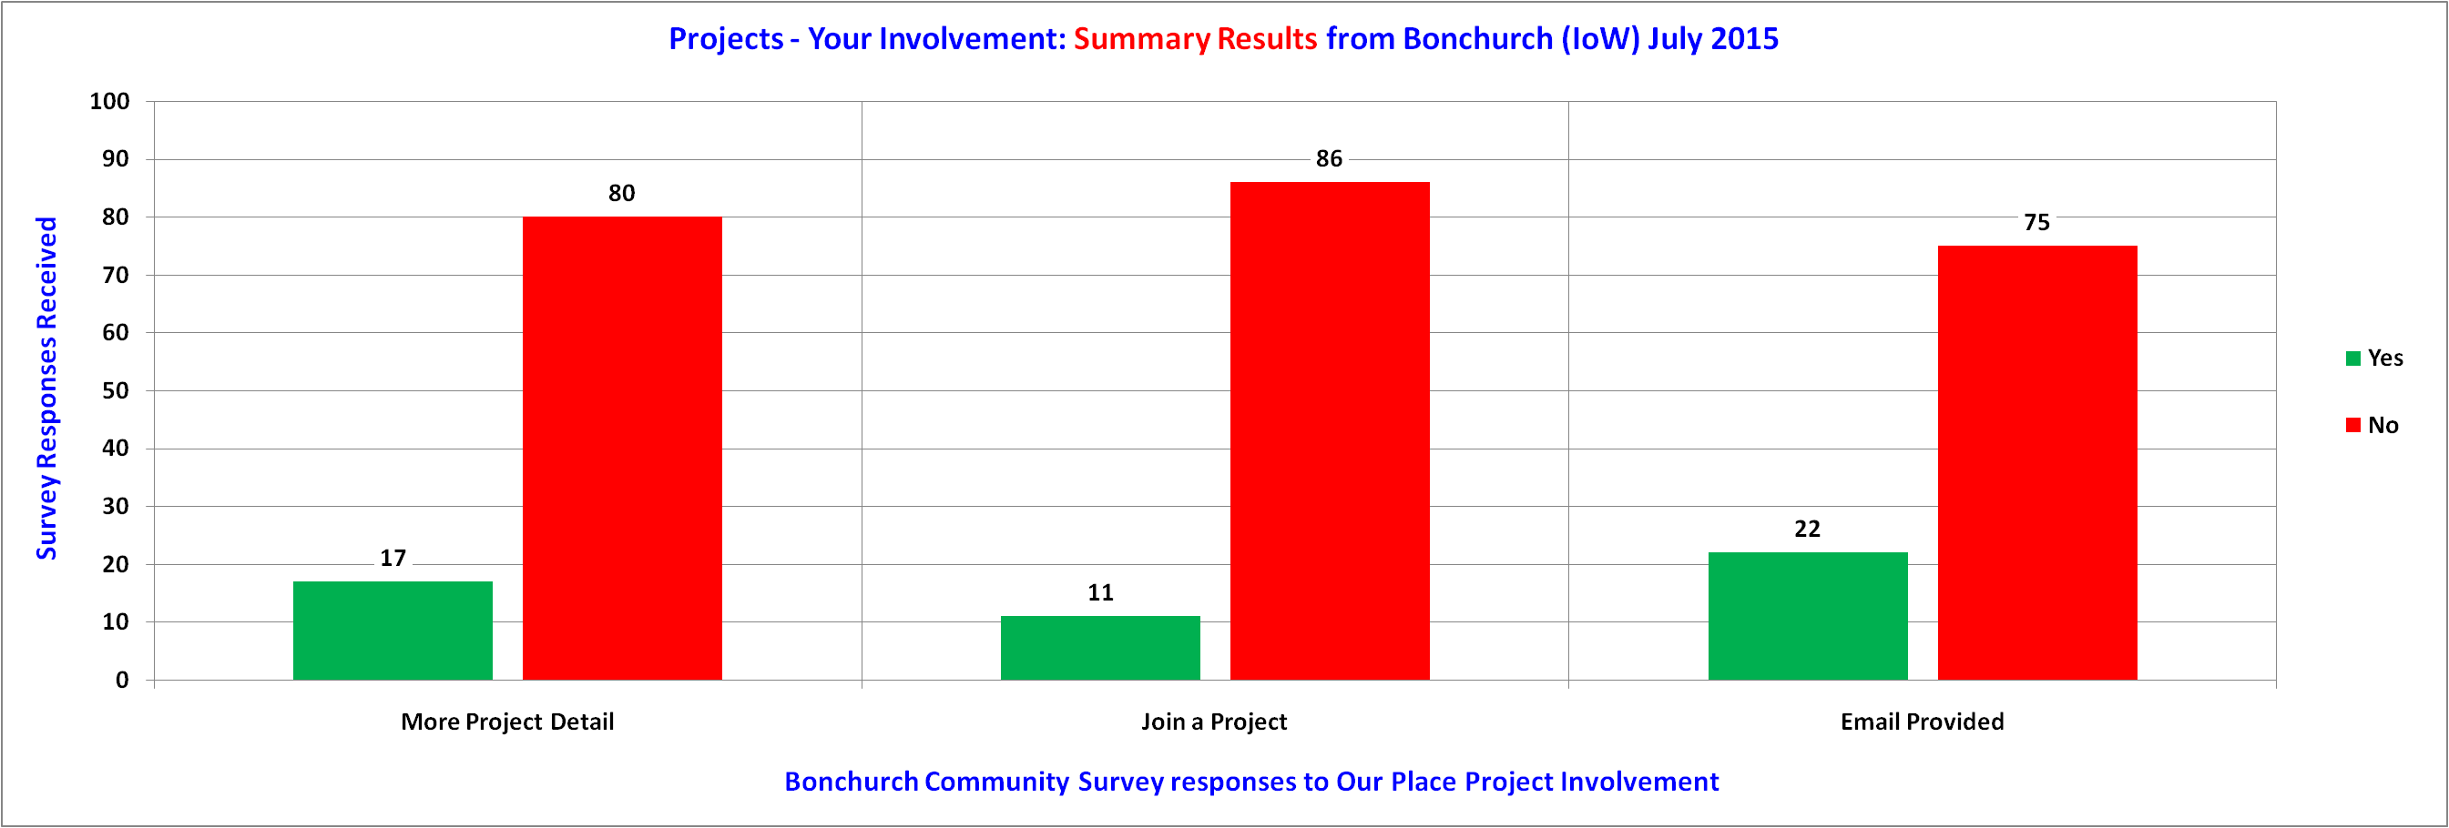
Projects - St Lawrence & Bonchurch

Slide 11
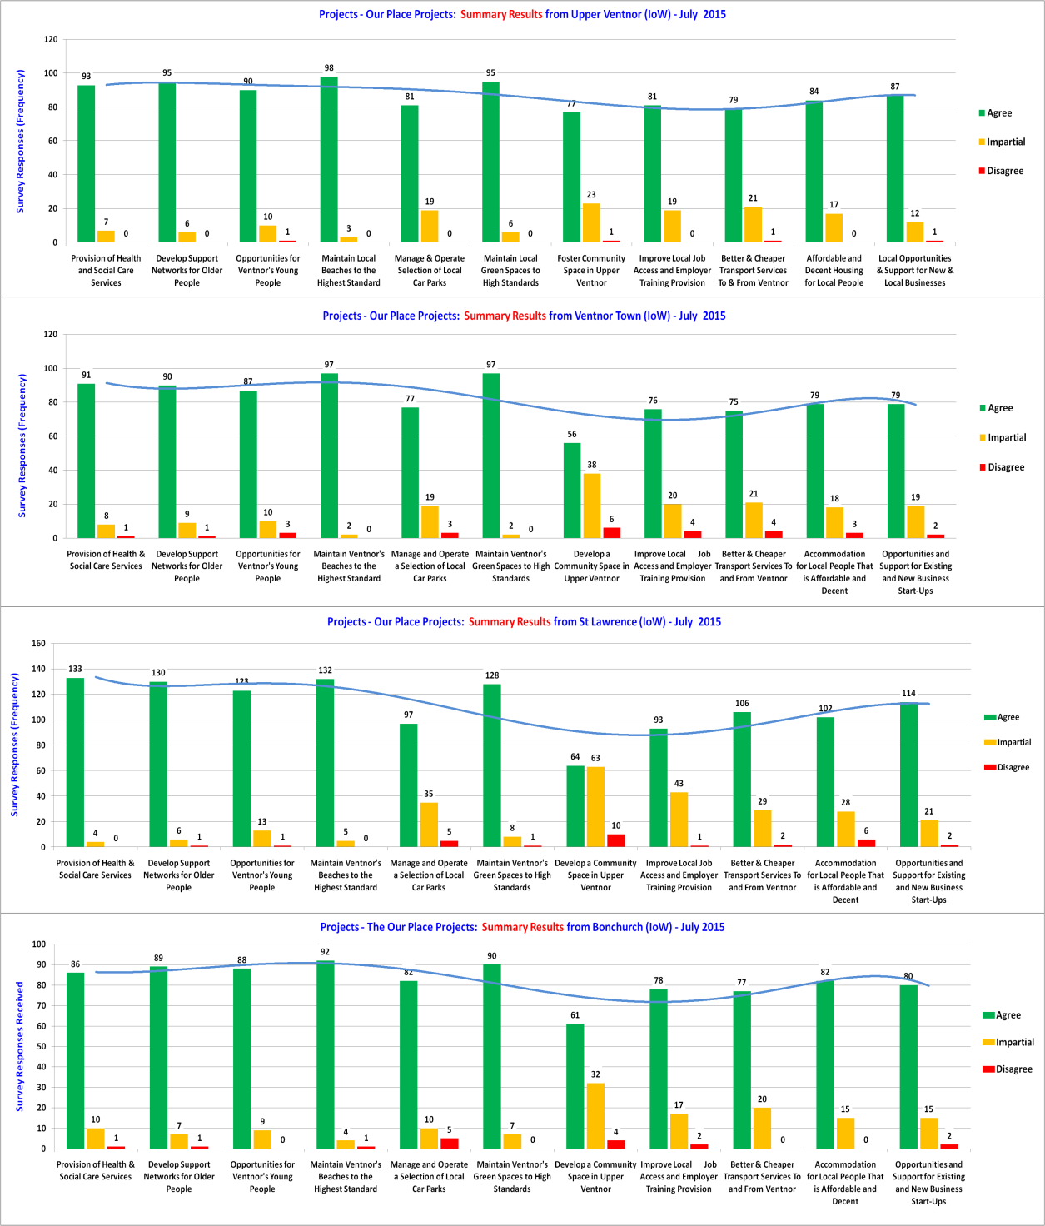
Projects - Importance Comparisons
Responses
77 to 98
Upper
Ventnor
Responses
56 to 97
Ventnor
Town
Responses
64 to 133
St Lawrence
Responses
61 to 92
Bonchurch

Slide 12
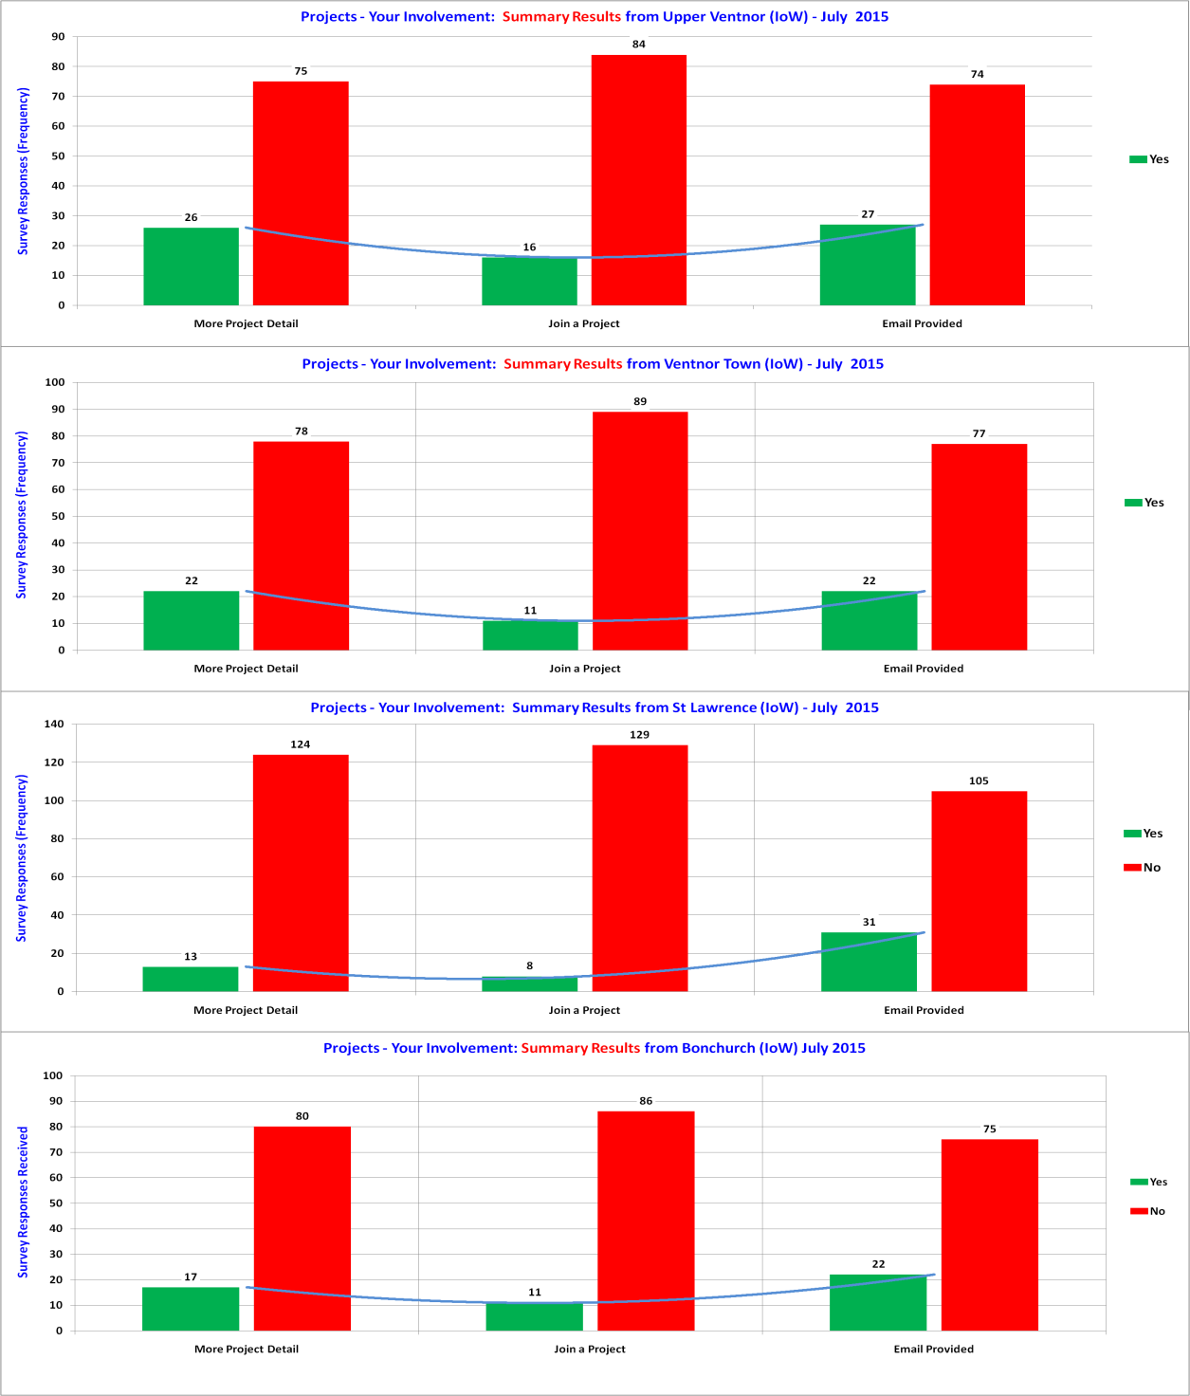
Projects - Your Involvement
Responses
16 to 27
Upper
Ventnor
Responses
11 to 22
Ventnor
Town
Responses
8 to 31
St Lawrence
Responses
11 to 22
Bonchurch

Slide 13
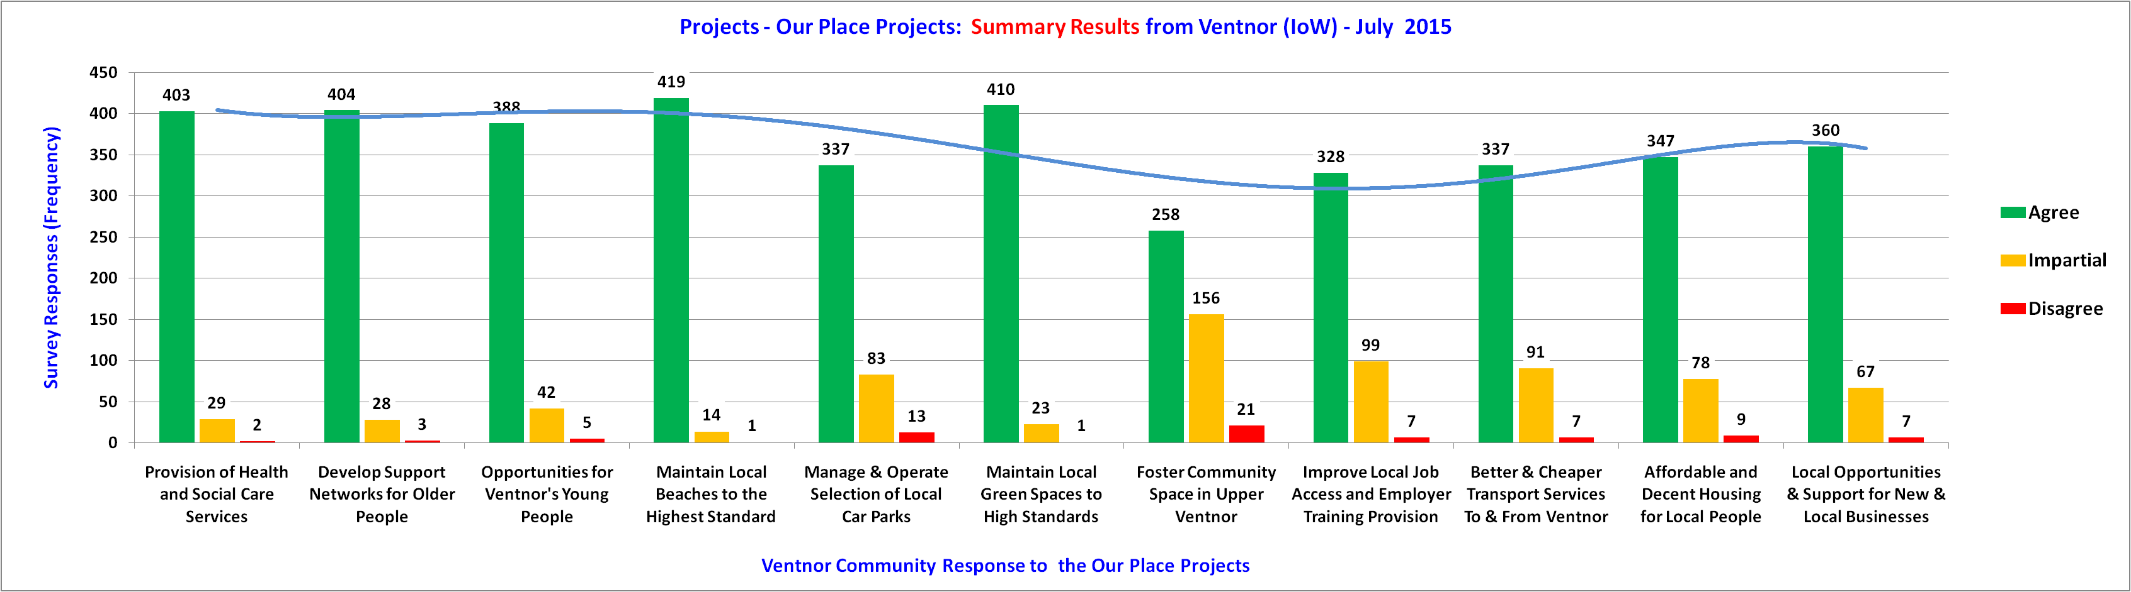
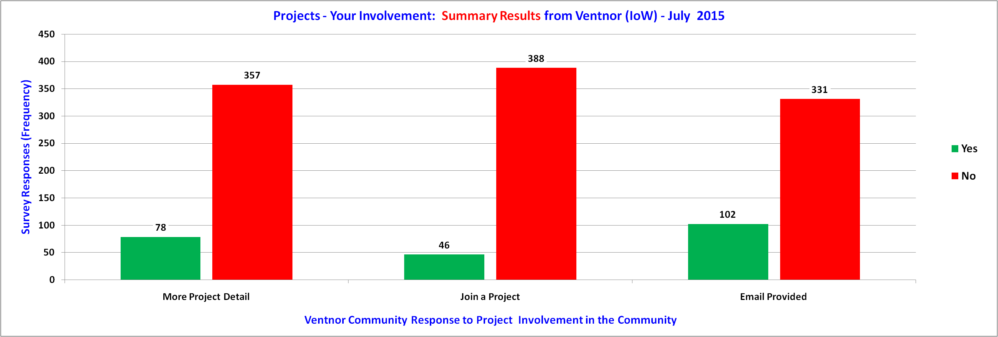
Projects Across Ventnor
Your Views
About You

Slide 14
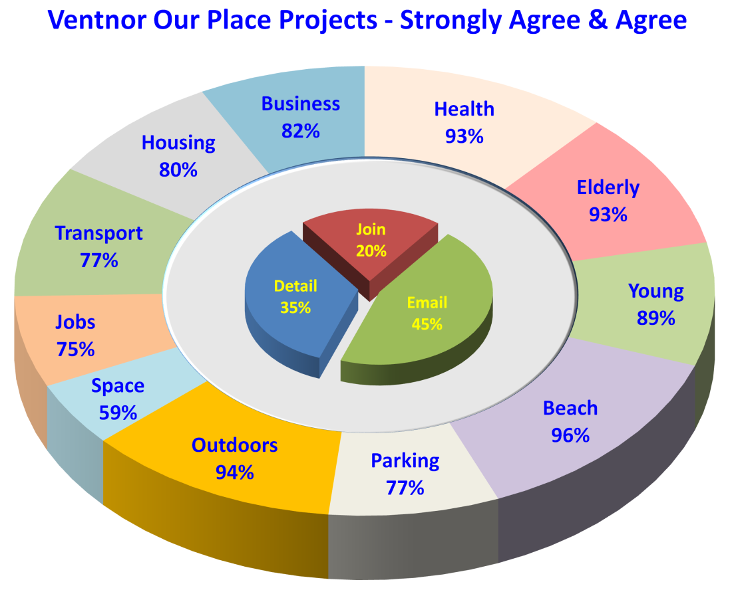
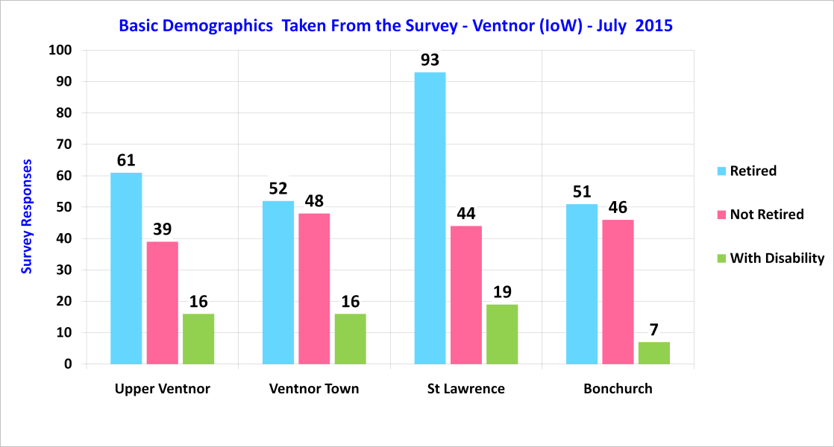
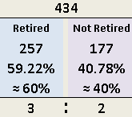
Projects - Importance Across Ventnor - 1 of 2
RT: 257 NR: 177 WD: 58
Notes:
Beach 72% Maintain local beaches to the highest standards.
Outdoors 63% Maintain local green spaces to high standards.
Health 62% Provision of health and social care services.
Elderly 54% Develop support networks for older people.
Transport 51% Better and cheaper transport to-and-from Ventnor.
Young 48% More opportunities for Ventnor's young people.
Housing 44% Affordable and decent housing for local people.
Parking 42% Manage and operate a selection of local car parks.
Business 41% Opportunities and support for new and local business.
Jobs 35% Improve local job access and employer training provision.
Space 25% Foster a community space in Upper Ventnor.

Slide 15
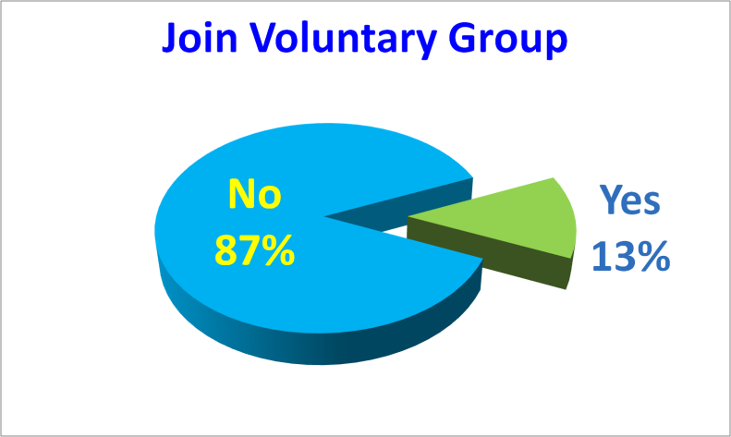
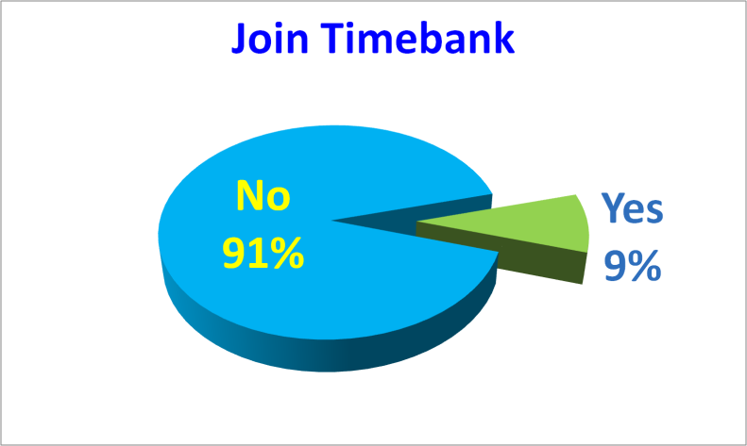
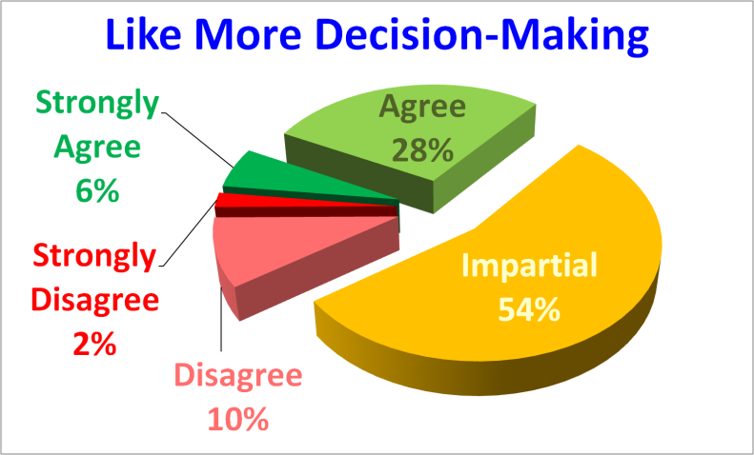
Projects - Involvement Across Ventnor - 2 of 2
Notes:
Beach 72% Maintain local beaches to the highest standards.
Outdoors 63% Maintain local green spaces to high standards.
Health 62% Provision of health and social care services.
Elderly 54% Develop support networks for older people.
Transport 51% Better and cheaper transport to-and-from Ventnor.
Young 48% More opportunities for Ventnor's young people.
Housing 44% Affordable and decent housing for local people.
Parking 42% Manage and operate a selection of local car parks.
Business 41% Opportunities and support for new and local business.
Jobs 35% Improve local job access and employer training provision.
Space 25% Foster a community space in Upper Ventnor.

Slide 16
Projects - Involvement Across Ventnor - 2 of 2
Notes:
Beach 72% Maintain local beaches to the highest standards.
Outdoors 63% Maintain local green spaces to high standards.
Health 62% Provision of health and social care services.
Elderly 54% Develop support networks for older people.
Transport 51% Better and cheaper transport to-and-from Ventnor.
Young 48% More opportunities for Ventnor's young people.
Housing 44% Affordable and decent housing for local people.
Parking 42% Manage and operate a selection of local car parks.
Business 41% Opportunities and support for new and local business.
Jobs 35% Improve local job access and employer training provision.
Space 25% Foster a community space in Upper Ventnor.

Slide 17
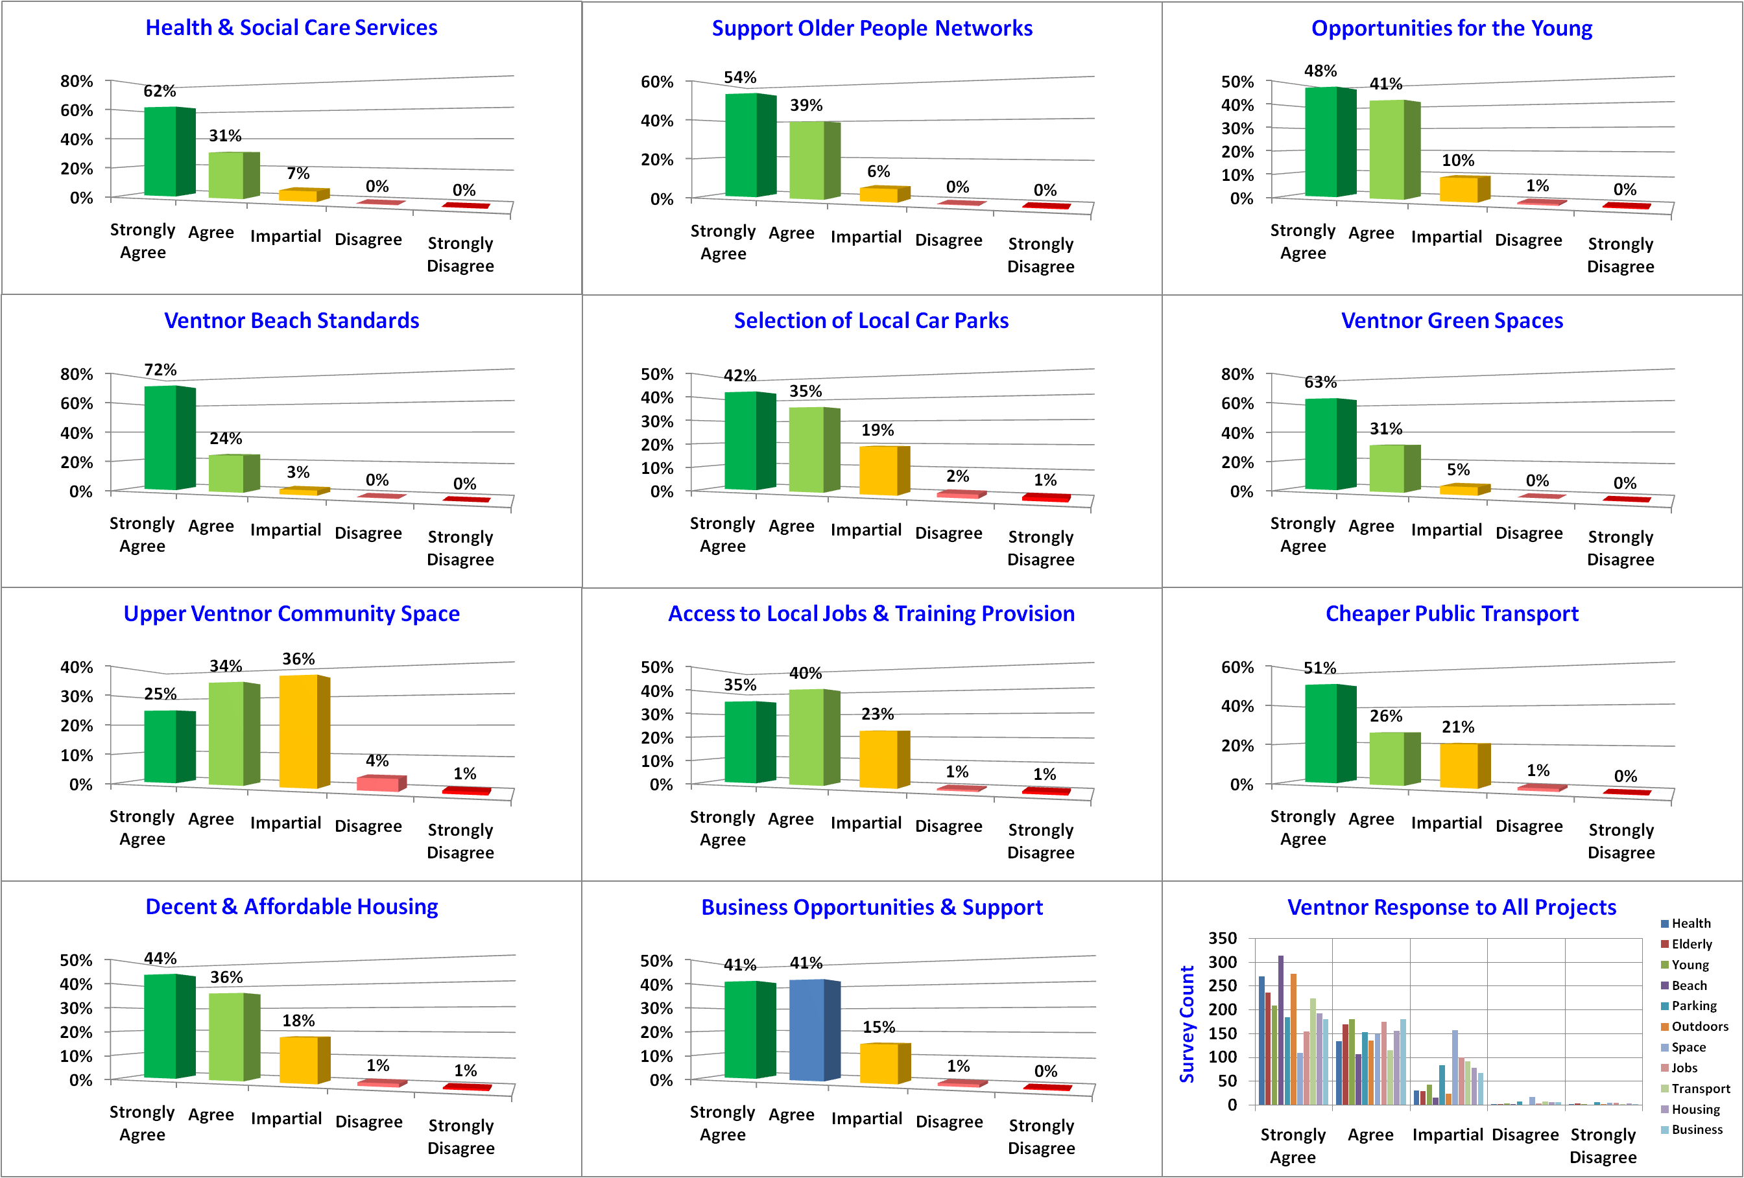
Projects – Our Place Across Ventnor - 3 of 4
Notes:
Beach 72% Maintain local beaches to the highest standards.
Outdoors 63% Maintain local green spaces to high standards.
Health 62% Provision of health and social care services.
Elderly 54% Develop support networks for older people.
Transport 51% Better and cheaper transport to-and-from Ventnor.
Young 48% More opportunities for Ventnor's young people.
Housing 44% Affordable and decent housing for local people.
Parking 42% Manage and operate a selection of local car parks.
Business 41% Opportunities and support for new and local business.
Jobs 35% Improve local job access and employer training provision.
Space 25% Foster a community space in Upper Ventnor.

Slide 18
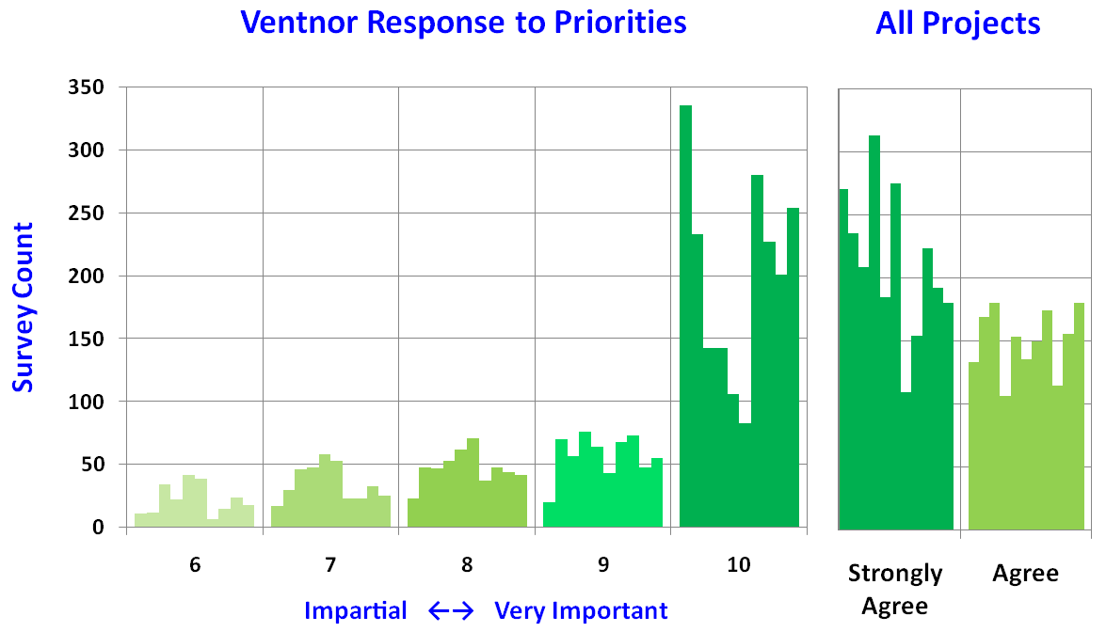
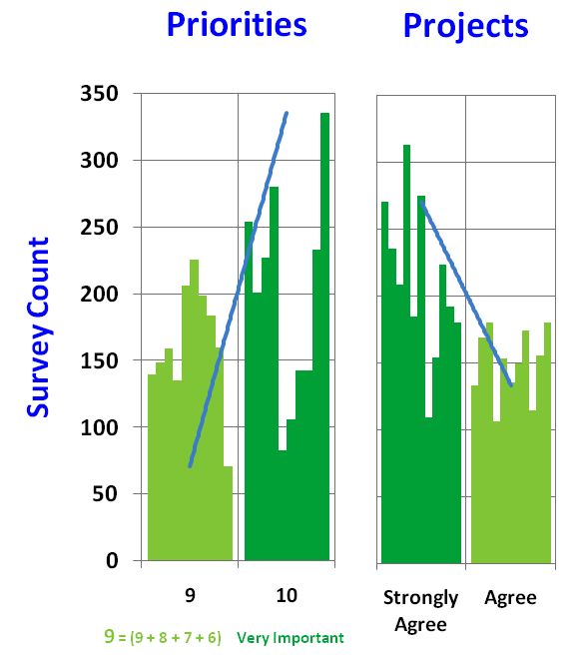
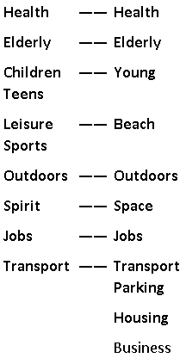
Matching Priorities to Our Place Projects - 4 of 4
Chart 1
Chart 2
Notes:
Beach 72% Maintain local beaches to the highest standards.
Outdoors 63% Maintain local green spaces to high standards.
Health 62% Provision of health and social care services.
Elderly 54% Develop support networks for older people.
Transport 51% Better and cheaper transport to-and-from Ventnor.
Young 48% More opportunities for Ventnor's young people.
Housing 44% Affordable and decent housing for local people.
Parking 42% Manage and operate a selection of local car parks.
Business 41% Opportunities and support for new and local business.
Jobs 35% Improve local job access and employer training provision.
Space 25% Foster a community space in Upper Ventnor.

Slide 19
Our Place Ventnor Survey
Section C – Detailed Projects
Discussion Only.

Slide 20
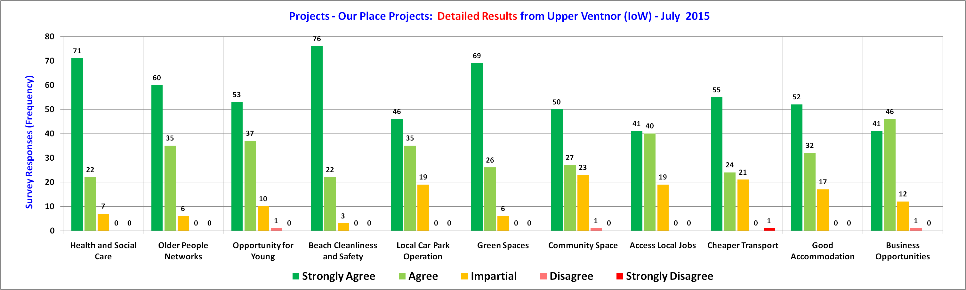
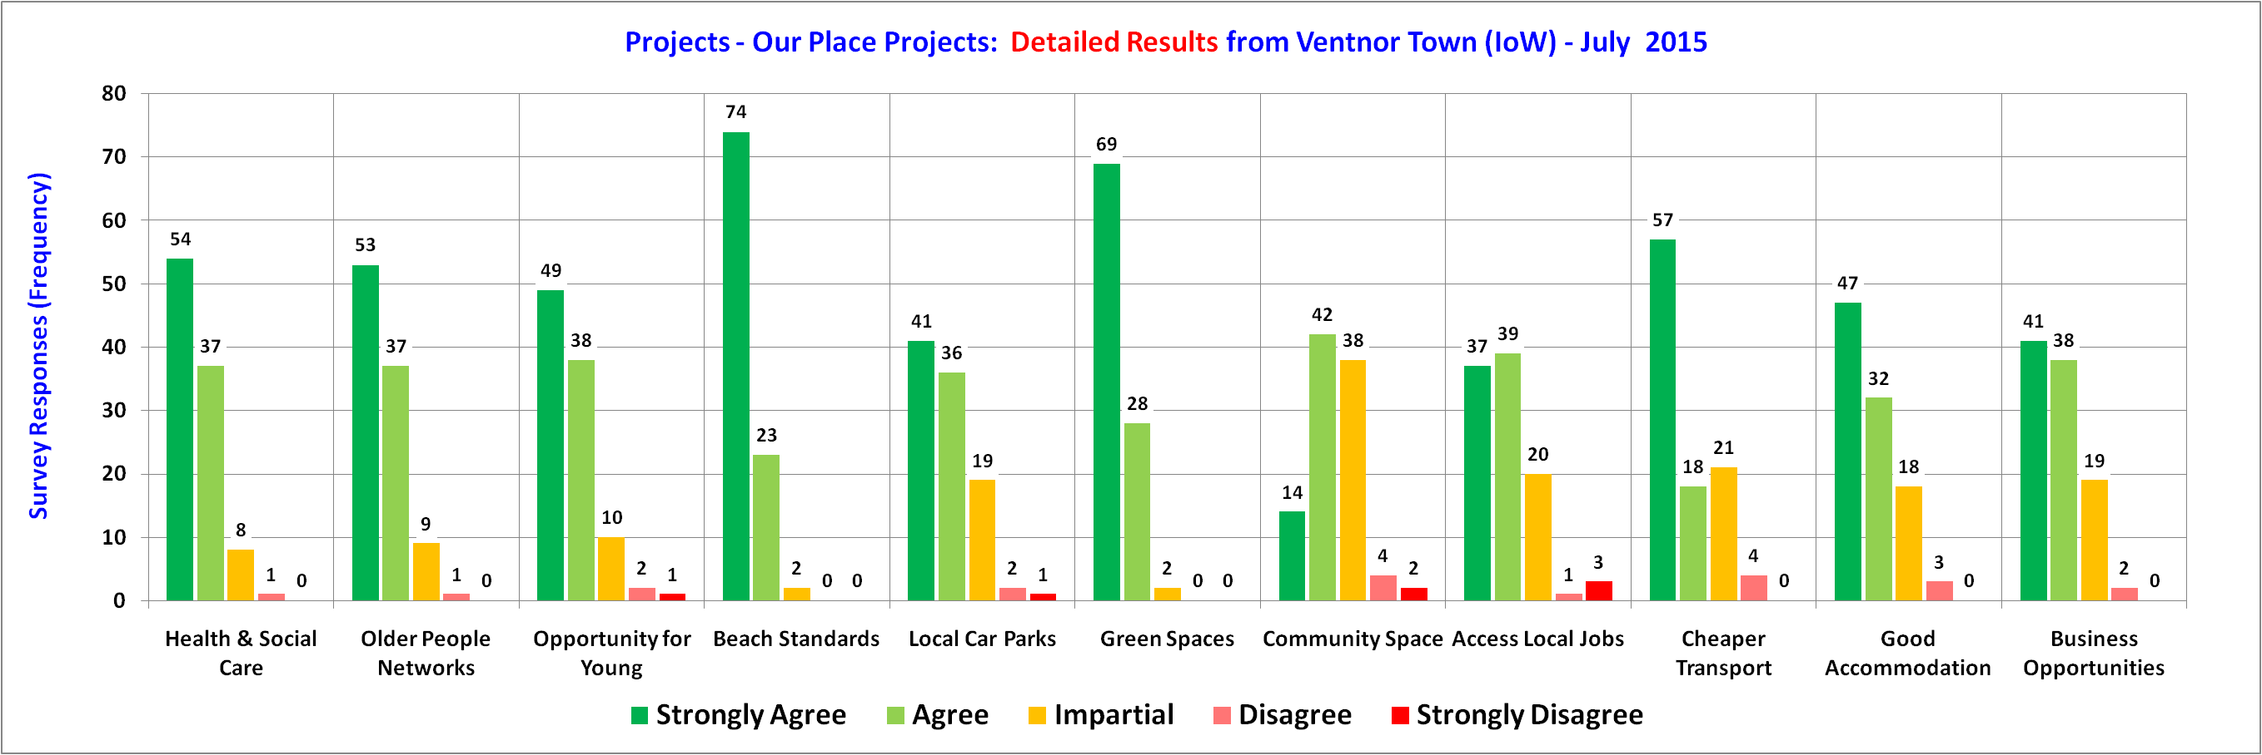
Detailed Projects – Upper Ventnor & Town

Slide 21
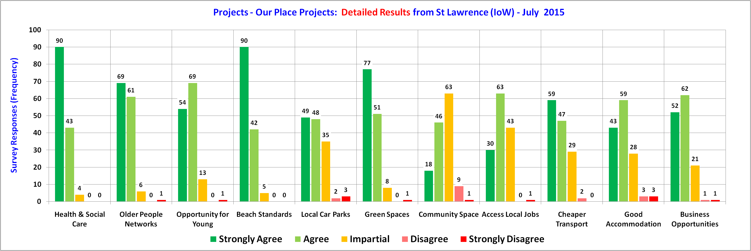
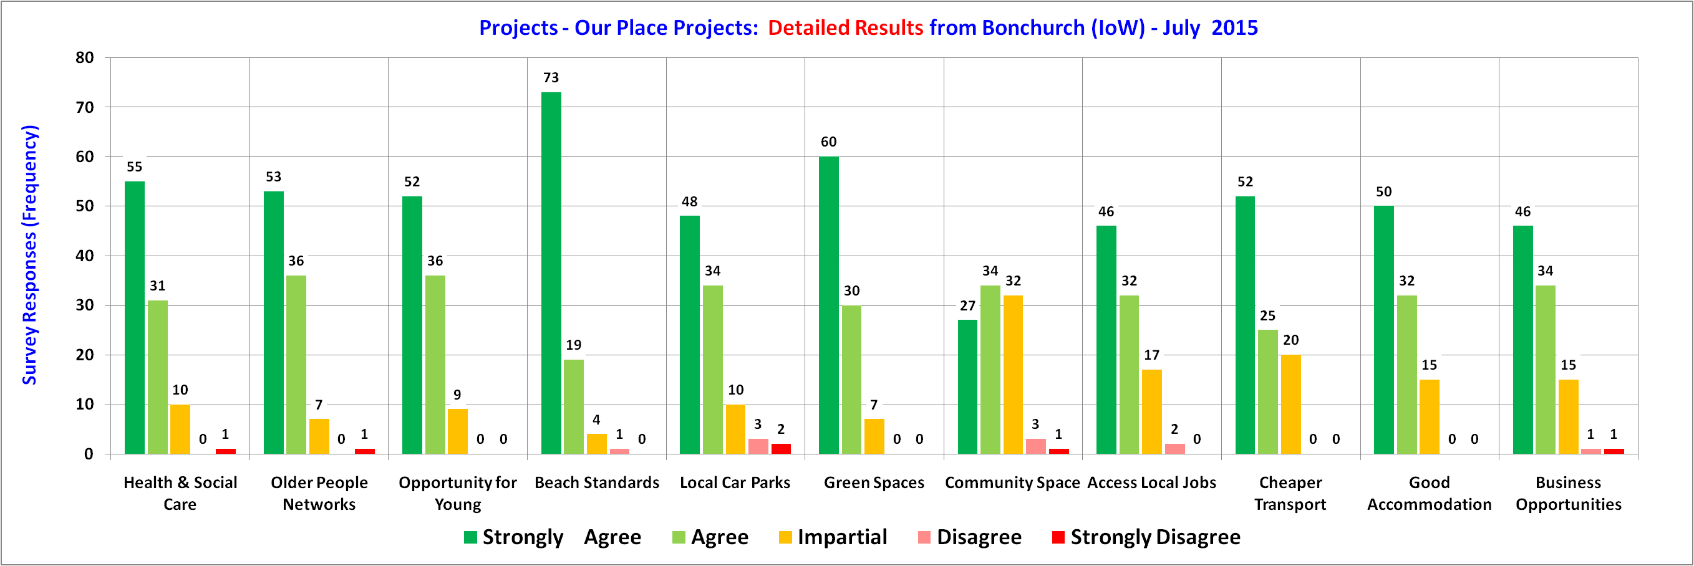
Detailed Projects – St Lawrence & Bonchurch

Slide 22
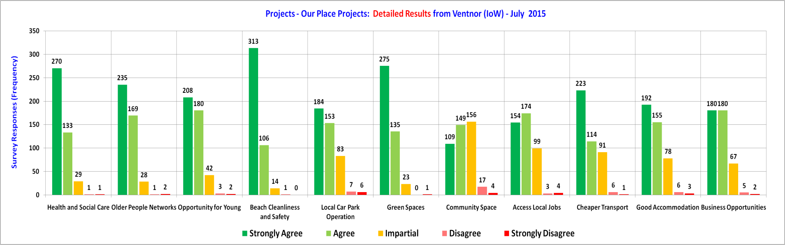
Detailed Projects – Across Ventnor

Slide 23
Our Place Ventnor Survey
Section C – The End
Notes:
http://www.jkp-ads.com/download.asp

