Slide 1
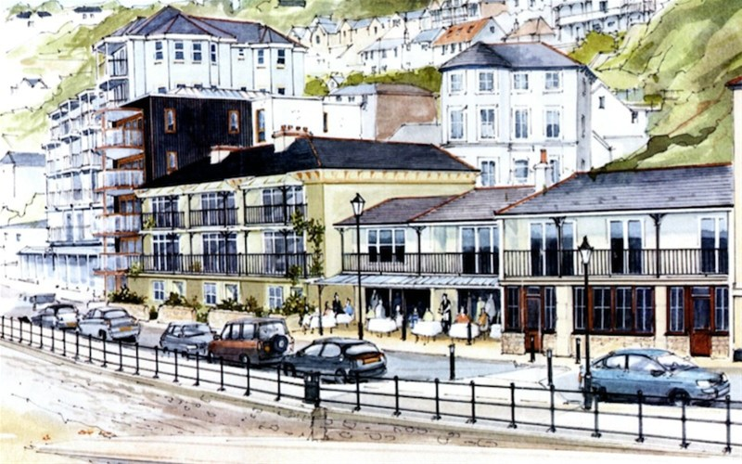

2015 Our Place Survey Results for Ventnor
Survey Section C: Engagement

Slide 2
Presentations Available: Detailed Results
◊ Priorities
◊ Facilities
◊ Opportunities
◊ Engagement
◊ Projects
◊ Investigation
____________________
◊ Comments
◊ Postcodes
2015
Our Place
Survey Results
For
Ventnor

Slide 3
Our Place Ventnor Survey
Basic Demographics

Slide 4
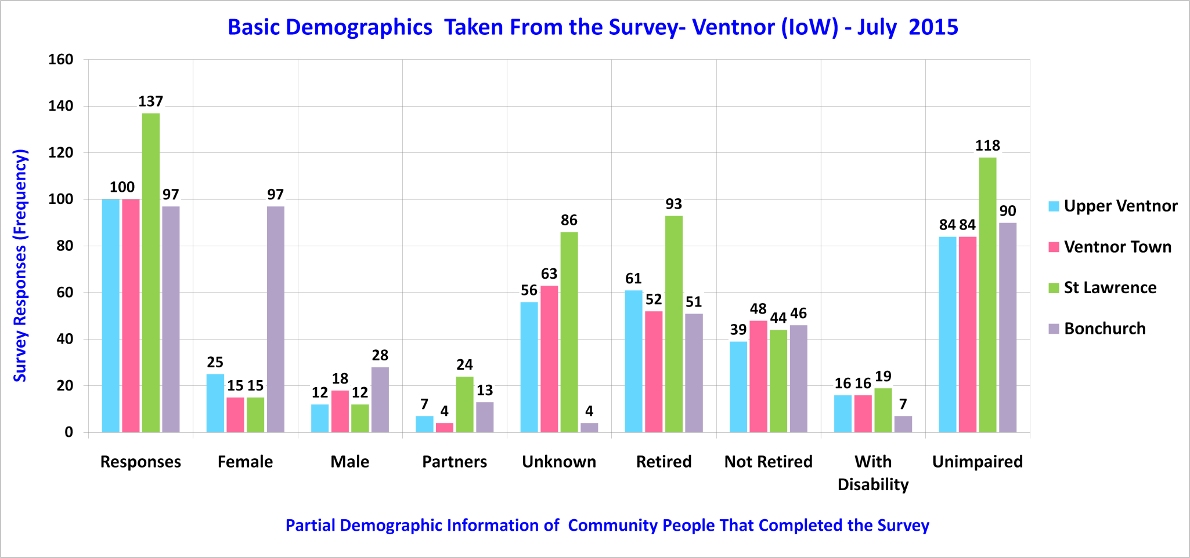
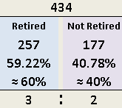
Sampled Ventnor Community

Slide 5
Our Place Ventnor Survey
Section C – Summary Engagement
Please note: Trend lines shown on some charts are for visual enhancement only.

Slide 6
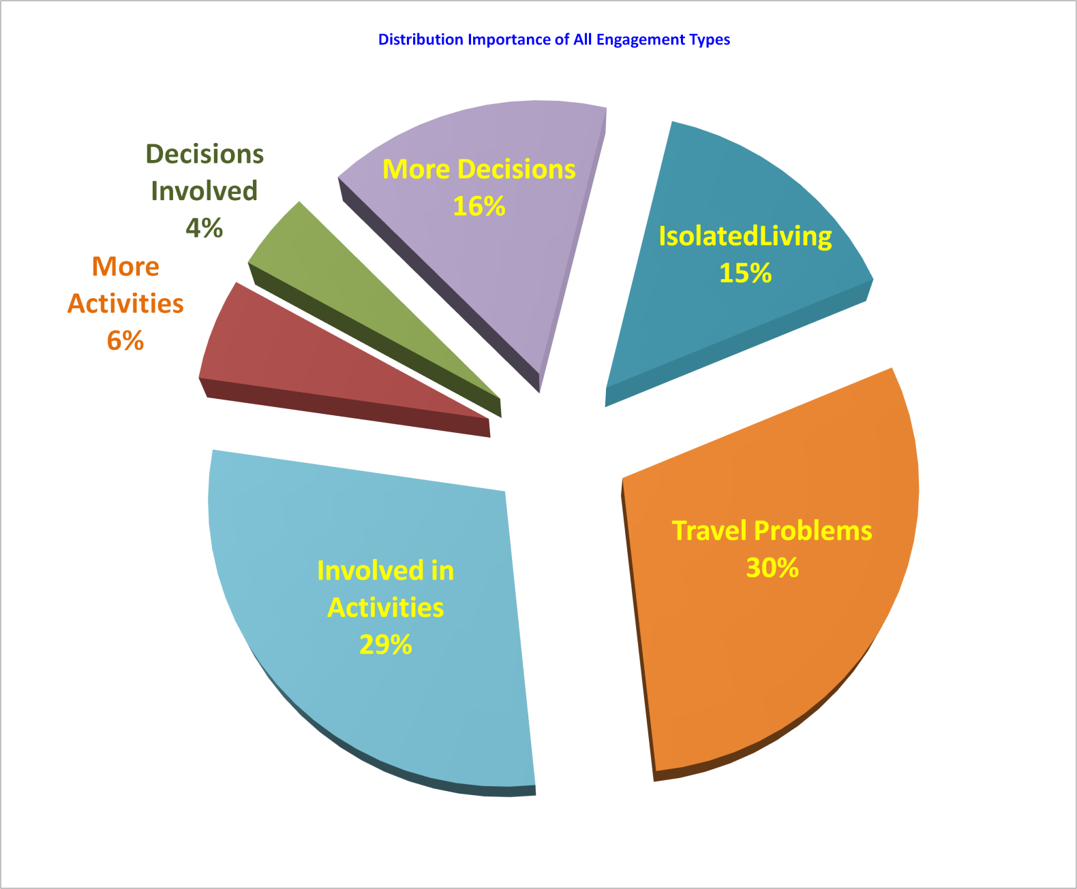
Engagement From 434 Survey Responses – 12.4%

Slide 7
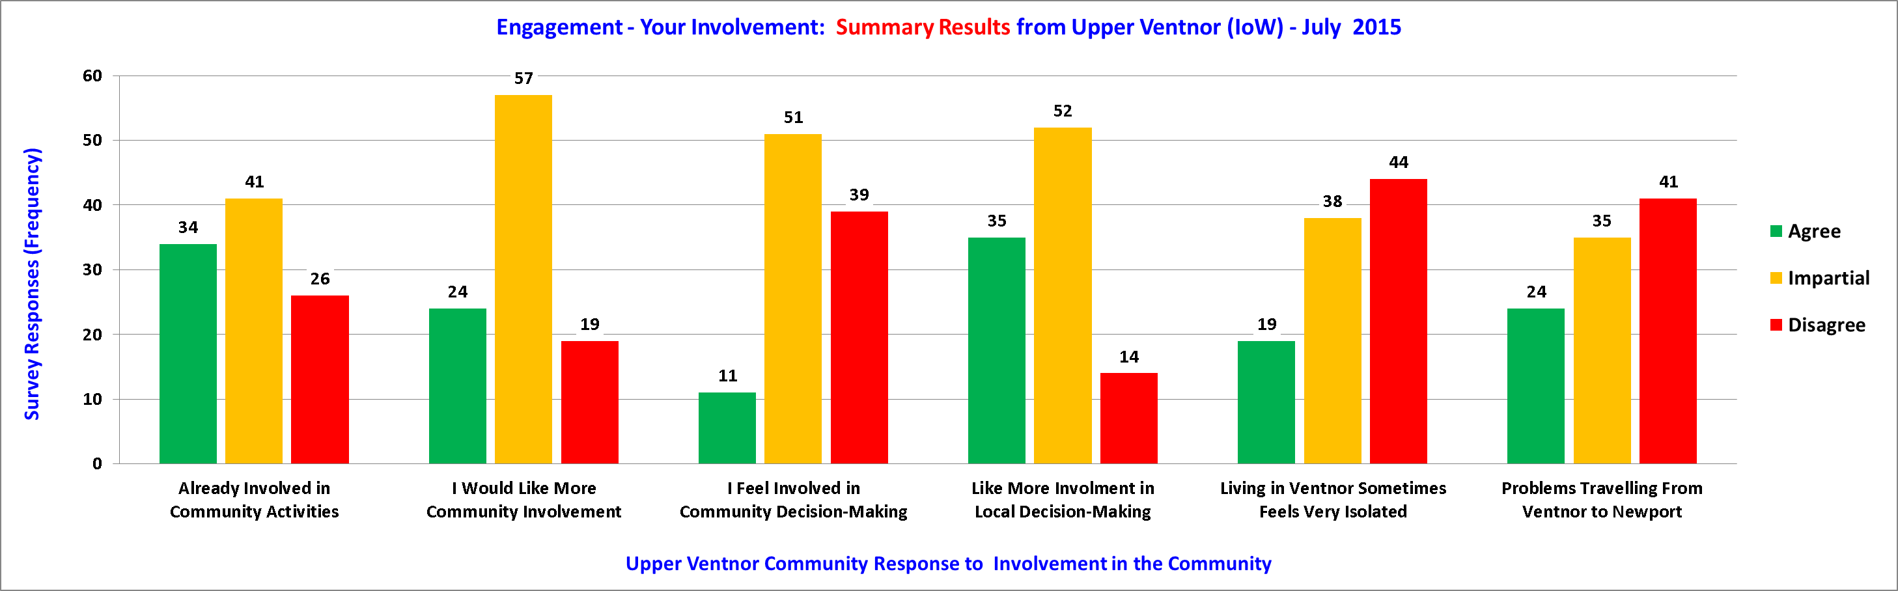
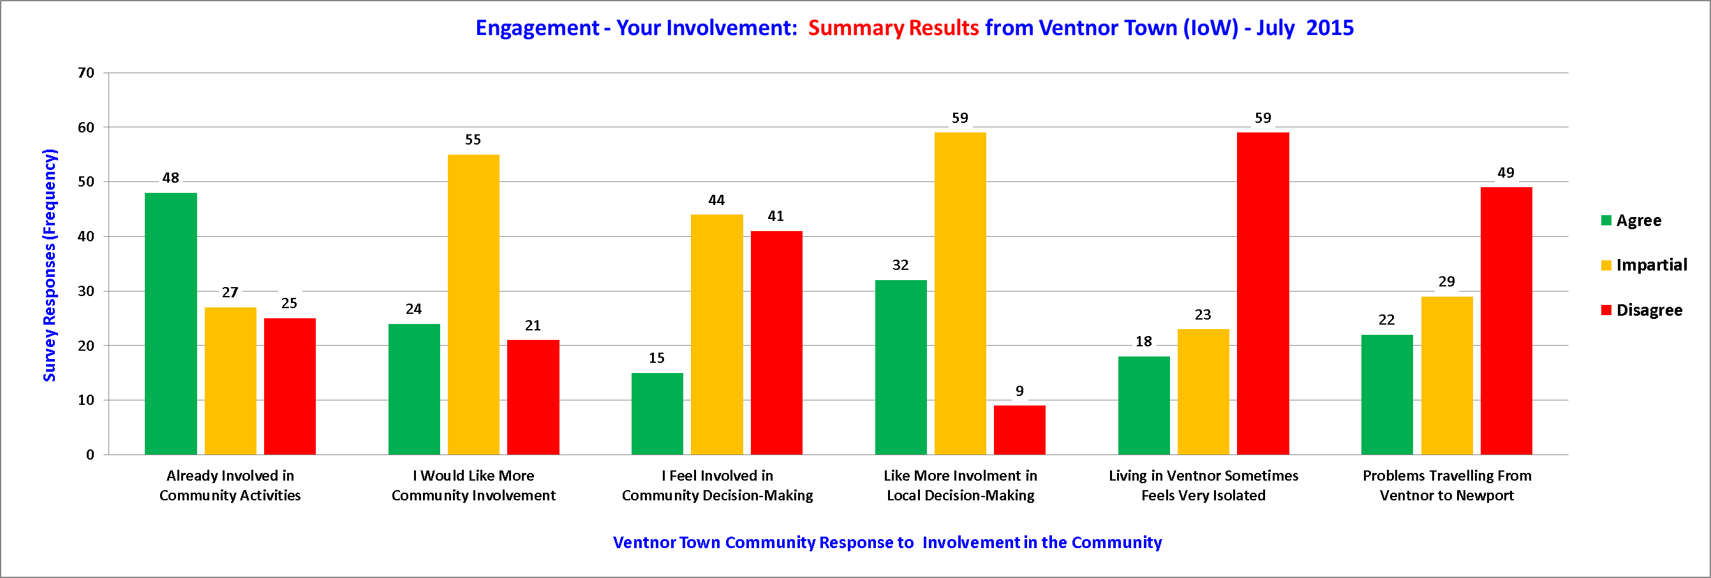
Engagement - Upper Ventnor & Ventnor Town

Slide 8
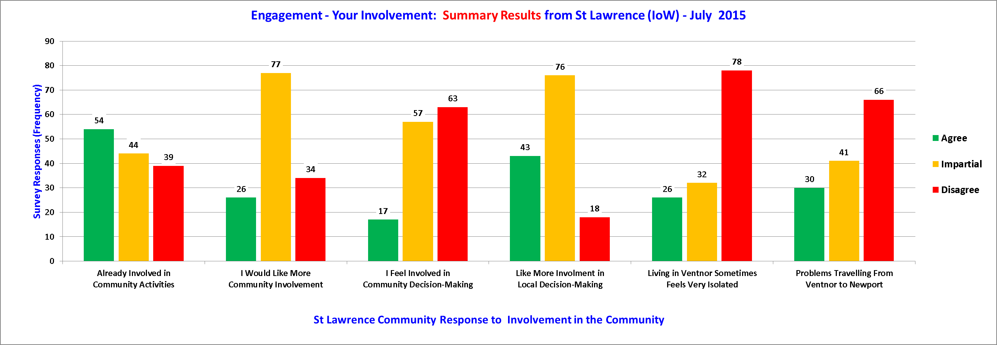
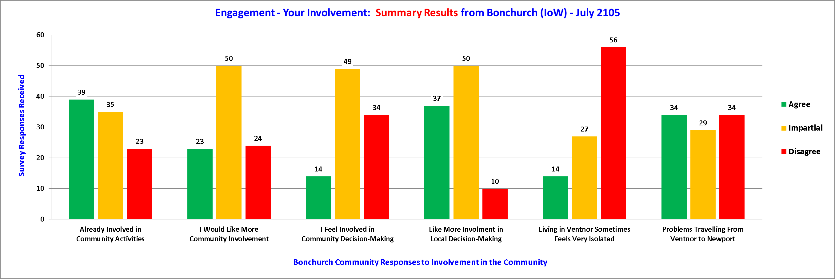
Engagement - St Lawrence & Bonchurch

Slide 9
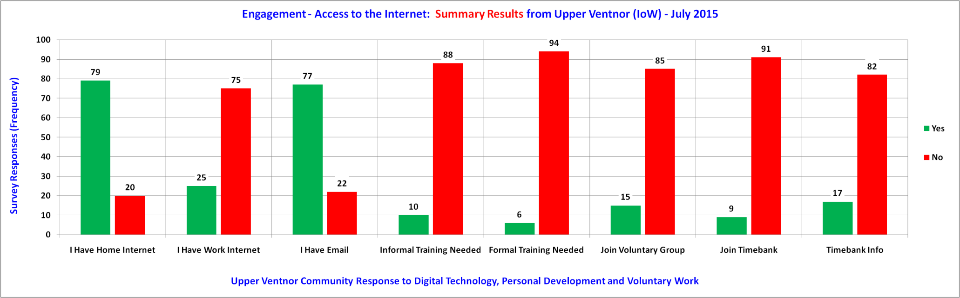
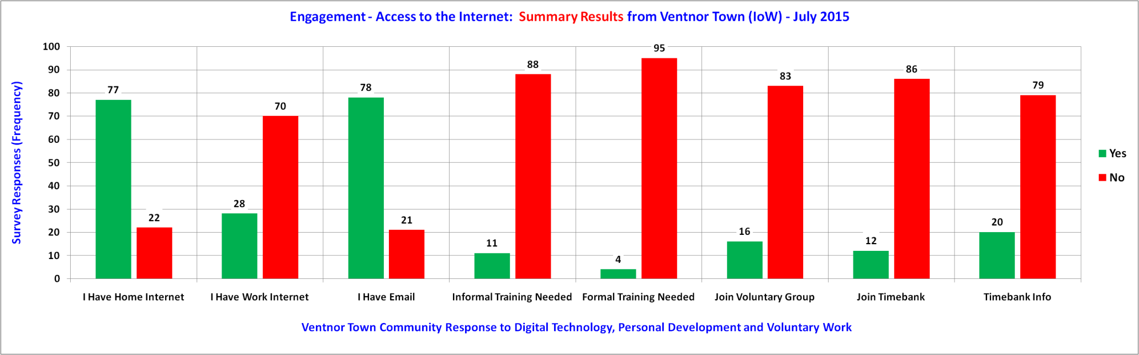
Engagement - Upper Ventnor & Ventnor Town

Slide 10
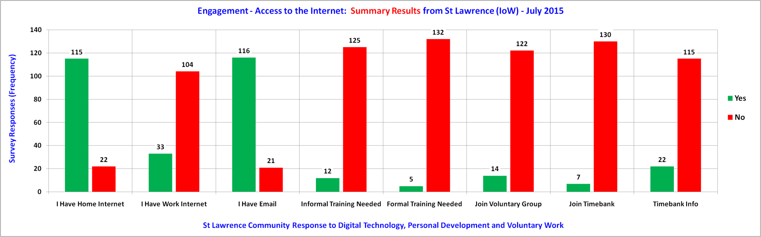
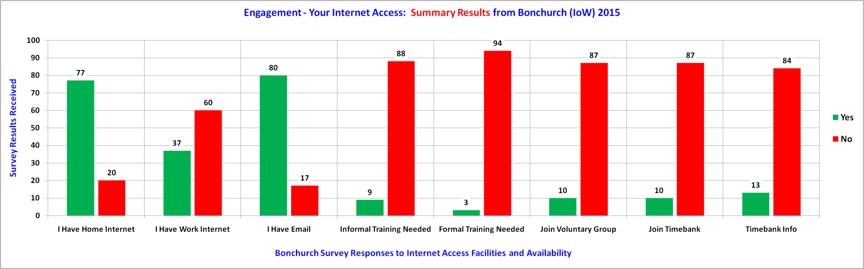
Engagement - St Lawrence & Bonchurch

Slide 11
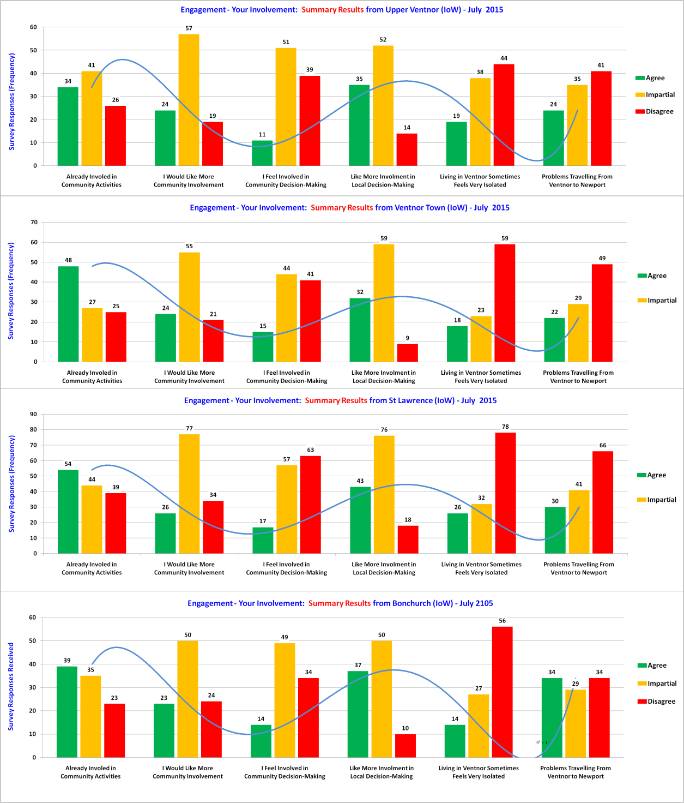
Engagement - Your Involvement Comparisons
Responses
11 to 35
Upper
Ventnor
Responses
15 to 48
Ventnor
Town
Responses
17 to 54
St Lawrence
Responses
14 to 39
Bonchurch

Slide 12
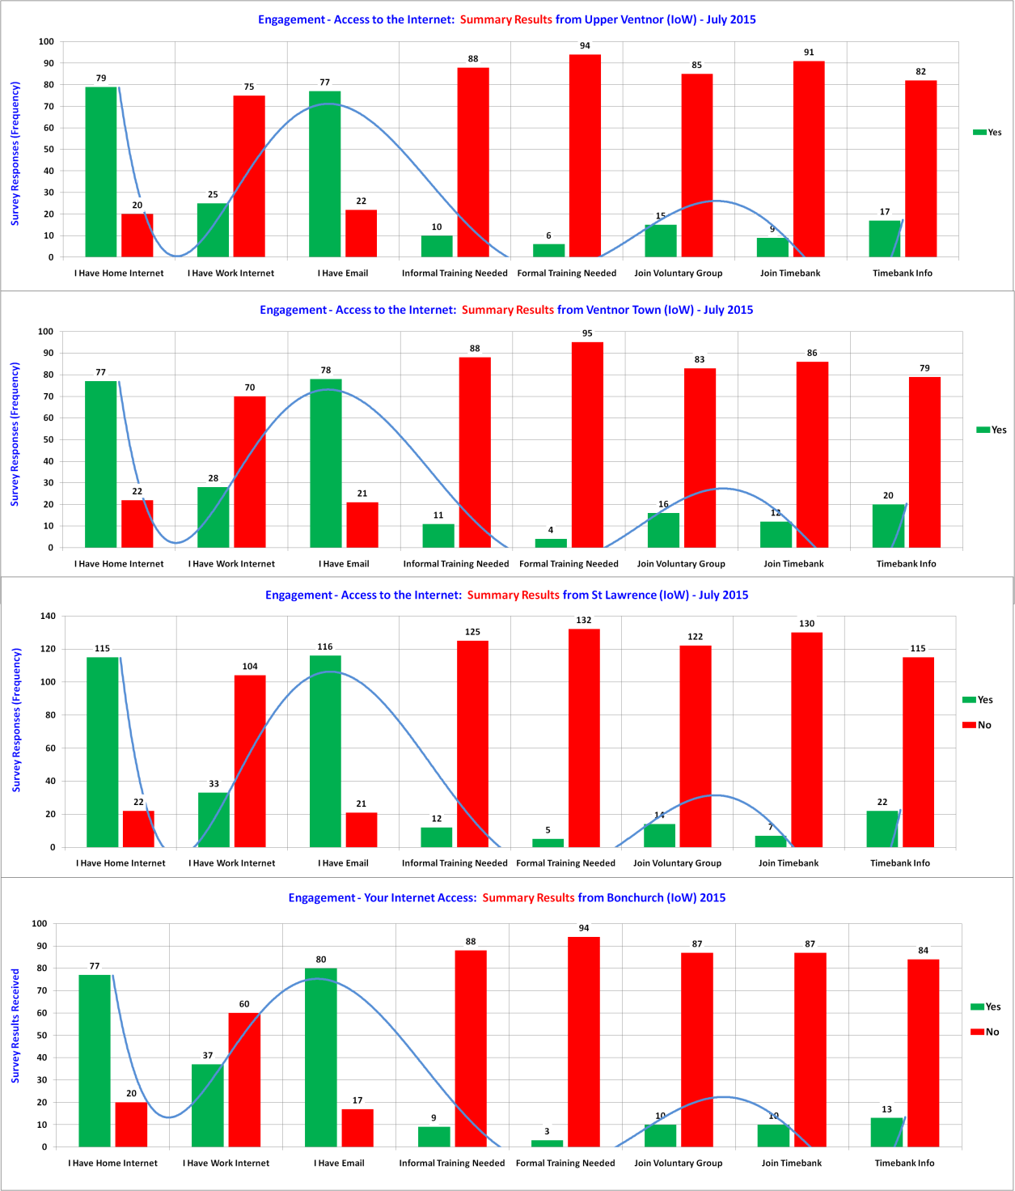
Engagement - Your Internet Access
Responses
6 to 79
Upper
Ventnor
Responses
4 to 77
Ventnor
Town
Responses
5 to 116
St Lawrence
Responses
3 to 80
Bonchurch

Slide 13
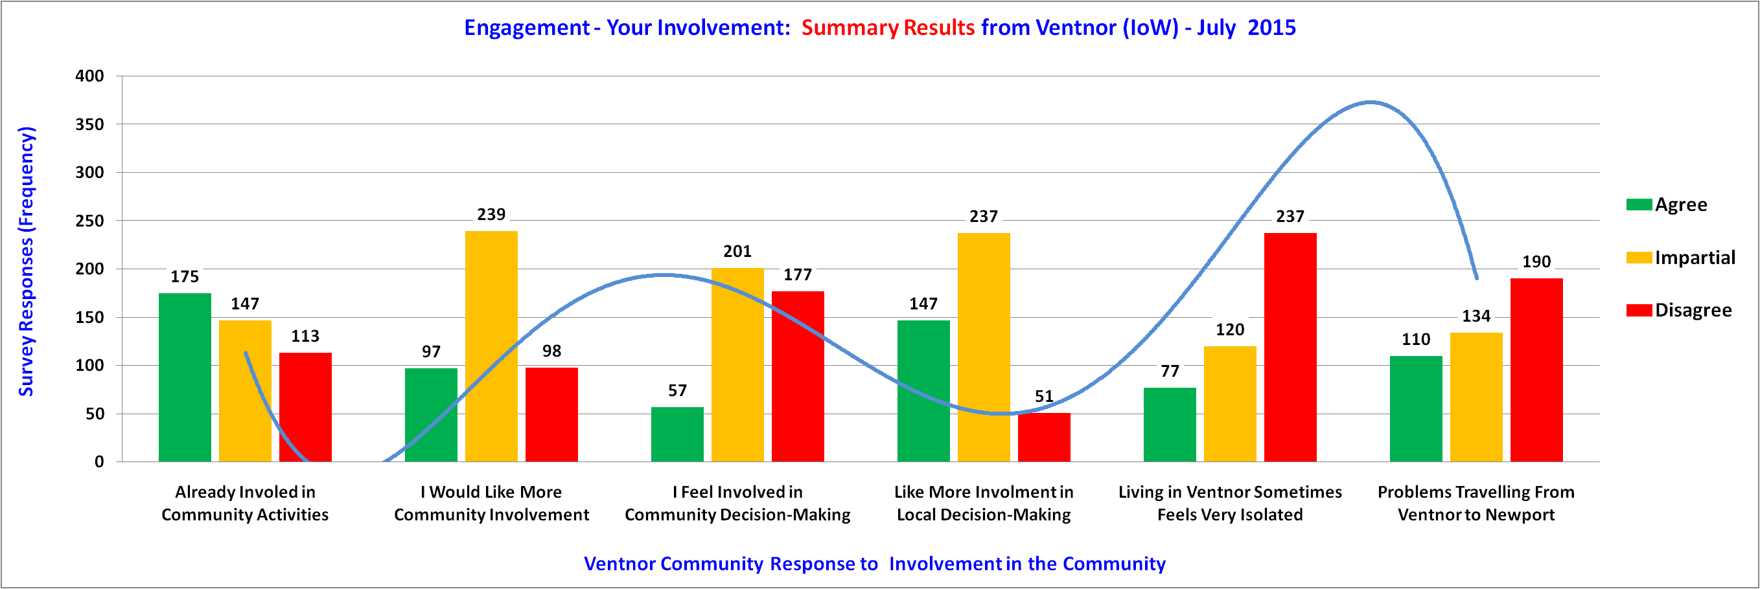
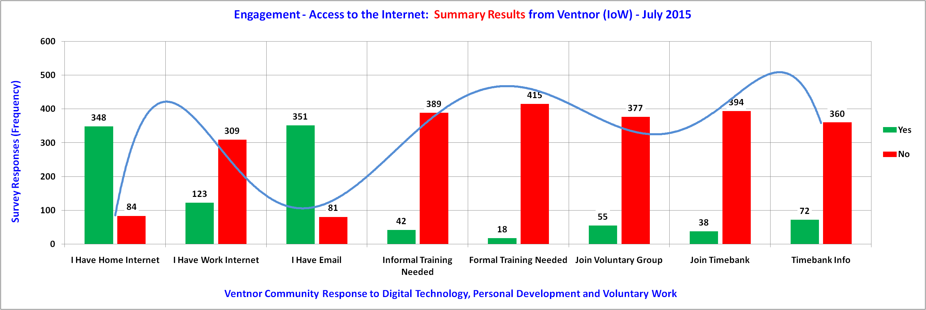
Engagement Across Ventnor
Your Views
About You

Slide 14
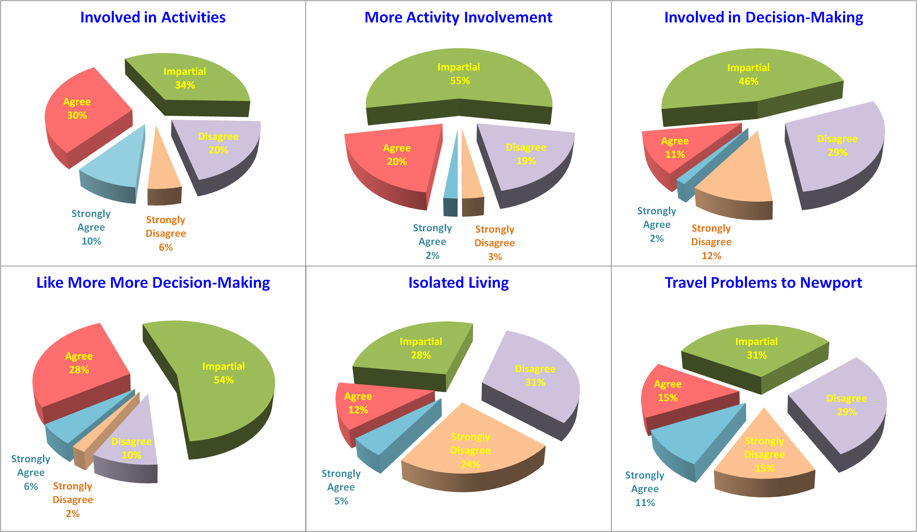
Engagement - Involvement Across Ventnor - 1 of 2

Slide 15
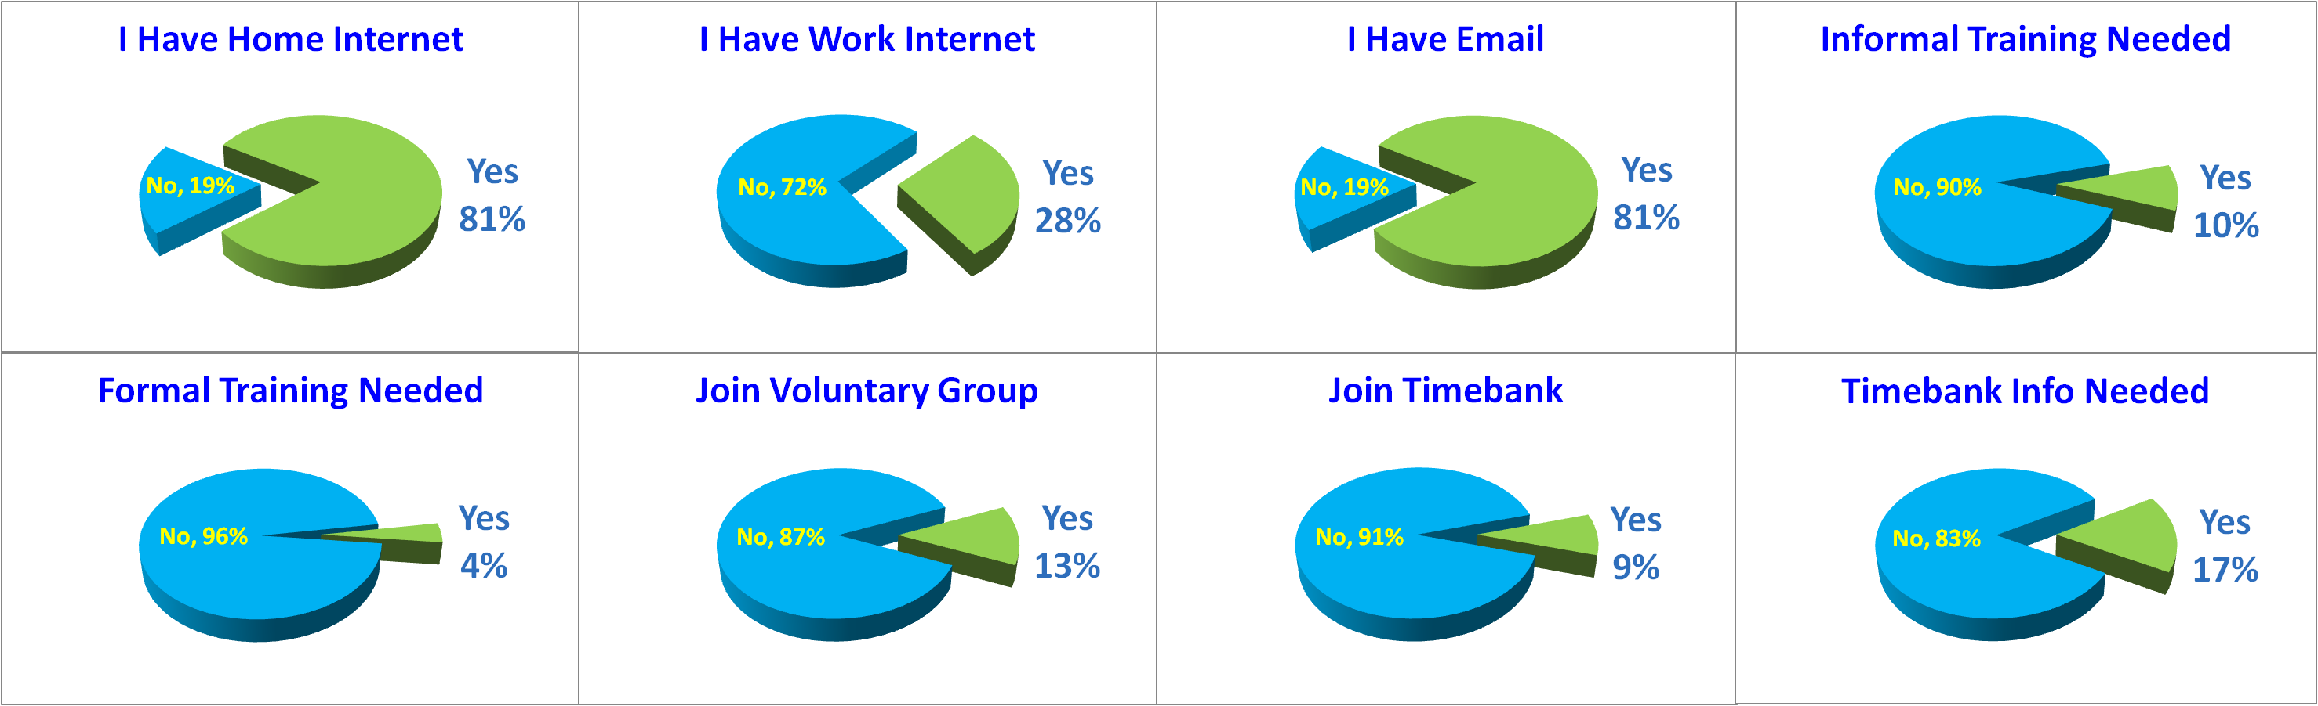
Engagement - Access Across Ventnor - 2 of 2

Slide 16
Our Place Ventnor Survey
Section C – Detailed Engagement
Discussion Only.

Slide 17
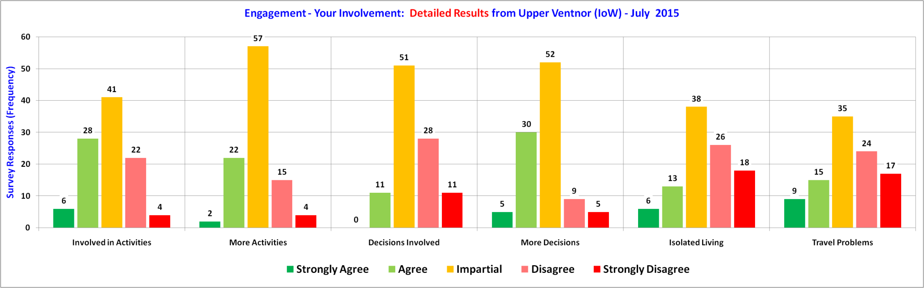
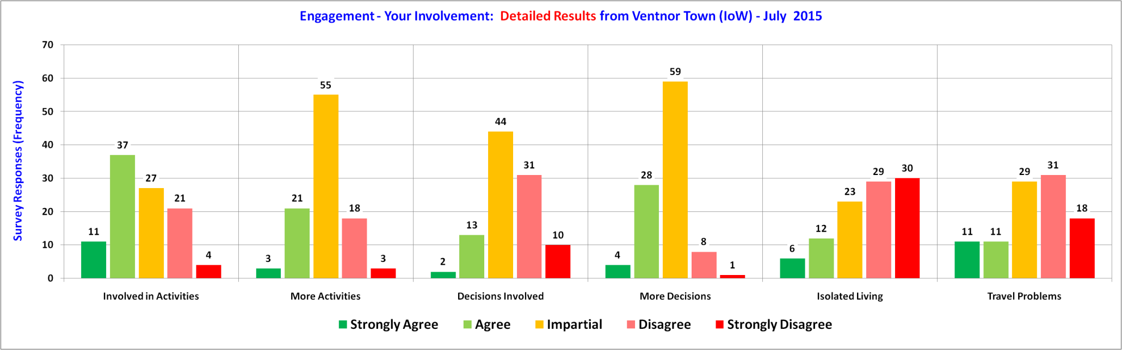
Detailed Engagement – Upper Ventnor & Town

Slide 18
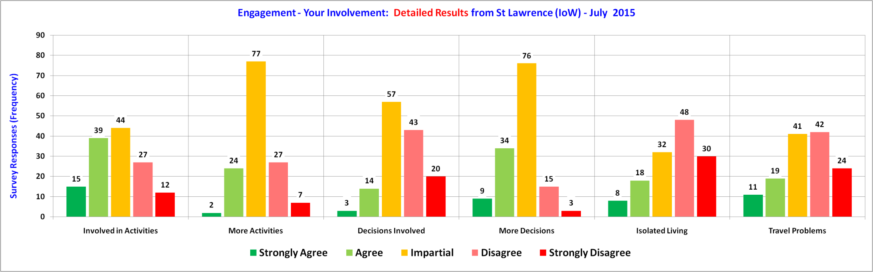
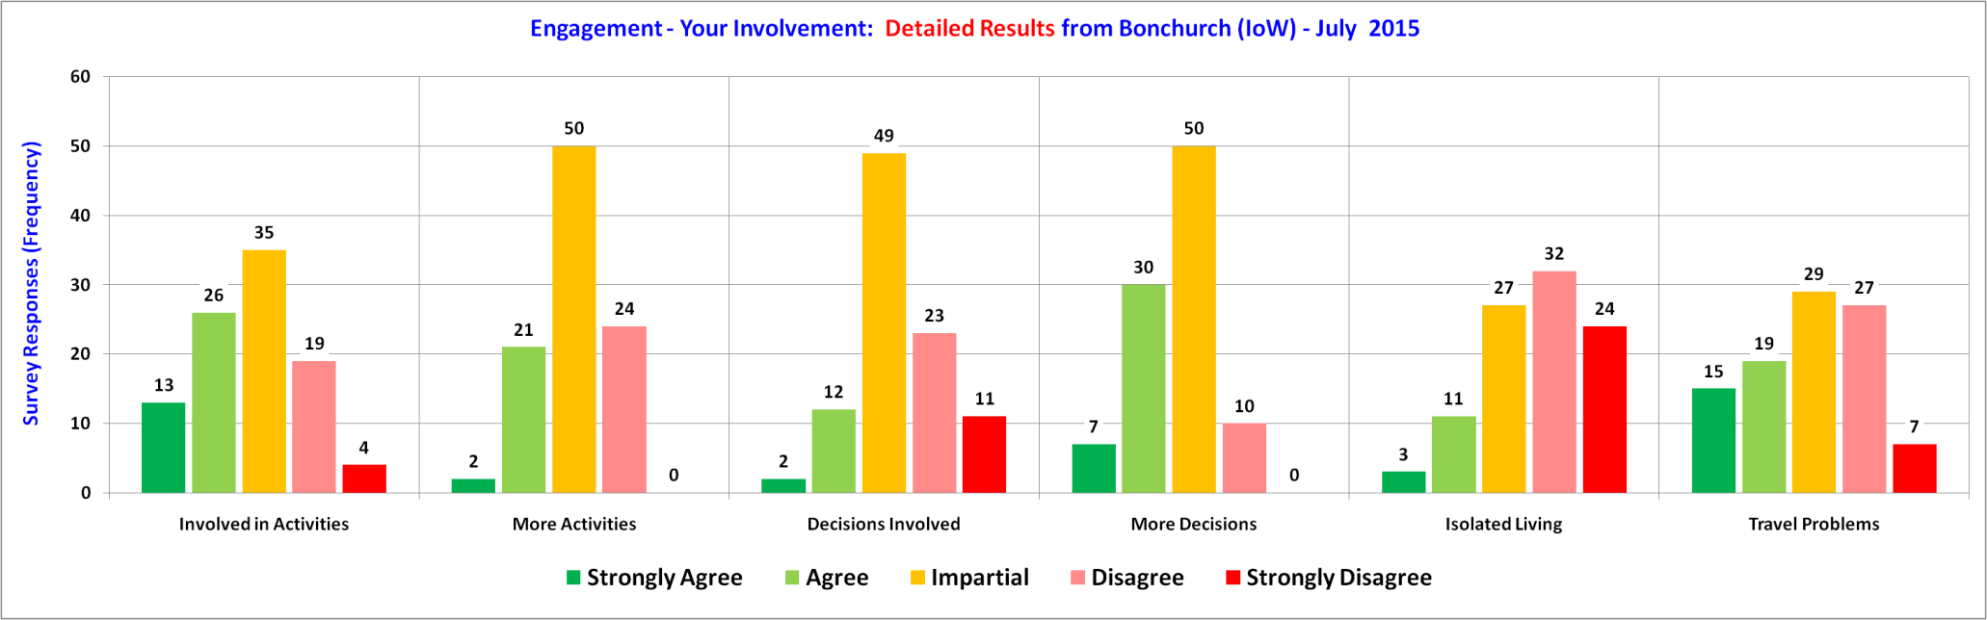
Detailed Engagement – St Lawrence & Bonchurch

Slide 19
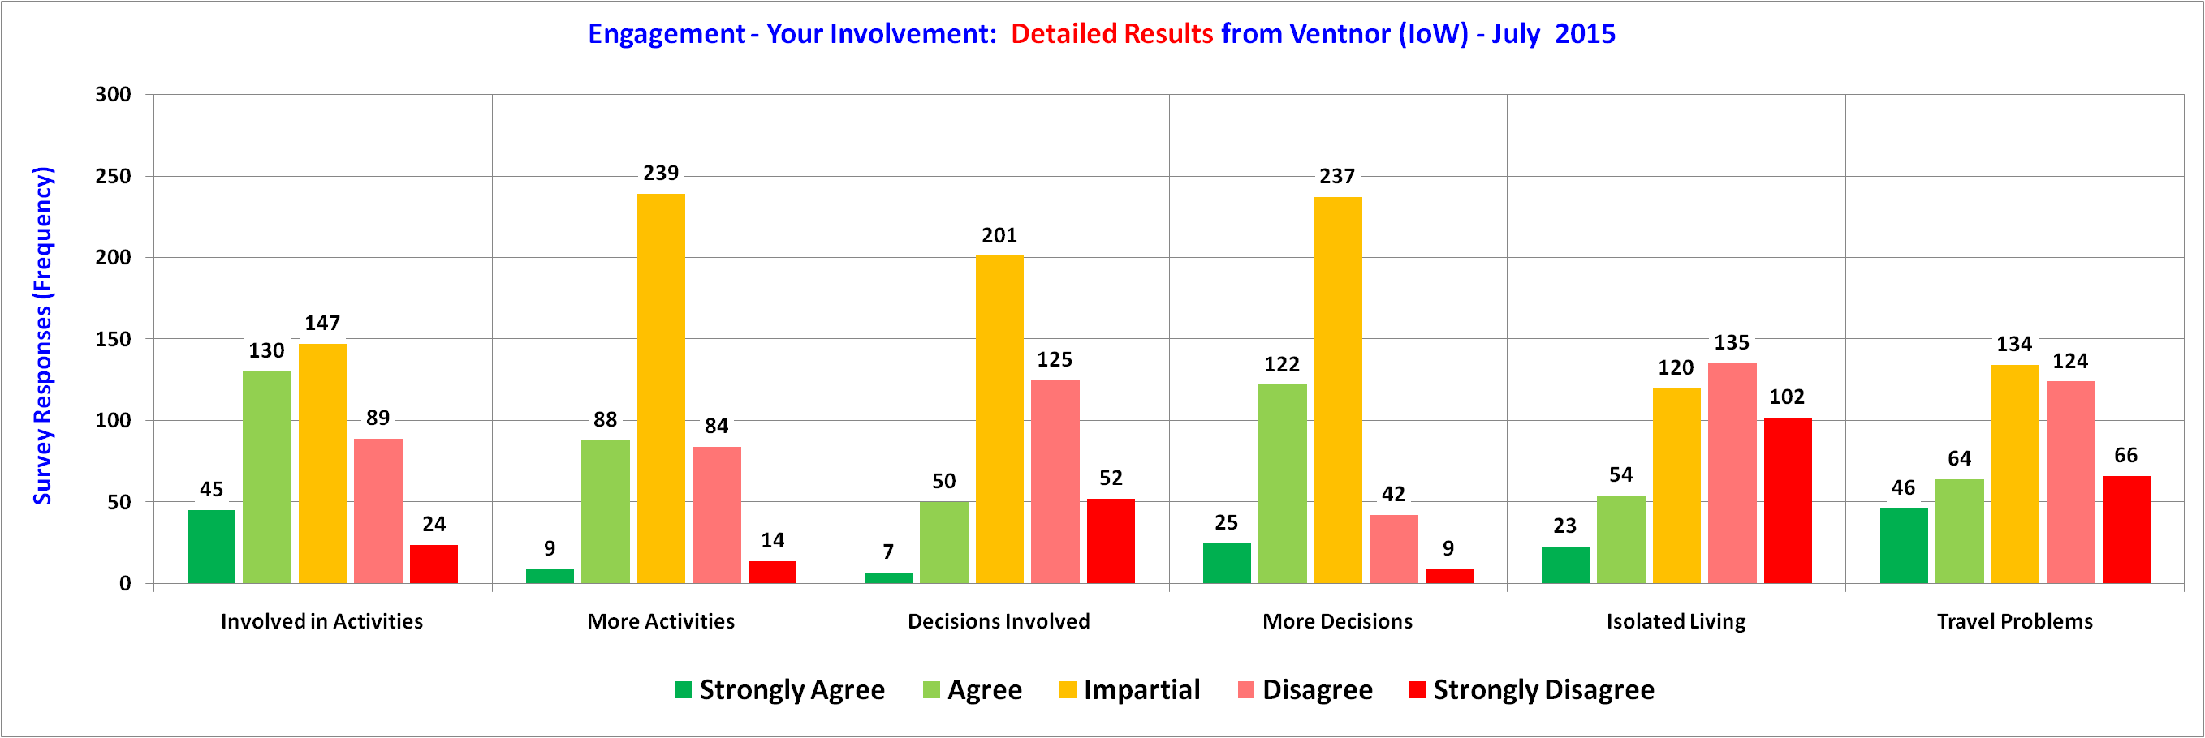
Detailed Engagement – Across Ventnor

Slide 20
Our Place Ventnor Survey
Section C – The End
Notes:
http://www.jkp-ads.com/download.asp

