Slide 1
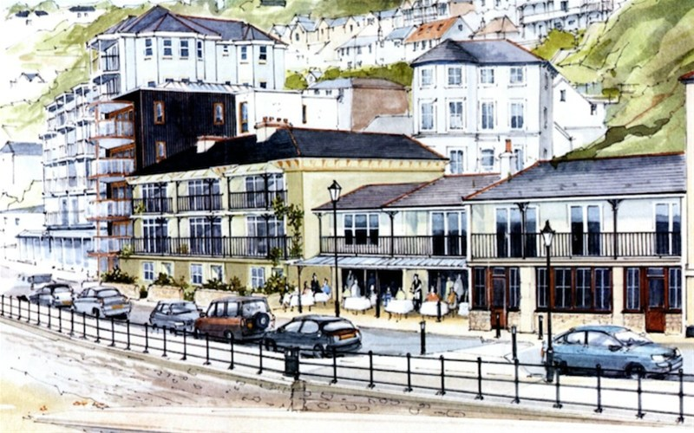

2015 Our Place Survey Results for Ventnor
Survey Section C: Opportunities

Slide 2
Presentations Available: Detailed Results
◊ Priorities
◊ Facilities
◊ Opportunities
◊ Engagement
◊ Projects
◊ Investigation
____________________
◊ Comments
◊ Postcodes
2015
Our Place
Survey Results
For
Ventnor

Slide 3
Our Place Ventnor Survey
Basic Demographics

Slide 4
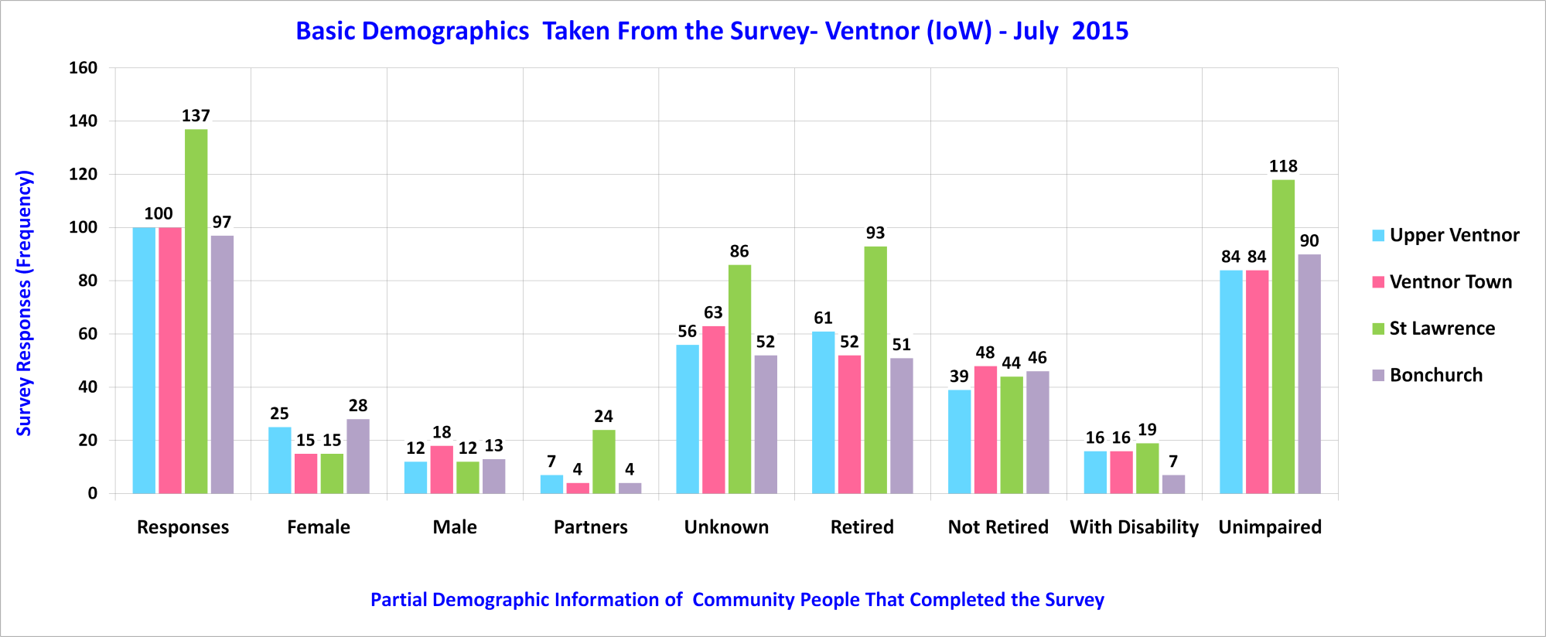
Sampled Ventnor Community

Slide 5
Our Place Ventnor Survey
Section C – Summary Opportunities
Please note: Trend lines shown on some charts are for visual enhancement only.

Slide 6
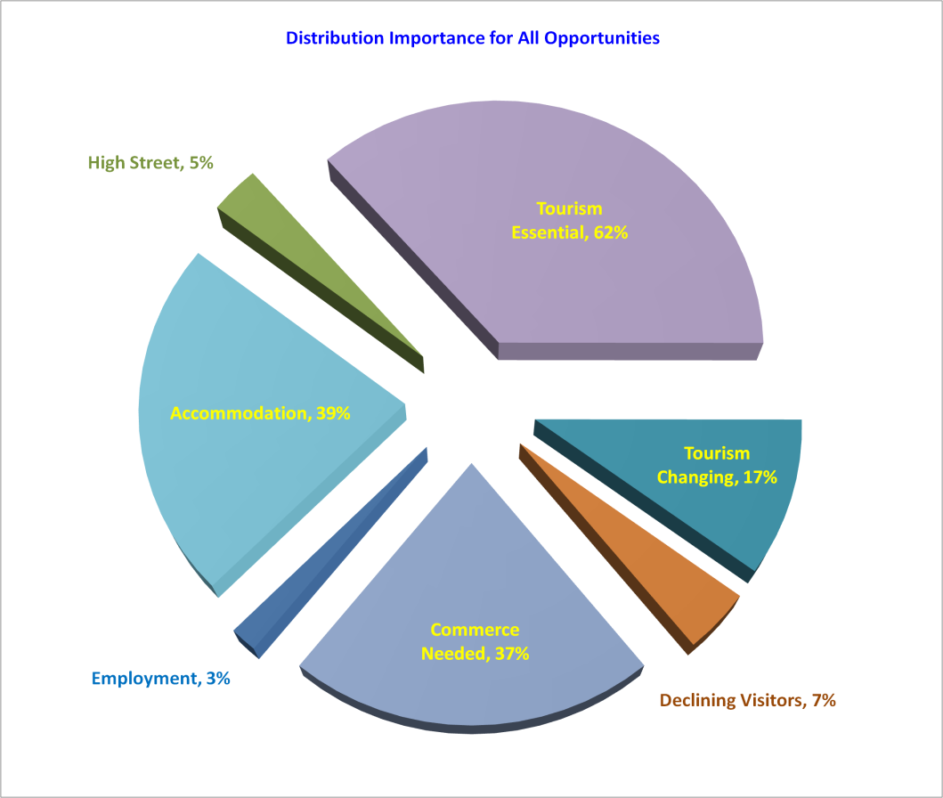
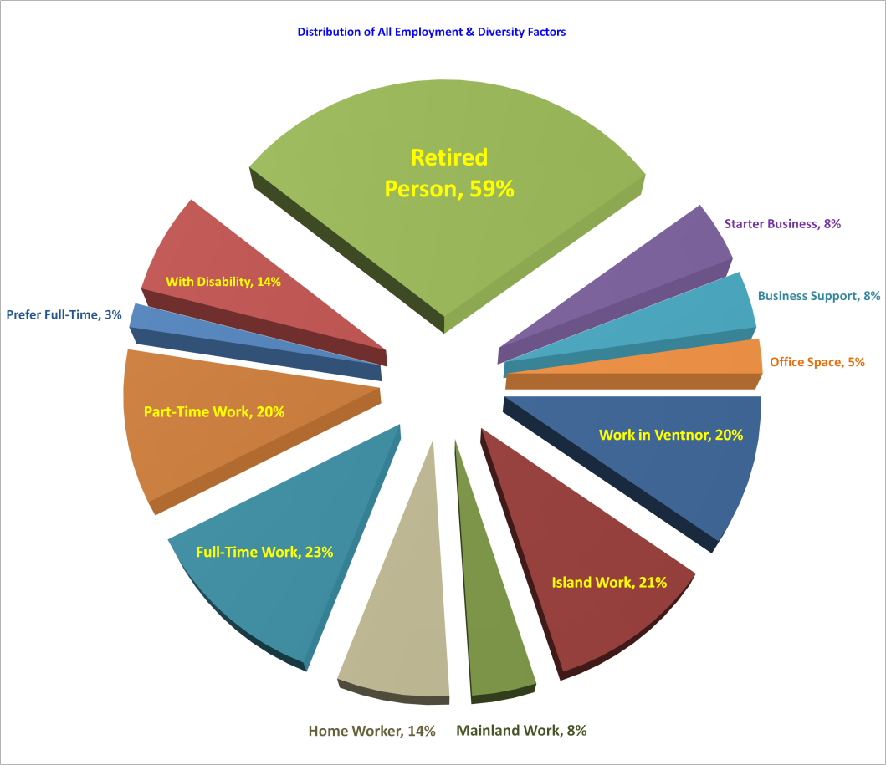
Opportunities From 434 Survey Responses – 12.4%
About You
Your Views

Slide 7
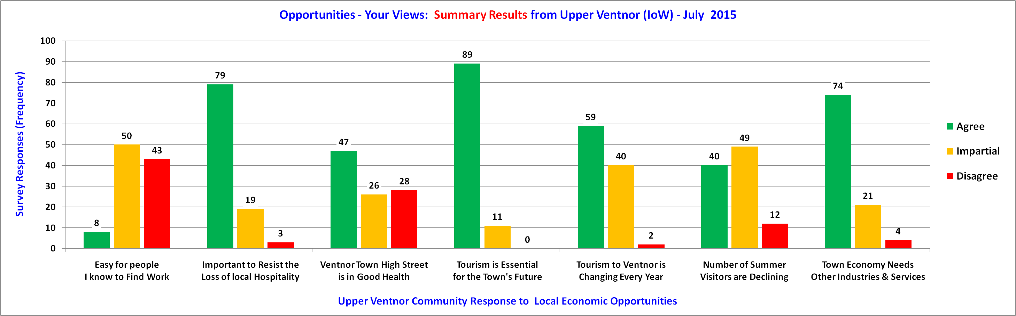
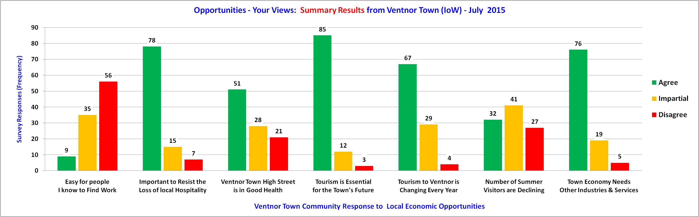
Opportunities - Upper Ventnor & Ventnor Town

Slide 8
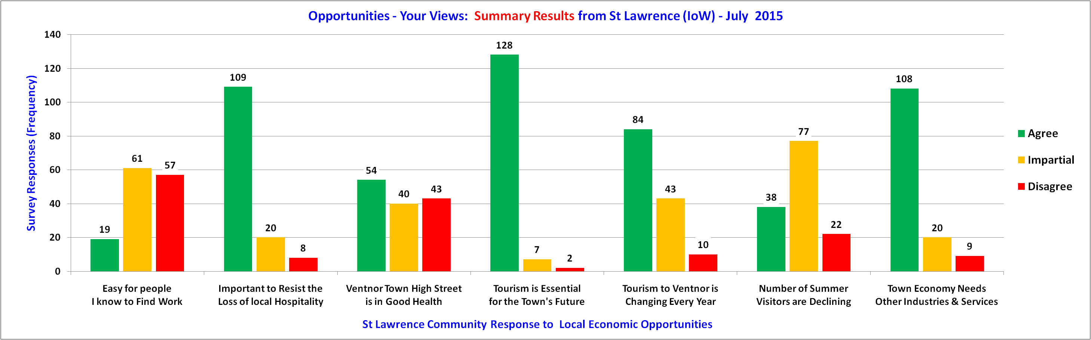
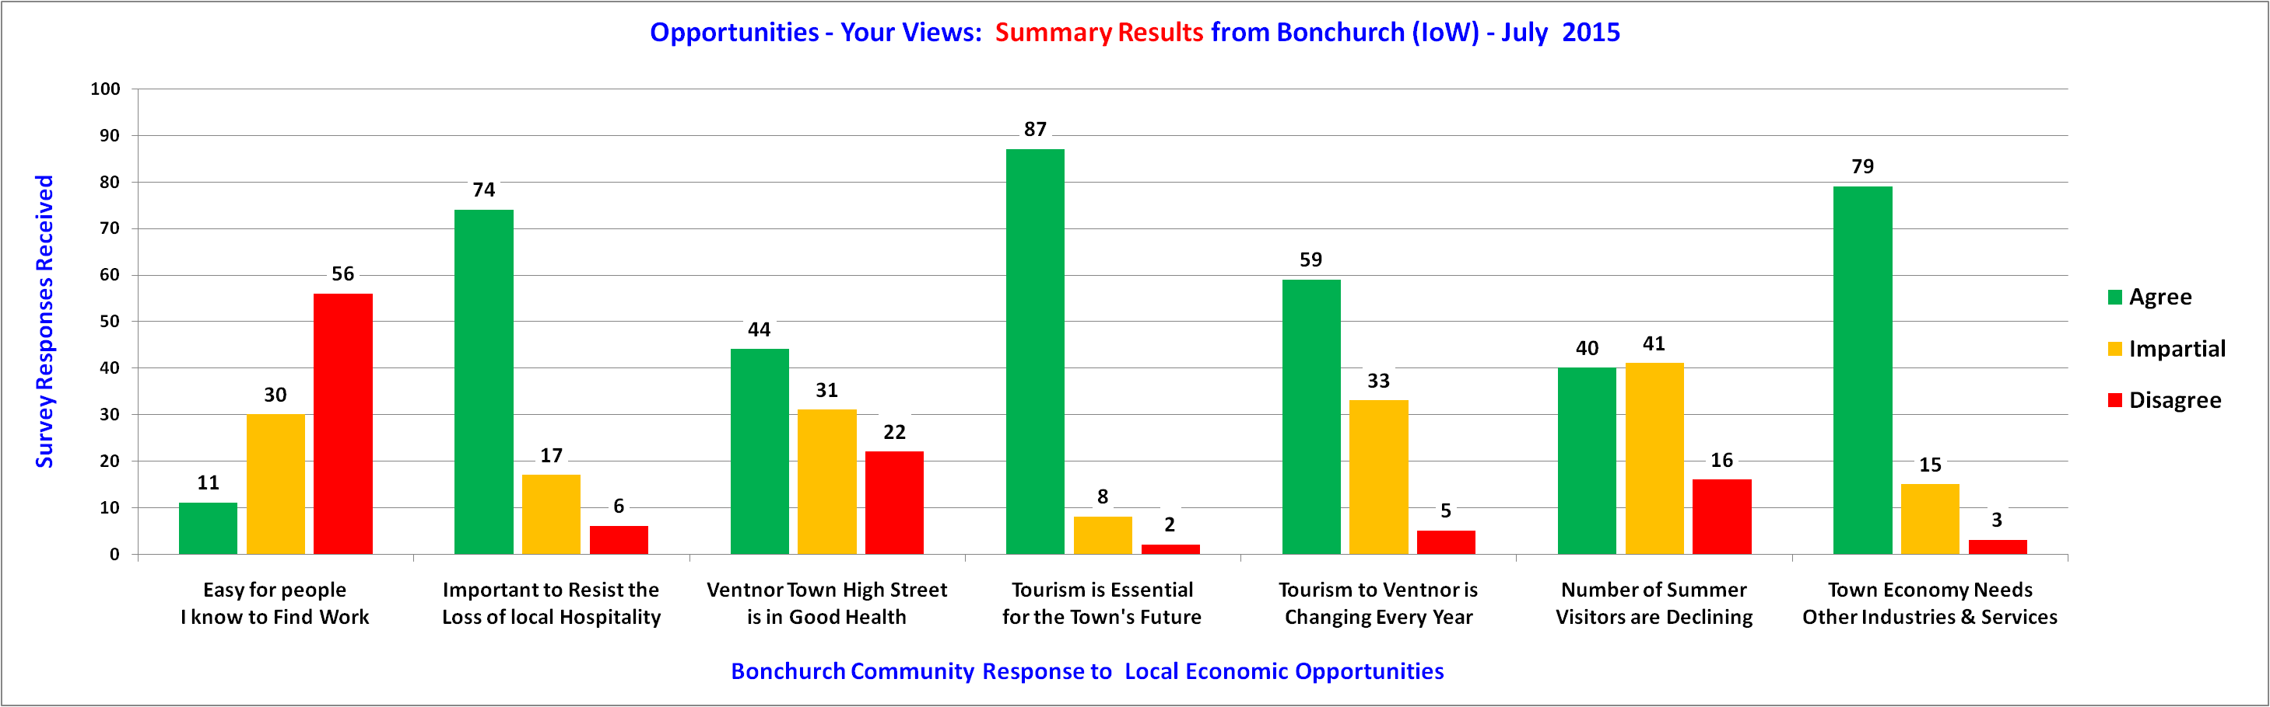
Opportunities - St Lawrence & Bonchurch

Slide 9
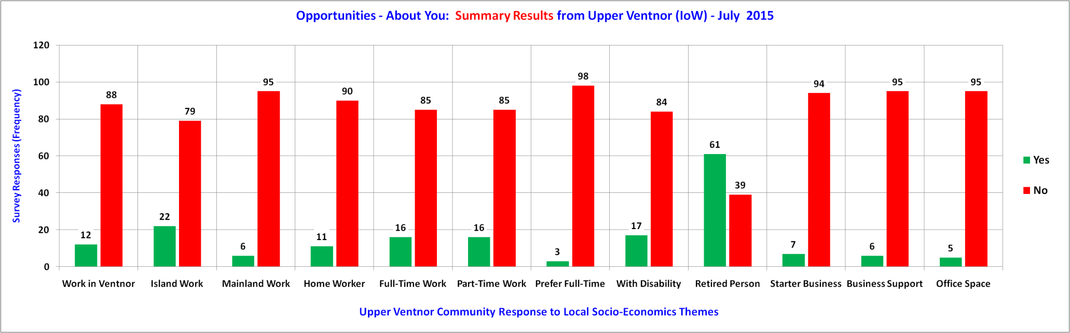
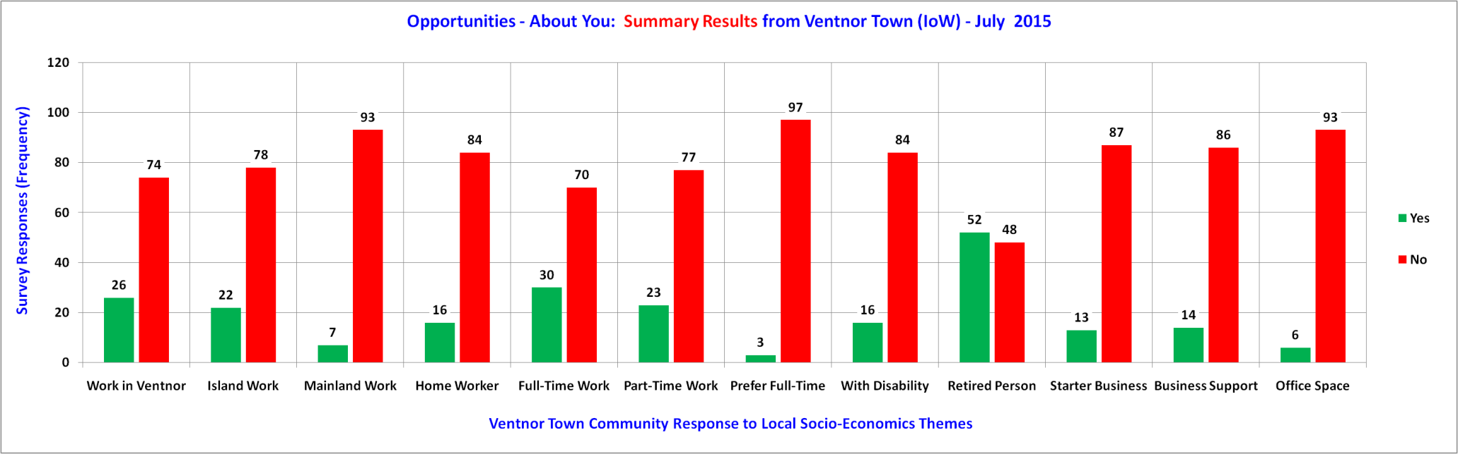
Opportunities - Upper Ventnor & Ventnor Town

Slide 10
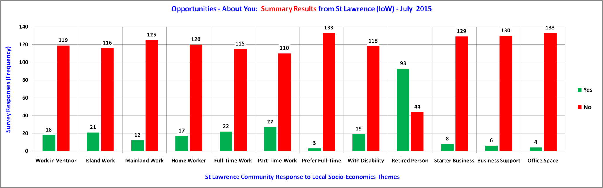
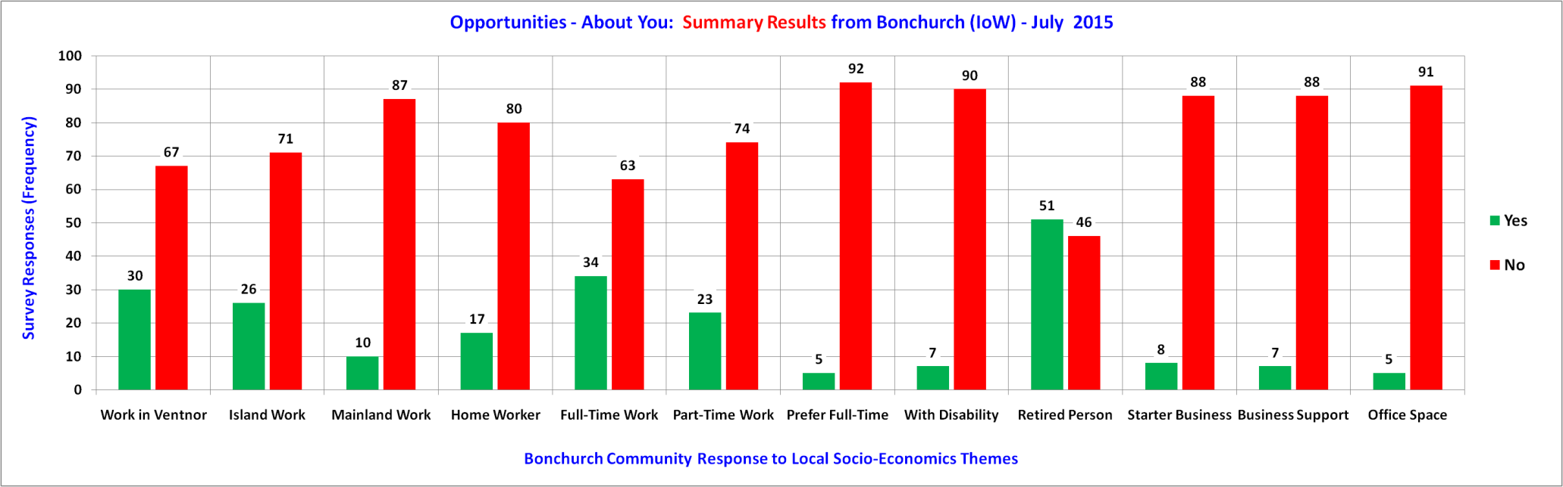
Opportunities - St Lawrence & Bonchurch

Slide 11
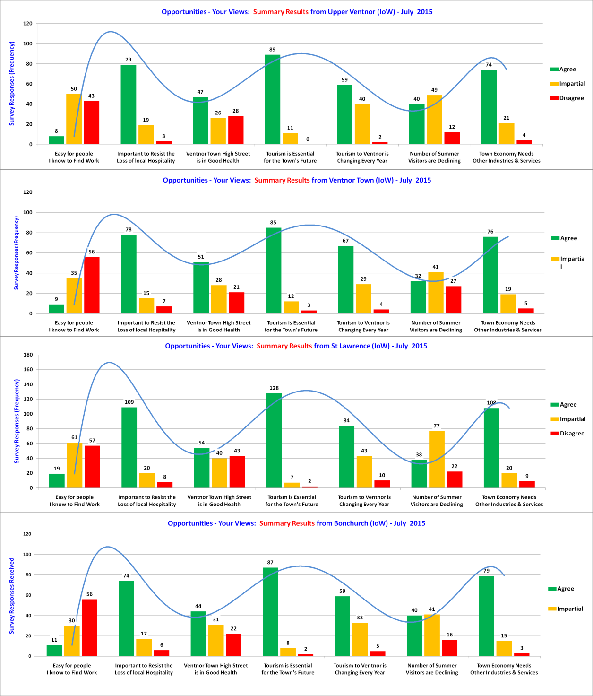
Opportunities - Your Views Comparisons
Responses
8 to 89
Upper
Ventnor
Responses
9 to 85
Ventnor
Town
Responses
19 to 128
St Lawrence
Responses
11 to 87
Bonchurch

Slide 12
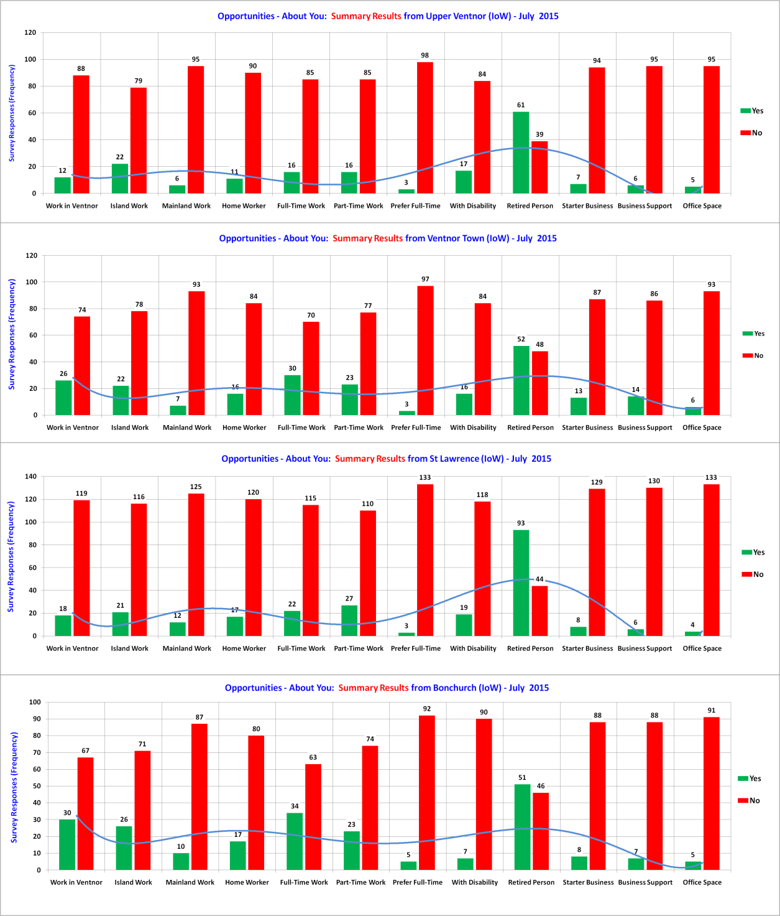
Opportunities - About You Comparisons
Responses
3 to 39
Upper
Ventnor
Responses
3 to 52
Ventnor
Town
Responses
3 to 93
St Lawrence
Responses
5 to 51
Bonchurch

Slide 13
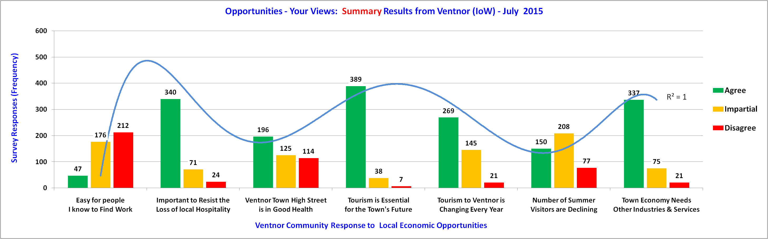
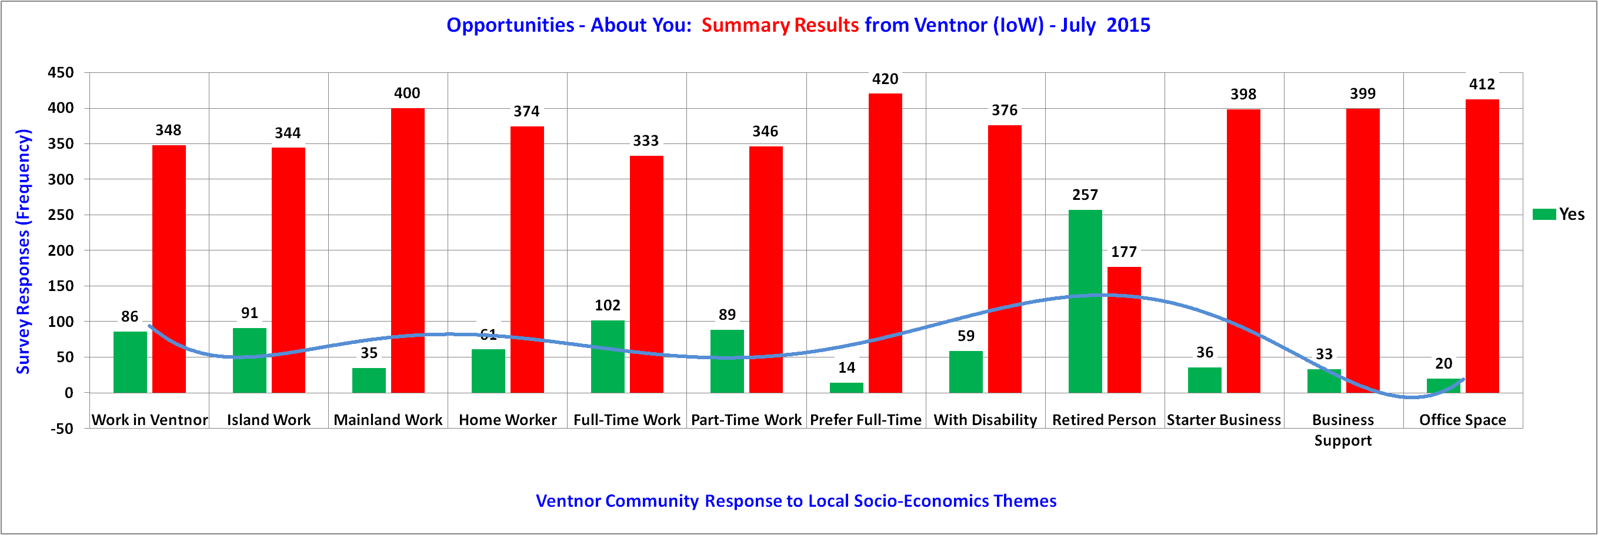
Opportunities Across Ventnor - 1 of 2
Your Views
About You

Slide 14
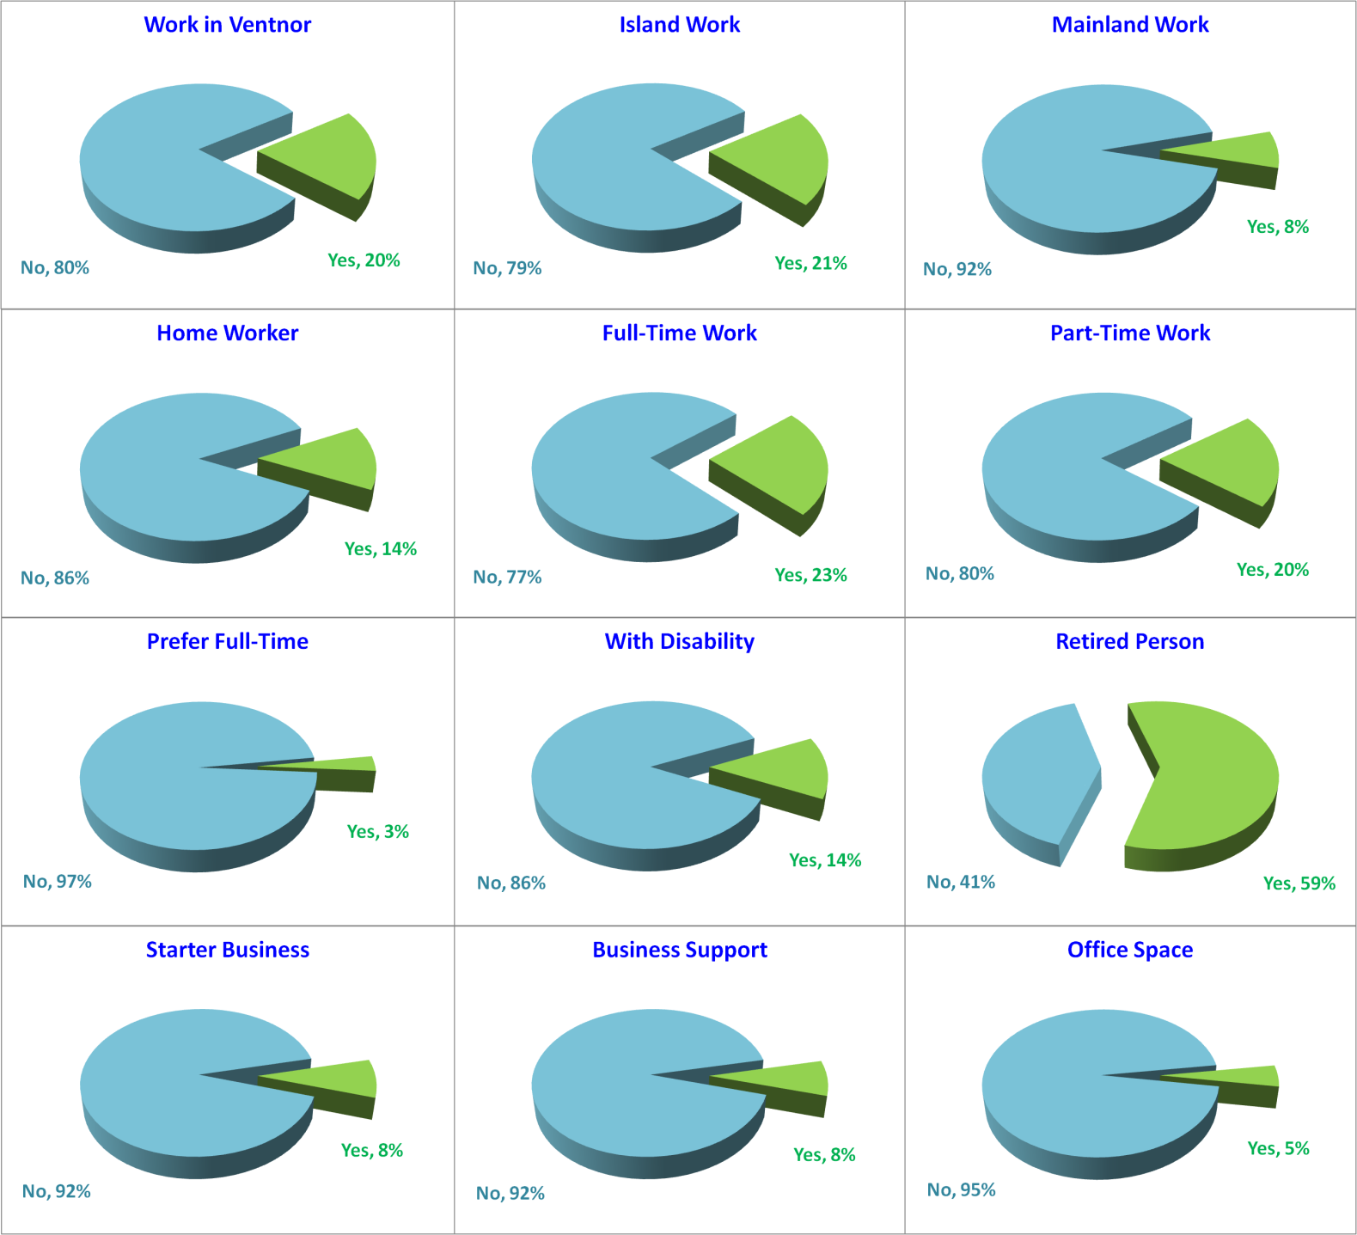
Opportunities About You Across Ventnor - 2 of 2
U:100
V:100
L:137
B:97
T:434

Slide 15
Our Place Ventnor Survey
Section C – Detailed Opportunities
Discussion Only.

Slide 16
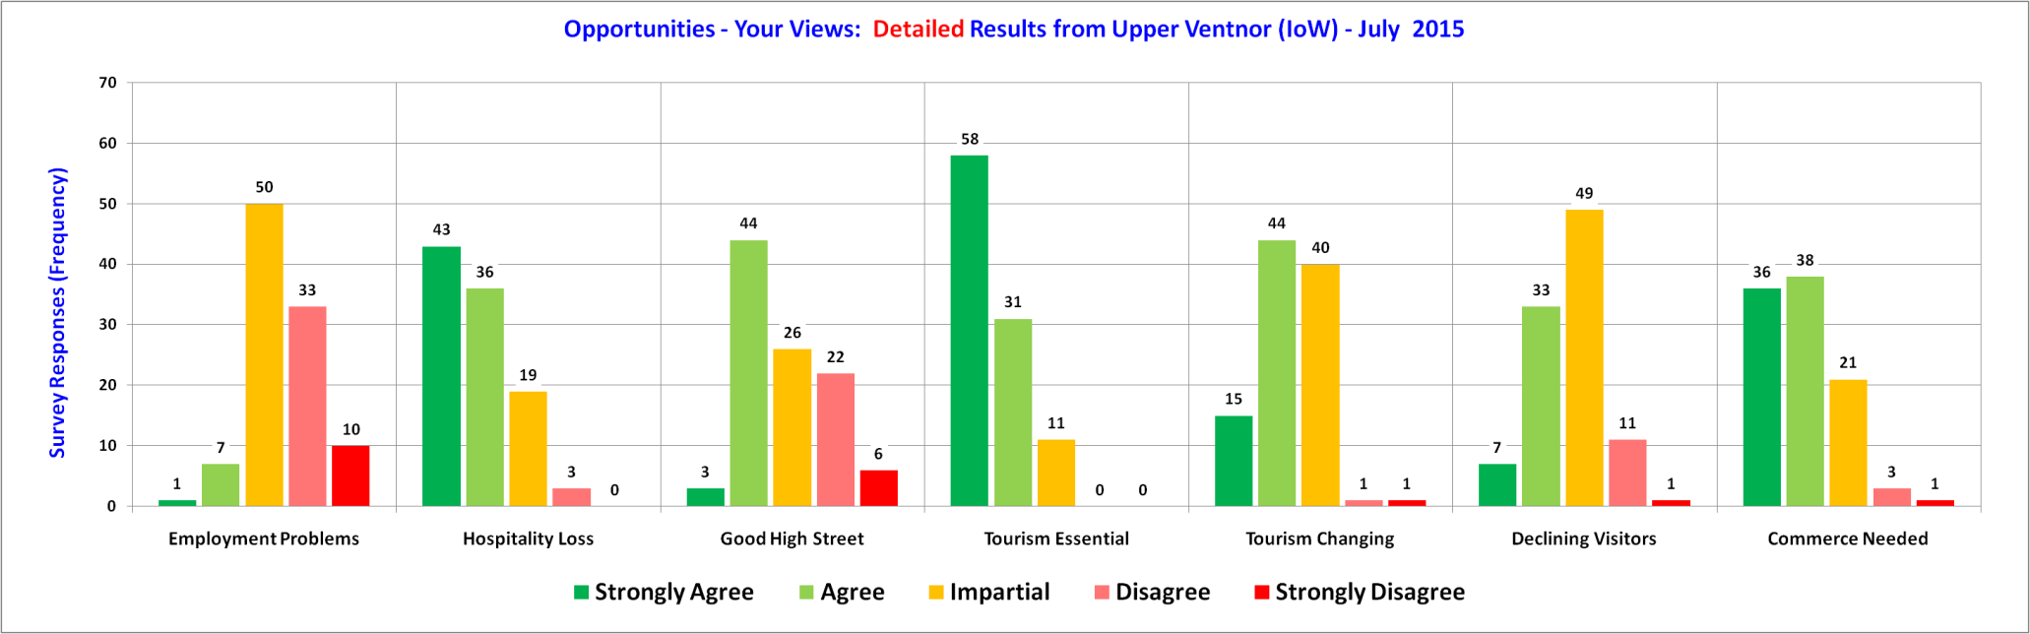
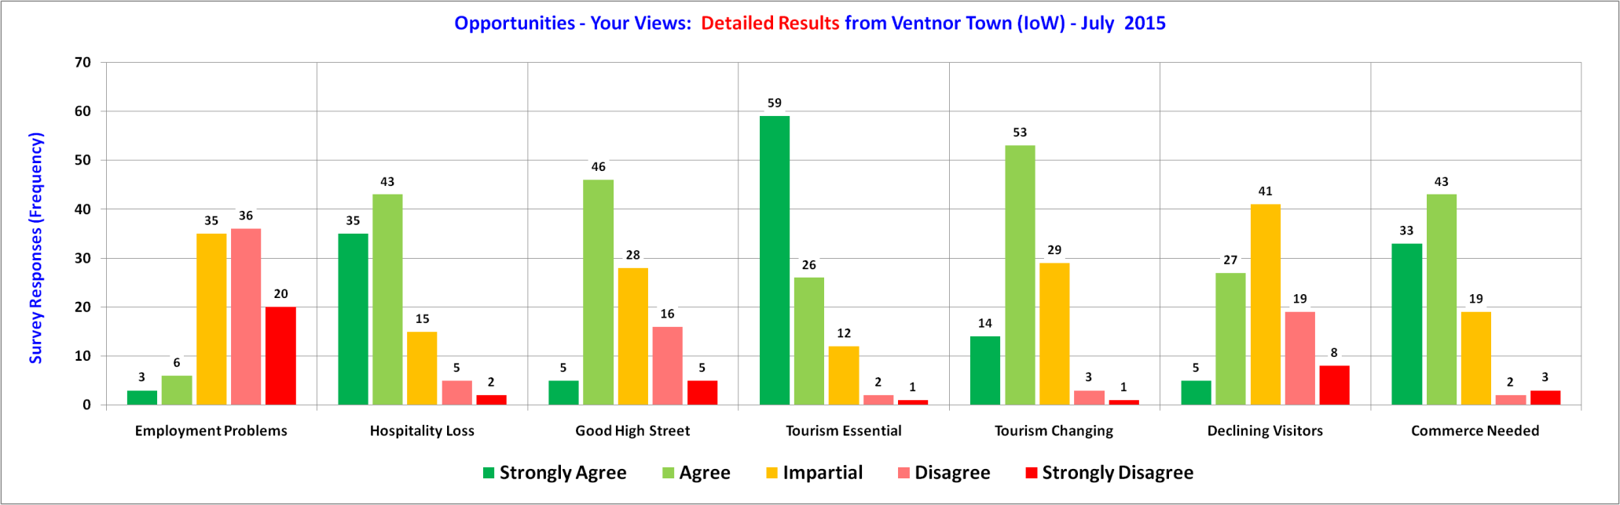
Detailed Opportunities – Upper Ventnor & Town

Slide 17
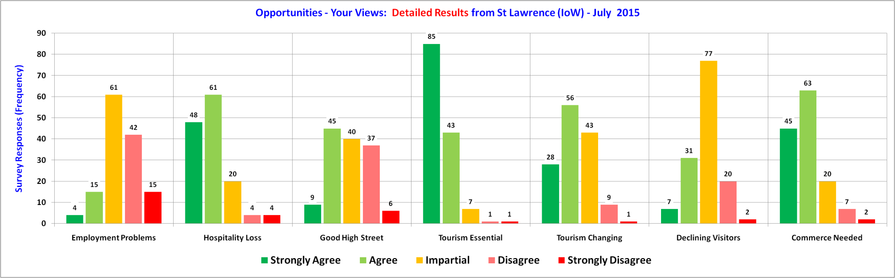
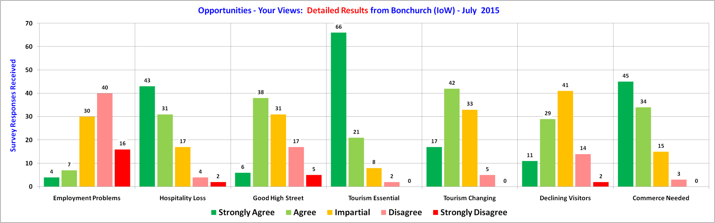
Detailed Opportunities – St Lawrence & Bonchurch

Slide 18
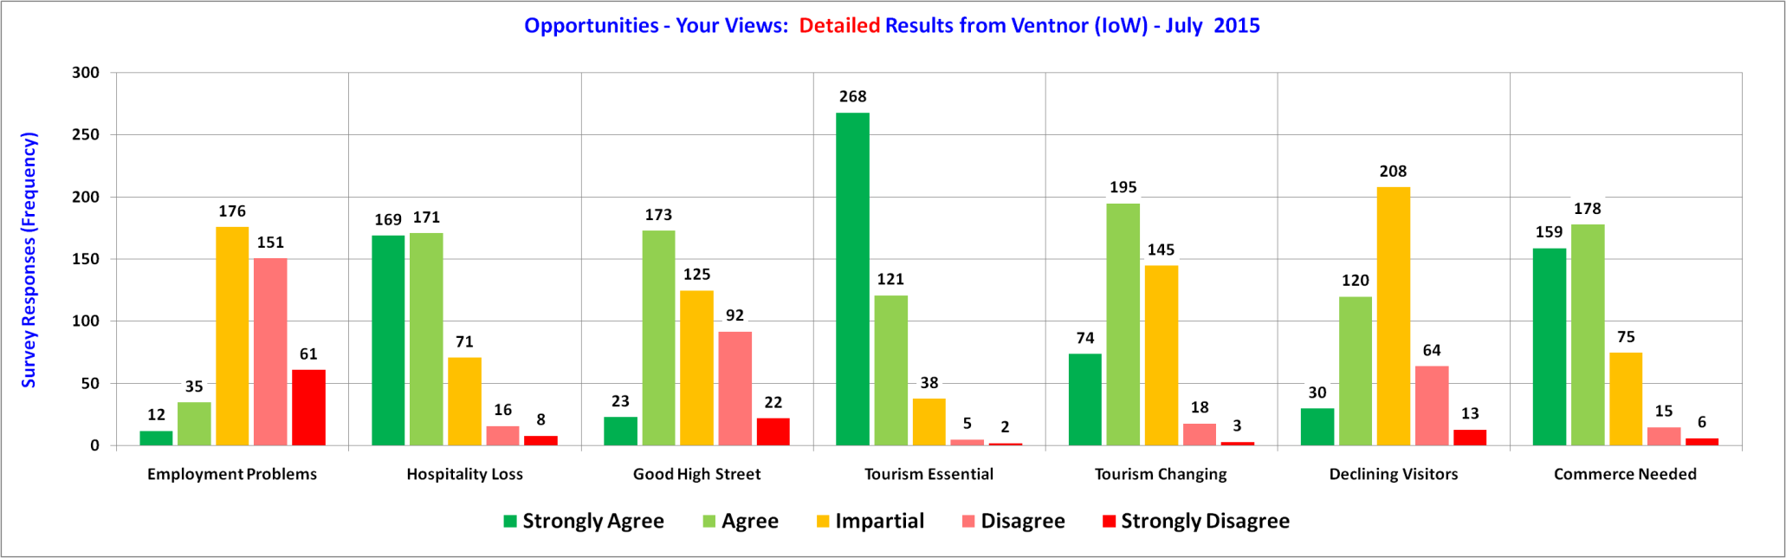
Detailed Opportunities – Across Ventnor

Slide 19
Our Place Ventnor Survey
Section C – The End

