Slide 1
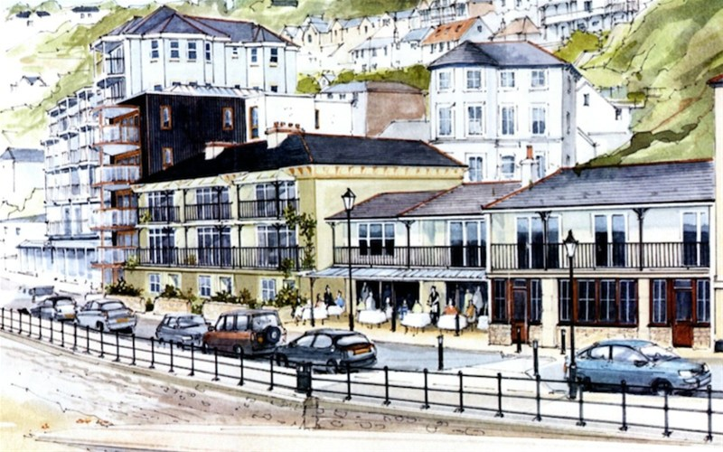

2015 Our Place Survey Results for Ventnor
Survey Section B: Facilities

Slide 2
Presentations Available: Detailed Results
◊ Priorities
◊ Facilities
◊ Opportunities
◊ Engagement
◊ Projects
◊ Investigation
____________________
◊ Comments
◊ Postcodes
2015
Our Place
Survey Results
For
Ventnor

Slide 3
Our Place Ventnor Survey
Basic Demographics

Slide 4
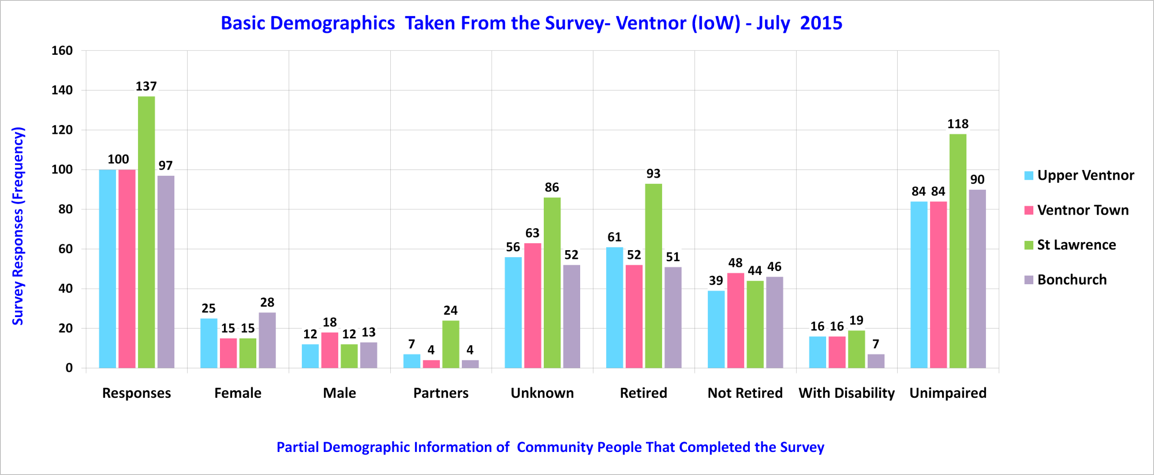
Sampled Ventnor Community

Slide 5
Our Place Ventnor Survey
Section B – Summary Facilities
Please note: Trend lines shown on some charts are for visual enhancement only.

Slide 6
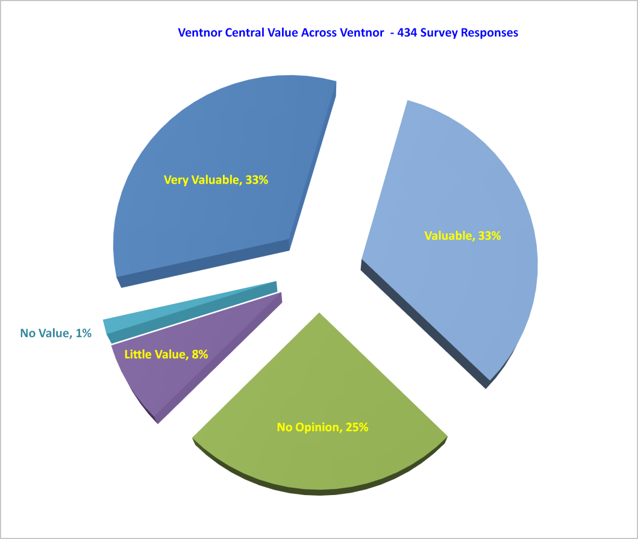
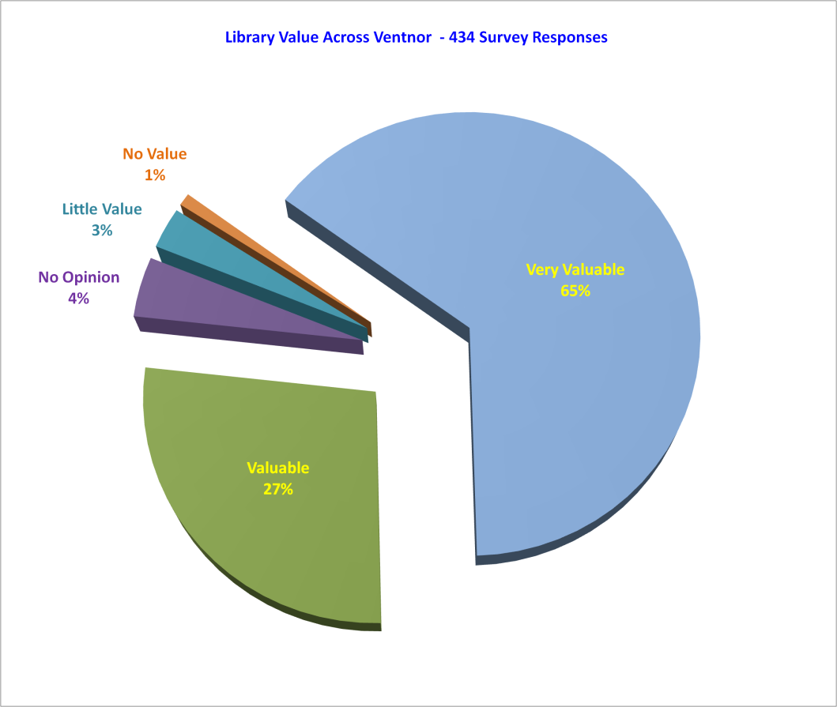
Facilities From 434 Survey Responses – 12.4%
92% Think it is necessary
66% Think it is necessary

Slide 7
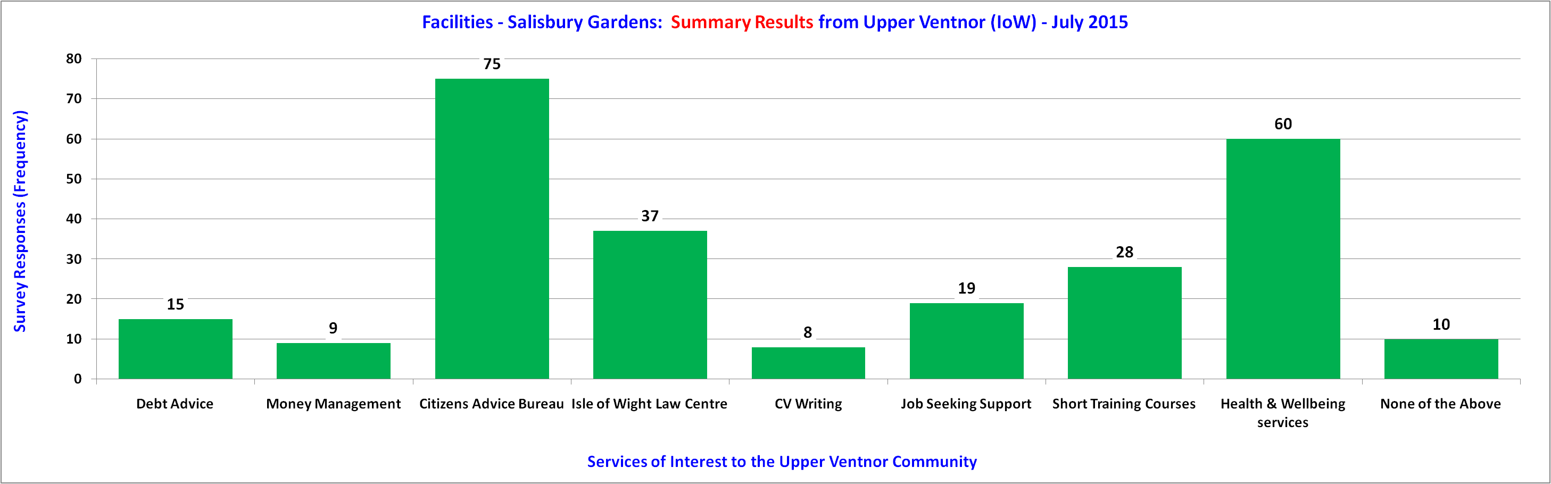
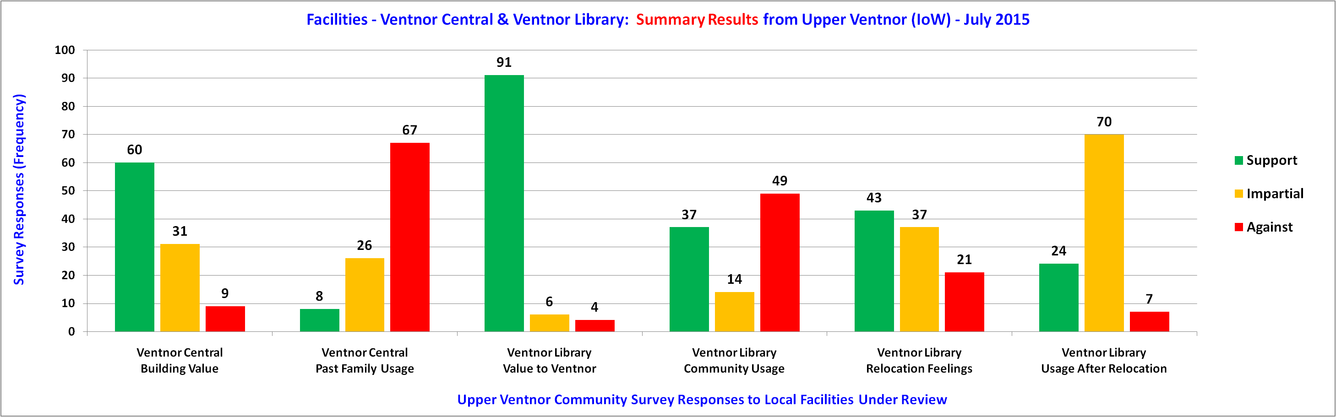
Facilities - Upper Ventnor

Slide 8
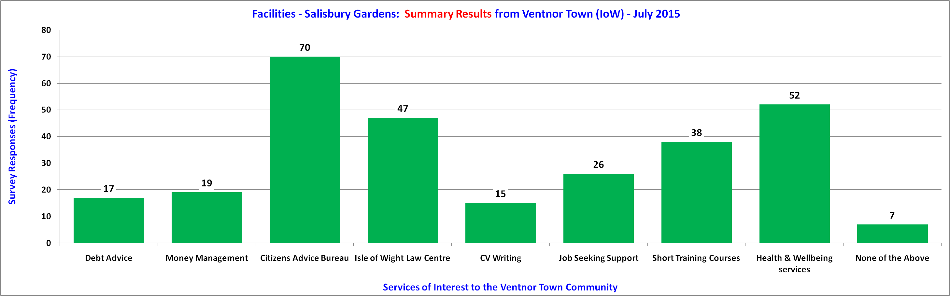
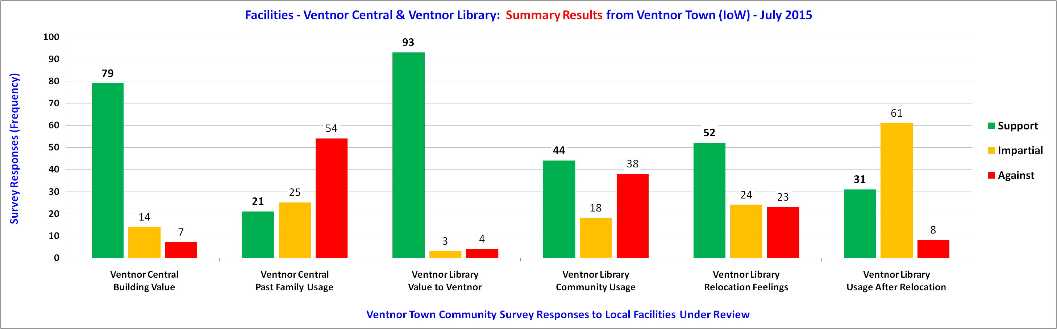
Facilities - Ventnor Town

Slide 9
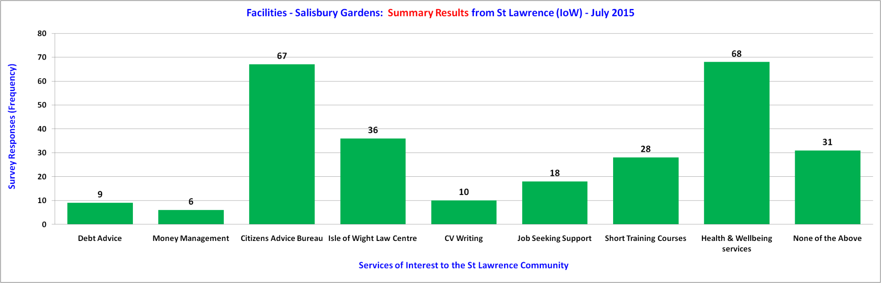
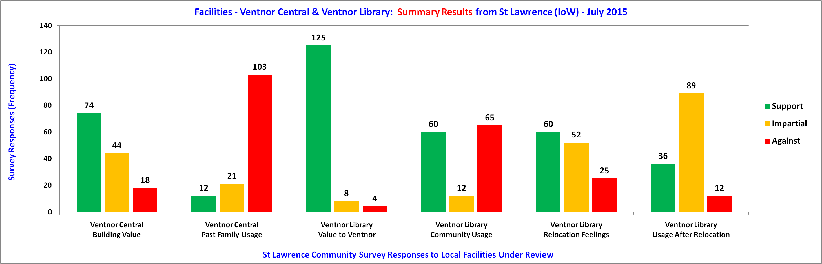
Facilities - St Lawrence

Slide 10
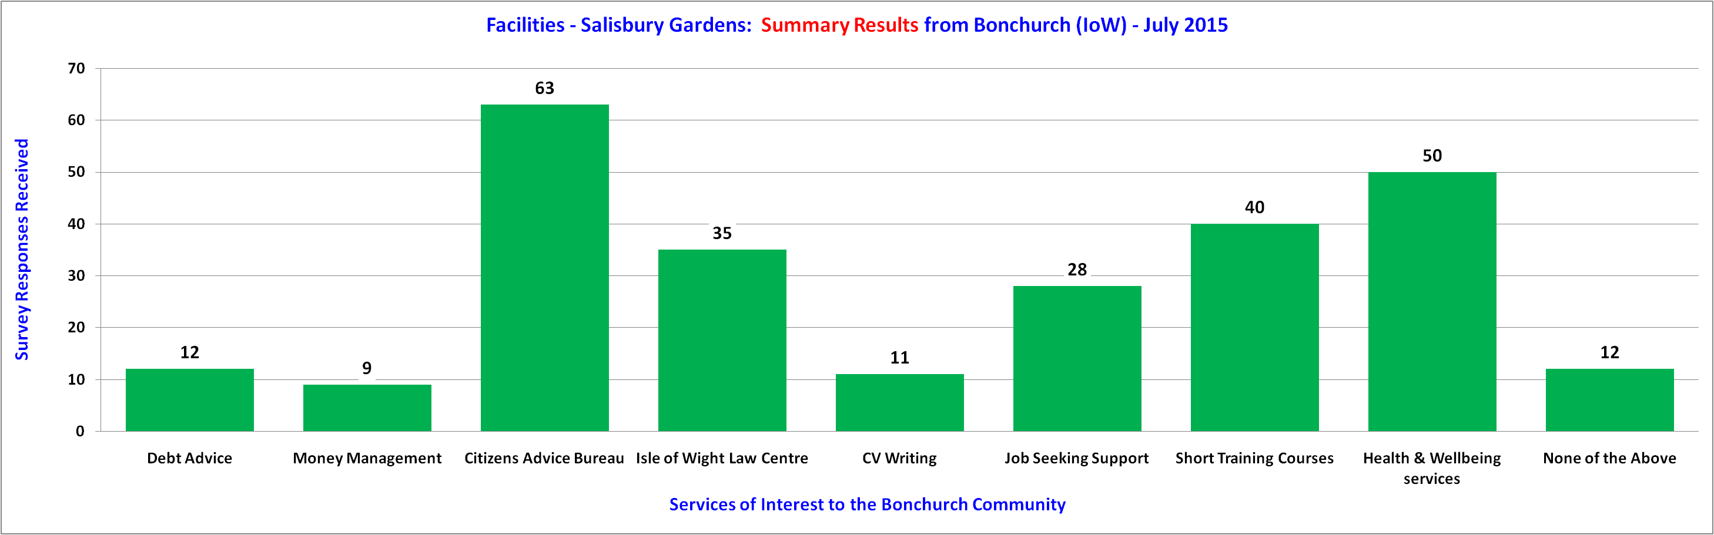
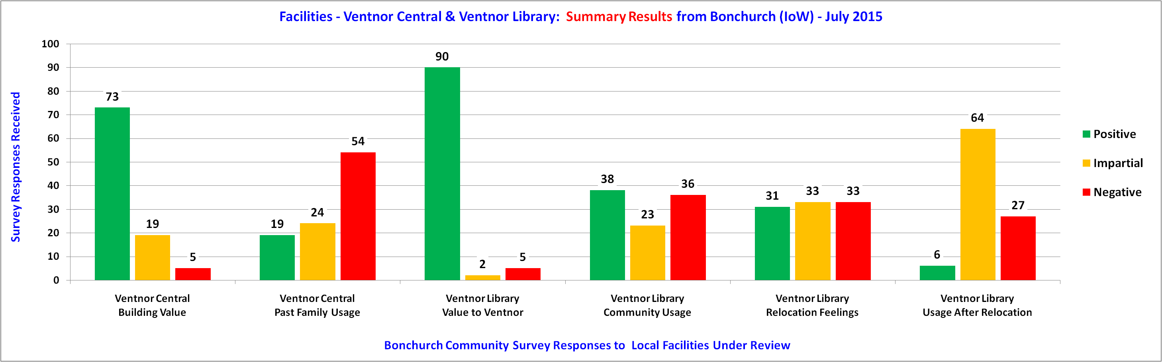
Facilities - Bonchurch

Slide 11
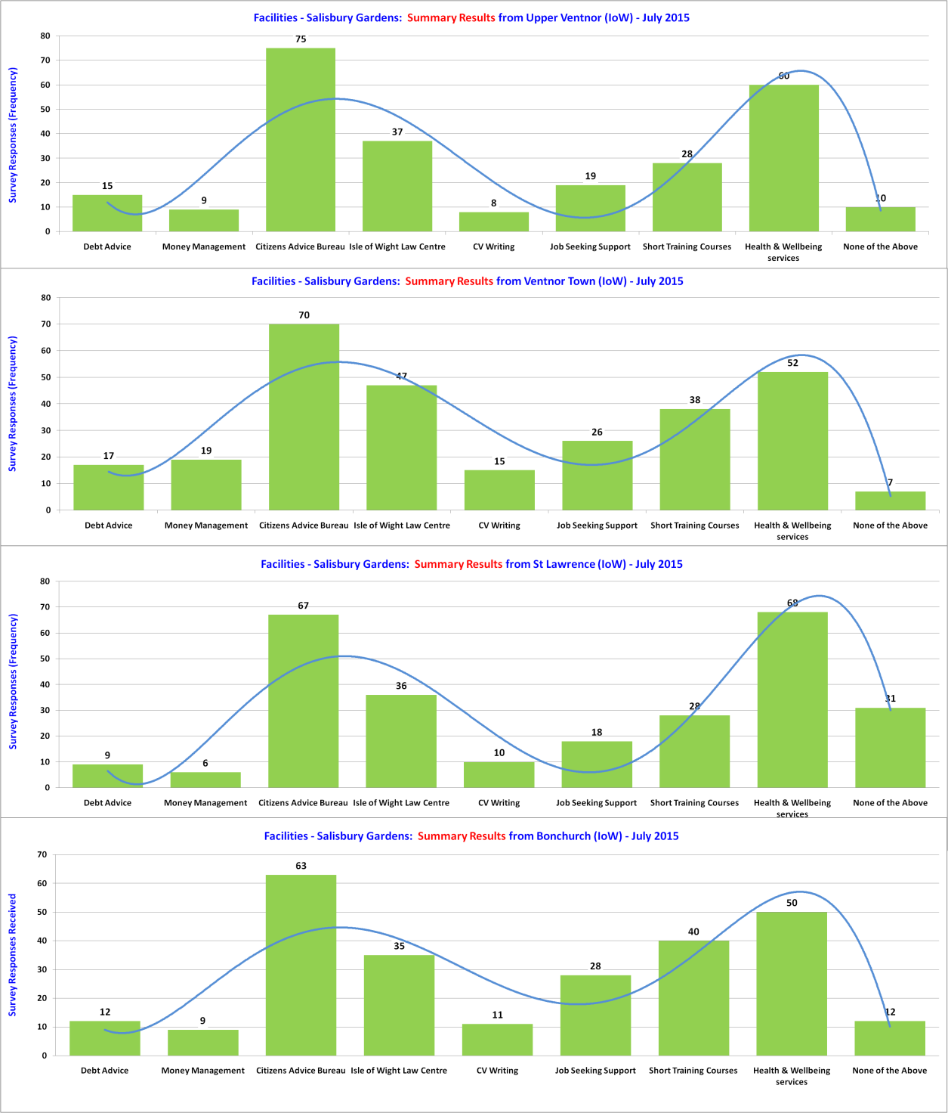
Facilities - Salisbury Gardens Comparisons
Responses
8 to 75
Upper
Ventnor
Responses
7 to 70
Ventnor
Town
Responses
6 to 68
St Lawrence
Responses
9 to 63
Bonchurch

Slide 12
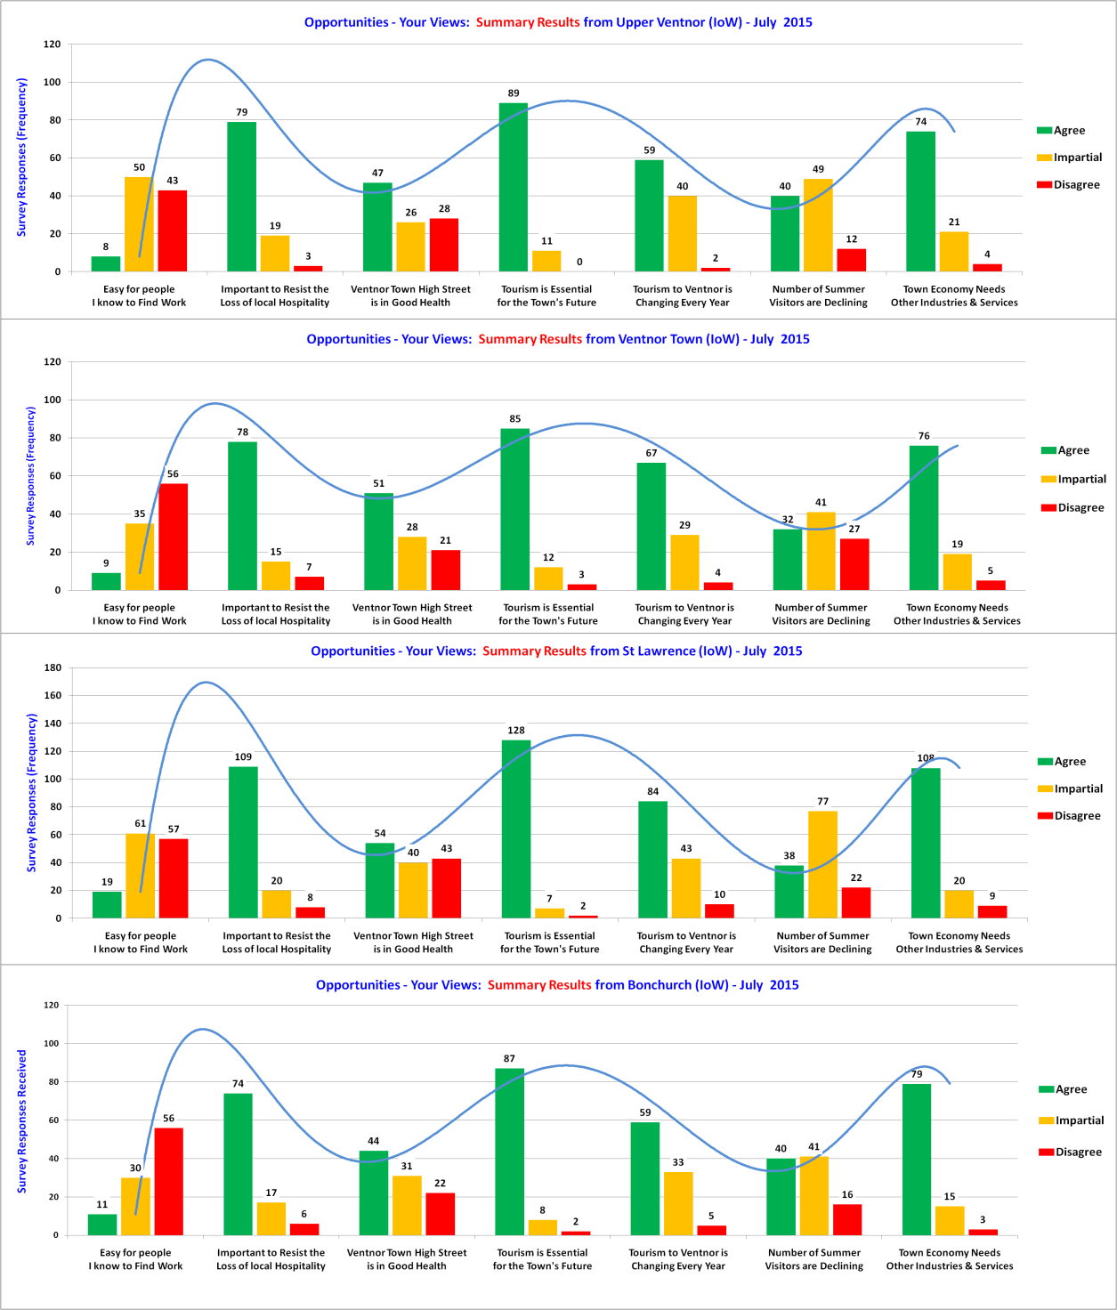
Facilities - Central & Library Comparisons
Responses
8 to 91
Upper
Ventnor
Responses
21 to 93
Ventnor
Town
Responses
12 to 125
St Lawrence
Responses
6 to 90
Bonchurch

Slide 13
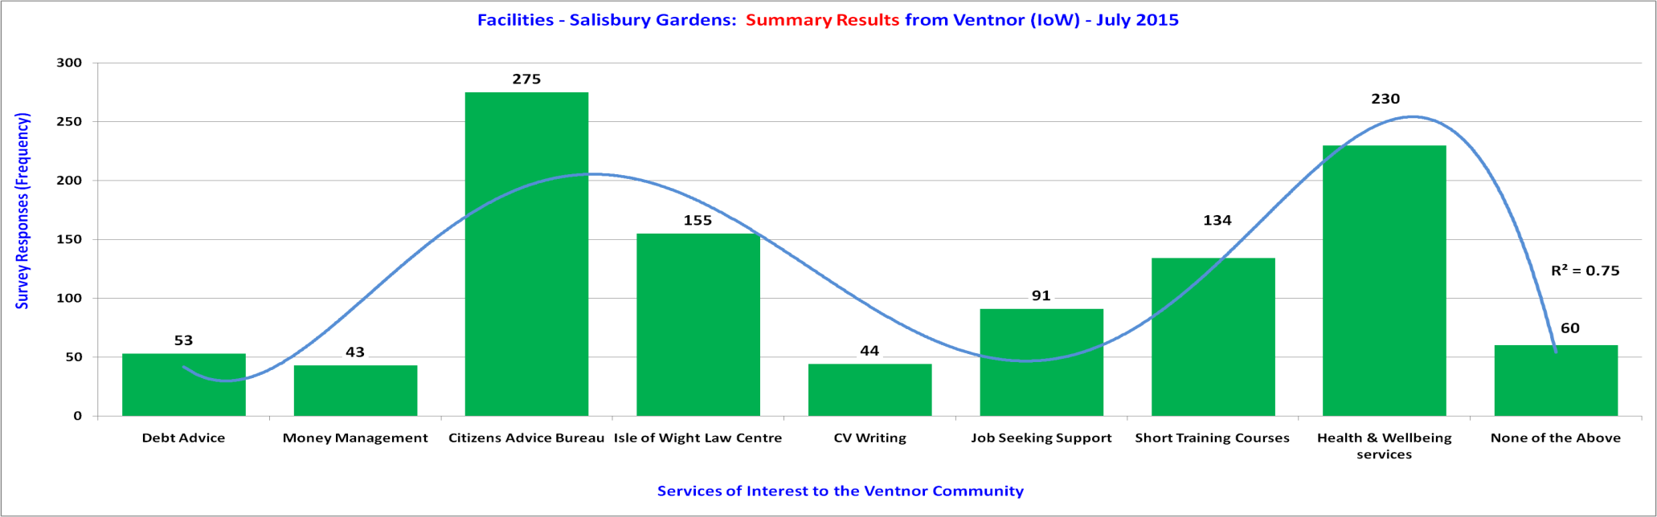
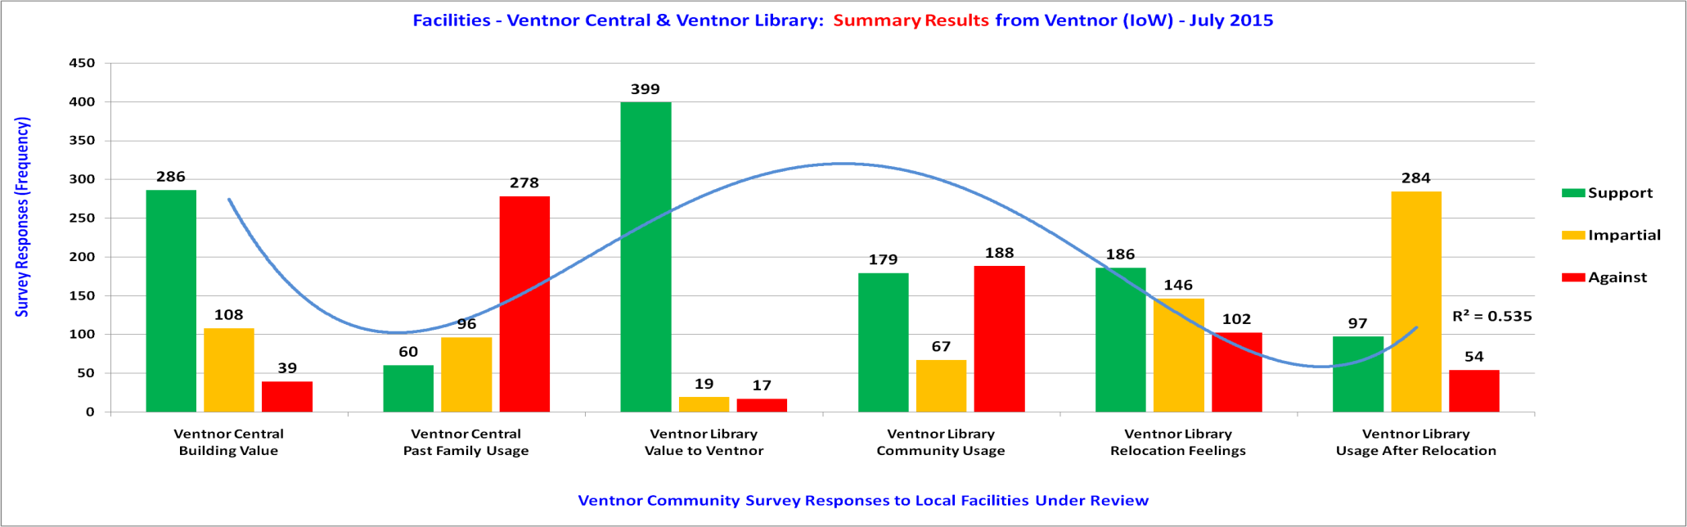
Facilities Across Ventnor - 1 of 2

Slide 14
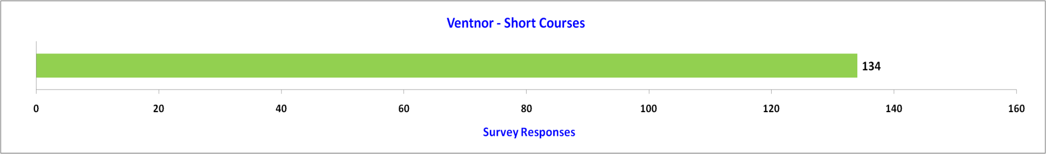
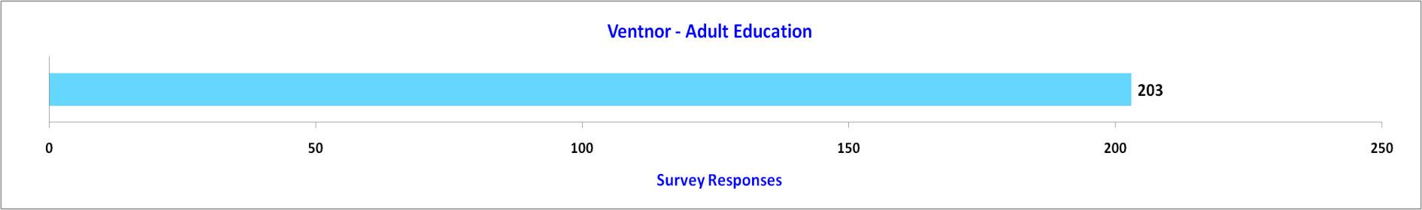
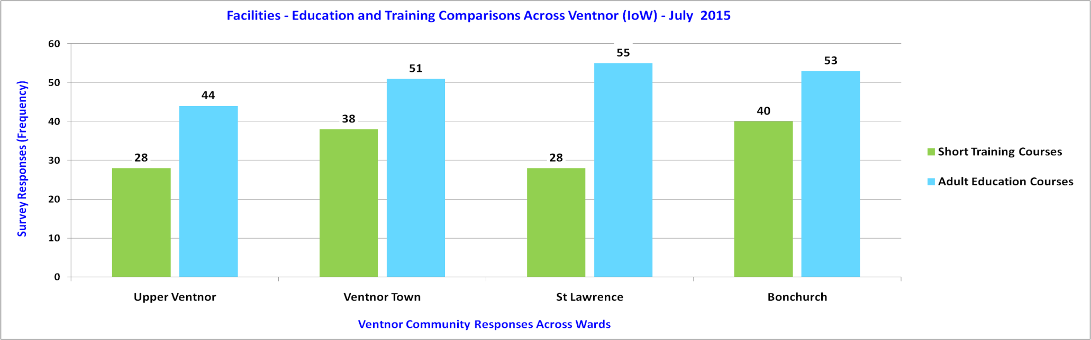
Facilities Across Ventnor - 2 of 2
30.9%
46.8%
U:100, V:100, L:137, B:97

Slide 15
Our Place Ventnor Survey
Section B – Detailed Facilities
Discussion Only.

Slide 16
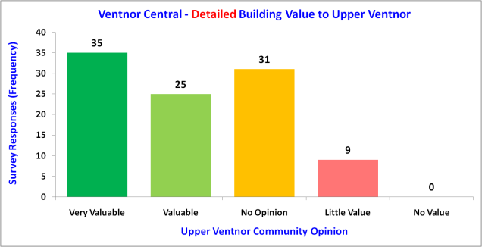
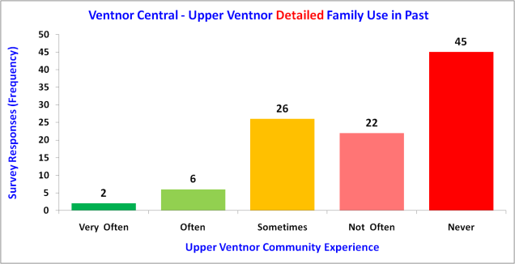
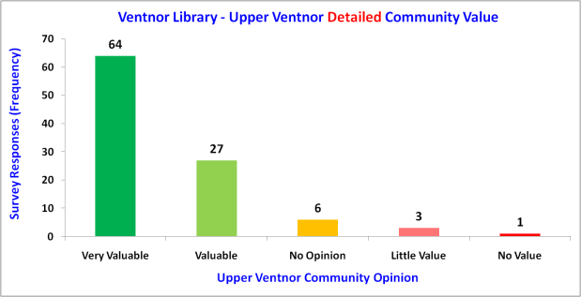
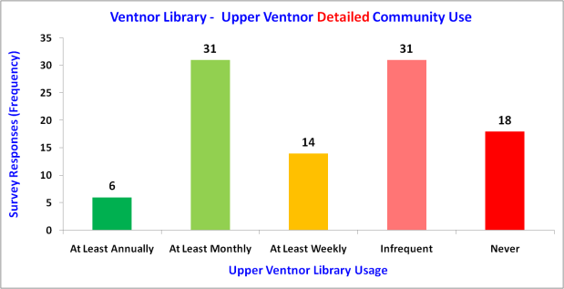
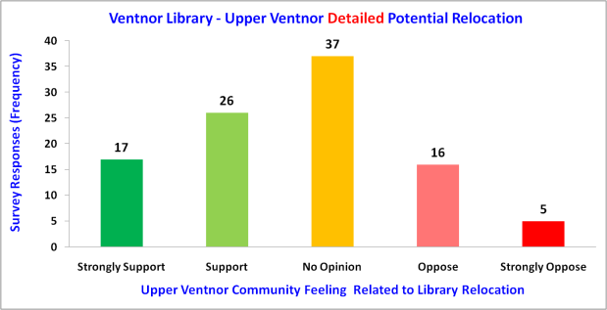
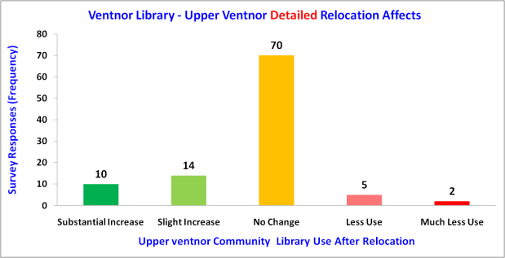
Detailed Facilities – Upper Ventnor

Slide 17
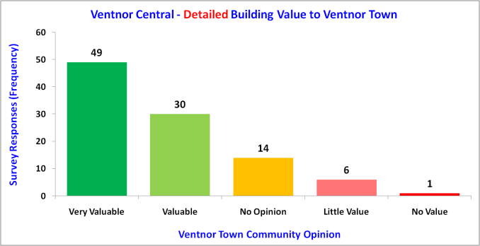
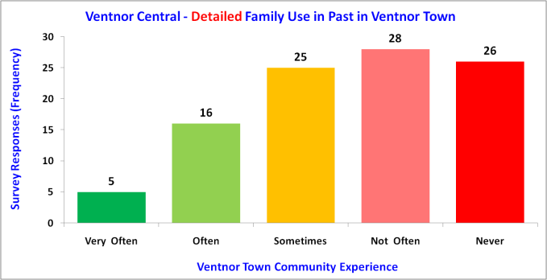
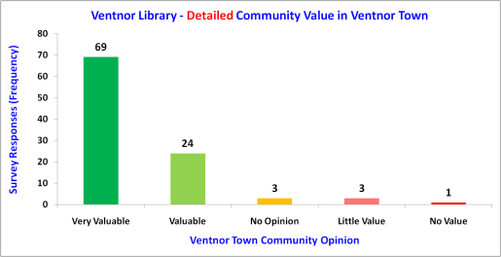
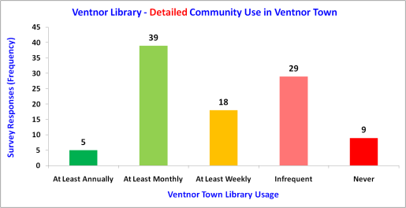
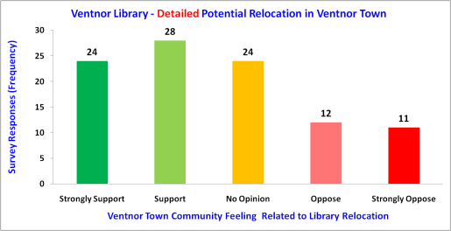
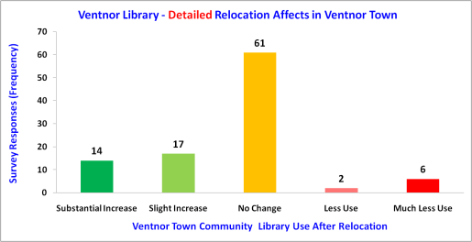
Detailed Facilities – Ventnor Town

Slide 18
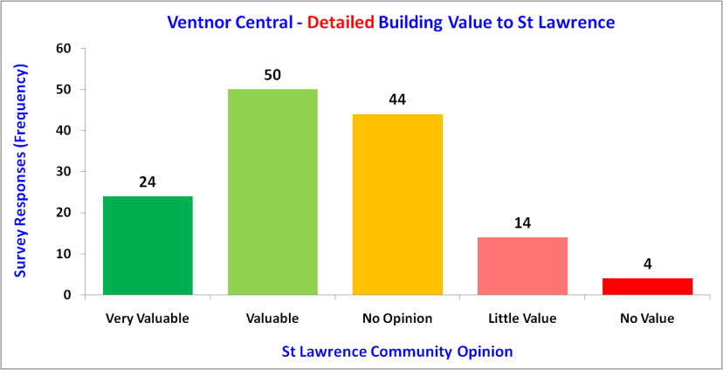
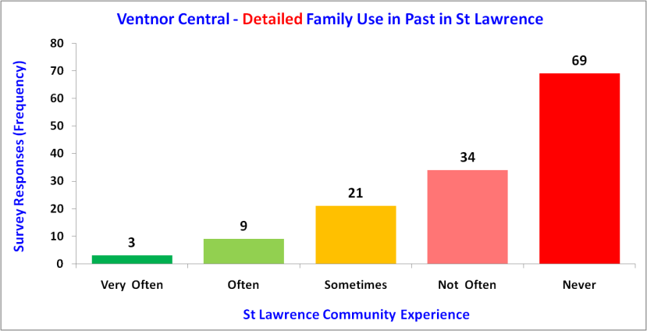
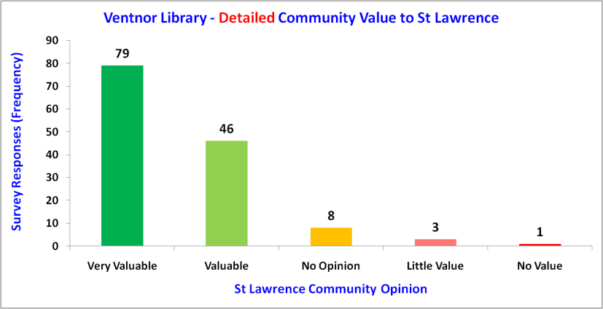
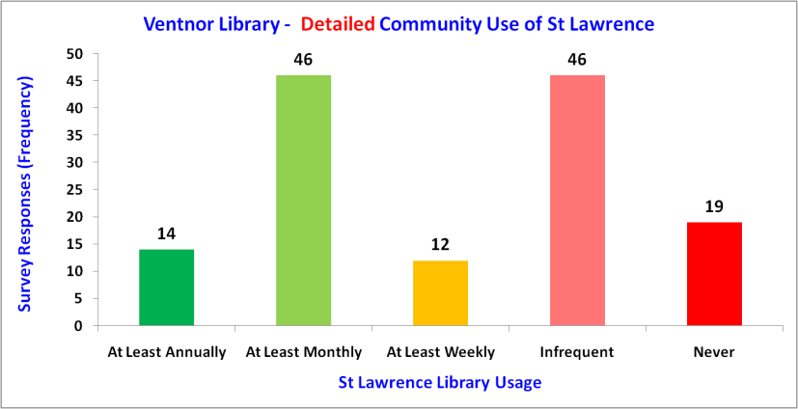
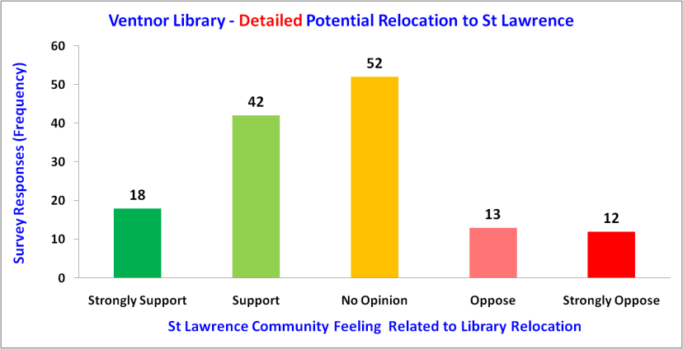
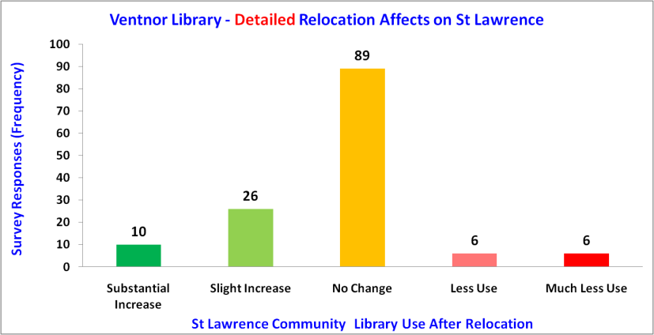
Detailed Facilities - St Lawrence

Slide 19
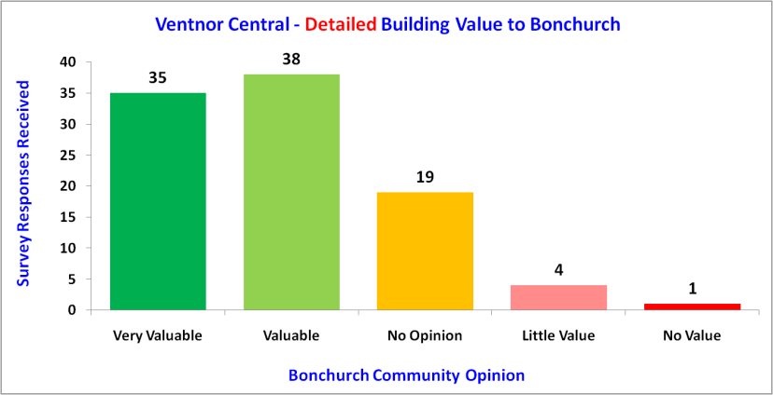
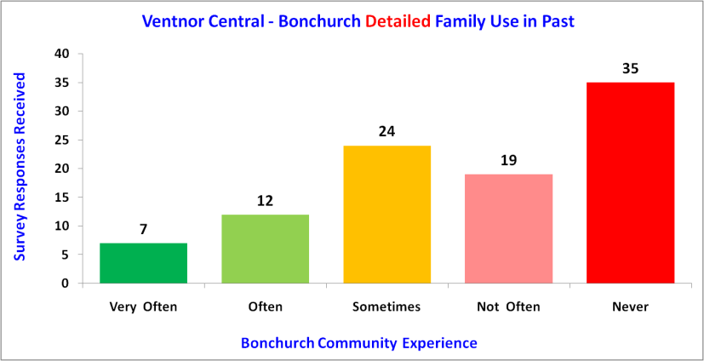
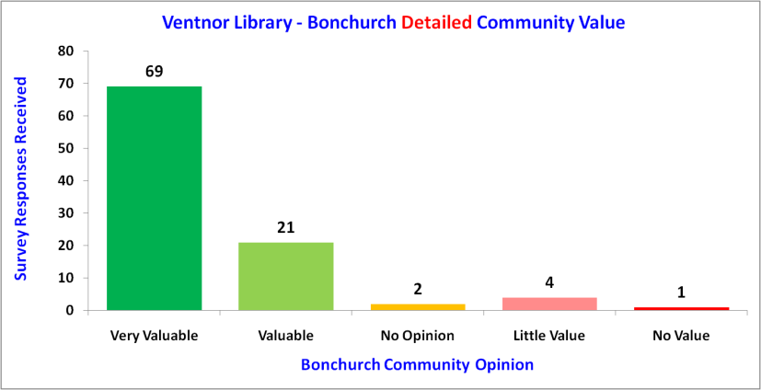
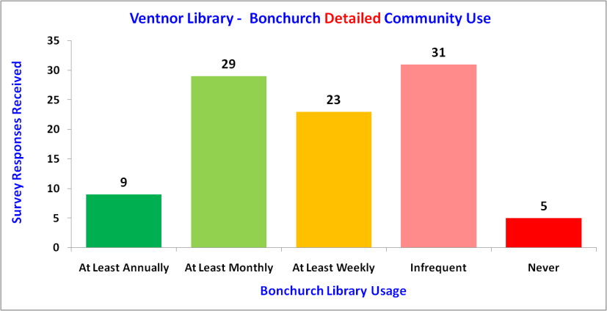
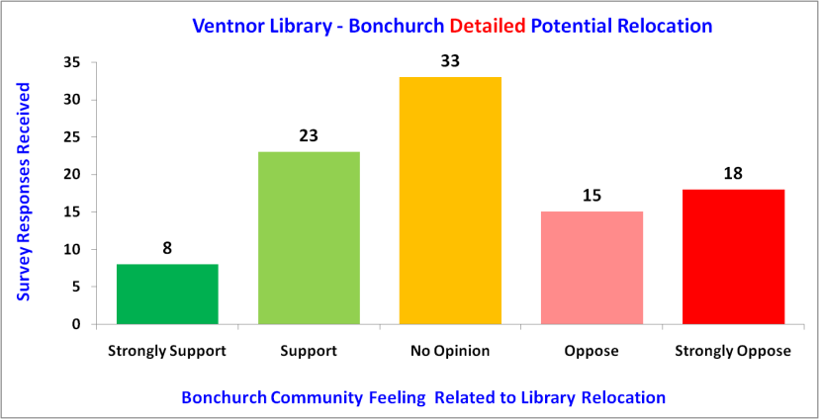
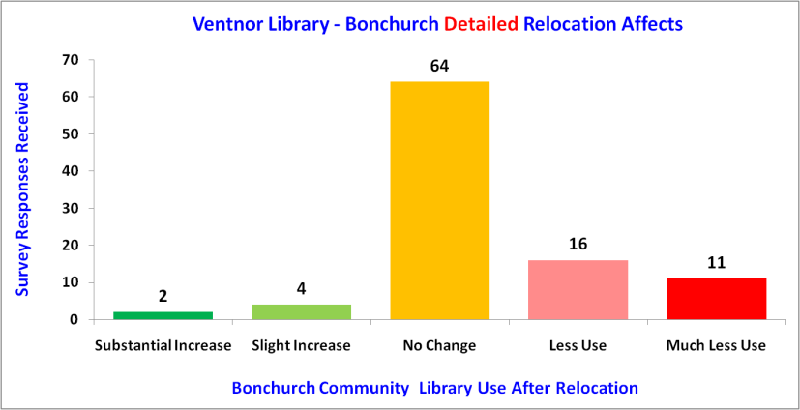
Detailed Facilities - Bonchurch

Slide 20
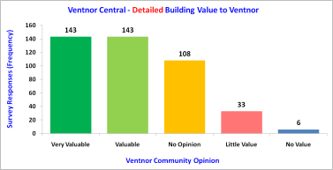
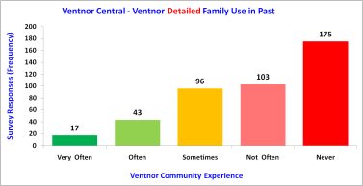
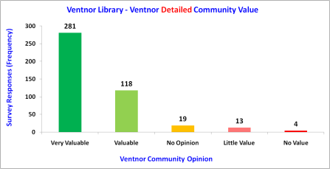
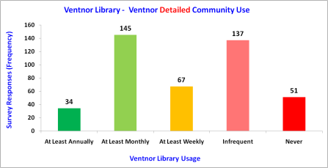
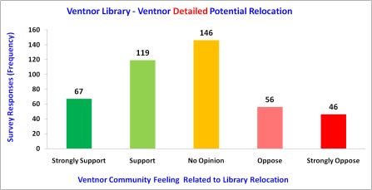
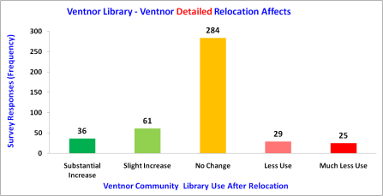
Detailed Facilities - Across Ventnor

Slide 21
Our Place Ventnor Survey
Section B – The End

