Slide 1
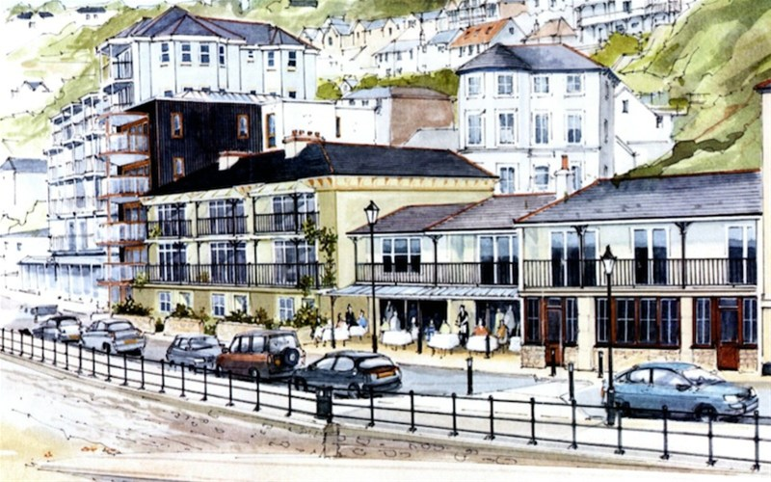

2015 Our Place Survey Results for Ventnor
Survey Section A: Priorities

Slide 2
Presentations Available: Detailed Results
◊ Priorities
◊ Facilities
◊ Opportunities
◊ Engagement
◊ Projects
◊ Investigation
____________________
◊ Comments
◊ Postcodes
2015
Our Place
Survey Results
For
Ventnor

Slide 3
Our Place Ventnor Survey
Basic Demographics

Slide 4
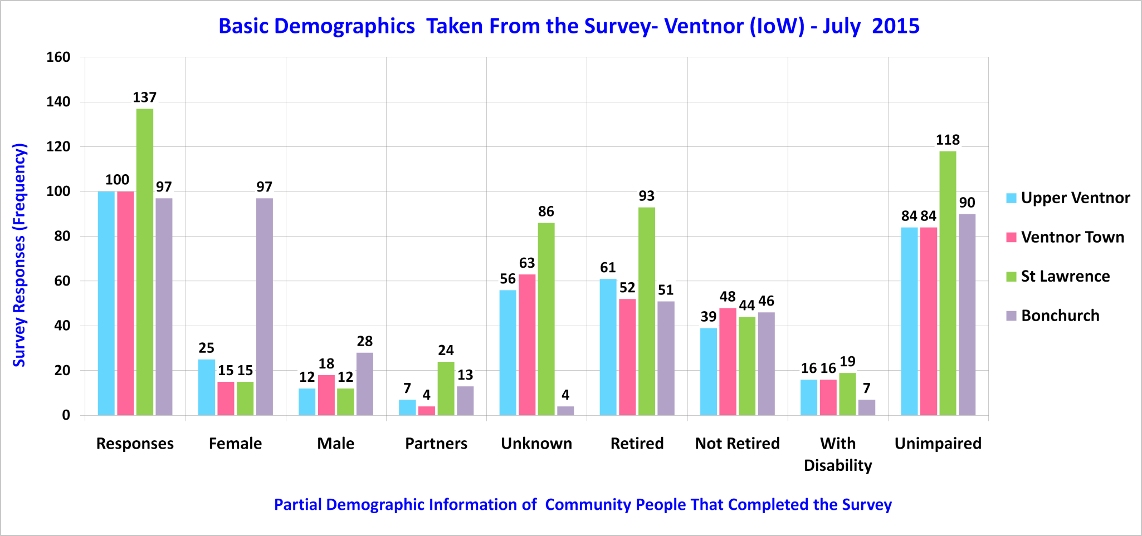
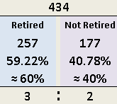
Sampled Ventnor Community

Slide 5
Our Place Ventnor Survey
Section A – Summary Priorities
Please note: Trend lines shown on some charts are for visual enhancement only.

Slide 6
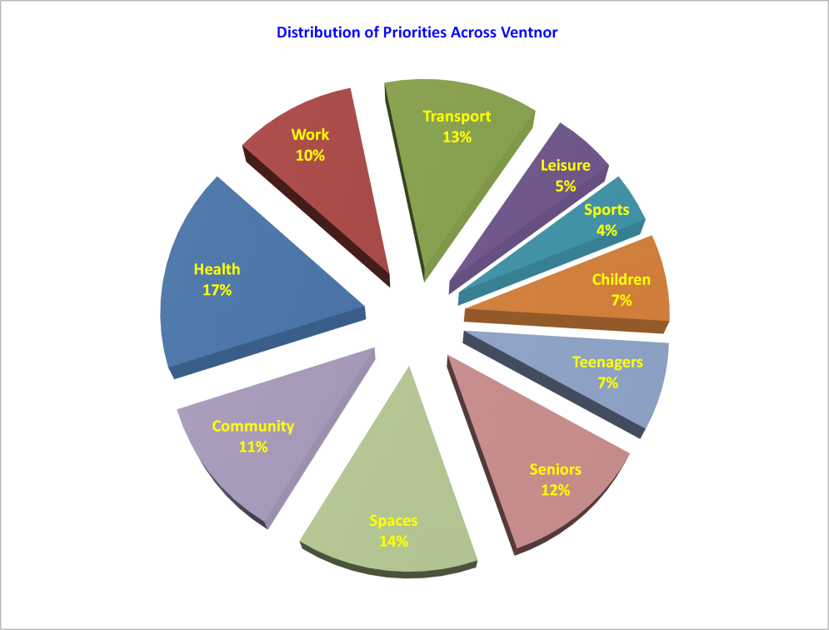
Priorities From 434 Survey Responses – 12.4%

Slide 7
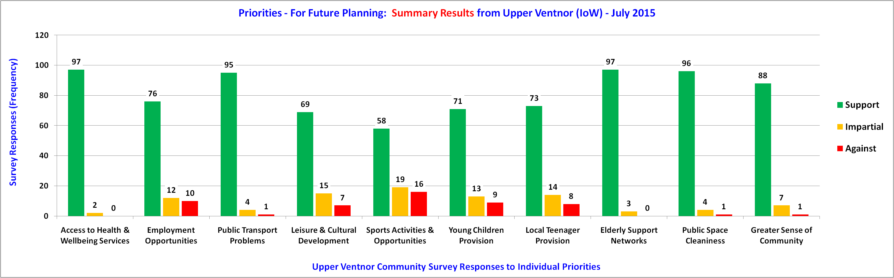
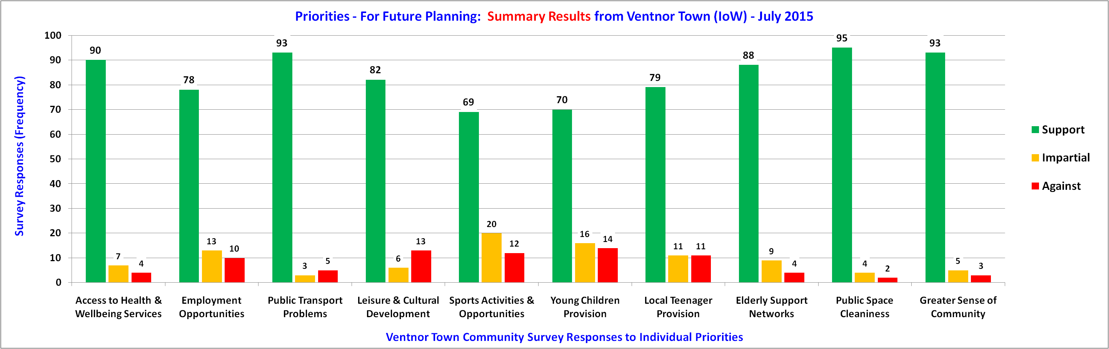
Priorities - Upper Ventnor & Ventnor Town

Slide 8
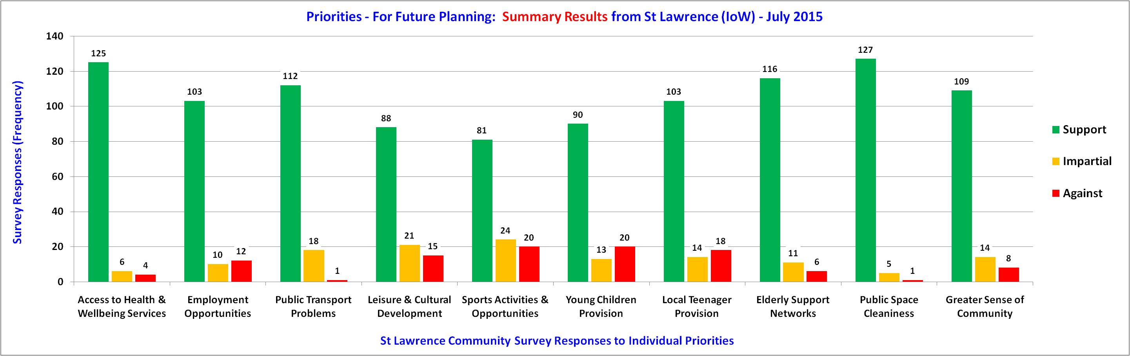
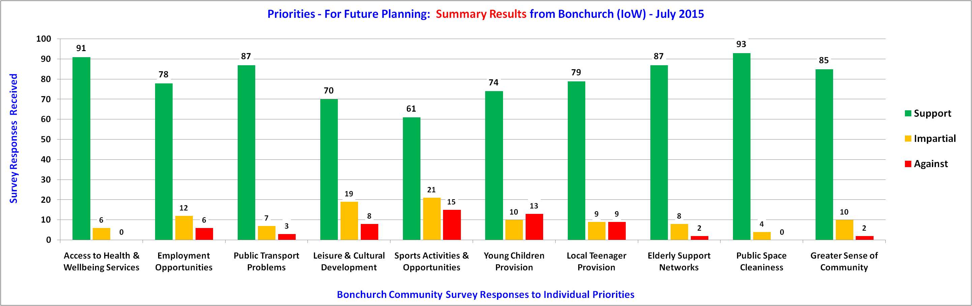
Priorities - St Lawrence & Bonchurch

Slide 9
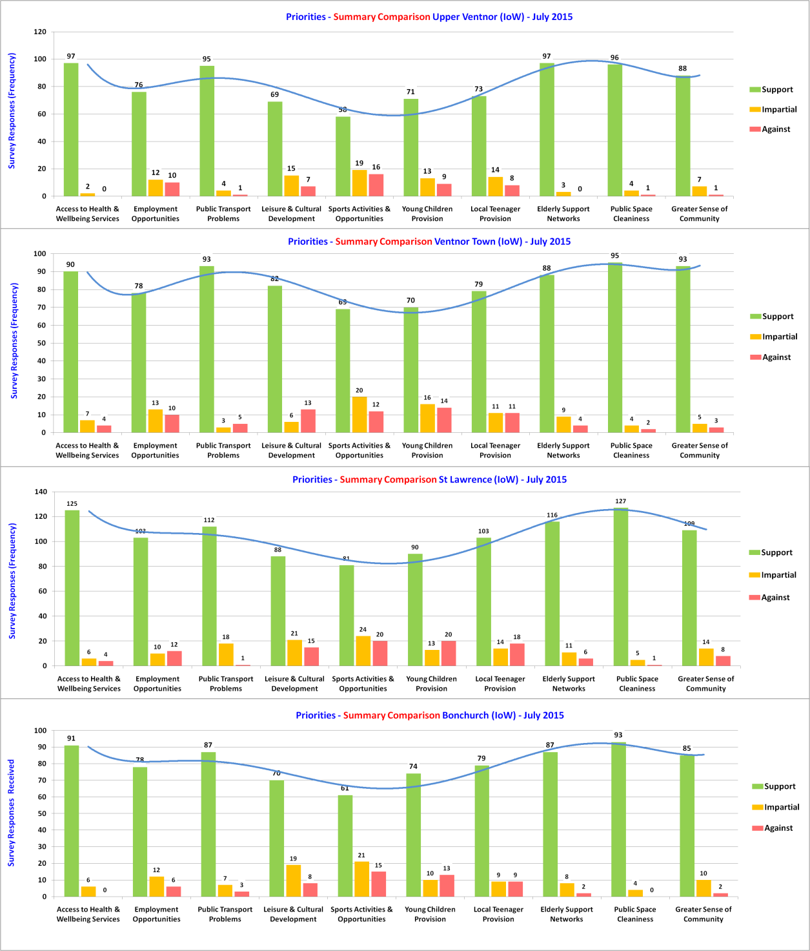
Priorities - Comparisons
Responses
58 to 97
Upper
Ventnor
Responses
69 to 95
Ventnor
Town
Responses
81 to 127
St Lawrence
Responses
61 to 93
Bonchurch

Slide 10
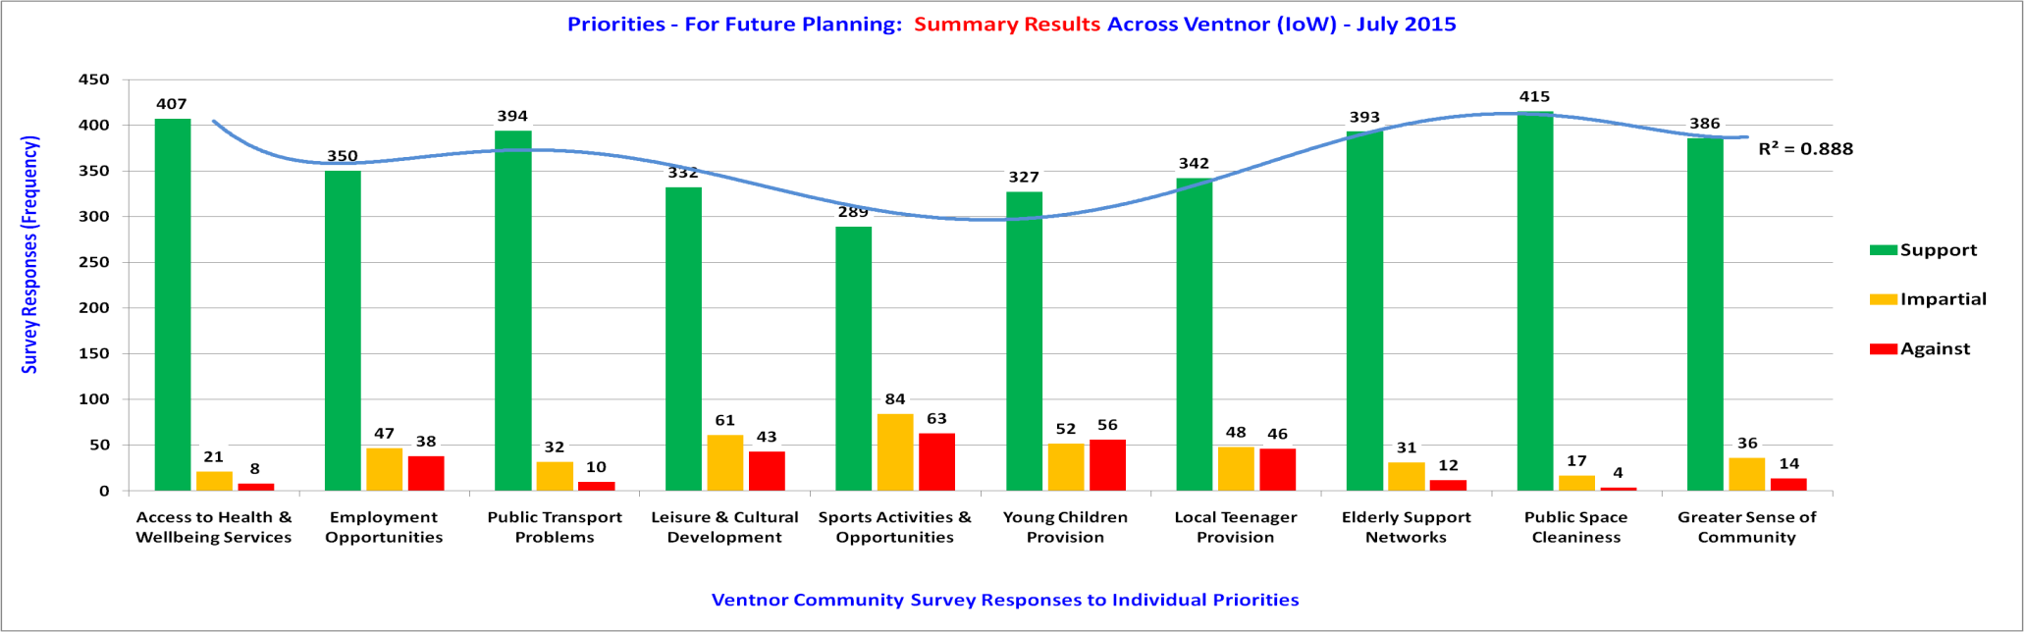
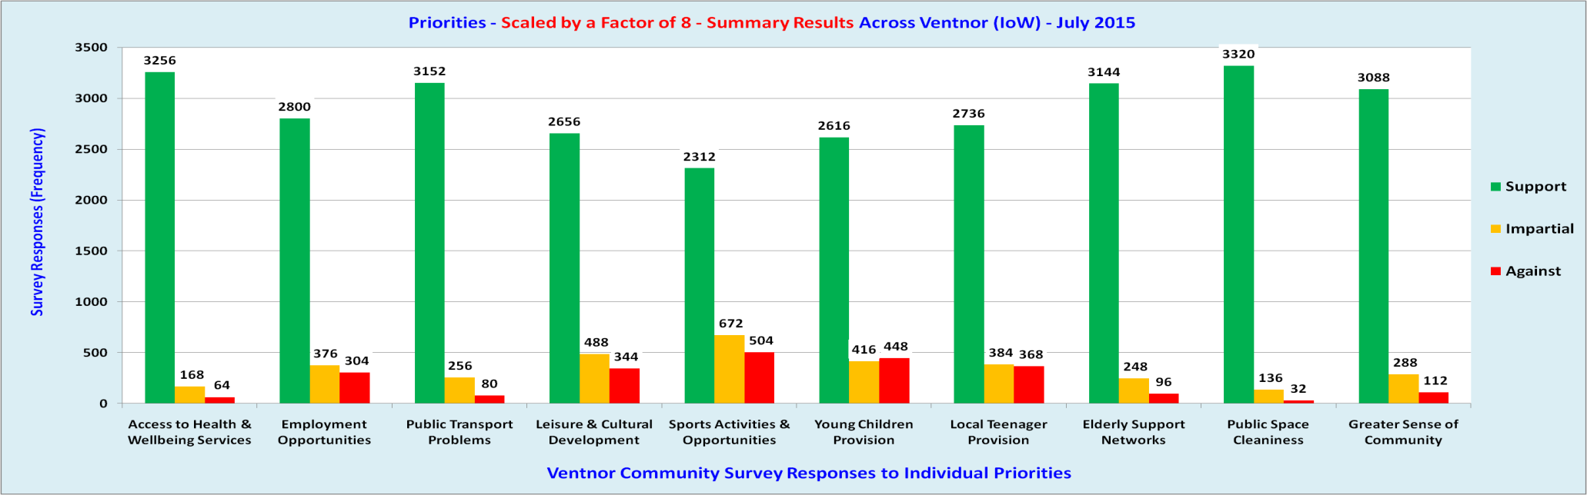
Priorities Across Ventnor

Slide 11
Our Place Ventnor Survey
Section A – Detailed Priorities
Discussion Only.

Slide 12
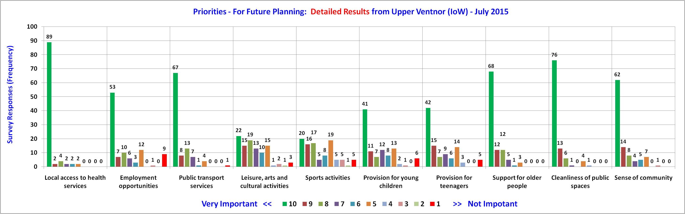
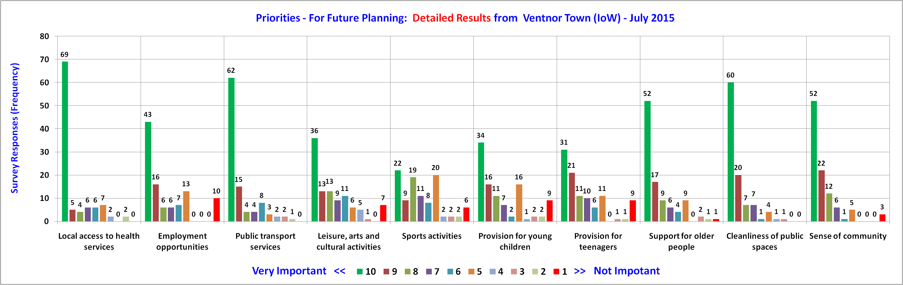
Detailed Priorities - Upper Ventnor & Ventnor Town

Slide 13
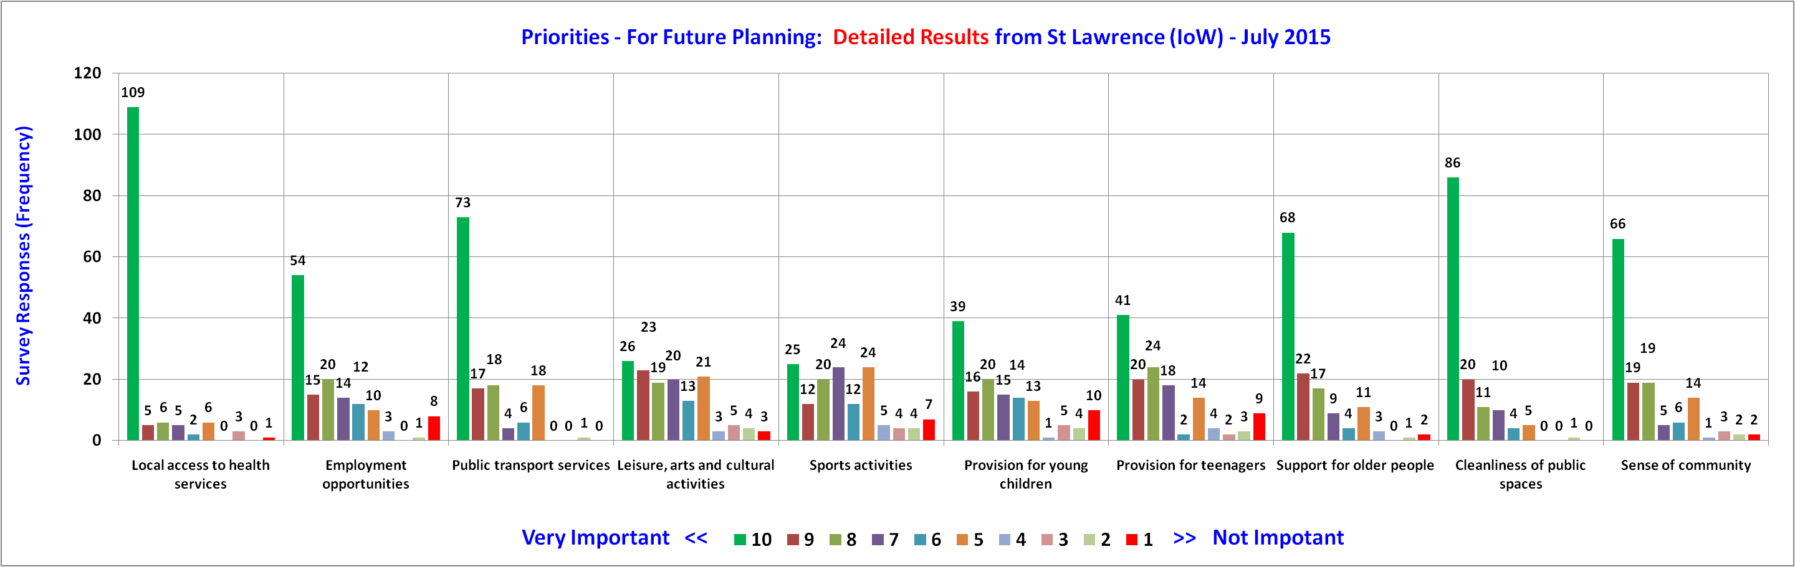
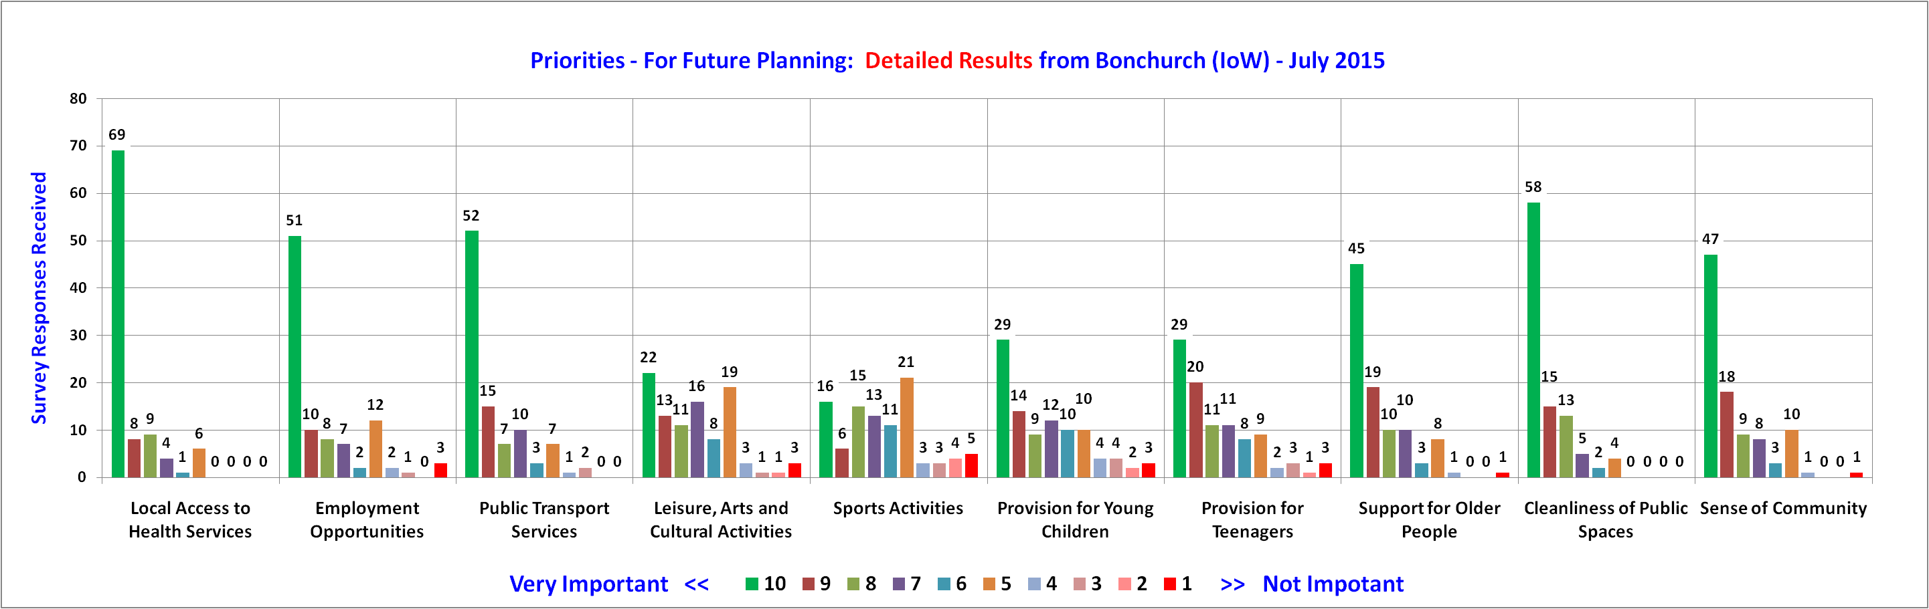
Detailed Priorities - St Lawrence & Bonchurch

Slide 14
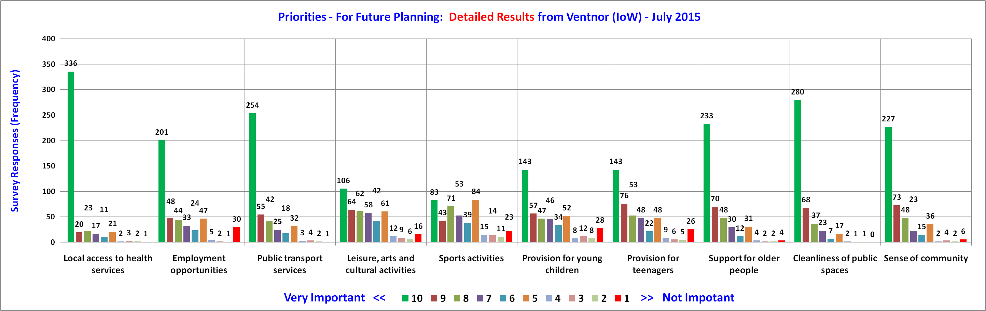
Detailed Priorities - Across Ventnor

Slide 15
Our Place Ventnor Survey
Section A – The End

