Slide 1
Continuation from PowerPoint presentation A-BasicVentnorSurveyResultsJuly2015.pptx

Slide 2
Our Place Ventnor Survey
Survey Comments

Slide 3
Our Place Ventnor Survey
Library Comments

Slide 4
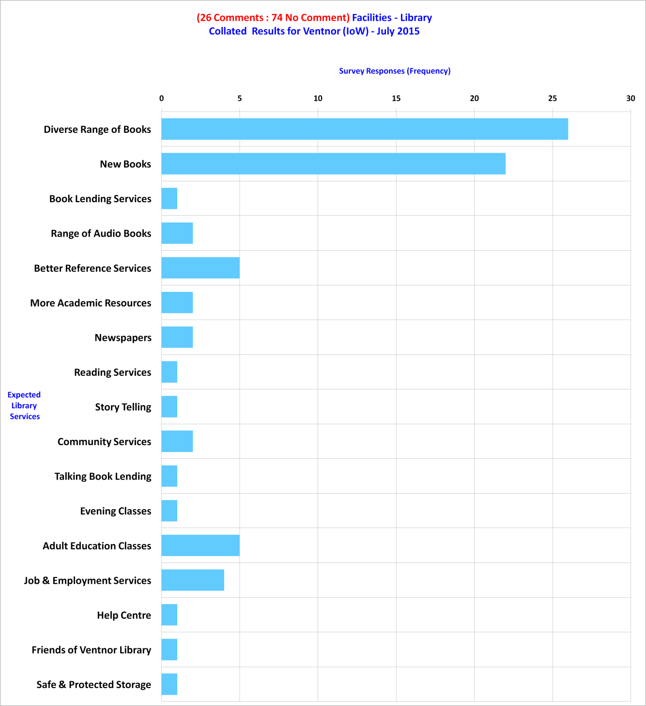
Part 1 of 5: Facilities - Library Comments

Slide 5
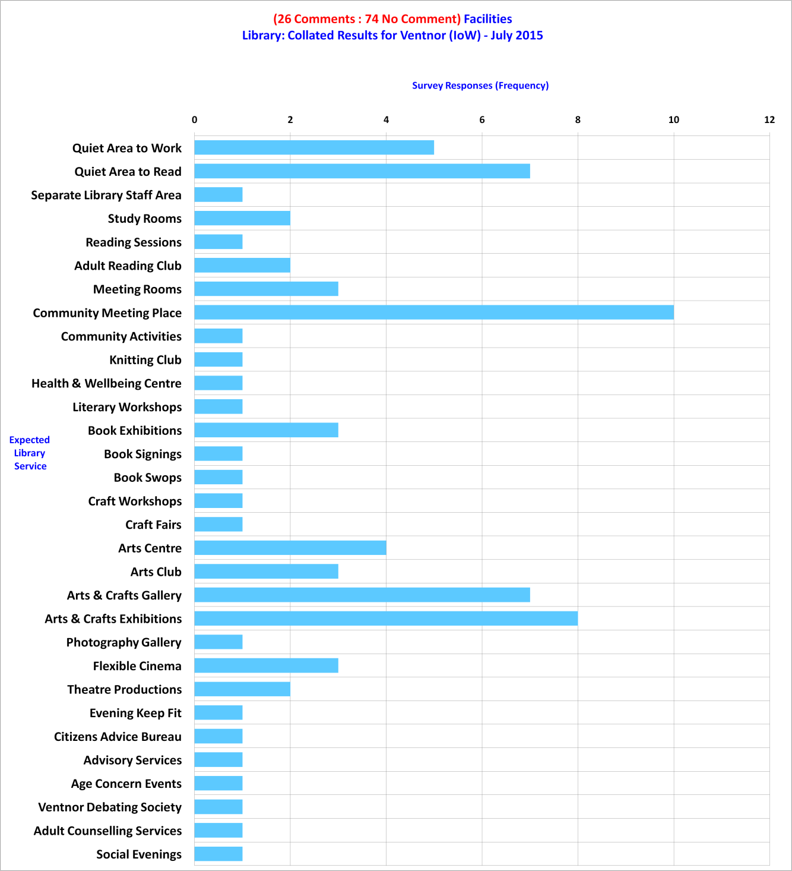
Part 2 of 5: Facilities - Library Comments

Slide 6
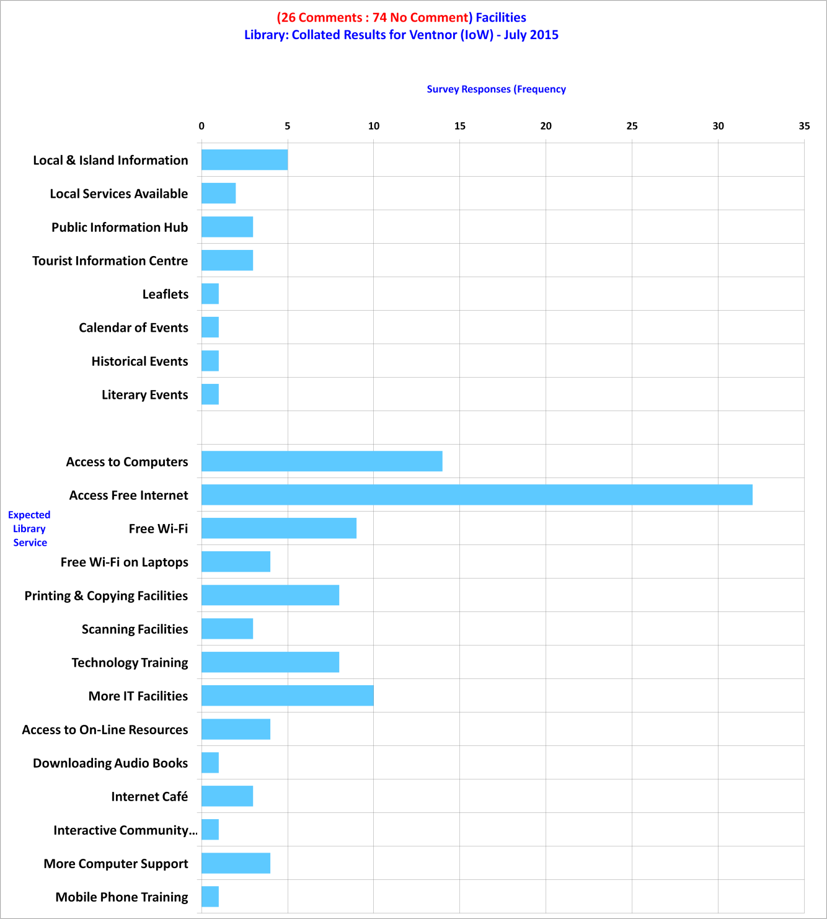
Part 3 of 5: Facilities - Library Comments

Slide 7
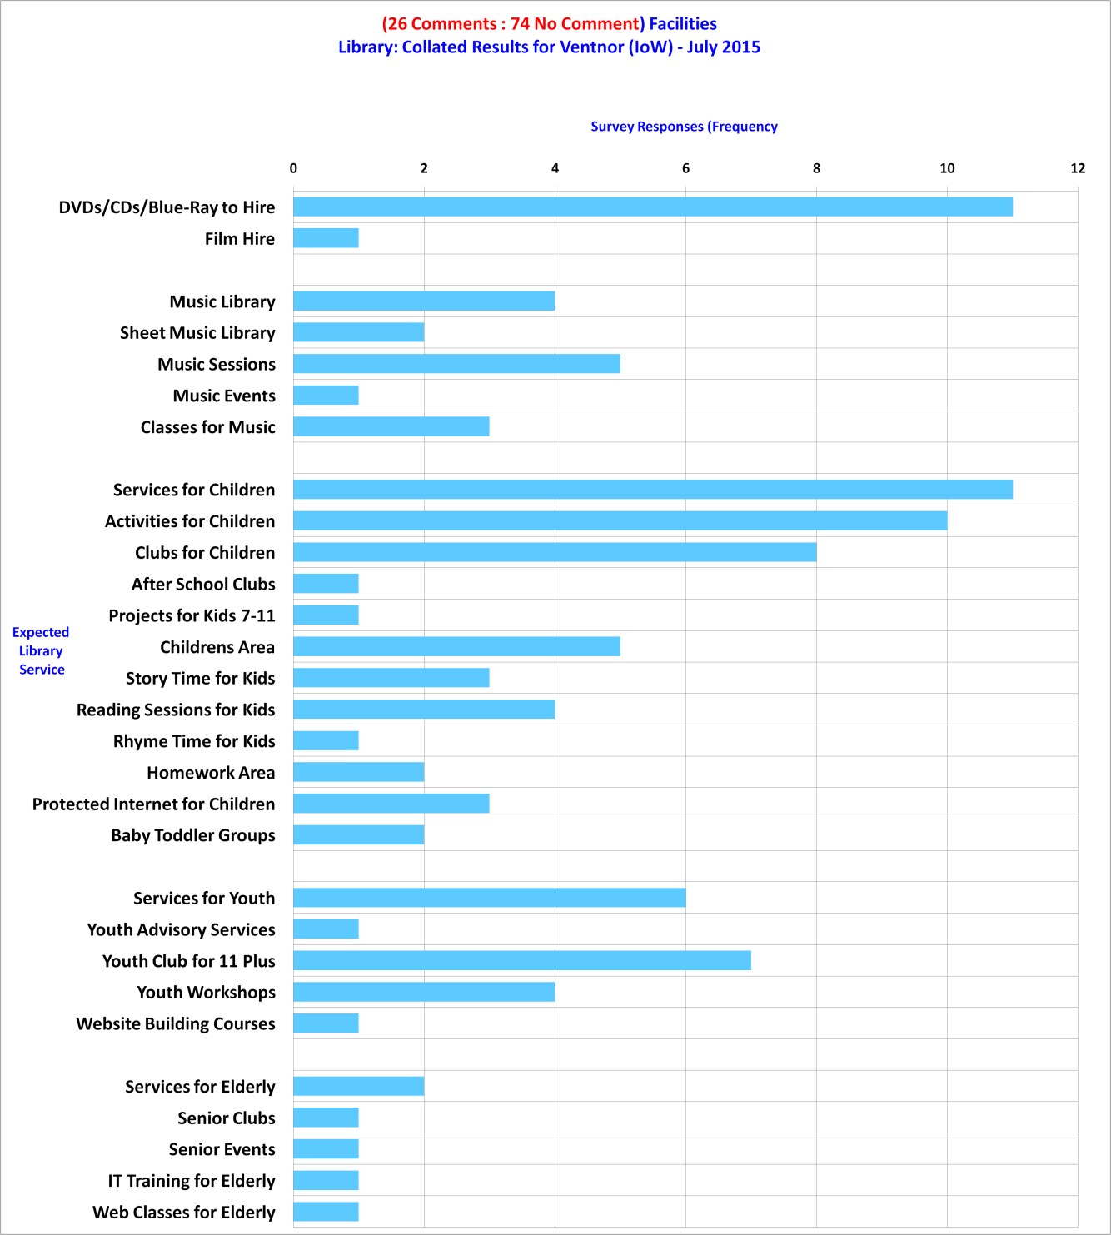
Part 4 of 5: Facilities - Library Comments

Slide 8
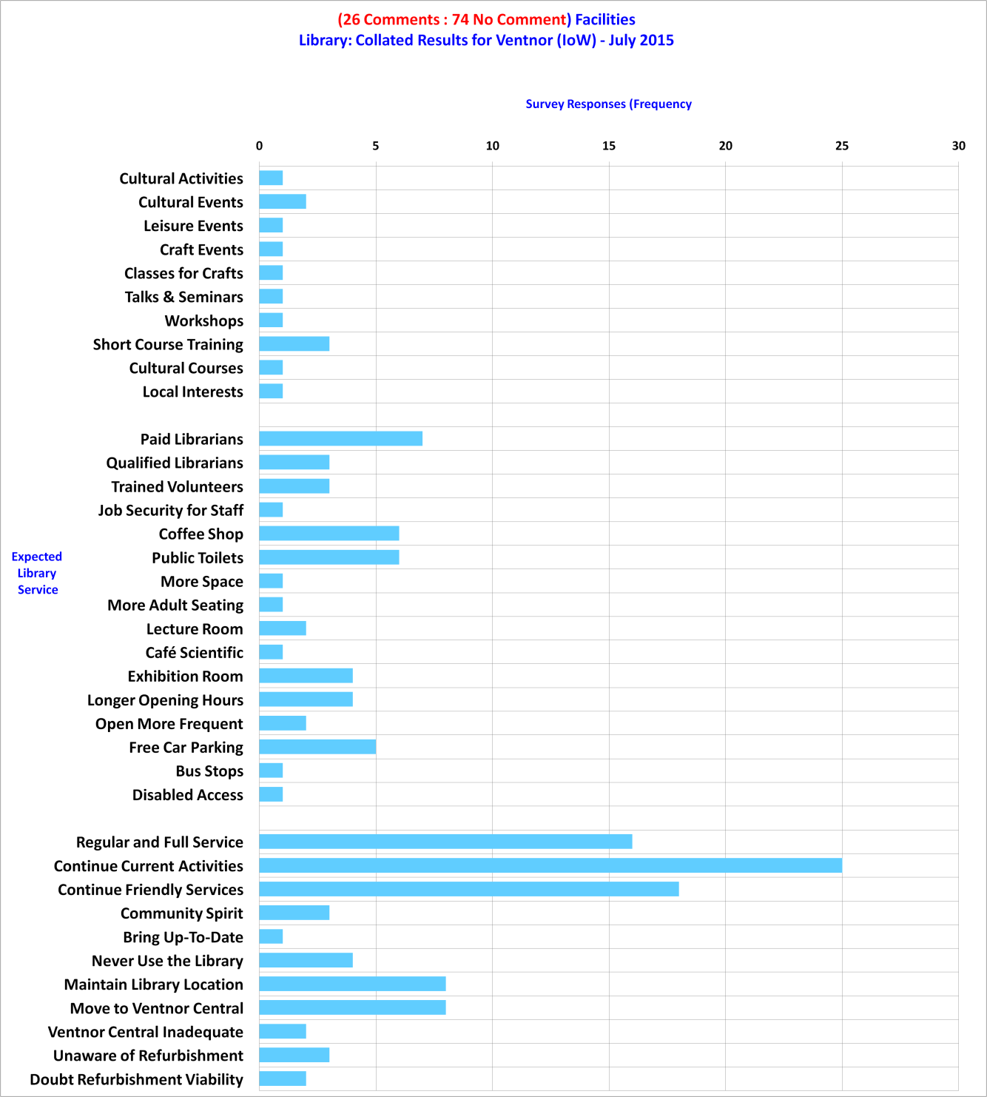
Part 5 of 5: Facilities - Library Comments

Slide 9
Our Place Ventnor Survey
Project Comments

Slide 10
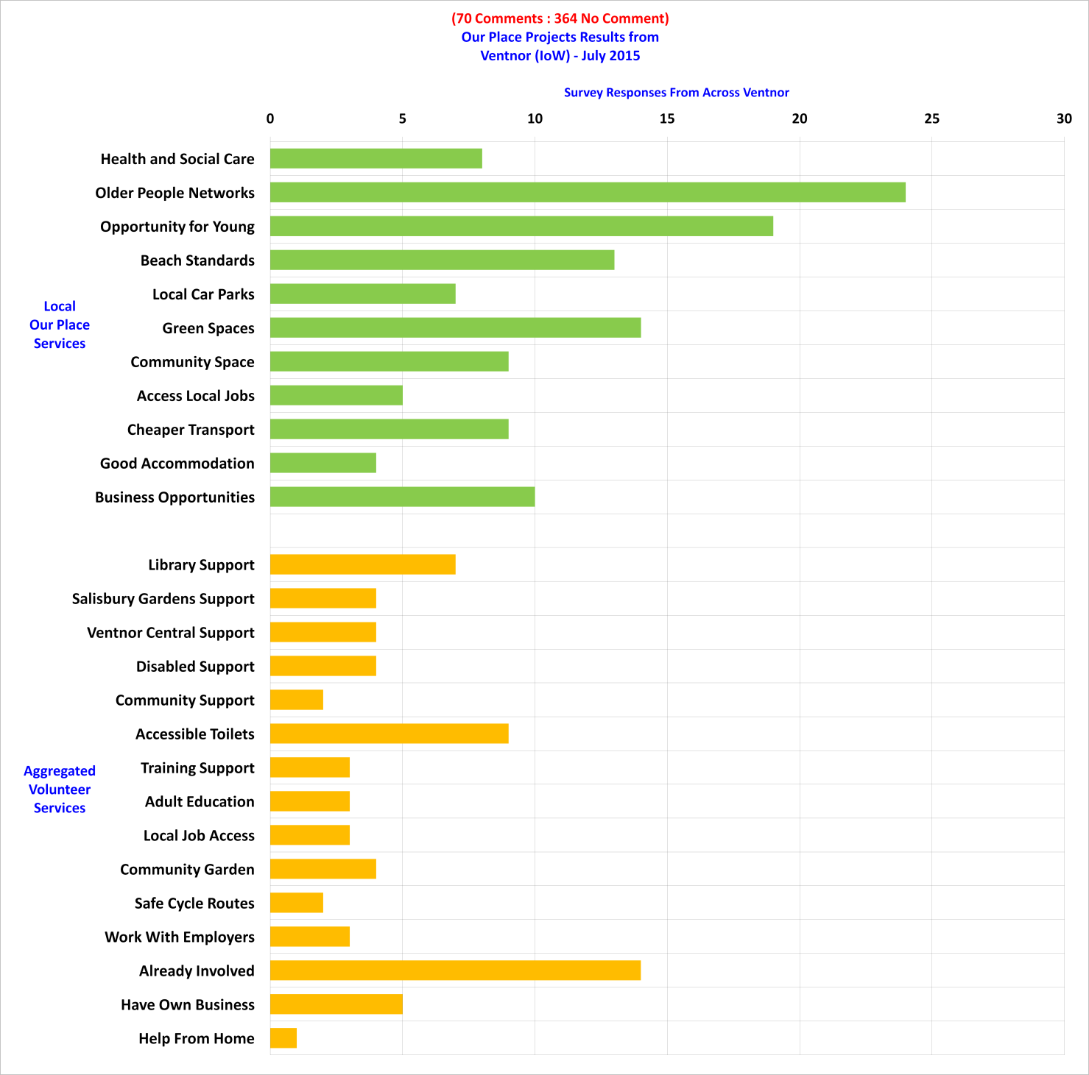
Part 1 of 1: Our Place - Project Comments

Slide 11
Our Place Ventnor Survey
Additional Comments

Slide 12
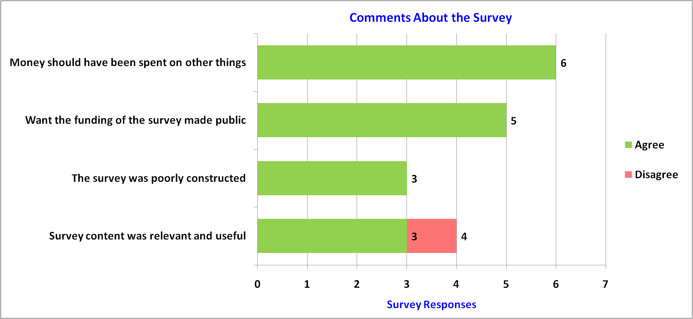
Part 1 of 21: Survey Comments

Slide 13
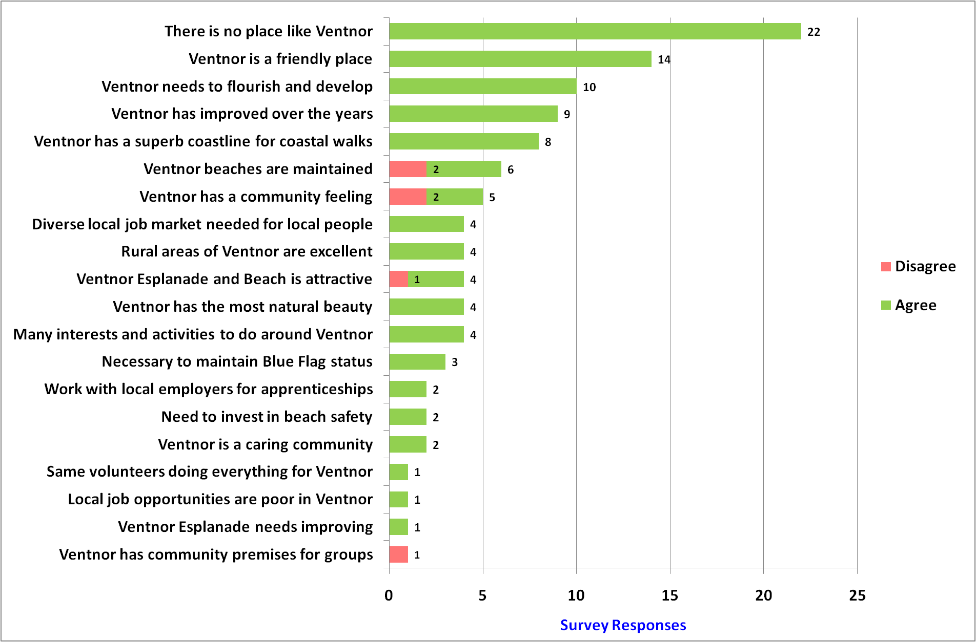
Part 2 of 21: Ventnor Comments

Slide 14
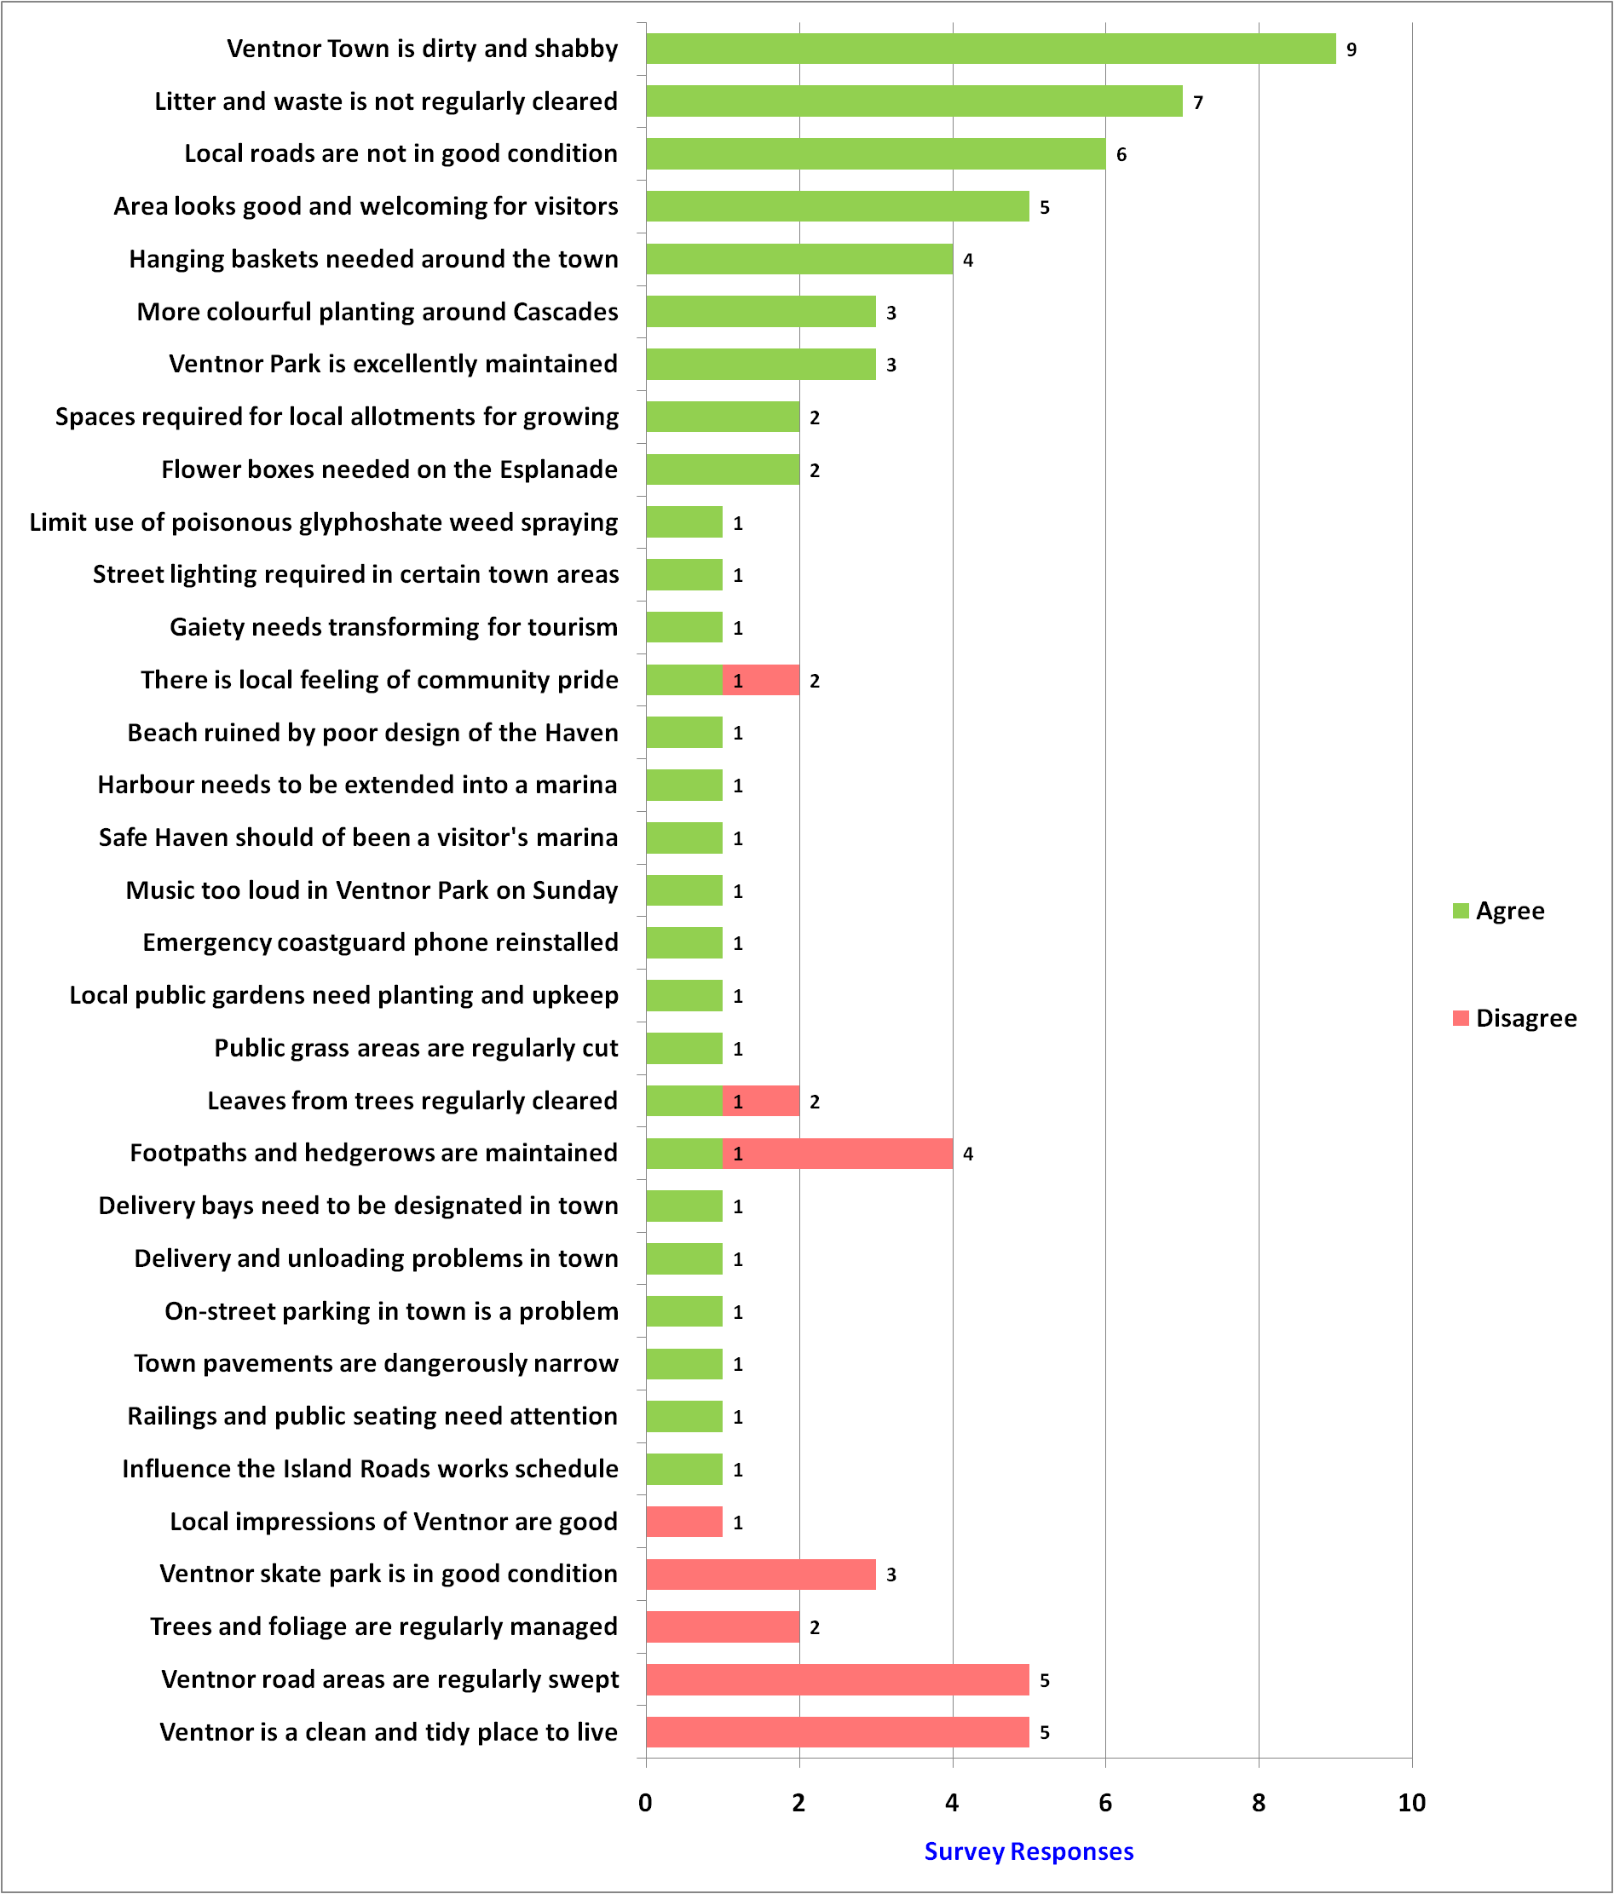
Part 3 of 21: Environment Comments

Slide 15
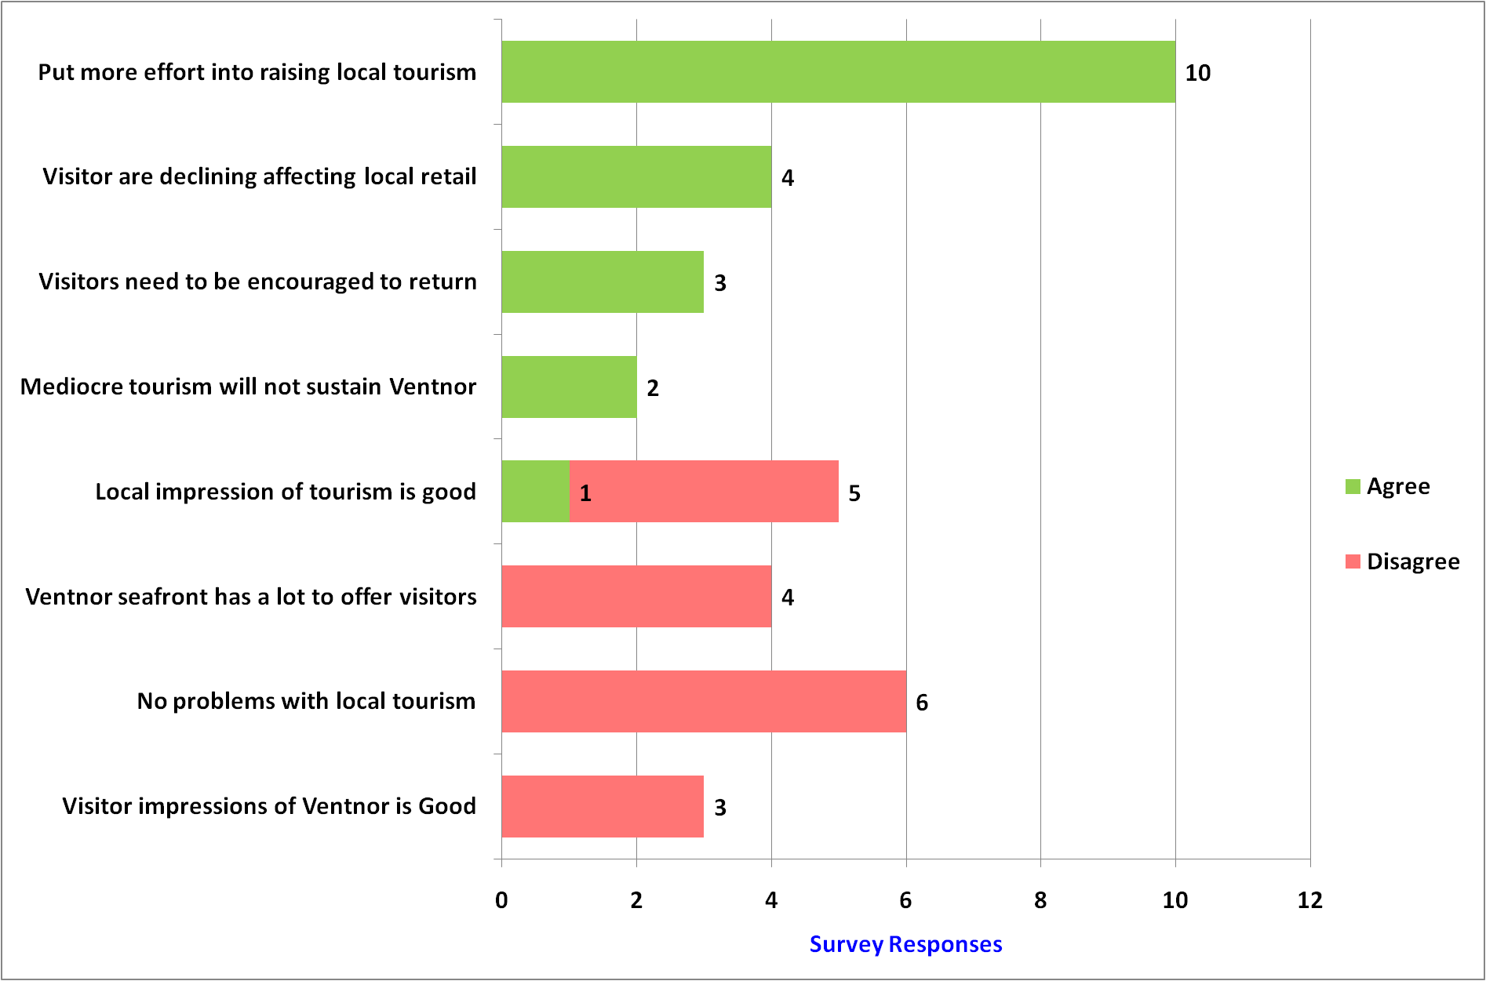
Part 4 of 21: Local Tourism Comments

Slide 16
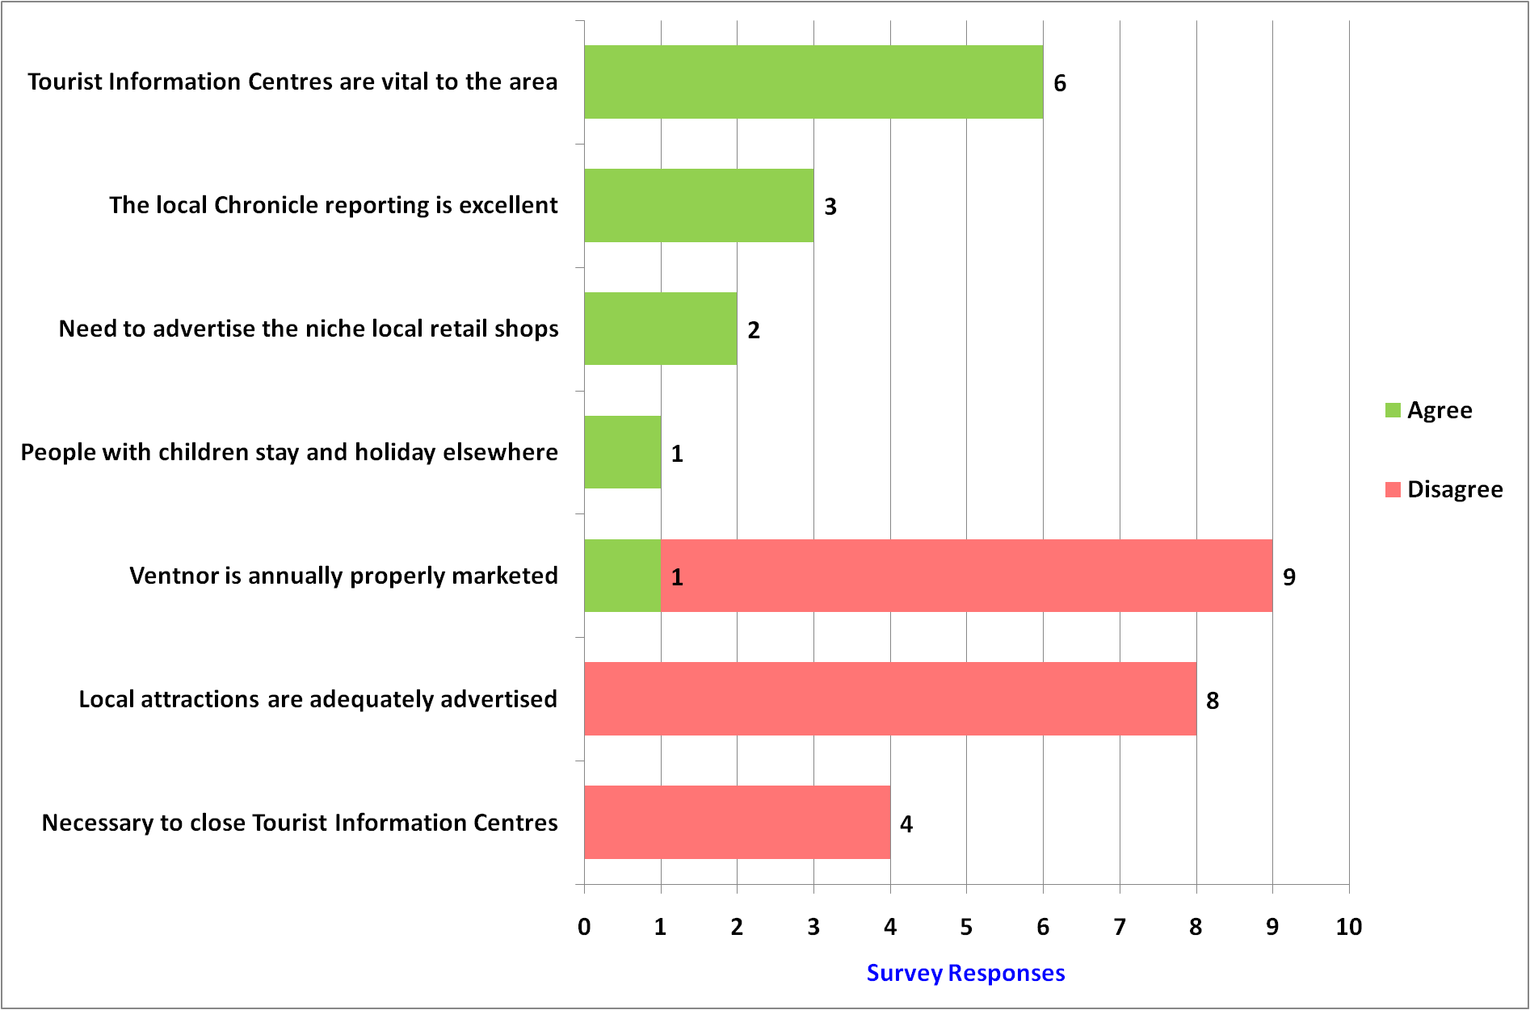
Part 5 of 21: Media & Marketing Comments

Slide 17
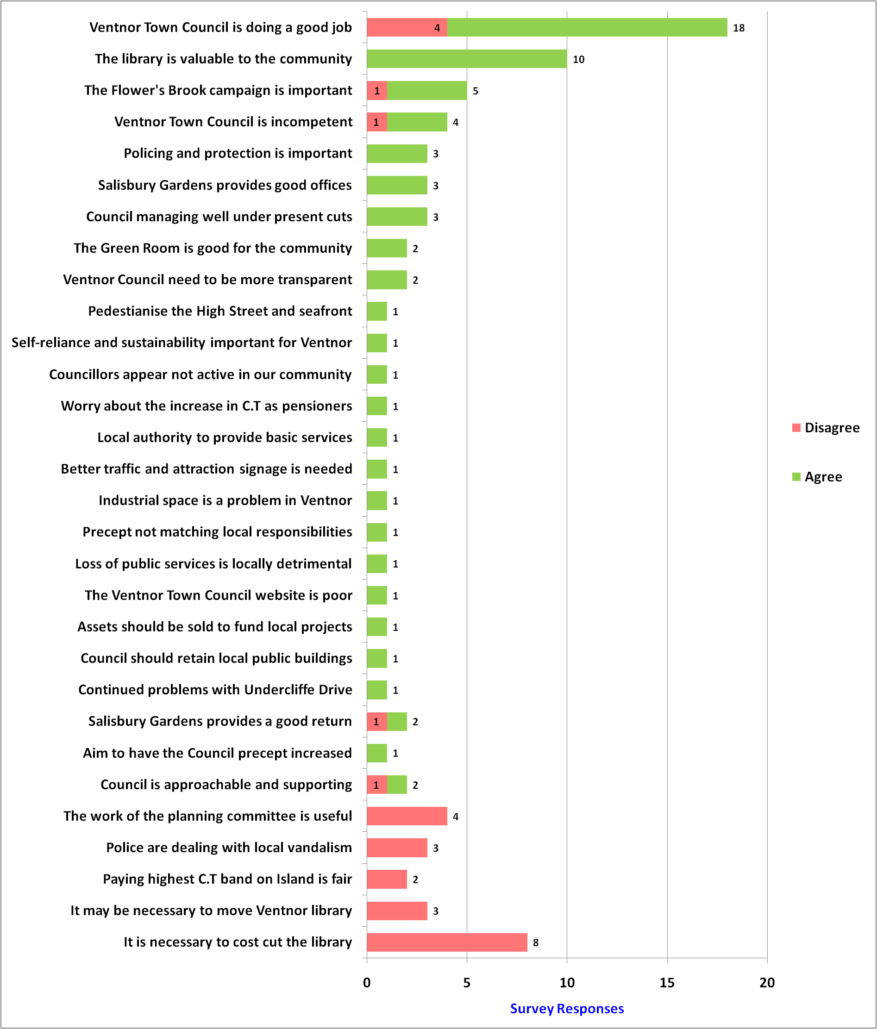
Part 6 of 21: Ventnor Town Council Comments

Slide 18
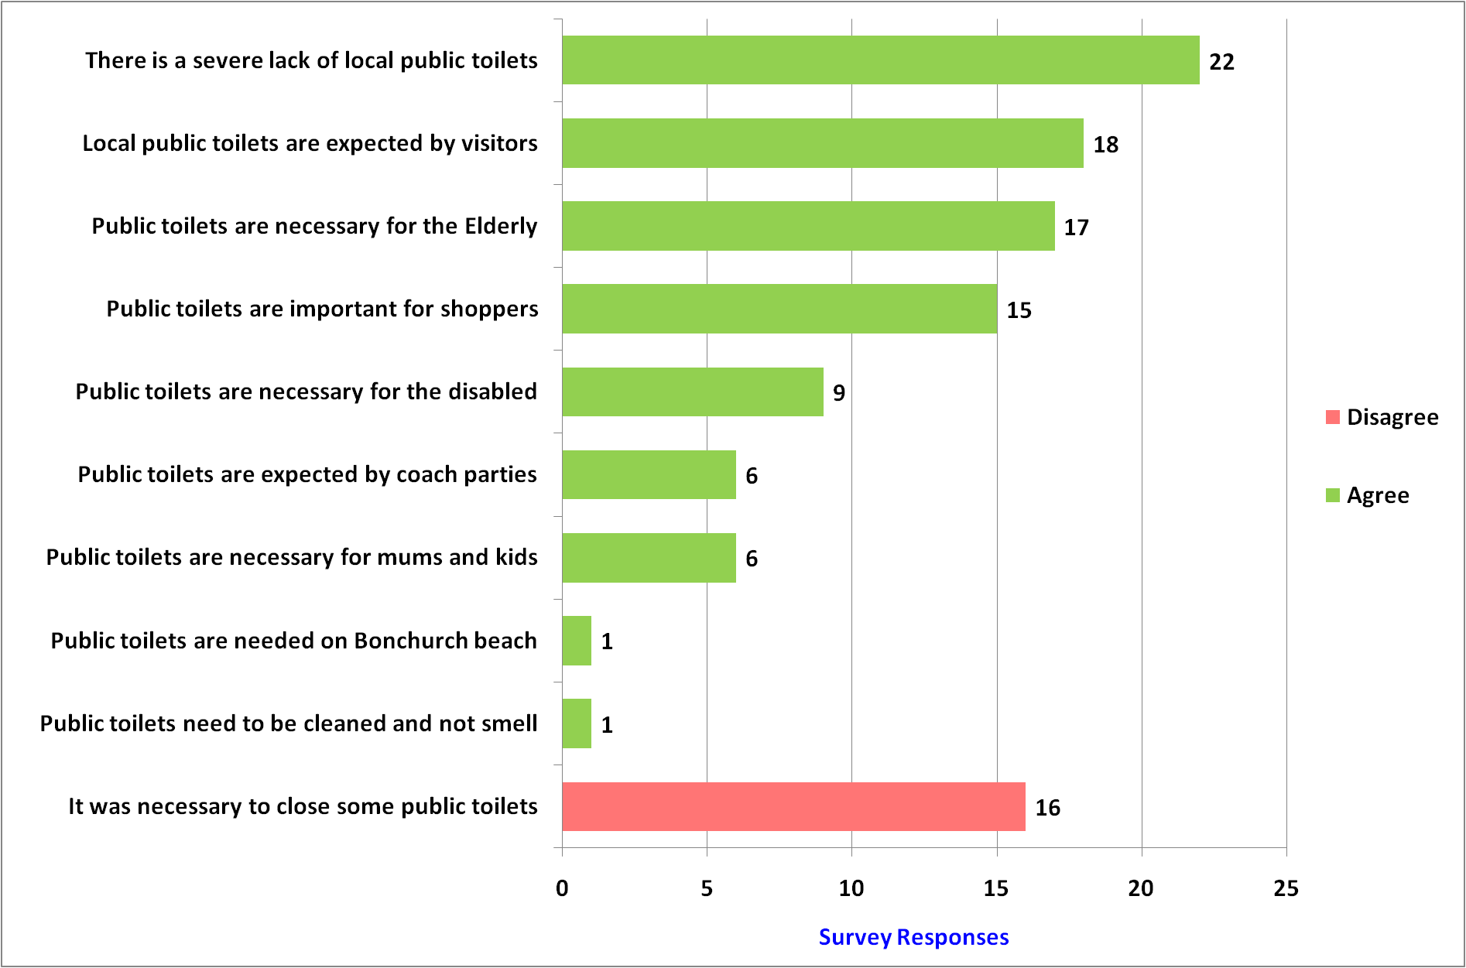
Part 7 of 21: Public Toilets Comments

Slide 19
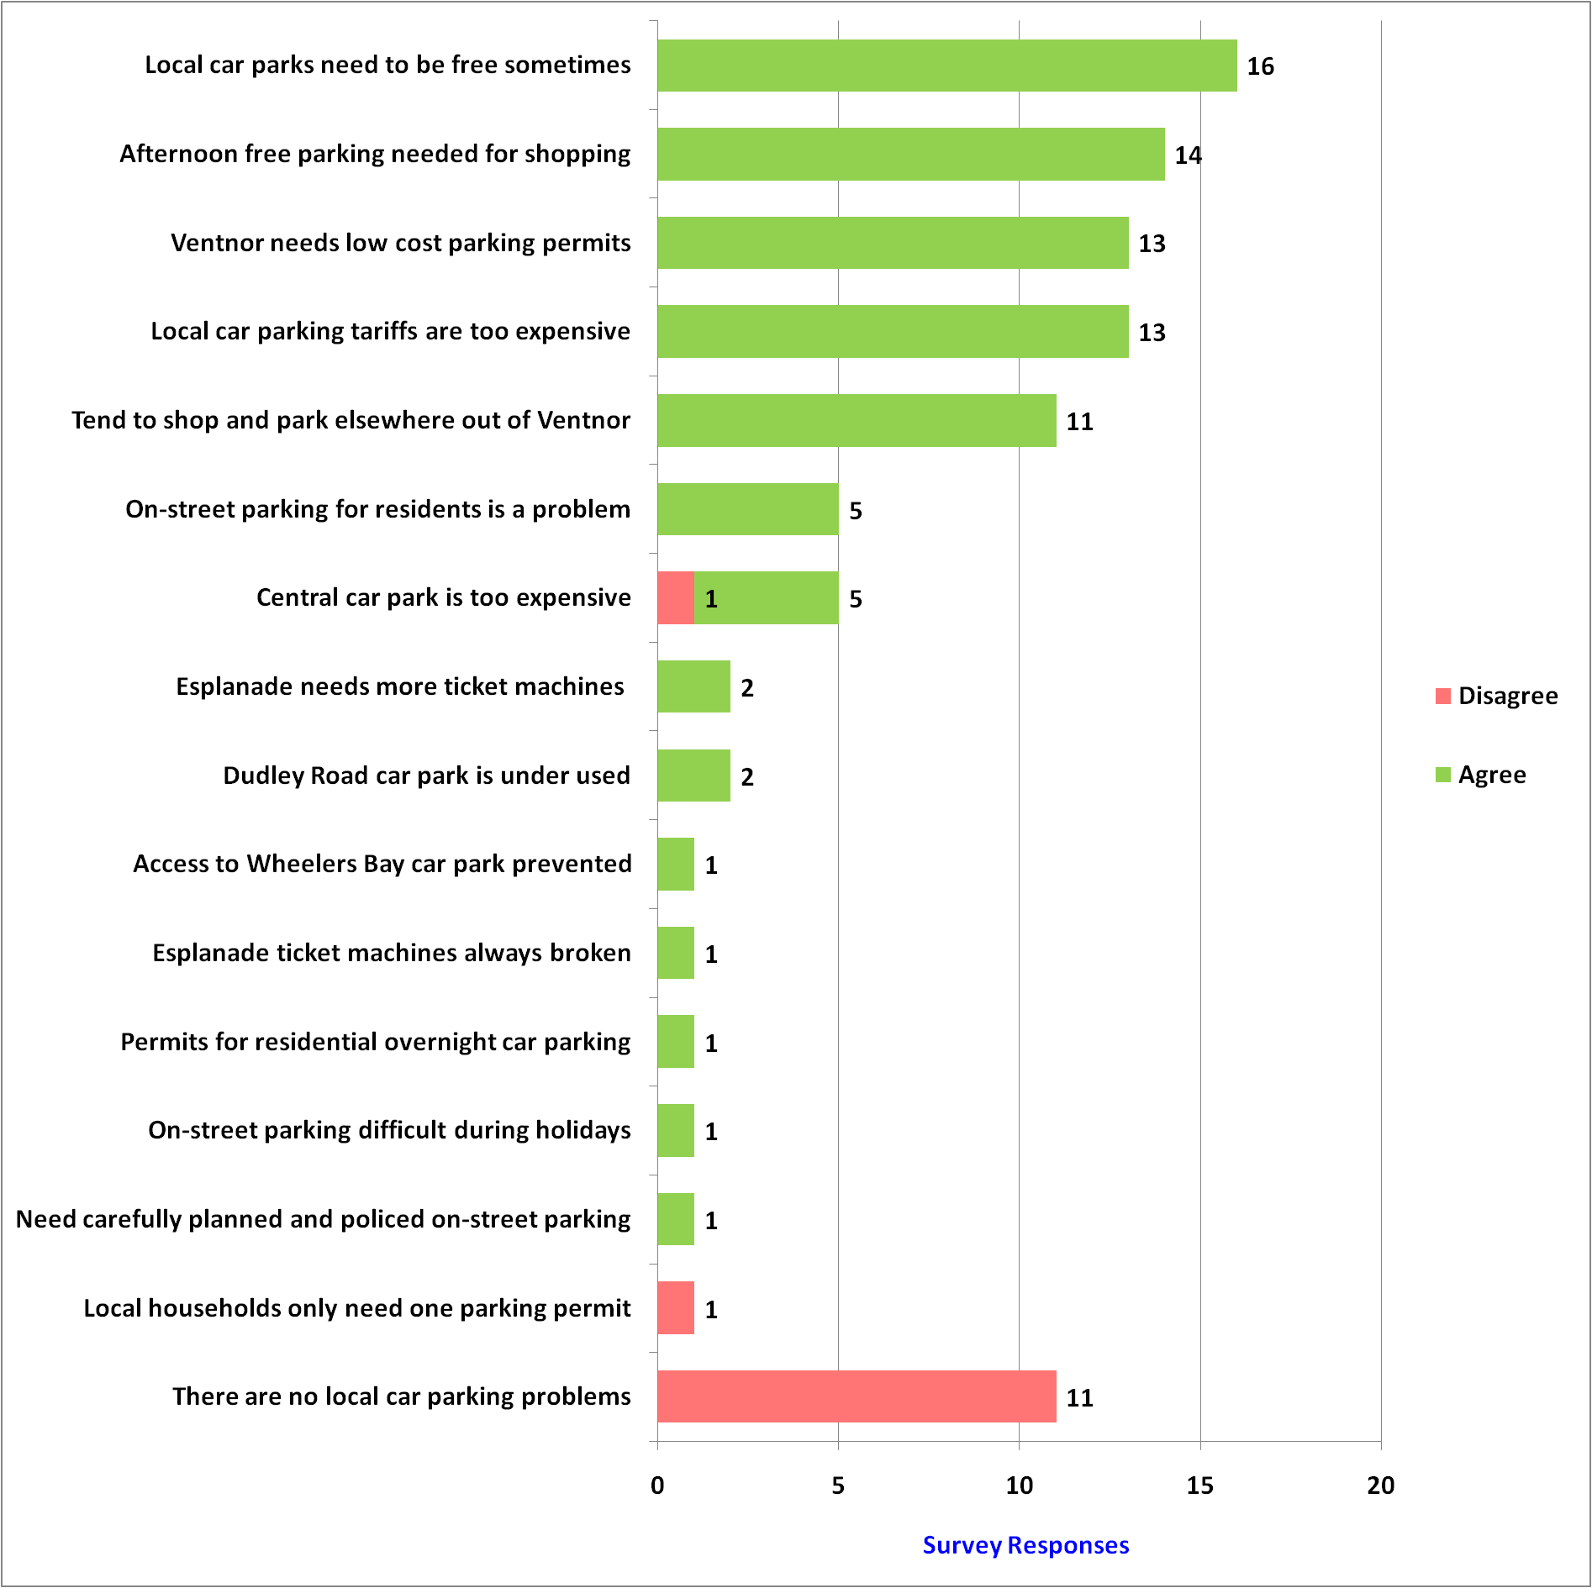
Part 8 of 21: Car Parking Comments

Slide 20
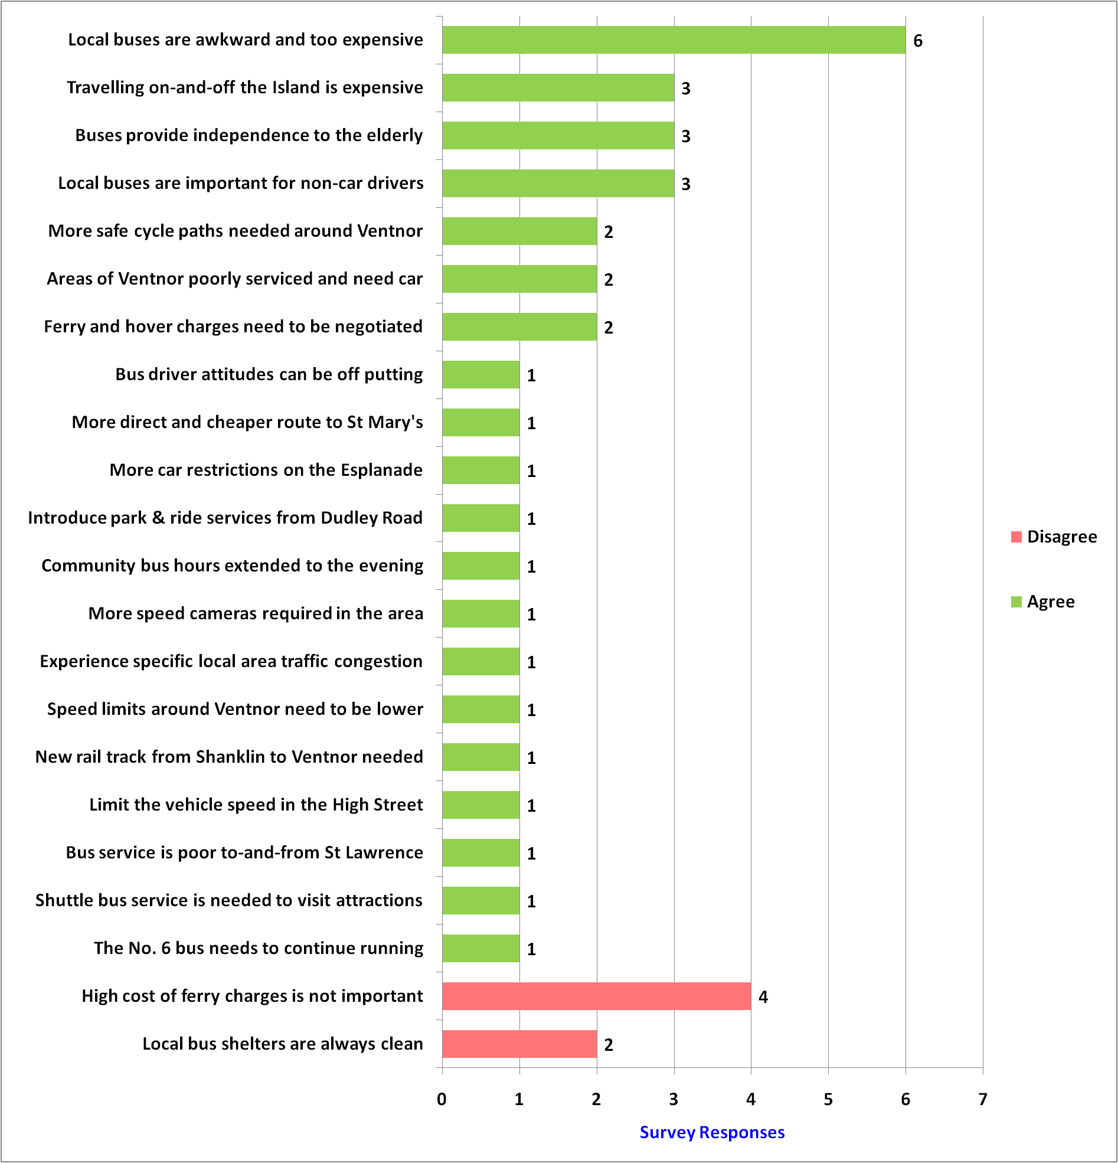
Part 9 of 21: Transport Comments

Slide 21
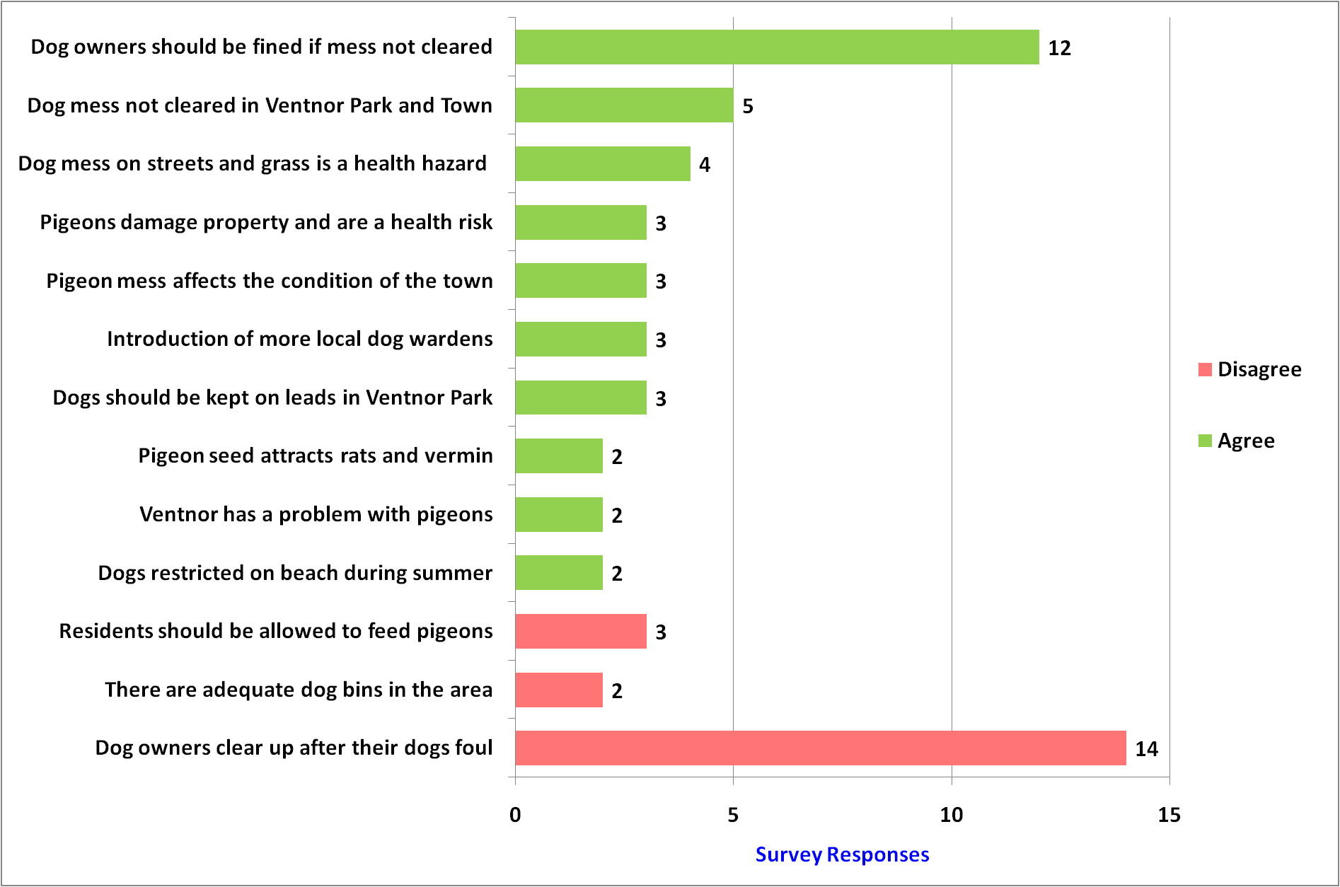
Part 10 of 21: Dogs & Pigeons Comments

Slide 22
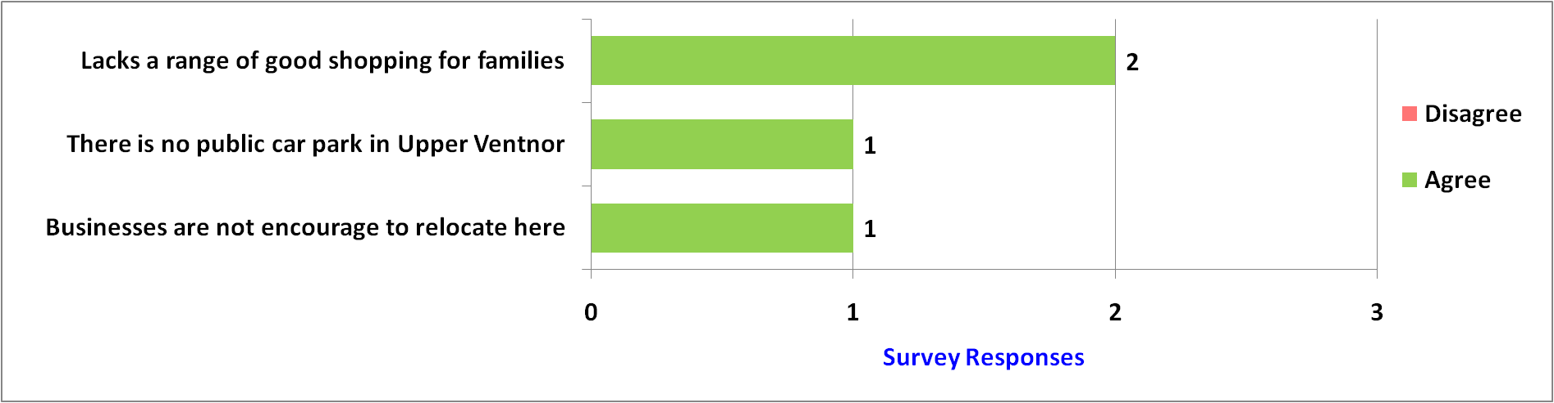
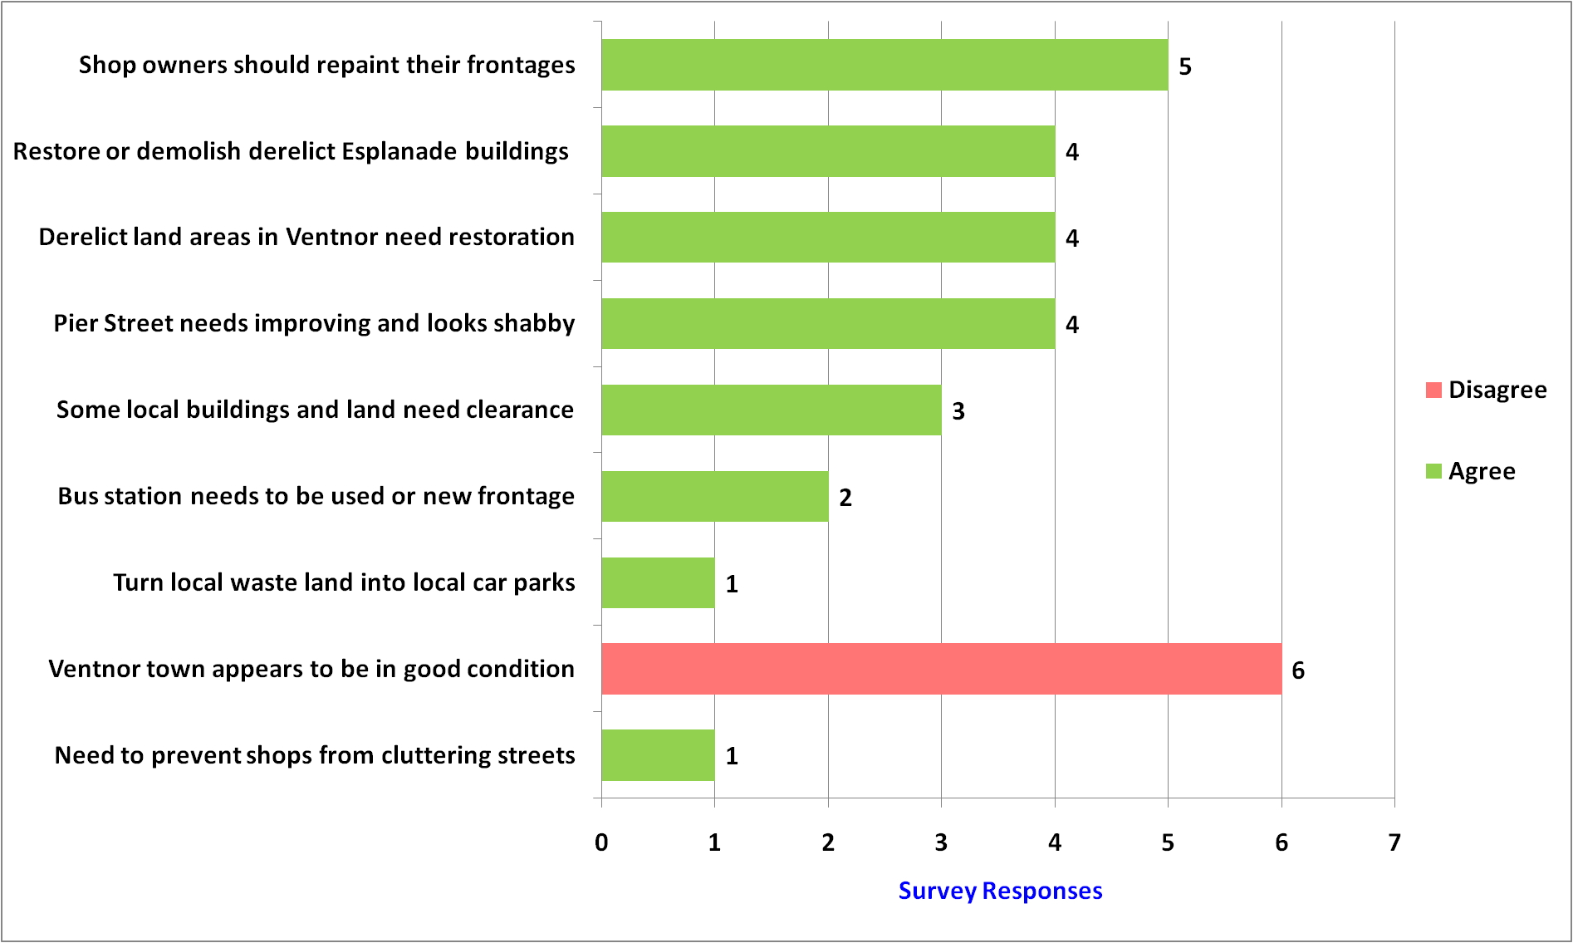
Part 11 of 21: Locality Comments
Upper Ventnor
Ventnor Town

Slide 23
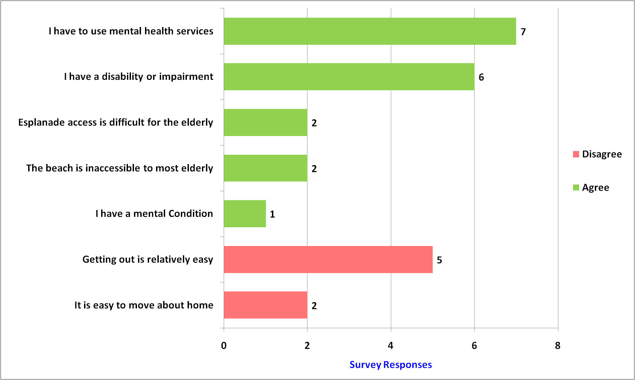
Part 12 of 21: Personal Comments

Slide 24
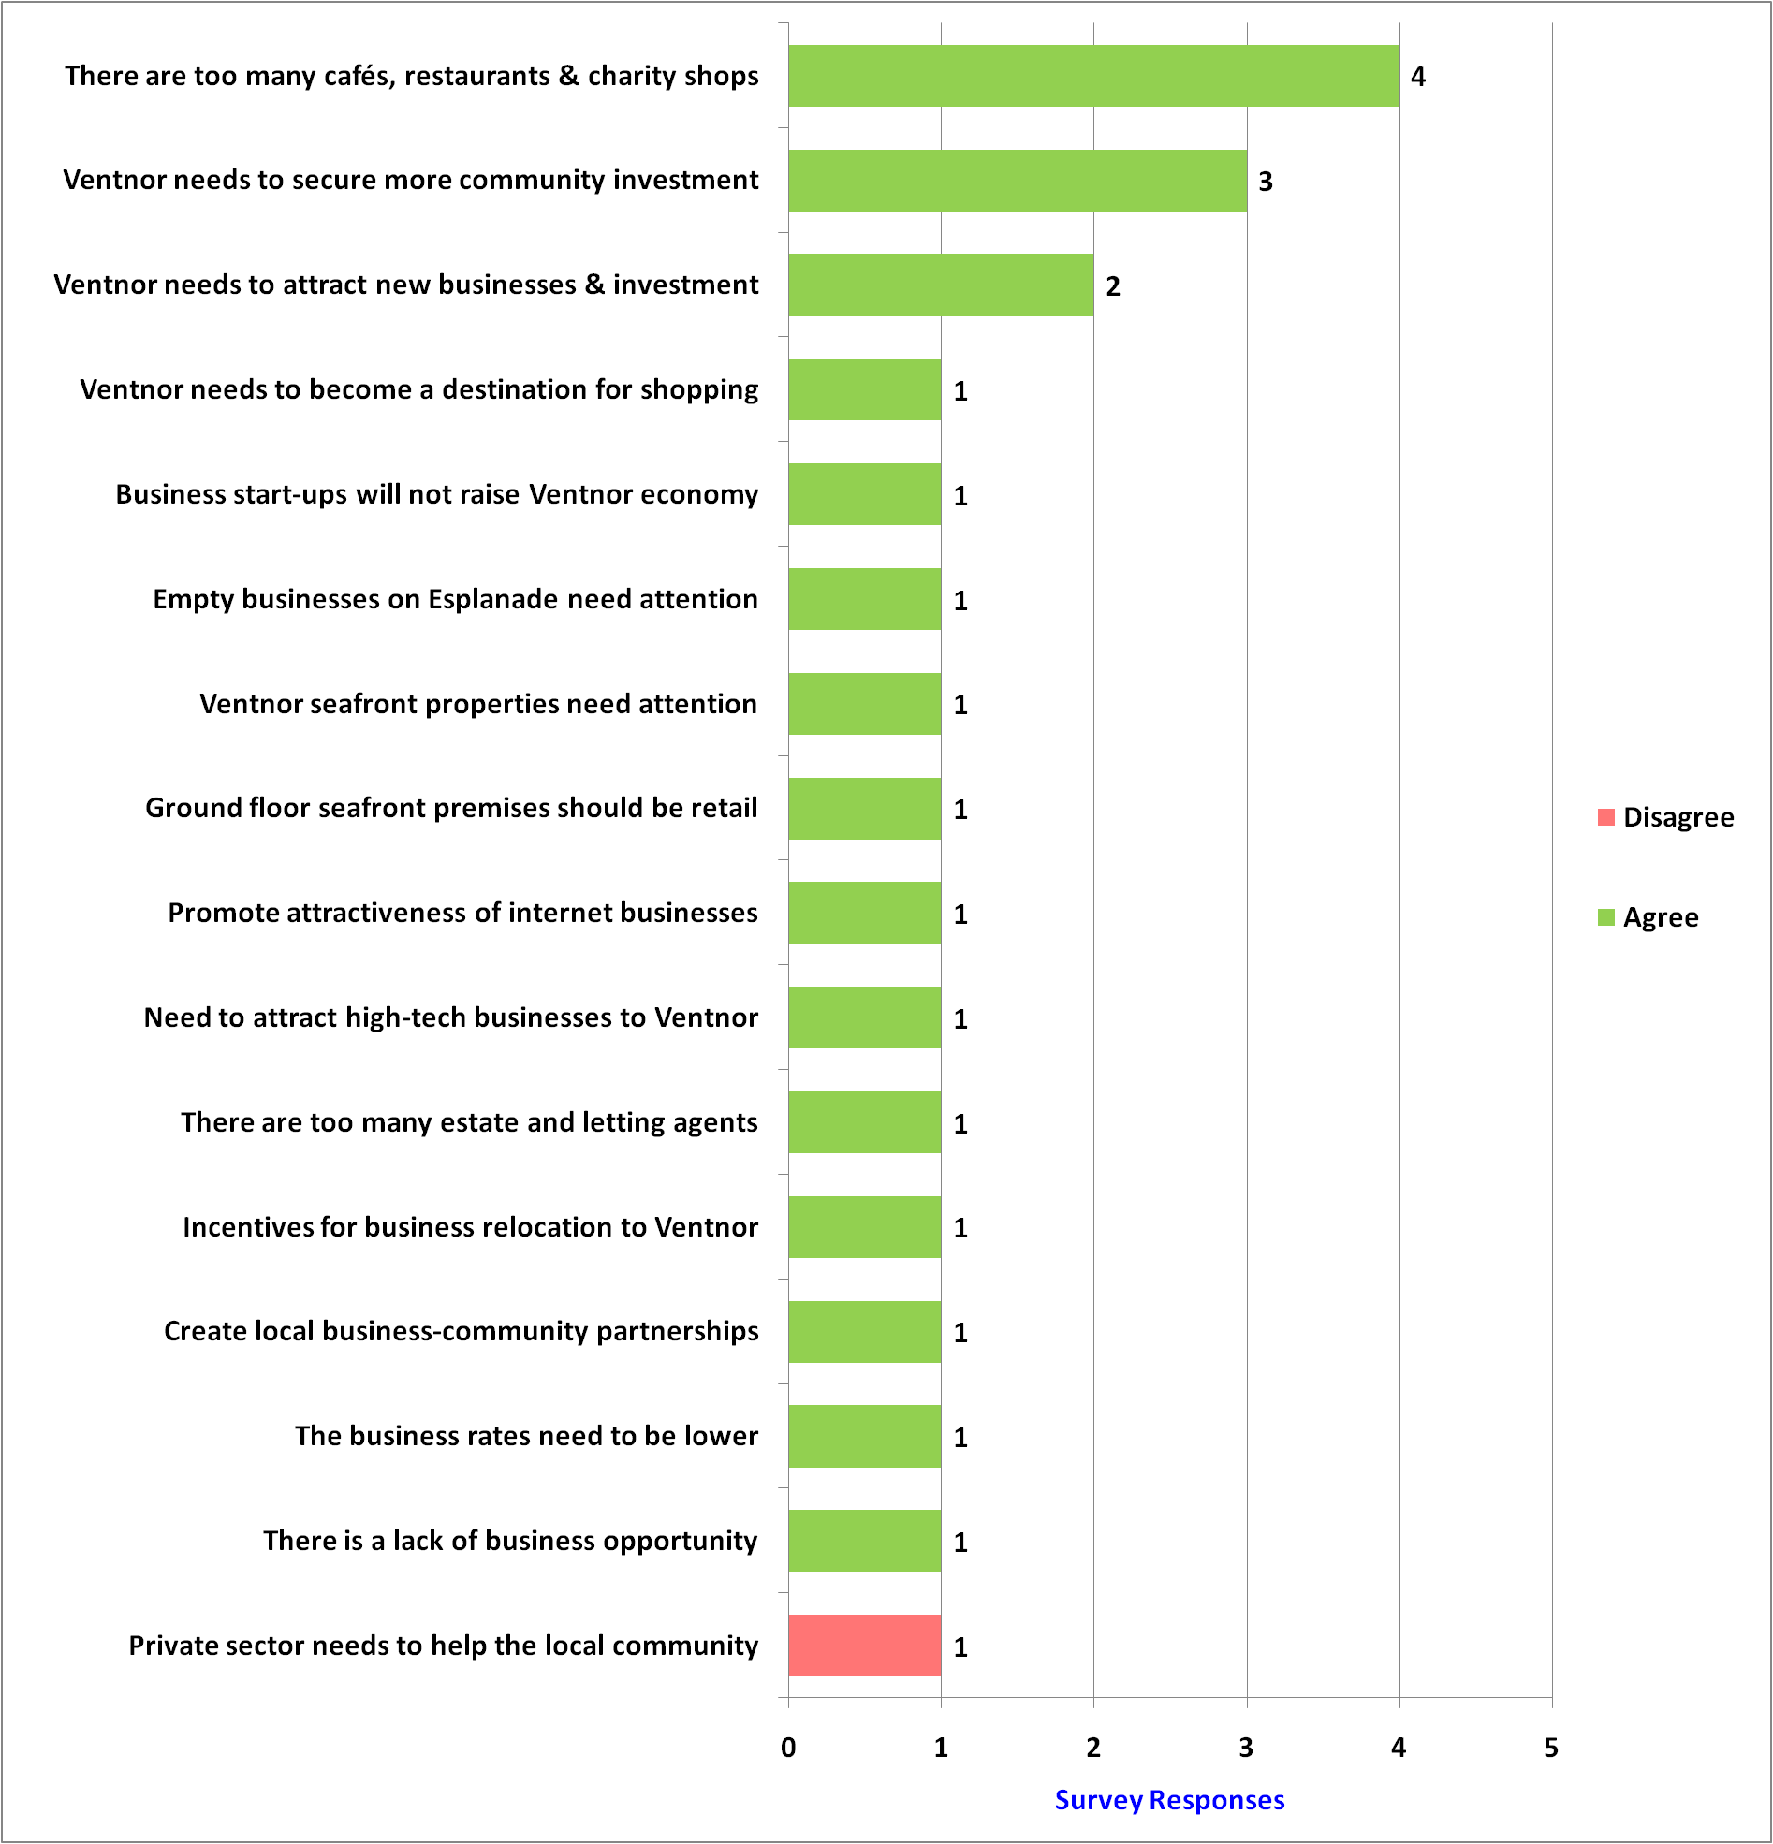
Part 13 of 21: Local Business Comments

Slide 25
A big thanks to all who responded to the survey.

